Slide 1
Norm relations and computational problems in number fields
Jean-François Biasse.
Joint works with M. R. Erukulangara, C. Fieker, T. Hofmann, A. Page,
C. van Vredendaal, and W. Youmans
Department of Mathematics & Statistics
Notes:
2

Slide 2
Main goal
Norm relation:
Goal: Compute norm relations. Use them to solve computational problems.
Notes:
Talking points:
Important hard problem in number theory
Closely related to class group and unit group computation
- Algorithms often measure time complexity in terms of log discriminant

Slide 3
Applications of norm relations
Ideal class group (GRH-certified or unconditional)
S-unit groups
Principal Ideal Problem
Decomposition of ideals
Minus part of class groups
Zeta functions
Goal: Reduce above problems to subfield computations.

Slide 4
Acknowledgments
Bibliography: Results coming from the following papers:
J.-F. Biasse and C. van Vredendaal Fast multiquadratic S-unit computation and application to the calculation of class groups Proceedings of the 13th Algorithmic Number Theory Symposium (ANTS XIII) Open Book Series - Mathematical Science Publishers, 2019, vol. 2 pp. 103-118
J.-F. Biasse, C. Fieker, T. Hofmann, and A. Page Norm relations and computational problems in number fields Journal of the London Mathematical Society 105(4):2373-2414, 2022.
J.-F. Biasse, M. R. Erukulangara, C. Fieker, T. Hofmann, and W. Youmans Mildly Short Vectors in Ideal Lattices of Certain Families of Cyclotomic Fields Without Quantum Computers Mathematical Cryptology, 2(1):84-107, 2022.
J.-F. Biasse, C. Fieker, T. Hofmann, and W. Youmans An Algorithm for Solving the Principal Ideal Problem with Subfields Advances in Mathematics of Communications. 2023
Funding:
CAREER: Algebraic Methods for the Computation of Approximate Short Vectors in Ideal Lattices. (PI: Biasse)

Slide 5
Definition of norm relations

Slide 6
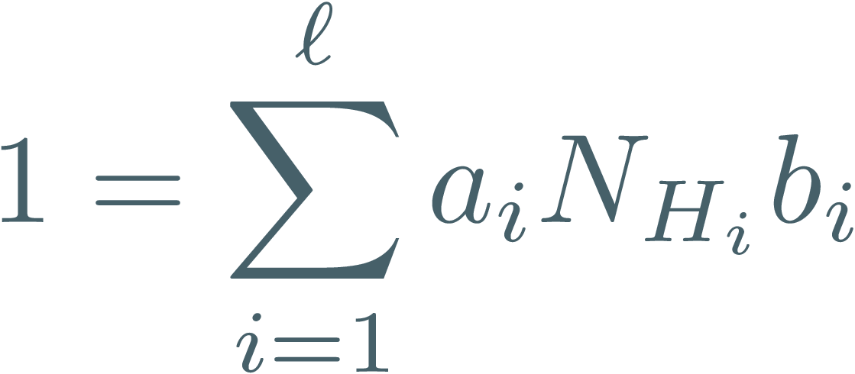
Norm relations as relations in $ℚ[G]$

Slide 7
Example

Slide 8
Existence of norm relations

Slide 9
On the denominator of a norm relation

Slide 10
Norm relations and Brauer relations

Slide 11
Abelian groups: Brauer relations of the dual

Slide 12
Closed formula for Abelian fields

Slide 13
Properties of relations for Abelian fields

Slide 14
Applications of norm relations

Slide 15
Additive structure: ring of integers

Slide 16
Analytic structure: zeta function

Slide 17
Multiplicative structure: $S$-unit groups

Slide 18
Saturation: the Grunwald-Wang theorem

Slide 19
Generating $d$-th powers

Slide 20
Class group structure

Slide 21
Other applications: PIP

Slide 22
Other applications: Ideal Decomposition
Notes:
Talking points:
Important hard problem in number theory
Closely related to class group and unit group computation
- Algorithms often measure time complexity in terms of log discriminant

Slide 23
More applications: minus part of class group
Notes:
Talking points:
Important hard problem in number theory
Closely related to class group and unit group computation
- Algorithms often measure time complexity in terms of log discriminant

Slide 24
Connection to Cryptography
Mildly Short Vector Problem (MSVP):
Ideal decomposition
Minus part
CDPR16 + Wes18

Slide 25
Numerical results

Slide 26
Class group computation
Notes:
Talking points:
Important hard problem in number theory
Closely related to class group and unit group computation
- Algorithms often measure time complexity in terms of log discriminant

Slide 27
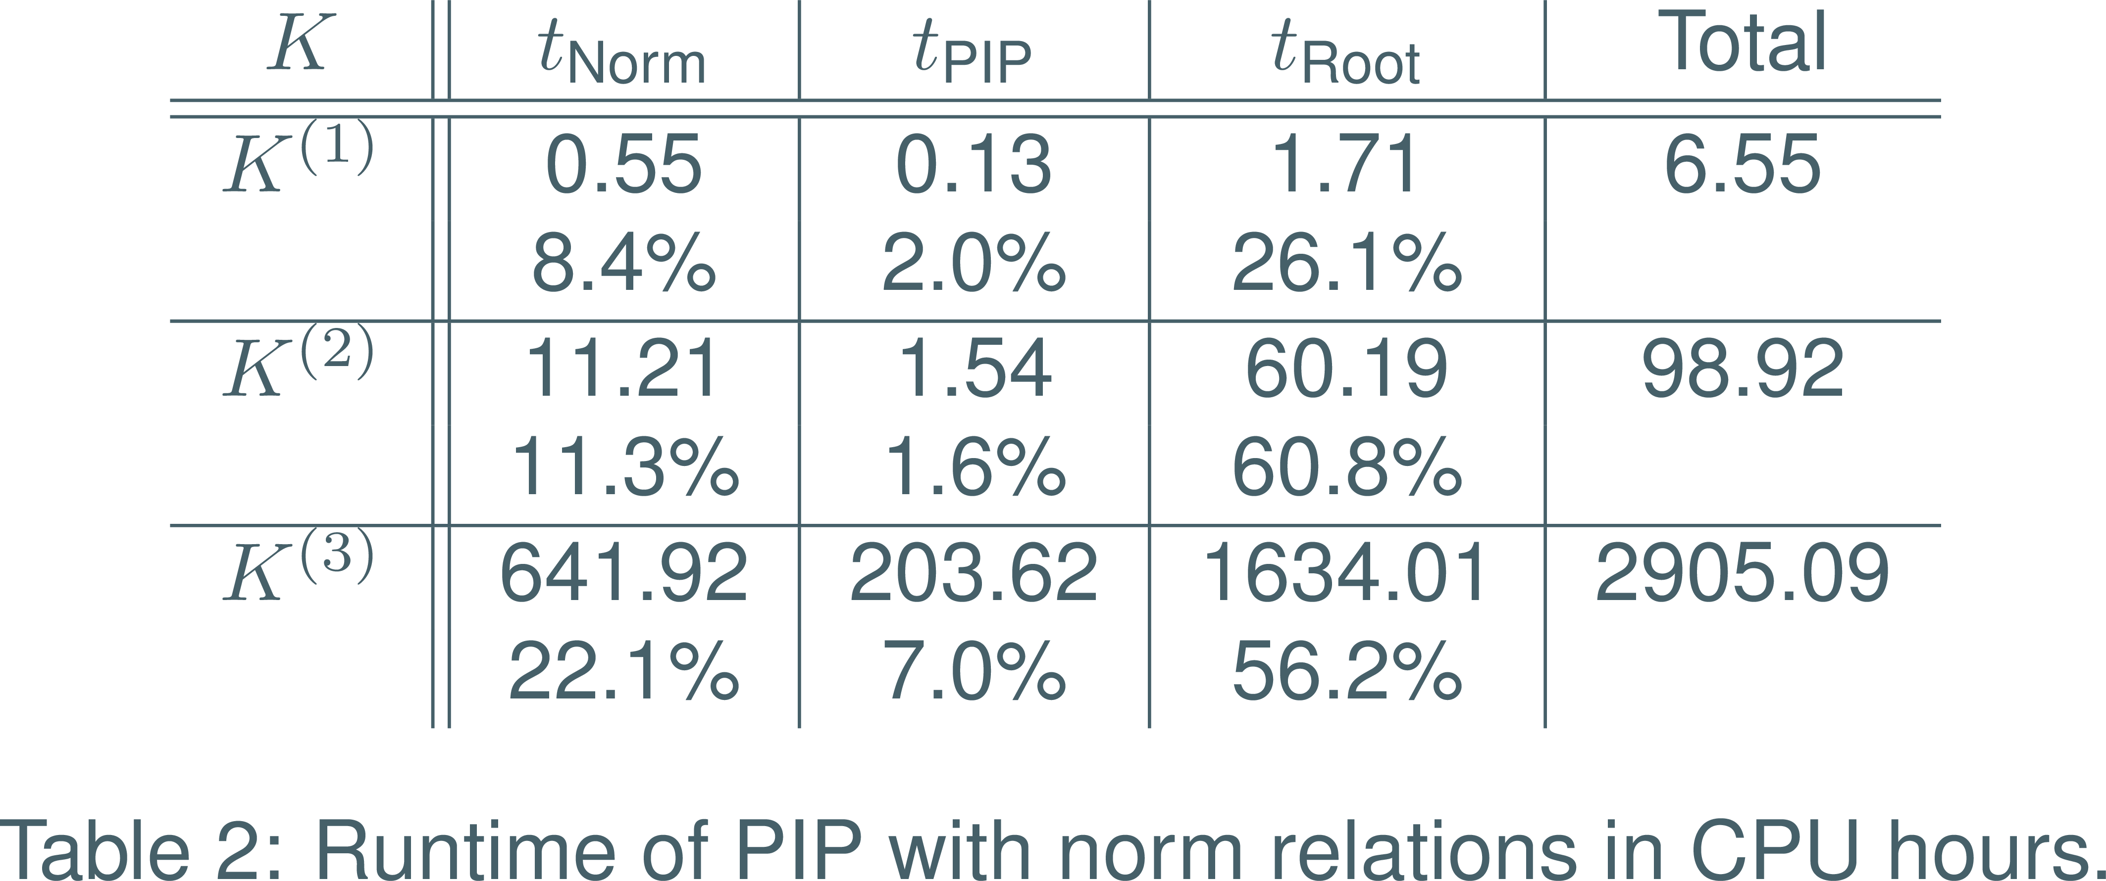
Resolution of PIP
Notes:
- Previous record was multiquadratic fields, degree 256/
At these degrees, bottleneck (in practice) is no longer PIP since it has been reduced to small degree
Computing relative norms and roots, polynomial time, is harder. (poly w.r.t input size, almost any integral element of K has huge norm ~ \sigma(x)^1800 )

Slide 28
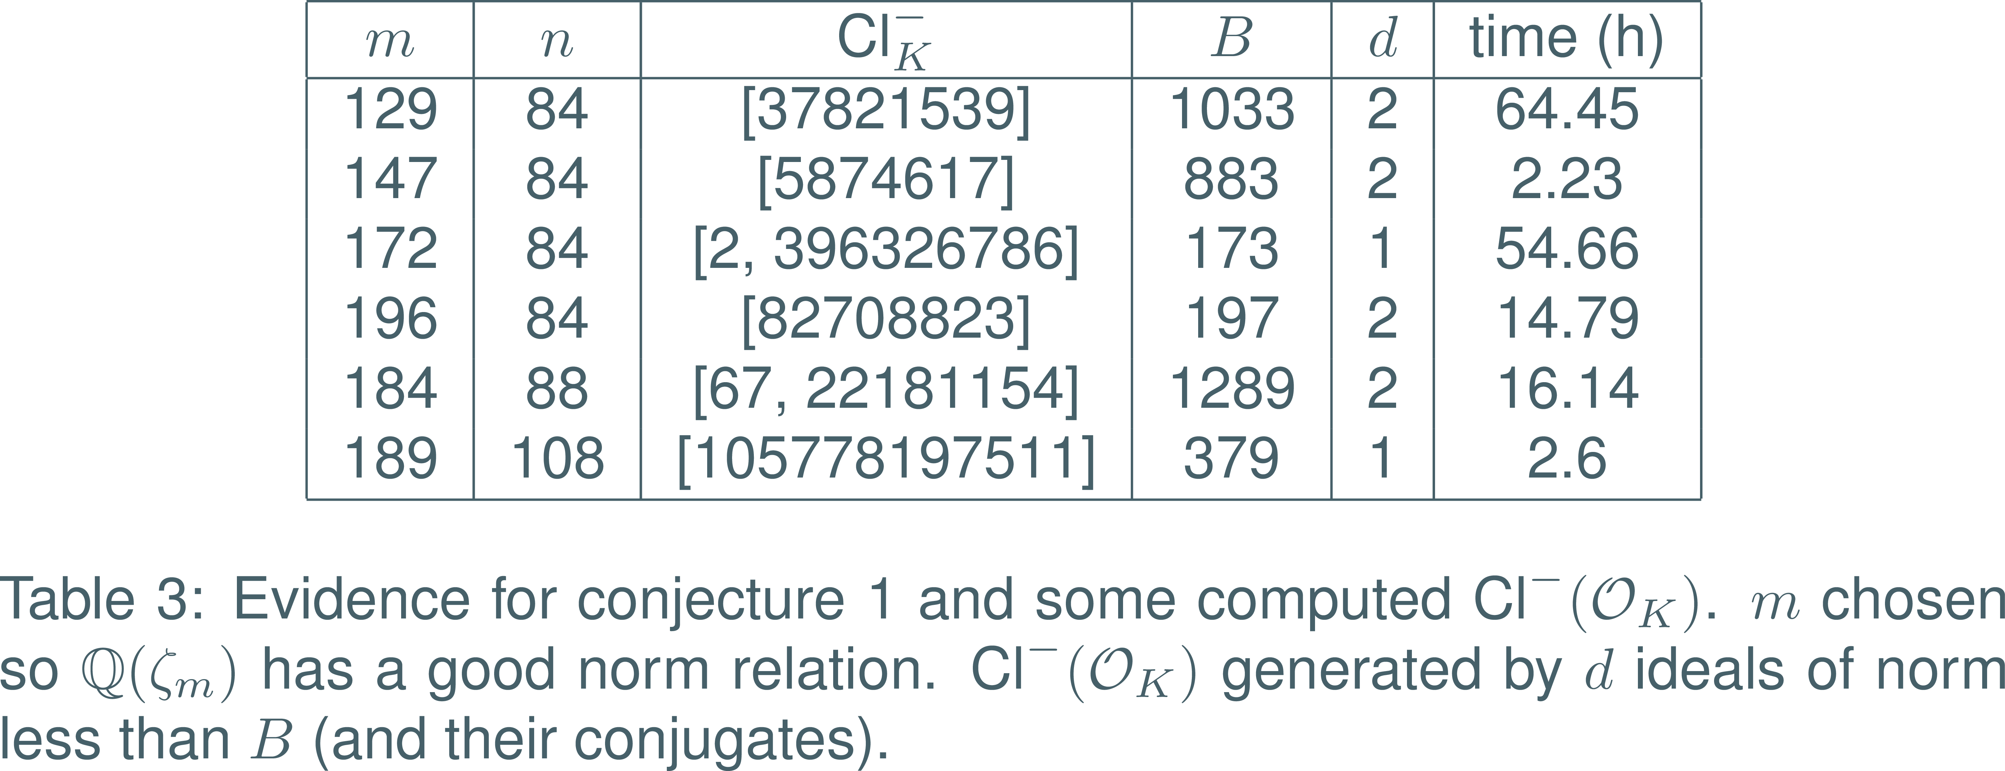
Computation of minus part.

Slide 29
Thank you for your attention

Slide 30
The Principal Ideal Problem
Highlights of previous work:
1989 - First subexponential-time algorithm by Hafner and McCurly for imaginary quadratic fields [HM90].
1990 - Extended to arbitrary fields of fixed degree by Buchmann [Buch90].
2014 - Heuristic subexponential algorithm in all classes of number fields by Biasse and Fieker [BF14].
Notes:
Fix footnote, citations

Slide 31
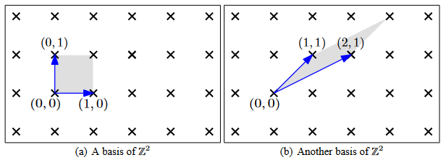
Connection to Cryptography
(O. Regev. “Lattices in Computer Science” lecture notes.)
Notes:
Talking points:
- Given an n dimensional lattice, if the basis vectors are skewed like in the second picture, finding the shortest possible vector in the lattice is hard.

Slide 32
Connection to Cryptography
 | Time | Method
1 (Exact SVP) | Exponential | Sieving, Enumeration
Polynomial | Exponential | BKZ
Subexponential | Subexponential | BKZ
Exponential | Polynomial | LLL, BKZ
Notes:
Talking points:
Gamma is approx. factor
Widely believed to be a hard problem for small enough gamma
Basis of security of some cryptographic schems.
Complexity in dimension of L

Slide 33
Connection to Cryptography
Notes:
If e_i 0 it is easy, solve matrix equation.
NIST, 4 cryptograpohic algorithms chosen for standardization so far.
2, crystals kyber+dilithium based on module LWE
3 of 4 use lattices and all rely on hardness of worst-case svp.

Slide 34
Connection to Cryptography
Relationship to PIP: An ideal (in a number field) is a lattice!
¹
Mildly Short Vector Problem (MSVP):
Notes:
Cryptosystems proposed that rely on the hardness of finding a short generator.
Solutions to MSVP in ideal lattice were short enough, so MSVP was THE underlying hardness assumption of these schemes.
Structured lattices give better efficiency

Slide 35
Outline of the talk
Goals:
Use subfield information to find generators of principal ideals more efficiently than previously possible.¹
Adapt to finding mildly short vectors in ideal lattices.²
1. Based on unpublished joint work with Jean-François Biasse, Claus Fieker, and Tommy Hofmann
2. Based on: J.-F. Biasse, C. Fieker, T. Hofmann, M. Erukulangara. “Mildly Short Vectors in Ideals of Cyclotomic Fields Without Quantum Computers”. In: Mathematical Cryptology 2.1 (Nov. 2022), pp. 84–107.
Notes:
Talking points:
Ideal lattices are a closely related problem that is important in cryptography.
We will talk more about that later.
Now we discuss goal 1.

Slide 36
The Case of Multiquadratics
Notes:
Talking points:
- Fields where our techniques were first developed
Simplest case: n = 2, biquadratic.
This is applied recursively for general multiquadratics

Slide 37
The Case of Multiquadratics
Notes:
Talking points:
- For some purposes this is ok, if we want the full unit group then we need to find elements of U that are squares and add their square roots (saturation)

Slide 38
The Case of Multiquadratics

Slide 39
Norm Relations (BFHP20)
Notes:
Talking points:
Generalized by BFHP, this is a summary
In general, H_i not ALL subgroups, the norm relation doesn’t involve ALL subfields. Nor is it unique.
We can write powers of elements of K as products of subfield elements.
Even better if denominator 1
highly parallelizable nature

Slide 40
Norm Relations (BFHP20)
Notes:
- nonabelian case not too much worse but no formula
explicit formula optimal wrt denominator and subfield degree.

Slide 41
Norm Relations (BFHP20)

Slide 42
Application to the PIP
Notes:
Talking points:
- Somehow stress this is original work
If input principal then relative norms must be, so if step 1 fails the input is not principal
Last point requires saturation techniques

Slide 43
Roots modulo units
Notes:
Talking points:
- Saturation relies on a local global principle for detecting and computing roots.

Slide 44
Roots modulo units
Notes:
Anything in this intersection is a dth power locally for each P, and also not an element of V^d. So its dth root is not contained in V.
We can work in residue field instead of completion. If we work with split primes, linear algebra over Fp

Slide 45
Application to the PIP Revisited
Now we can solve PIP using norm relations.

Slide 46
Recall: Connection to Cryptography
Mildly Short Vector Problem (MSVP):
CDW. Quantum!
CDPR16 + Wes18
Notes:
Fix footer: explain Landau notation
Talking points:
- N is the degree of the field
Ideal lattices in cyclotomic fields used in RLWE for example.
Structured lattices give better efficiency
Both extended to arbitrary cyclotomics (Weselowski PhD thesis, CDW21)
Quantum polynomial time algorithm plus CDW gives quantum polynomial time resolution of MSVP.

Slide 47
CDW (MSVP in General Ideals)
Notes:
Class group: note finite abelian, identity is principal ideal class
Minus part: note being in the kernel means being principal in K^+

Slide 48
CDW (MSVP in General Ideals)
Notes:
- Step 2 is the part that requires a quantum computer right… emphasize that since decompositions are our main contribution?

Slide 49
CDW (MSVP in General Ideals)
Notes:
It is the properties of the stickelberger lattice that let us deduce the bound on the norm as well

Slide 50
Recall: Connection to Cryptography
Mildly Short Vector Problem (MSVP):
CDW. Quantum!
CDPR16 + Wes18

Slide 51
CDW (MSVP in General Ideals)
Notes:
It is the properties of the stickelberger lattice that let us deduce the bound on the norm as well

Slide 52
CDW (MSVP in General Ideals)
Notes:
It is the properties of the stickelberger lattice that let us deduce the bound on the norm as well

Slide 53
Ideal Decomposition
Goal: decompose relative norms in subfields using
Notes:
Stress again step 3 nontrivial. Even more involved than before: roots module S-units.

Slide 54
Applications of Ideal Decomposition
Notes:
Say: we removed quantum steps, replacing the hardest steps with algorithms using norm relations.
In families of fields with good norm relations we get an asymptotic improvement over standard methods.

Slide 55
Numerical results (3)

Slide 56
Complexity (Abelian)
Notes:
First statement: say for fields admitting norm relation!
Beat bkz by long margin on very narrow family of fields
The more we want to beat bkz the sparser these fields become
“in fact”, awkward?

Slide 57
Complexity (Cyclotomics)
Notes:
First statement: say for fields admitting norm relation!
Beat bkz by long margin on very narrow family of fields
The more we want to beat bkz the sparser these fields become
“in fact”, awkward?

Slide 58
Complexity (Cyclotomics)
Notes:
Recall lambda n = largest cyclic factor, phi n = degree, so e.g. first column is percent of conductors with lambda(n) < phi(n)^(3/8), aka largest subfield has degree less than the deree of K to 3/8

Slide 59
Complexity (Cyclotomics)
Notes:
Recall lambda n = largest cyclic factor, phi n = degree, so e.g. first column is percent of conductors with lambda(n) < phi(n)^(3/8), aka largest subfield has degree less than the deree of K to 3/8

Slide 60
Conclusion
Reduced instances of PIP and ideal decomposition to subfields when a norm relation is available.
Reduced MSVP in cyclotomic ideal lattices to subfields in a density 1 subset of cyclotomic fields.
Gave numerical and asymptotic results that show that for certain families of fields this method outperforms the state of the art.

Slide 61
Future Work:
Improve compact representations.

Slide 62
References
R. Cramer, L. Ducas, and B. Wesolowski. “Mildly Short Vectors in Cyclotomic Ideal Lattices in Quantum Polynomial Time”. In: J. ACM 68.2 (2021), 8:1–8:26.
J. L. Hafner and K. S. McCurley. “A rigorous subexponential algorithm for computation of class groups”. In: J. Amer. Math. Soc. 2.4 (1989), pp. 837–850. issn: 0894-0347.
B.Wesolowski. “Arithmetic and geometric structures in cryptography”. PhD thesis. Lausanne, Switzerland: Ecole Polytechnique Federale de Lausanne, 2018.

Slide 63
S-Units from Norm Relations
Notes:
d-th roots efficient+poly time (unevaluated products + compact rep?)
Can be difficult in practice since there are obstructions at powers of 2 (failure of local-global principle ala Grunwald-Wang)
- How to transition to BFHP result? Feels awkward

Slide 64
Ideal Decomposition
Obvious approach: decompose relative norms in subfields using

Slide 65
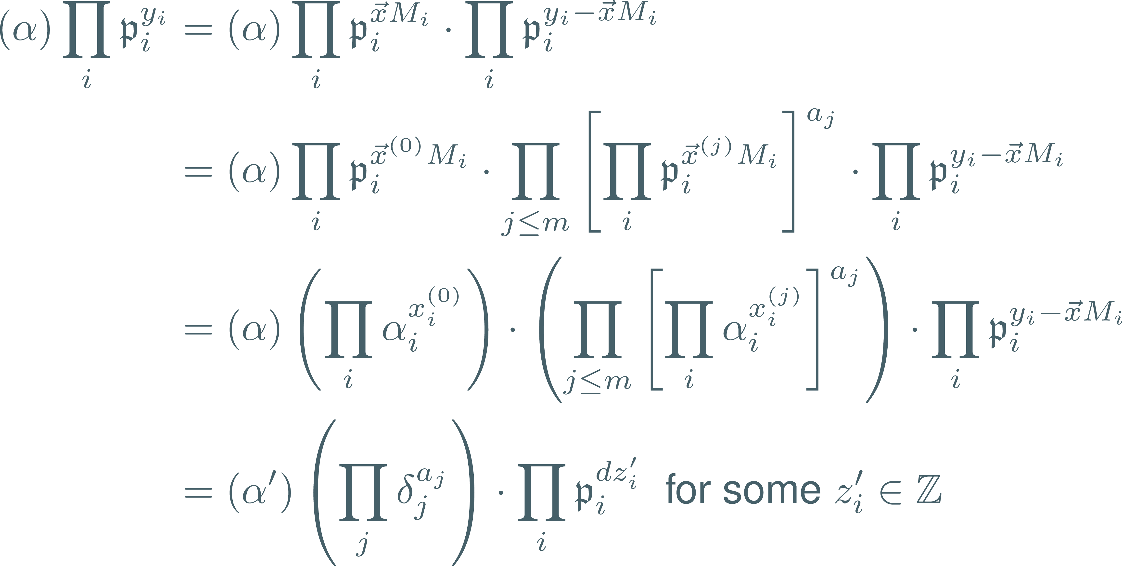
Notes:
- Emphasize that solving the previous linear system lets us make this transformation
“Notice we are only partly there: the alpha’ times deltas may not be d-th power”
“To resolve this we need another tool used often when working with norm relations”

Slide 66
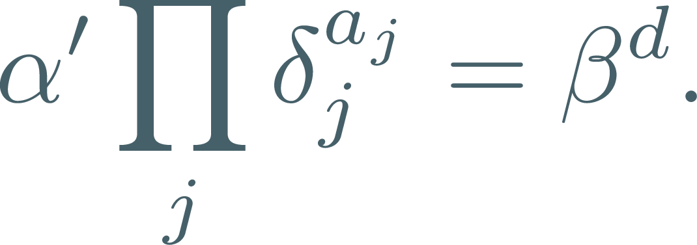
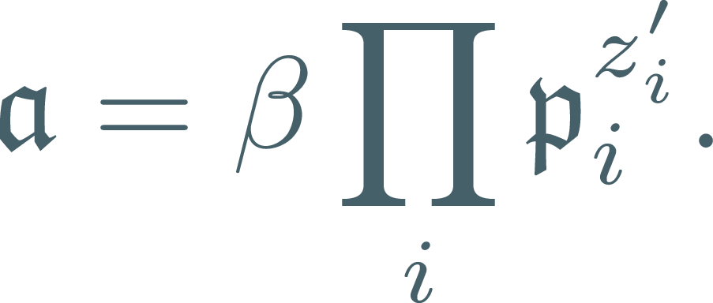
Ideal decomposition
Notes:
Root computation non trivial. As stated before we can keep them in product form, then use a technique called compact representation to manage the size and keep the root computation efficient.
Mention that while theoretically efficient, bottleneck in practice (disregarding our compact rep issues)?

Slide 67
Mildly short vectors
Notes:
Talking points:
- We consider how we can apply norm relations to remove this quantum step

Slide 68
Ideal Decomposition
Notes:
Talking points:
- If a principal then we can find decomposition with y_i = 0.

Slide 69
Complexity
Notes:
First statement: say for fields admitting norm relation!
Beat bkz by long margin on very narrow family of fields
The more we want to beat bkz the sparser these fields become
“in fact”, awkward?

