Slide 1
Stochastic Modelling of Extreme Precipitation – From Global Scale to Urban Scale
Dr. Chandra R. Rajulapati
University of Saskatchewan
Retreat for Young Researchers in Probability and Areas of Application
Sep. 28, 2019
Banff International Research Station, Banff

Slide 2



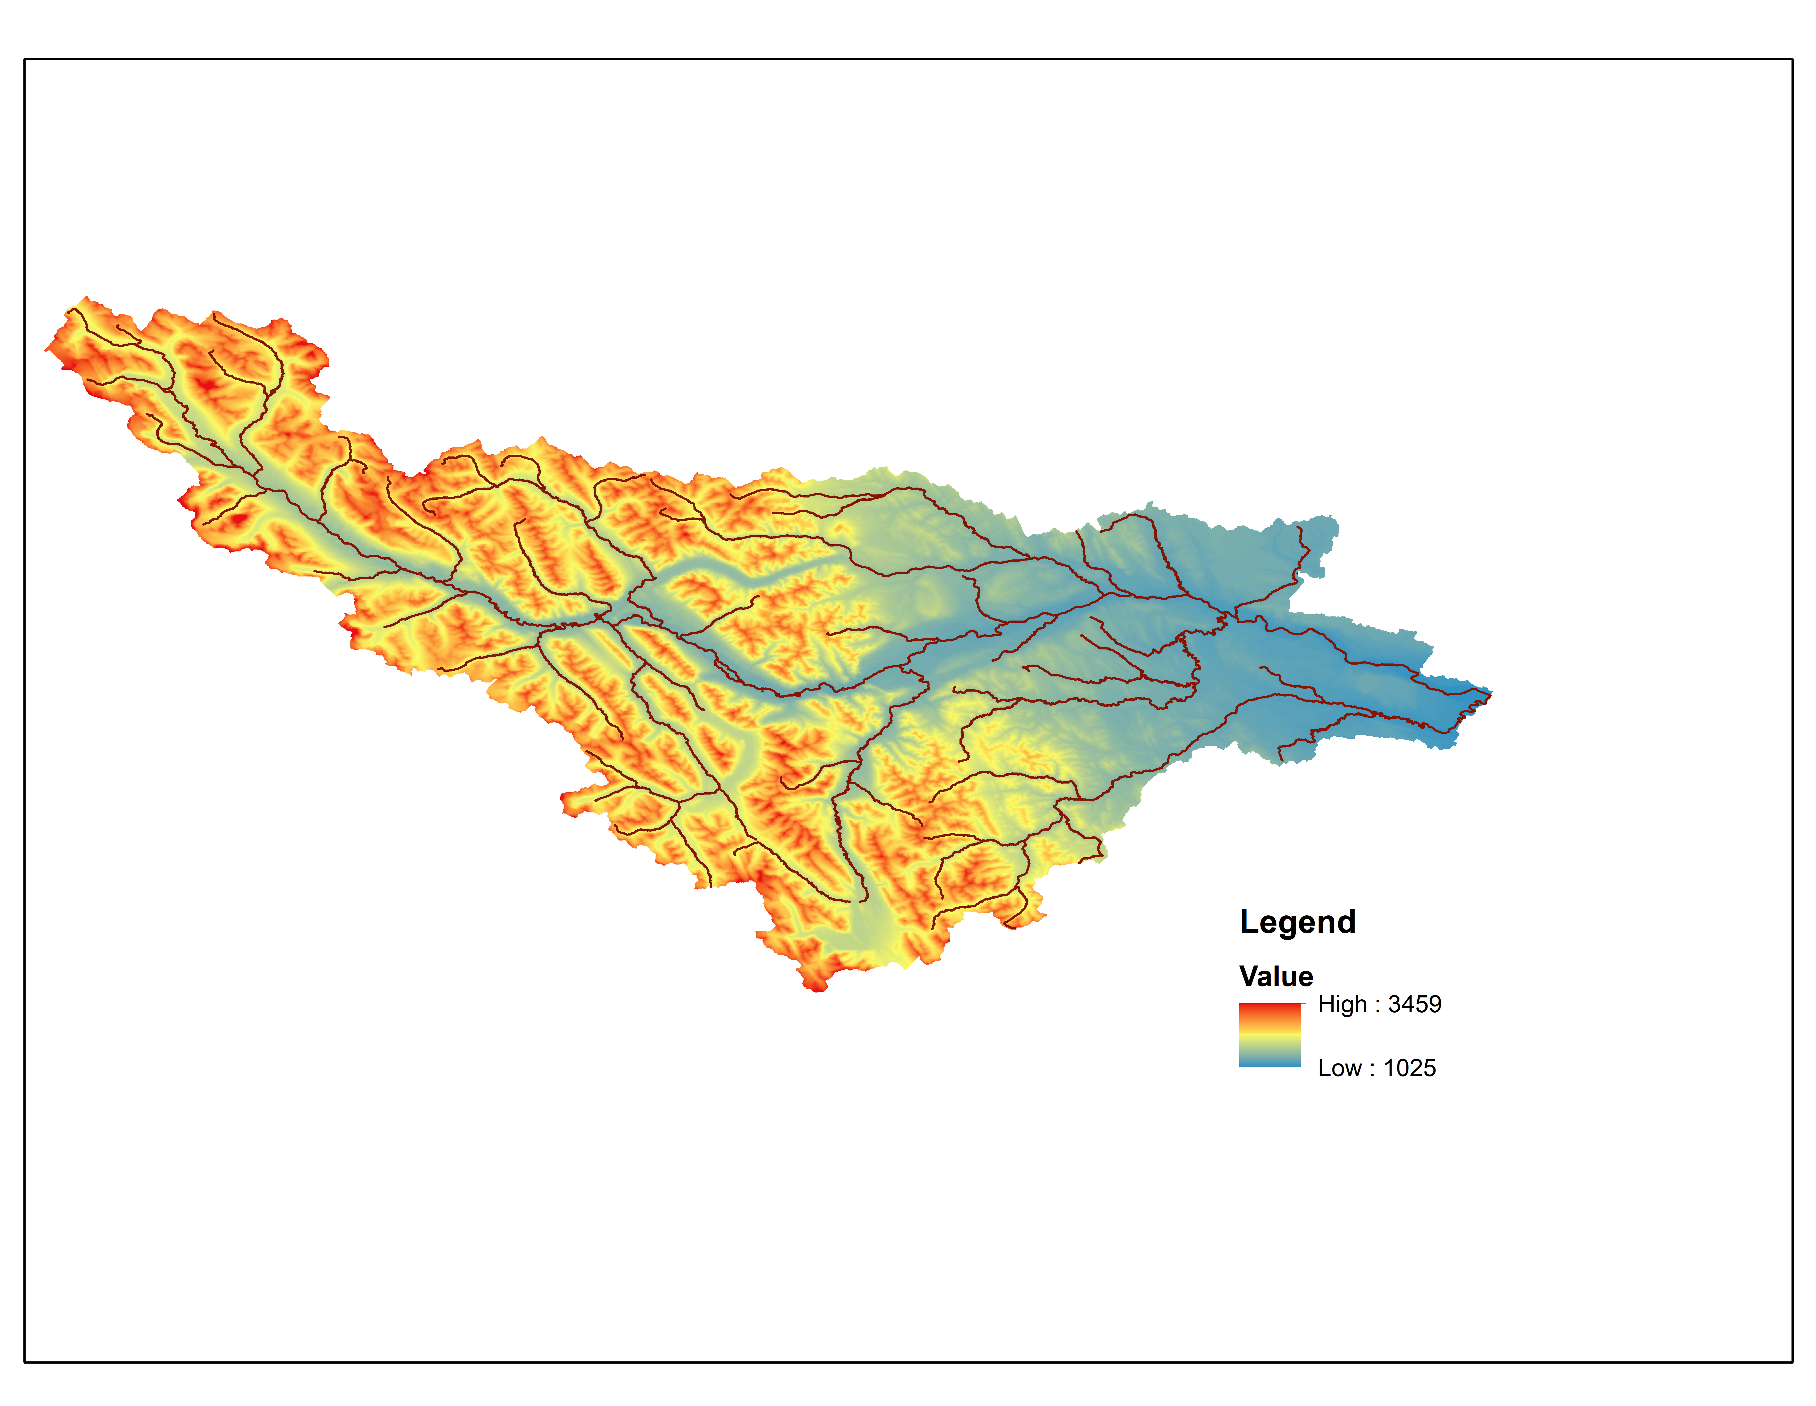

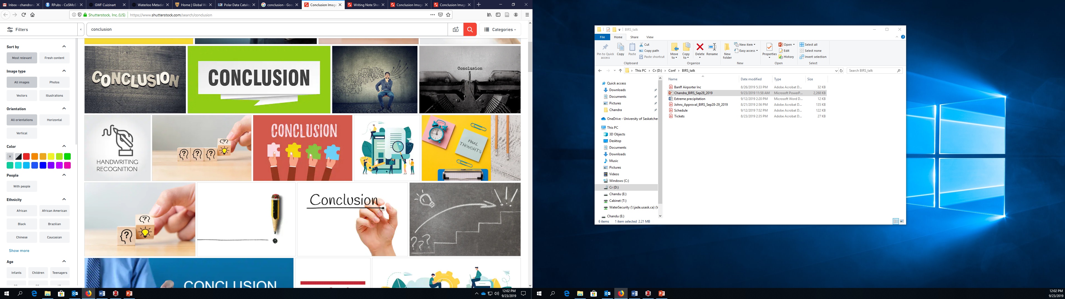
Overview
A little background about me
Introduction to modelling precipitation
Global scale – uncertainties
Regional scale – hydrological modelling
Urban scale – how different are uncertainties?
Conclude - a few insights and challenges ahead
Source: Google images

Slide 3




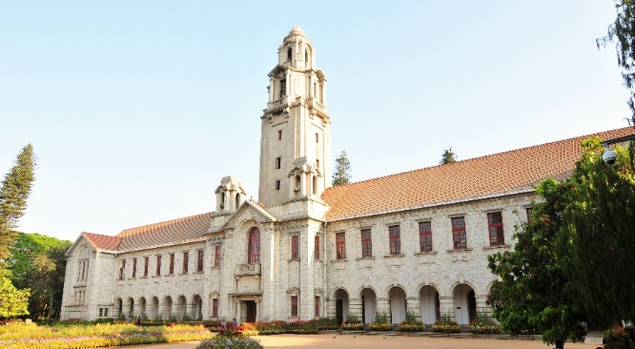
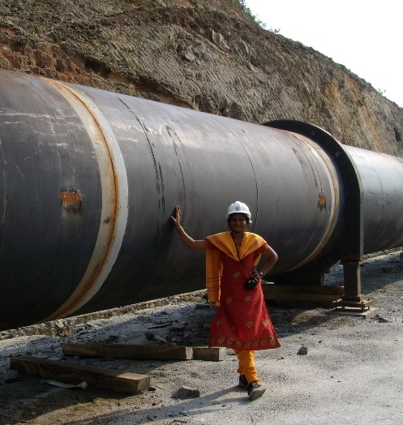
A little background about me
PIMS-GWF Postdoctoral fellow (Nov. 2018 – Nov. 2020) – a joint fellowship – Working with Prof. John Pomeroy, Dr. Saman Razavi, and Dr. Simon Papalexiou
Postdoctoral Researcher, Indian Institute of Science (IISc), Bangalore, India (2017-2018)
Doctoral Degree from IISc, Bangalore, India (2012-2017)
Work experience
Hydel power plants
High rise buildings

Slide 4
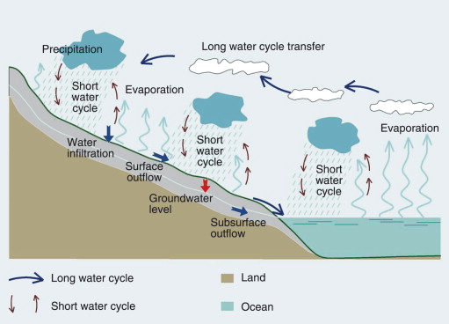
Introduction
Precipitation – most important variable – high spatial variability and intermittency
Involves complicated processes
Pretty confident with Halley’s comet coming close to earth, but difficult to say what is the average precipitation in the next month
Source: https://www.sciencedirect.com/topics/earth-and-planetary-sciences/hydrologic-cycle

Slide 5
Introduction
Yet we have decisions to take:
  design a dam or a levee
  Construct an urban drainage system
  Predict areas probable to flood
Stochastic modelling is one among other methods
History provides valuable clue to the future!
Model the statistical parameters of historical time series
Notes:
We have gauges measuring the precipitation, use the measurements

Slide 6

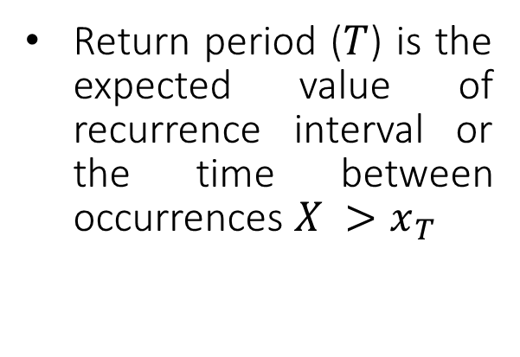
Introduction
Intensity – Duration – Frequency (IDF) relationships
Return period ($T$) is the expected value of recurrence interval or the time between occurrences $X >x_{T}$
$$P\left(X>x_{T}\right) >\frac{1}{T}$$
10-year return level is 180 mm/hr
  The probability that the intensity will equal or exceed 180 mm/hr in any year is approximately 0.1 (1/10).
Notes:
Return period is the average recurrence interval between events equaling or exceeding a specified magnitude.

Slide 7
Introduction
Useful for predictions - a dam or levee may be designed for 1000-year return levels, spillways for 10,000-year, urban drainage for 5-year
Calculate projected return levels
  Minimum of 30 years of data.
Rain gauge data – major source of data
Do we have enough gauge data?

Slide 8
Global Scale
Daily gauges
Min 30 years of data
With less than 20% data gaps

Slide 9
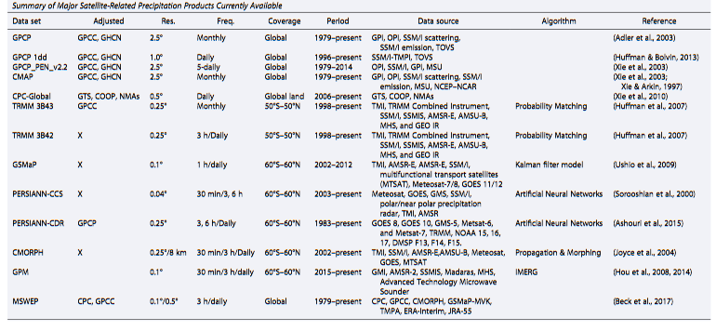
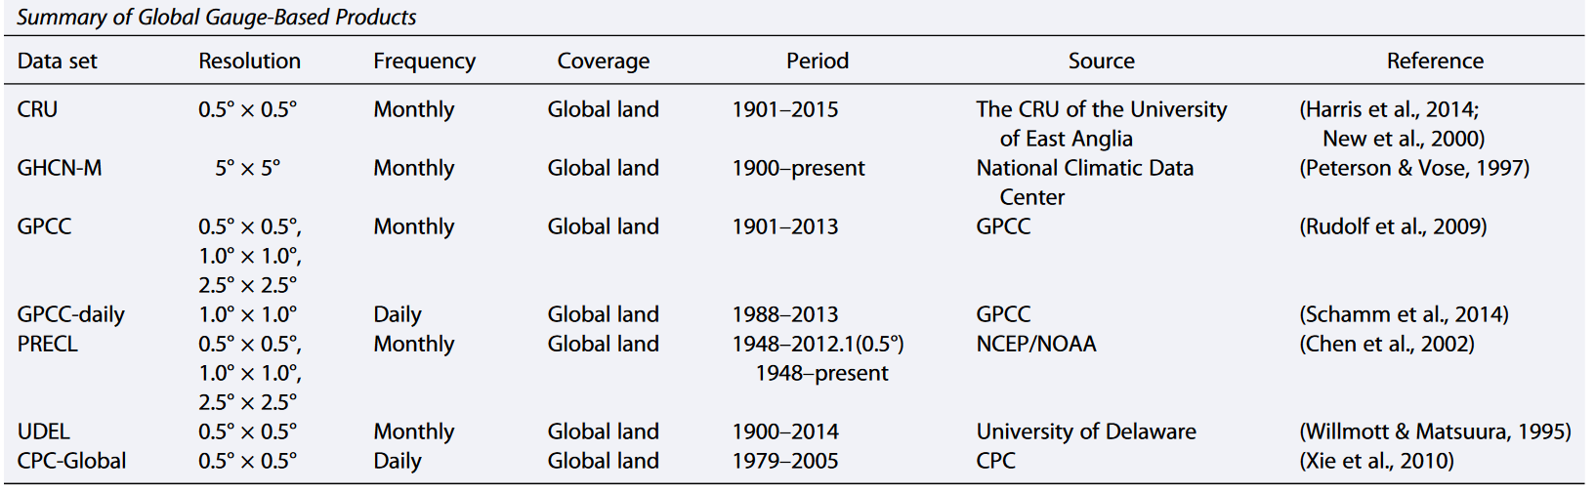
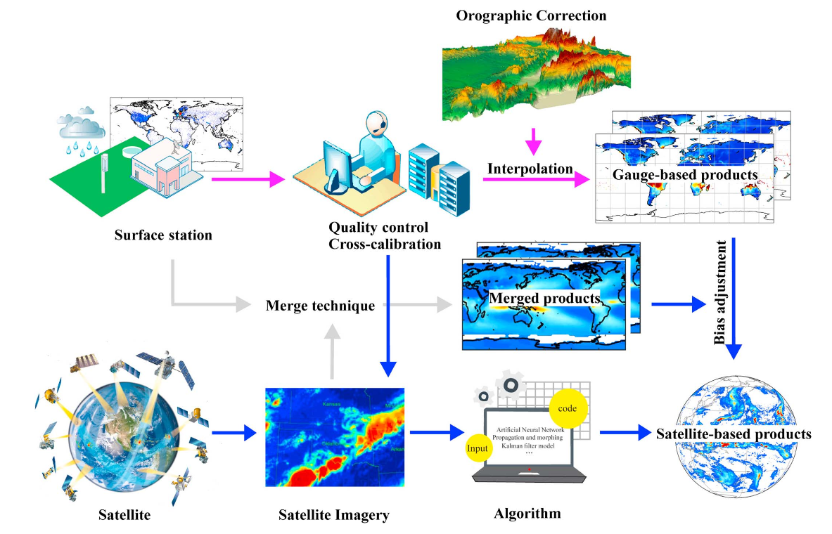
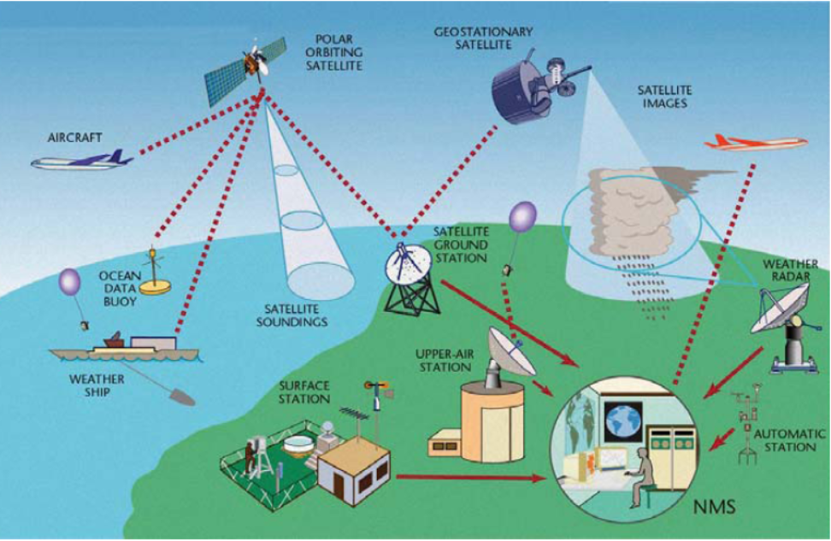
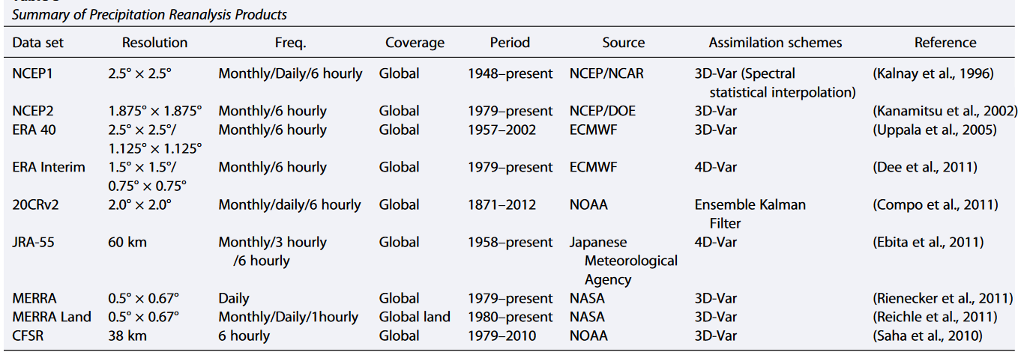
Gridded precipitation products
Datasets based on observations
Other than Rain gauges
Satellites
Reanalysis
  merge irregular observations and models that encompass many physical and dynamical processes in order to generate a synthesized estimate of the state of the system – precipitation is an output
Source: Sun et al., 2018
Notes:
The idea behind reanalysis systems is to merge irregular observations and models that encompass many phy-sical and dynamical processes in order to generate a synthesized estimate of the state of the system across auniform grid, with spatial homogeneity, temporal continuity, and a multidimensional hierarchy.

Slide 10
Gridded precipitation products
Assimilated data products: MSWEP (Multi-Source Weighted-Ensemble Precipitation)
Source: Sun et al., 2018

Slide 11
Gridded precipitation products
Modelling extreme precipitation – Global scale
Several ways to draw an extreme sample
Annual maxima or threshold maxima follows GEV and GPD resp., following extreme value theory
Number of extremes equal to the
number of years
Tail sample (typically 1%, 5% extremes)
Here we consider 5% of tail sample and fit two types of tails – Power type and exponential

Slide 12
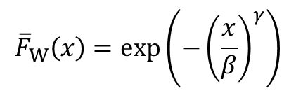

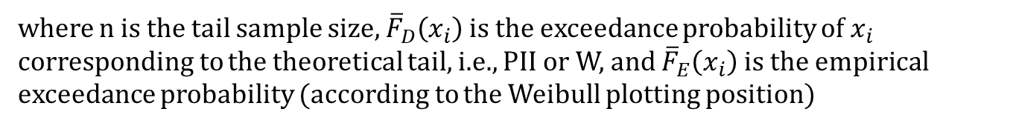
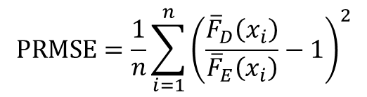
Gridded precipitation products
The tail functions of the Pareto II and Weibull distributions are given, resp, by
where γ and β are shape (or the tail index) and scale parameters, respectively
Estimates of parameters by fitting the theoretical tails to the empirical ones by minimizing the Probability Root Mean Square Error (PRMSE) norm
$${\overline{F}}_{PII}\left(x\right)={\left(1+γ\frac{x}{β}\right)}^{−\frac{1}{γ}}$$
$${\overline{F}}_{W}\left(x\right)=exp\left({−\left(\frac{x}{β}\right)}^{γ}\right)$$
$$PRMSE=\frac{1}{n}\sum_{i=1}^{n}{{\left(\frac{{\overline{F}}_{D}\left(x_{i}\right)}{{\overline{F}}_{E}\left(x_{i}\right)}−1\right)}^{2}}$$
where n is the tail sample size, ${\overline{F}}_{D}\left(x_{i}\right)$ is the exceedance probability of $x_{i}$ corresponding to the theoretical tail, i.e., PII or W, and ${\overline{F}}_{E}\left(x_{i}\right)$ is the empirical exceedance probability (according to the Weibull plotting position)

Slide 13
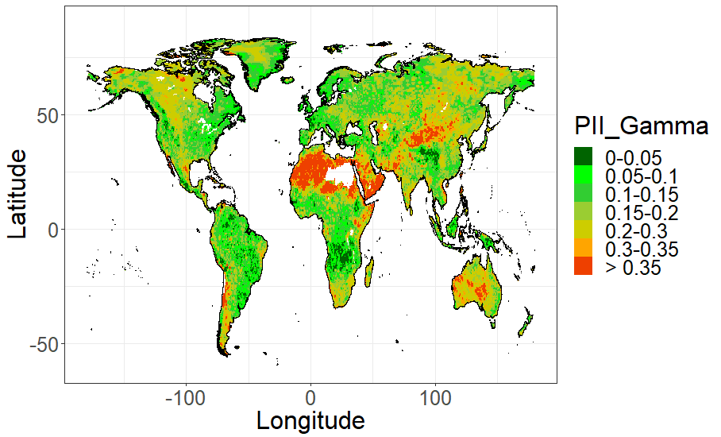
Gridded precipitation products
Multi-Source Weighted-Ensemble Precipitation (MSWEP)
Pareto II

Slide 14
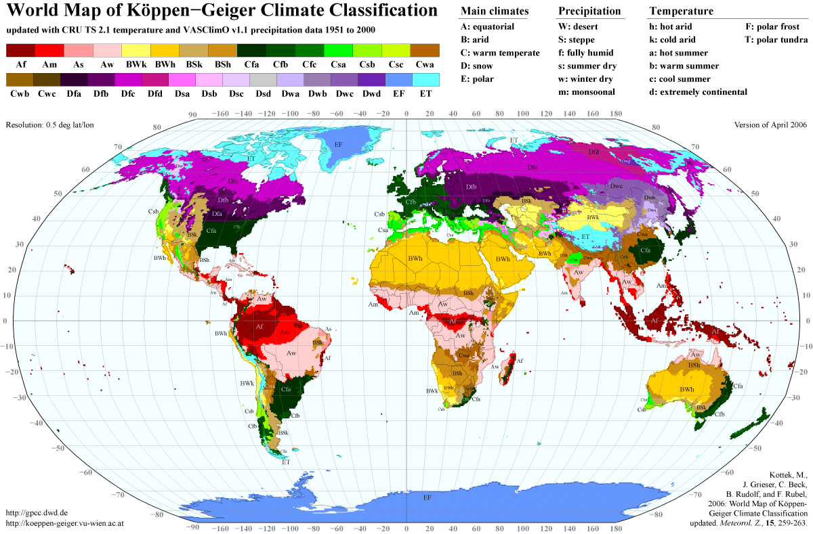
Pareto II

Slide 15
Gridded precipitation products
High value of tail index may not necessarily mean high precipitation
Brazilian and African tropical forests typically receive high precipitation, but this is consistent throughout the observation period we considered, and therefore a light tail is noticed.
Desert parts of Africa and rangelands of Australia, where a heavy tail is observed, one can expect extreme events much larger than the average precipitation.
Understanding tail behaviour helps in better preparedness in facing the extreme precipitation events, which always pose challenge to the society

Slide 16
Gridded precipitation products
Multi-Source Weighted-Ensemble Precipitation (MSWEP)
Pareto II

Slide 17
Gridded precipitation products
High value of tail index may not necessarily mean high precipitation
Brazilian and African tropical forests typically receive high precipitation, but this is consistent throughout the observation period we considered, and therefore a light tail is noticed.
Desert parts of Africa and rangelands of Australia, where a heavy tail is observed, one can expect extreme events much larger than the average precipitation.
Understanding tail behaviour helps in better preparedness in facing the extreme precipitation events, which always pose challenge to the society

Slide 18
Uncertainty with datasets
Dataset name | Temporal resolution | Spatial resolution | Data source
National Centers for Environmental Prediction -Climate Forecast System Reanalysis (CFSR) | sub-daily (1979-2017) | 0.5 deg (Global) | Reanalysis
Multi-Source Weighted-Ensemble Precipitation (MSWEP) | Daily (1979-2016) | 0.5 deg (Global) | Observations Satellite Reanalysis
Climate Prediction Center Unified Gauge-Based Analysis of Global Daily Precipitation (CPC) | Daily (1979-2017) | 0.5 deg (Land) | Observations
Precipitation Estimation from Remotely Sensed Information using Artificial Neural Networks (PERSIANN) Climate Data Record | sub-daily (1983-2017) | 0.25 deg (60S – 60N) | Observations Satellite
WATCH Forcing Data ERA-Interim (WFDEI) corrected using Global Precipitation Climatology Centre | Daily (1979-2016) | 0.5 deg (Land) | Observations Reanalysis

Slide 19
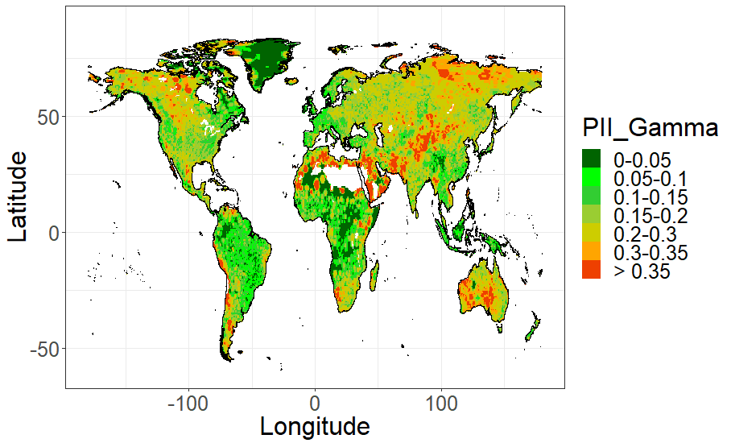
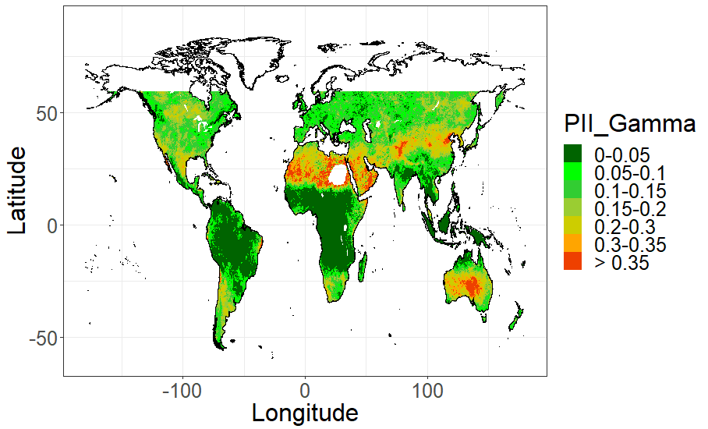
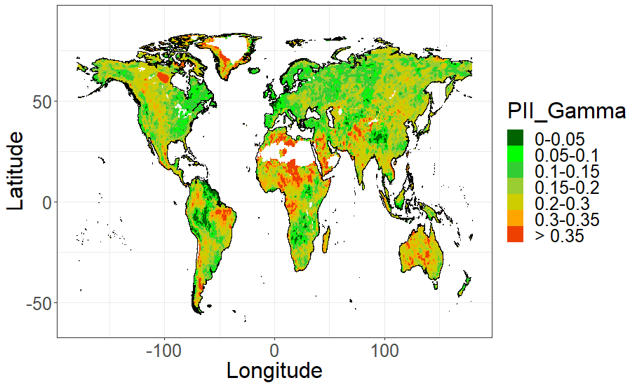
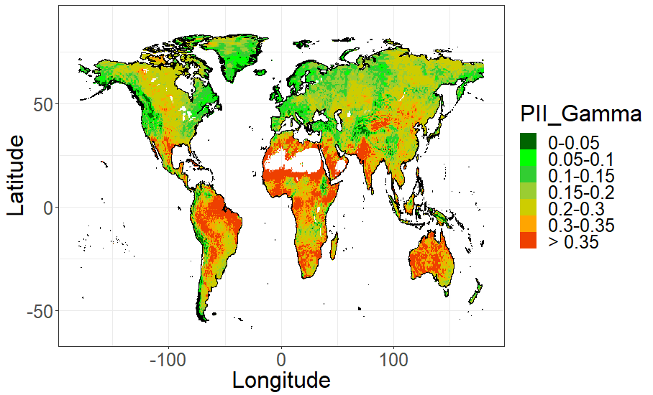
Uncertainty with datasets
CPC
PERSIANN
MSWEP
WFDEI
CFSR

Slide 20
Uncertainty with datasets

Slide 21
Uncertainty with datasets
Comparison of empirical (blue) and calculated return levels using Pareto II (orange) and Weibull (green) for T-year return period (T=39 years for CPC and CFSR; 38 years for MSWEP and WFDEI; 35 years for PERSIANN) at global and continental scale.
Empirical return levels are the maximum of observed precipitation.
Whiskers denote the 95% empirical confidence interval

Slide 22
Uncertainty with datasets
Predicted 100- and 1000-year return levels using both Pareto-II (orange) and Weibull (green) distributions at global and continental scale.
The left side and right side of the plot shows 100-year and 1000-year return period respectively.

Slide 23
Comparison with InSitu observations

Slide 24
100-year return levels

Slide 25
Points to remember
The degree of discrepancy varies from region to region, with low differences in NA and Europe, and huge differences in Africa and SA.
Returns levels underestimated by the satellite-based PERSIANN and overestimated by the reanalysis-based CFSR, when compared with CPC and InSitu
In mid and high latitudes, while the other products show medium to heavy tails, the satellite-based PERSIANN indicate light tails
The reanalysis datasets, CFSR and WFDEI, differ substantially in their spatial patterns in tropics - possible reason for this difference could be that the simulated precipitation extremes are effected by the parameterizations of deep convection
Ground bases observations – very very important – unfortunately number of gauges have been reducing may be due to increasing operational and staffing costs associated with ground-based data collection, restrictions on the release of the data by NMA etc.

Slide 26
Regional Scale
Typically precipitation modelling is same as global scale
At regional scale we are more interested in understanding how precipitation is affecting streamflow
Use a hydrological model
Gridded precipitation products are useful
Now we know which product is good for a region

Slide 27
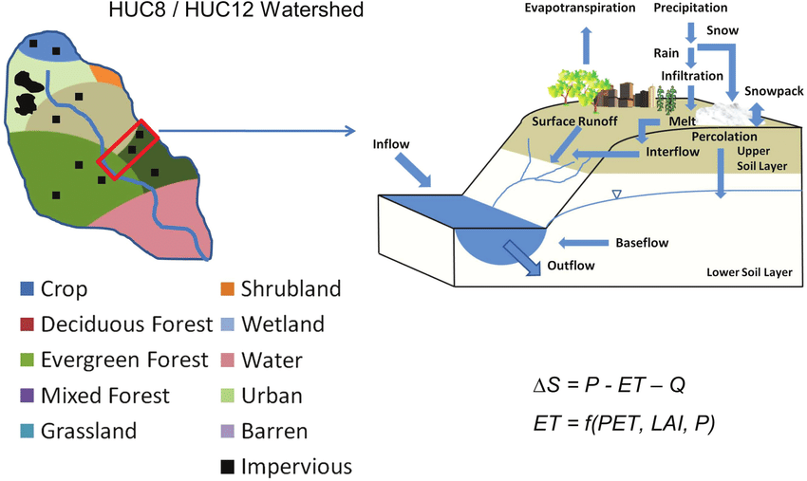
Hydrological modelling - MESH
MESH (Modélisation Environnementale communautaire - Surface Hydrology) is the hydrology land-surface scheme (HLSS) of Environment and Climate Change Canada's (ECCC's) community environmental modelling system
Water balance
grouped response unit (GRU) watershed delineation concept
Source: Zhang et al., 2018

Slide 28
Hydrological modelling - MESH
Bow River Basin – above Calgary

Slide 29
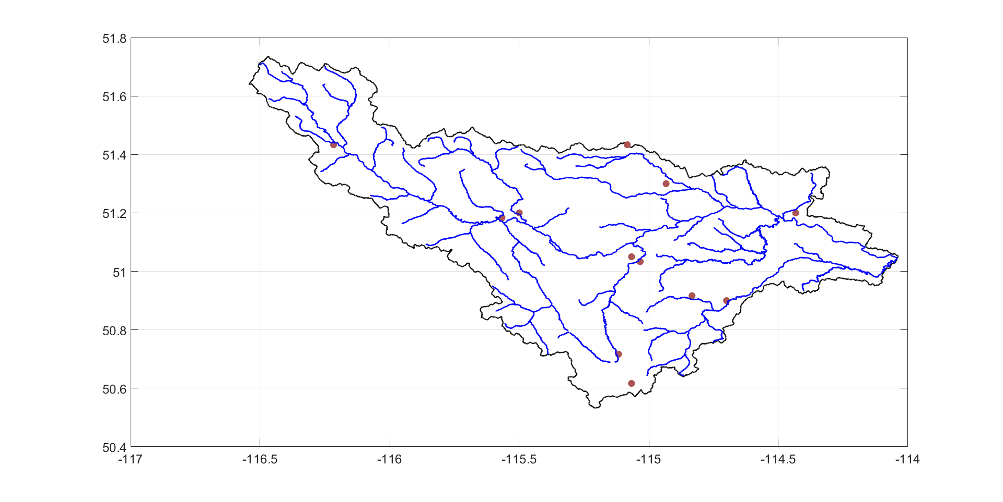
Hydrological modelling
10
9
5
A
2
1
3
C
12
B
6
4
11
7
8

Slide 30
Points to remember
Precipitation has heavier tail than streamflow
Grids with urban GRUs have higher peaks compared to other GRUs
Similar behaviour in the mountains? But model shows different results

Slide 31
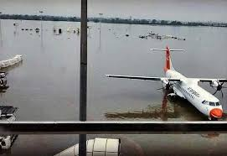
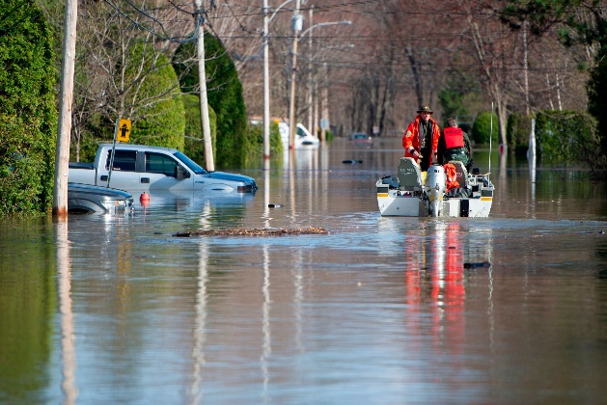
Urban Scale
Urbanization alters hydrologic response of catchment
  Increase in volume of runoff
  Peak flow increases
  Time to peak increases
Important in urban flooding studies
After Urbanization
Q
Before Urbanization
t
https://sites.google.com/view/itraiufm/home?authuser=0

Slide 32
Different uncertainty issues
Gridded products not an option anymore
Rely on InSitu observations
Short-duration (hourly to sub-hourly) time scales
Case study – Bangalore – one of the major cities in India
Notes:
More than 30 years of data

Slide 33
Case study – Bangalore city
Rain gauge measuring data at 15 min interval
Annual maximum series (AMS) is prepared for durations 15 min, 30 min, 1 hour, 3 hour etc.
Generalized extreme value (GEV) distribution
Return levels are obtained for return periods 2, 5, 10, 25, 50 and 100 year using

Slide 34
Parameter Uncertainty
Estimates of GEV parameters
Maximum Likelihood Method (MLE)
Bayesian analysis

Slide 35
Parameter Uncertainty
Unnormalized posterior density of the parameters is given by
θ is the parameter vector
pdf of annual maximum precipitation (X) given the parameter vector (θ)
is the prior distribution of parameters

Slide 36
Parameter Uncertainty
24 hour
12 hour
6 hour
3 hour
1 hour
30 min
15 min
2-year
5-year
10-year
25-year
50-year
100 year
Probability density function (pdf) of 10-year return levels (mm/hr) for various durations in comparison with return levels from Maximum Likelihood Estimation (MLE) method
Pdf of return levels for 15-min duration at different return periods in comparison with return levels obtained from MLE method.

Slide 37
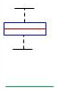
Parameter Uncertainty
Duration | Classical Approach |  | Bayesian Approach
 | Mean | Variance | Mean | Variance
15 min | 128.48 | 65.56 | 131.80 | 76.94
30 min | 98.1 | 32.62 | 100.97 | 51.32
12 hour | 9.09 | 0.73 | 9.25 | 0.65
24 hour | 4.89 | 0.21 | 4.95 | 0.18
*All units in mm/hr
Bayesian
Classical
Probabilistic IDF relationships for 10-year return period

Slide 38
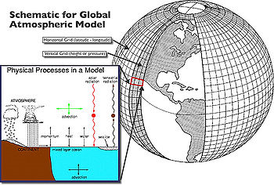
Projected IDF Relationships
General Circulation Models (GCMs):
Tools for simulating time series of climate variables globally, accounting for effects of greenhouse gases in the atmosphere.
can simulate largescale circulation patterns (e.g., pressure and geo potential heights) well
do not reproduce well nonsmooth fields such as precipitation.
Climate models are systems of differential equations based on the basic laws of physics, fluid motion, and chemistry. To “run” a model, scientists divide the planet into a 3-dimensional grid, apply the basic equations, and evaluate the results. Atmospheric models calculate winds, heat transfer, radiation, relative humidity, and surface hydrology within each grid and evaluate interactions with neighboring points.
https://www.ipcc-data.org/guidelines/pages/gcm_guide.html

Slide 39
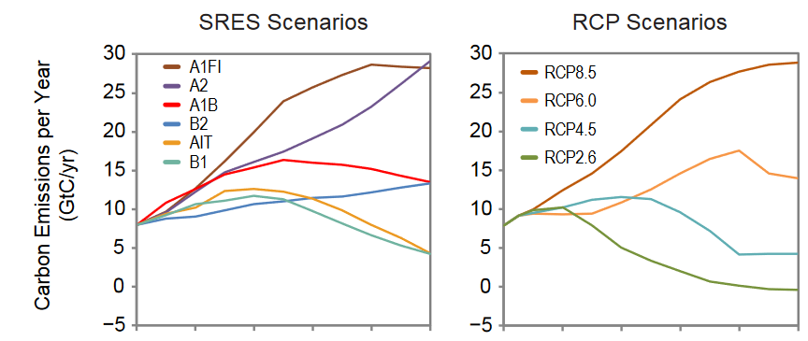
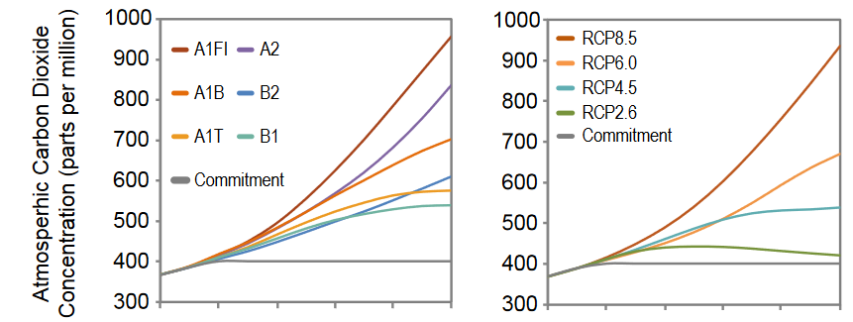
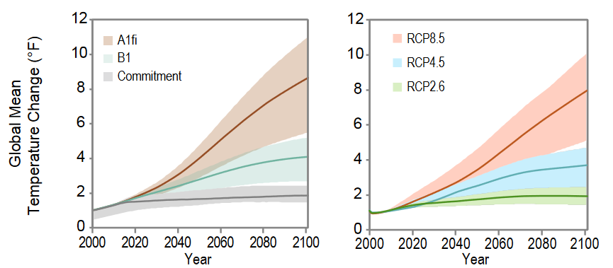
Projected IDF Relationships
https://www.ipcc.ch/

Slide 40
Model Uncertainty
GCM model with future climate scenarios and latitude-longitude
Model Name | Latitude | Longitude | Abbreviation | Climate Scenarios
ACCESS1_0 | 12.5 N | 76.875 E | A1 | RCP 4.5, RCP 8.5
BCC-CSM1-1 | 12.55 N | 78.75 E | BC1 | RCP 2.6, RCP 4.5, RCP 6.0, RCP 8.5
BCC-CSM1-1-M | 12.89 N | 77.6 E | BC1M | RCP 2.6, RCP 4.5, RCP 6.0, RCP 8.5
BNU-ESM | 12.55 N | 78.75 E | BNU | RCP 2.6, RCP 4.5, RCP 8.5
CanESM2 | 12.55 N | 78.7 E | CAN | RCP 2.6, RCP 4.5, RCP 8.5
CCSM4 | 12.7225 N | 77.5 E | C4 | RCP 2.6, RCP 4.5, RCP 6.0, RCP 8.5
CMCC-CMS | 12.1 N | 76.8 E | CMS | RCP 4.5, RCP 8.5
CNRM-CM5 | 11.9 N | 77.34 E | CN5 | RCP 4.5, RCP 8.5
CSIRO-MK3-6-0 | 12.12 N | 76.875 E | CM60 | RCP 2.6, RCP 4.5, RCP 6.0, RCP 8.5
FGOALS-G2 | 12.55 N | 78.75 E | FG2 | RCP 2.6, RCP 4.5, RCP 8.5
FGOALS-S2 | 12.4 N | 75.9 E | FS2 | RCP 2.6, RCP 4.5, RCP 6.0, RCP 8.5
GFDL-CM3 | 13 N | 78.75 E | GF3 | RCP 2.6, RCP 6.0
GFDL-ESM2G | 13.14 N | 76.25 E | GF2G | RCP 2.6, RCP 4.5, RCP 6.0, RCP 8.5
GFDL-ESM2M | 13.14 N | 76.25 E | GF2M | RCP 2.6, RCP 4.5, RCP 6.0, RCP 8.5
GISS-E2-R | 13 N | 76.25 E | GISS | RCP 4.5
HadGEM2-CC | 12.5 N | 76.87 E | HADC | RCP 4.5, RCP 8.5
HadGEM2-ES | 12.5 N | 76.875 E | HADE | RCP 2.6, RCP 4.5, RCP 6.0, RCP 8.5
INMCM4 | 12.75 N | 78 E | IN4 | RCP 4.5, RCP 8.5
IPSL-CM5A-LR | 12.31 N | 78.75 E | IPCL | RCP 2.6, RCP 4.5, RCP 6.0, RCP 8.5
IPSL-CM5A-MR | 12.6 N | 77.5 E | IPCM | RCP 2.6, RCP 4.5, RCP 6.0, RCP 8.5
MIROC5 | 11.9 N | 78.75 E | MI5 | RCP 2.6, RCP 4.5, RCP 6.0, RCP 8.5
MIROC-ESM-CHEM | 12.55 N | 78.75 E | MIEC | RCP 2.6, RCP 4.5, RCP 6.0, RCP 8.5
MIROC-ESM | 12.55 N | 78.75 E | MIE | RCP 2.6, RCP 4.5, RCP 6.0, RCP 8.5
MPI-ESM-LR | 12.12 N | 78.75 E | MPI | RCP 2.6, RCP 4.5, RCP 6.0, RCP 8.5
MRI-CGCM3 | 12.89 N. | 77.62 E | MRI | RCP 2.6, RCP 4.5, RCP 6.0, RCP 8.5
NorESM1-M | 12.31 N | 77.5 E | NEM | RCP 2.6., RCP 4.5, RCP 6.0, RCP 8.5

Slide 41
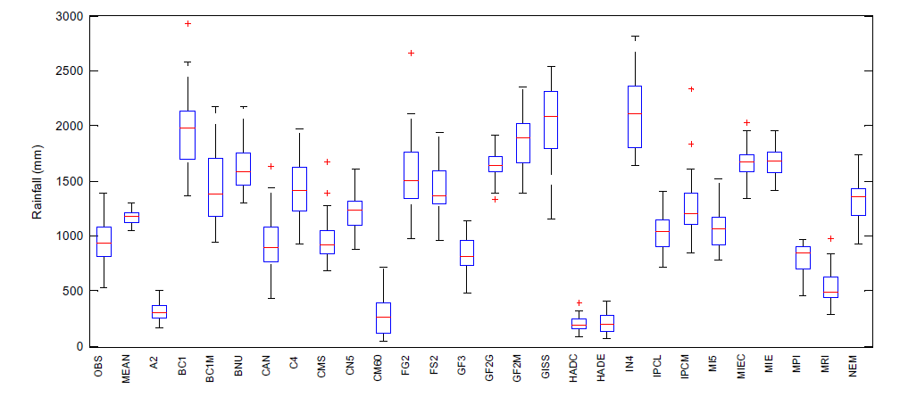
Model Uncertainty
Precipitation (mm)
Annual precipitation from 26 GCMs. Mean precipitation across all GCMs (MEAN) and the observed gauge data (OBS) are also shown
RCP 2.6: 20, RCP 4.5: 25, RCP 6.0: 16 and RCP 8.5: 24 GCMs
Three time slices: 2021-2050; 2051-2080; 2071-2100
Notes:
2021-2100 for three time slices, near future to far future

Slide 42
Model Uncertainty
GCM-Model Name | RCP2.6 2021-2050 | RCP2.6 2051-2080 | RCP2.6 2071-2100
BCC-CSM1-1 | 0.037 | 0.049 | 0.148
BCC-CSM1-1-M | 0.056 | 0.023 | 0.031
BNU-ESM | 0.042 | 0.038 | 0.030
CanESM2 | 0.046 | 0.056 | 0.098
CCSM4 | 0.033 | 0.092 | 0.113
CSIRO-MK3-6-0 | 0.059 | 0.035 | 0.053
FGOALS-G2 | 0.032 | 0.024 | 0.029
FGOALS-S2 | 0.021 | 0.021 | 0.019
GFDL-CM3 | 0.040 | 0.035 | 0.038
GFDL-ESM2G | 0.032 | 0.020 | 0.029
GFDL-ESM2M | 0.071 | 0.028 | 0.022
HadGEM2-ES | 0.015 | 0.047 | 0.100
IPSL-CM5A-LR | 0.086 | 0.081 | 0.056
IPSL-CM5A-MR | 0.049 | 0.038 | 0.034
MIROC5 | 0.044 | 0.031 | 0.029
MIROC-ESM-CHEM | 0.025 | 0.070 | 0.021
MIROC-ESM | 0.030 | 0.080 | 0.028
MPI-ESM-LR | 0.128 | 0.021 | 0.042
MRI-CGCM3 | 0.036 | 0.028 | 0.028
NorESM1-M | 0.117 | 0.183 | 0.049
Reliability Ensemble Averaging (REA)
Model performance criterion:
CDF deviations between the observed data and GCM projected precipitation for control period
Model convergence criterion:
CDFs deviation for all GCMs for projected period from the weighted mean CDF.
Notes:
Control period 1969-1998
Obtain mean GCM from weights of control period
Got the projections at daily scale

Slide 43
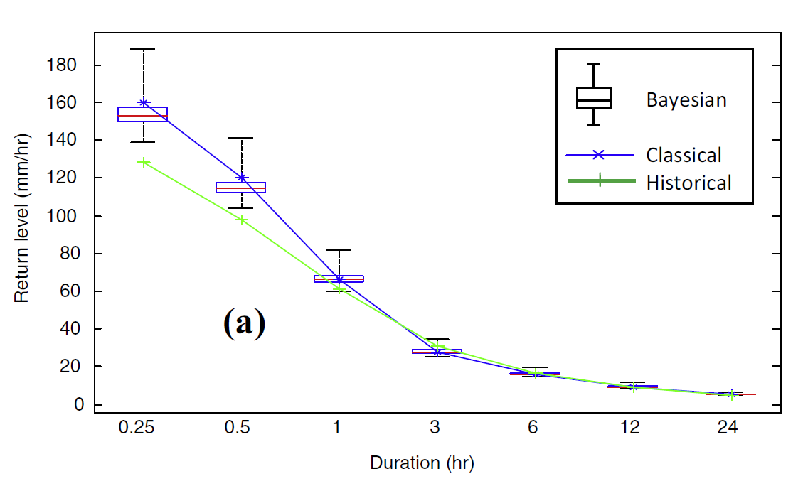
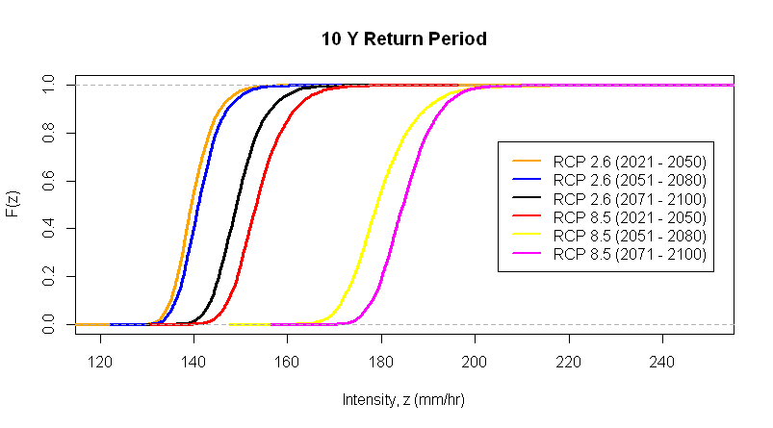
Projected Probabilistic IDF Relationships
Variation in return levels for various durations in comparison with classical approach and historical time line for the near future
(2021–2050)
Cumulative distribution function (cdf) of return level for 15-min duration, for RCP 2.6 and RCP 8.5 scenarios, and for the future three time slices for a 10-year return period.

Slide 44
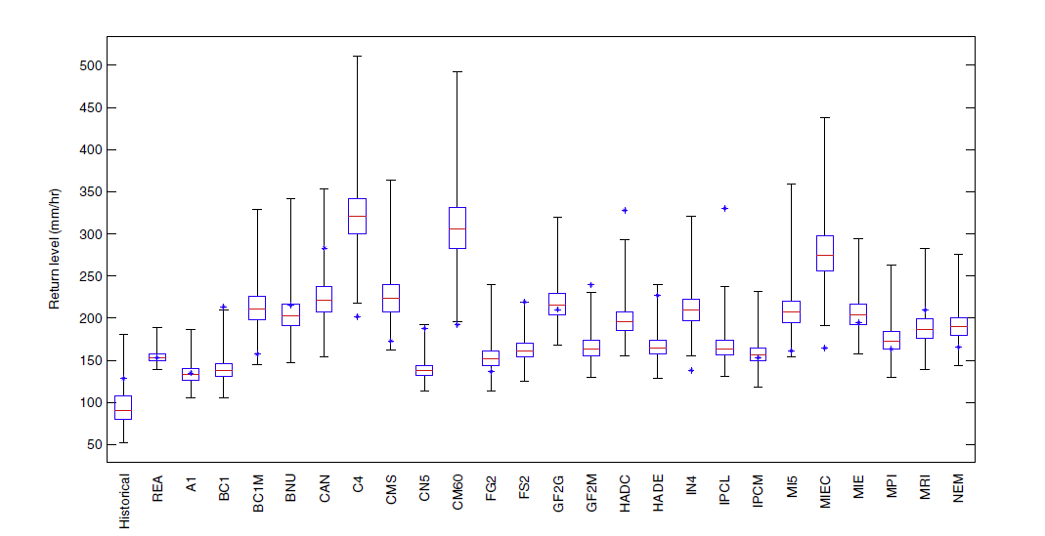
Projected Probabilistic IDF Relationships
Uncertainty in 10-year return levels for near future (2021–50) for different GCMs, REA averaged, and the uncertainty in return levels for historical time period (1969–2003) for 15-min. duration, for RCP 8.5 Scenario.
Notes:
difference in return levels from the classical approach and the Bayesian approach. The deviance being high for most of the GCMs, it is important that one should consider an ensemble of GCMs in obtaining the future projections

Slide 45
Percentage change (between mean of return levels from Bayesian approach and classical approach) in return levels for different GCMs and different RCP scenarios
Scenario GCM | RCP 2.6 (2021-50) | RCP 4.5 (2021-50) | RCP 6.0 (2021-50) | RCP 8.5 (2021-50) | RCP 8.5 (2071-2100)
REA | 1.4 | 1.2 | 1.4 | 0.8 | 0.8
A1 | - | -7.9 | - | -0.4 | -1.8
BC1 | -1.4 | 4.2 | 35.0 | -34.9 | -41.8
BC1M | -5.7 | -6.9 | 70.7 | 36.0 | 27.2
BNU | -5.2 | 21.2 | - | -4.6 | 57.2
CAN | 8.6 | -13.1 | - | -20.8 | 3.4
C4 | 29.4 | -30.3 | 17.1 | 60.0 | 48.1
CN5 | - | 12.3 | - | -26.3 | -32.6
CM60 | -13.3 | -18.1 | 13.6 | 61.1 | 154.5
GF2G | -3.1 | -20.8 | 104.2 | 3.6 | -33.7
GF2M | 37.2 | 1.5 | 31.3 | -30.6 | -48.8
GISS | - | 20.5 | - | - | -
HADC | - | -44.8 | - | -39.9 | -56.7
HADE | -17.8 | 6.7 | 23.6 | -26.8 | 20.5
IN4 | - | 32.5 | - | 53.1 | 162.1
IPCL | -2.3 | 4.8 | 0.5 | -49.9 | -47.1
IPCM | 13.5 | 11.7 | 79.4 | 2.9 | -34.6
MI5 | -10.6 | -0.7 | 12.2 | 29.4 | 147.1
MIEC | 39.9 | 17.8 | 41.4 | 69.6 | 79.8
NEM | -10.3 | -0.4 | 22.1 | 15.1 | -26.9

Slide 46
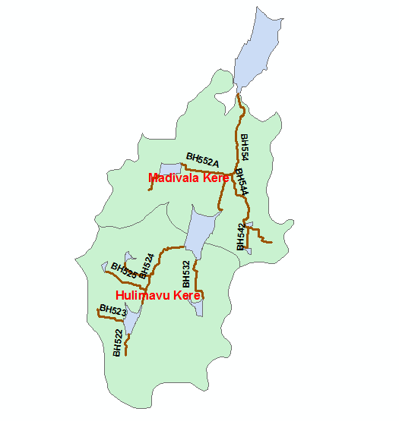
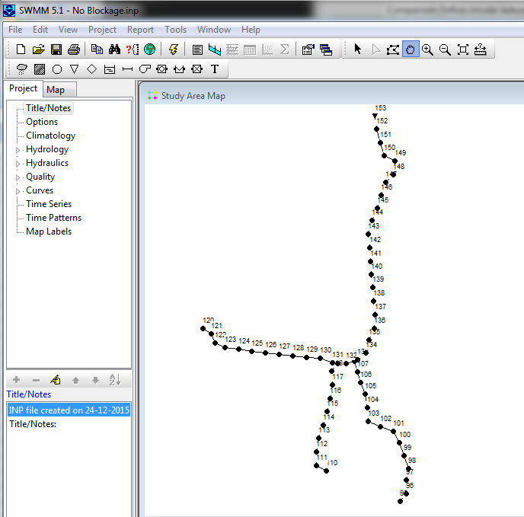
Flood Analysis – Storm water drainage
With 30% reduction in Runoff due to Rainwater Harvesting
Propose structural and non-structural measures
Fire personal deploy at the flooding site
Resiliency of system - time to get back to the normal situation

Slide 47
Quantification of Uncertainty in Spatial Return Levels of Urban Precipitation Extremes
Notes:
1948-2002
Min-17 years, max-54 years
See th stations <2 km, max distance- 52 km

Slide 48
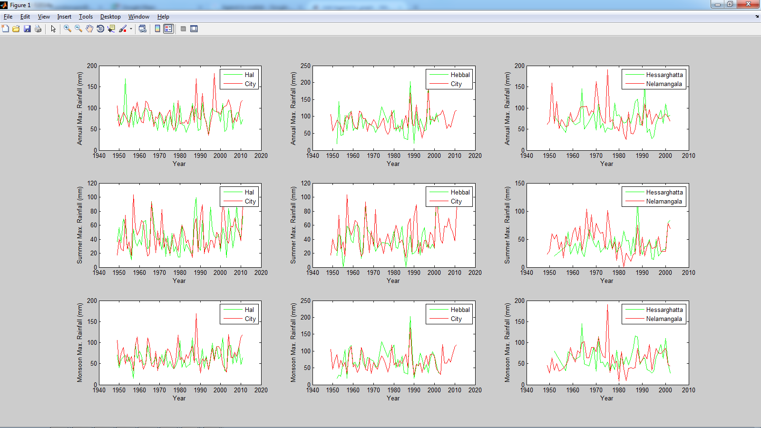
Introduction
Annual, summer and monsoon maximum daily precipitation values form 1948 onwards at the three pairs of stations

Slide 49
Quantification of Uncertainty in Spatial Return Levels of Urban Precipitation Extremes
Notes:
1948-2002
Min-17 years, max-54 years
See th stations <2 km, max distance- 52 km

Slide 50
Hierarchical Bayesian Analysis
Data layer
Process layer
Prior layer
θ = (θ₁, θ₂)
θ₁ - parameters in the data layer (parameters of the GEV distribution)
θ₂ - parameters in the process layer (parameters of latent spatial process).

Slide 51
Hierarchical Bayesian Analysis
Data layer
Process layer
Location and scale parameters as Gaussian process
GP (mean, covariance)

Slide 52
Hierarchical Bayesian Analysis
S.No. | Covariates | Short form
Geographic
1 | Elevation | elev
2 | Latitude | lat
3 | Longitude | lon
Climatological
4 | Mean Annual Precipitation | MAP
5 | Mean Summer Precipitation | MSP
6 | Mean Monsoon Precipitation | MMP
7 | Mean Difference (Tmax-Tmin) Annual Temperature | DAT
8 | Mean Difference (Tmax-Tmin) Summer Temperature | DST
9 | Mean Difference (Tmax-Tmin) Monsoon Temperature | DMP

Slide 53
Hierarchical Bayesian Analysis
Prior layer
Regression parameters are set to follow uniform distribution
α_{ϕ} ∼ Unif (–∞,+∞)
Variogram parameters are set to follow uniform distribution based on the maximum and minimum range and sill of the empirical variogram
β_{μ,0} ∼ Unif(2,35) β_{μ,1} ∼ Unif(16,100)
β_{σ,0} ∼ Unif(0.005,0.05) β_{σ,1} ∼ Unif(5,50)

Slide 54
Results
Case | Covariates | DIC
Annual | MMP, elev | 10409.69
 | DTA, elev | 10410.18
Summer | MSP, elev | 9888.81
 | DTS, elev | 9889.62
Monsoon | lon, lat | 10405.87
 | elev | 10406.63
Summer maximum
Monsoon maximum
Annual maximum

Slide 55
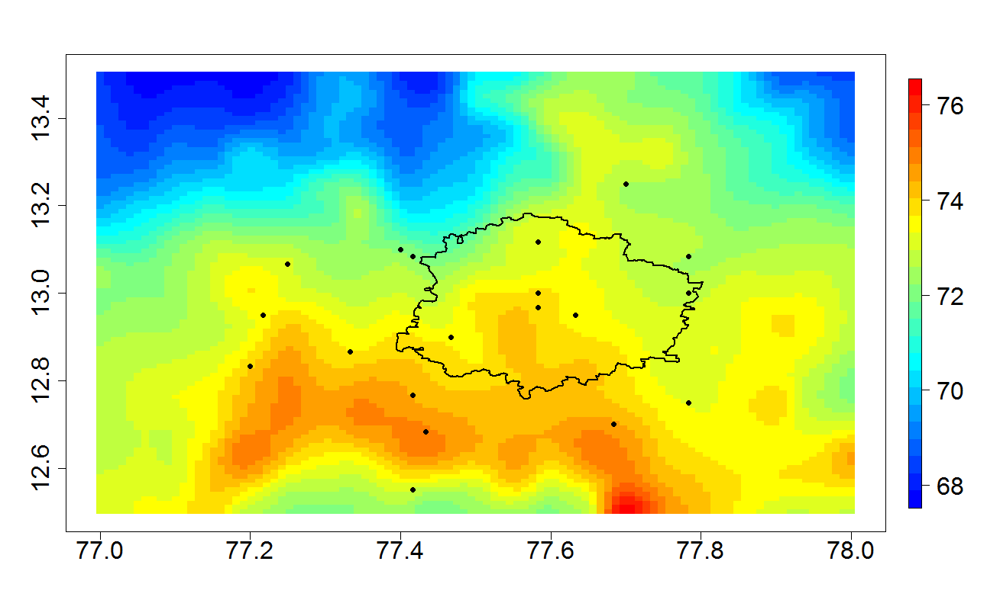
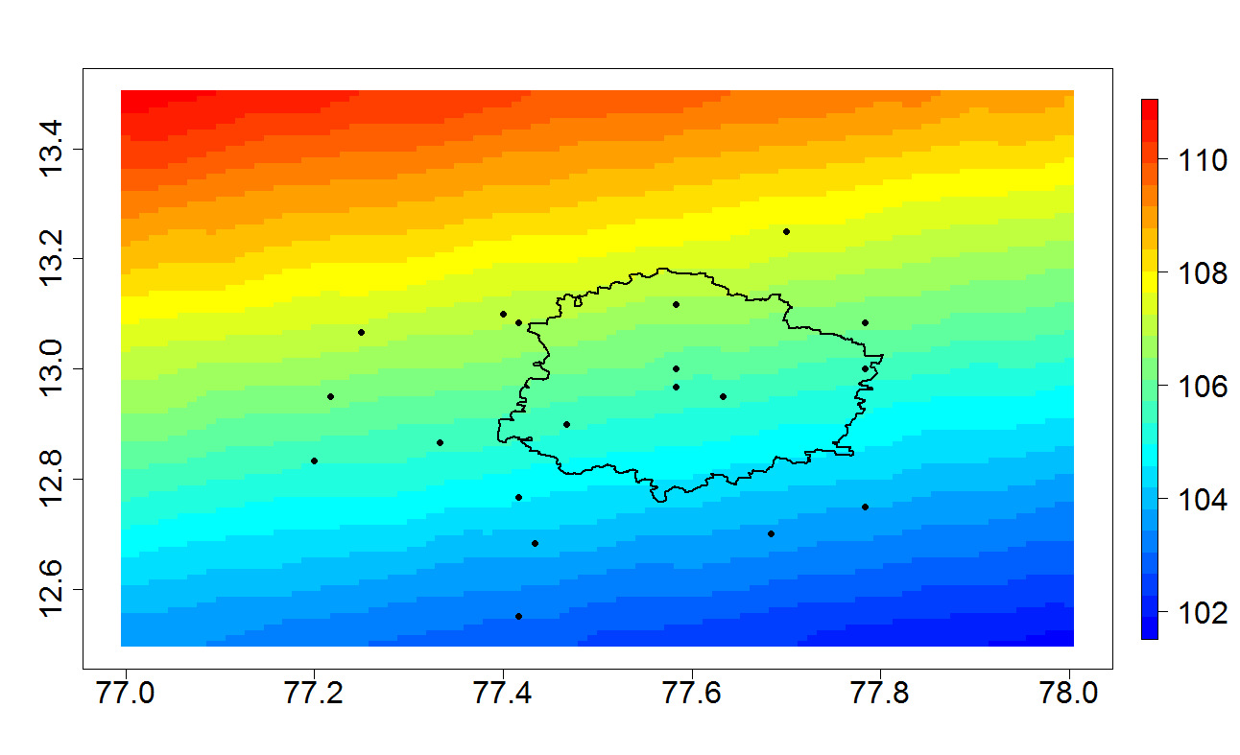
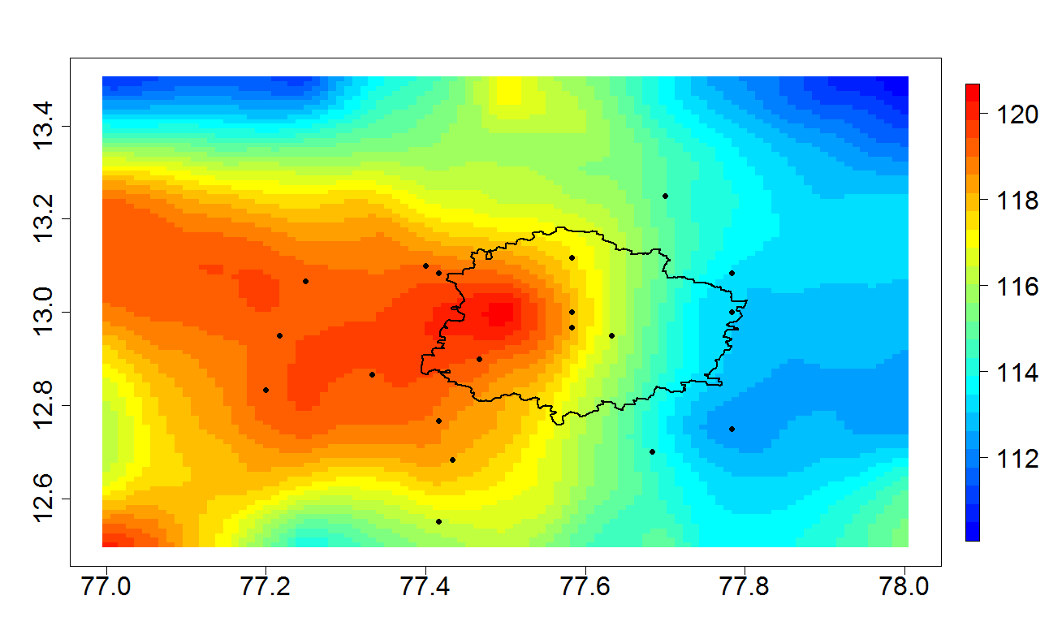
Results
(a)
(b)
Latitude
Return level maps for 10 year return period for selected hierarchical model. (a) Summer, (b) monsoon and (c) annual precipitation.
(c)
Longitude

Slide 56
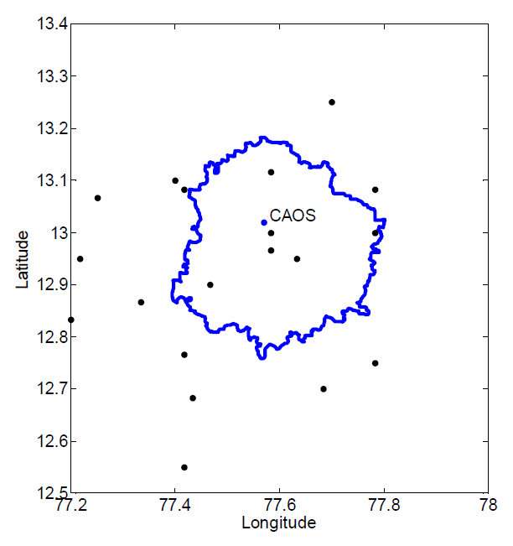
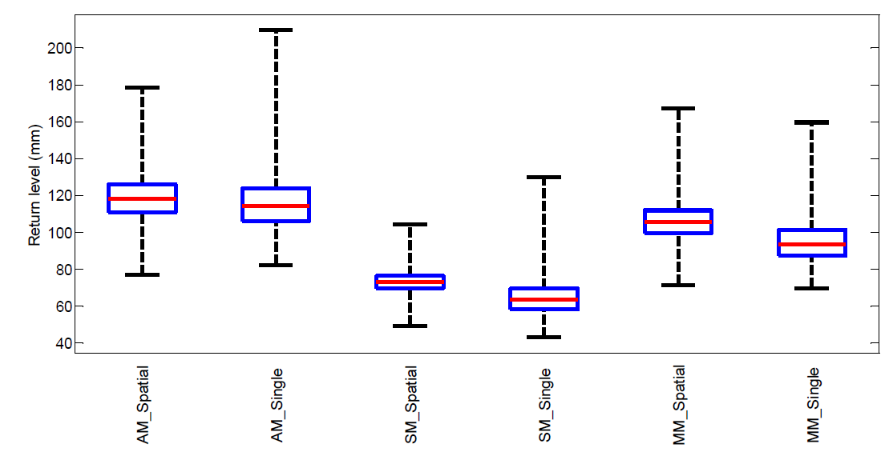
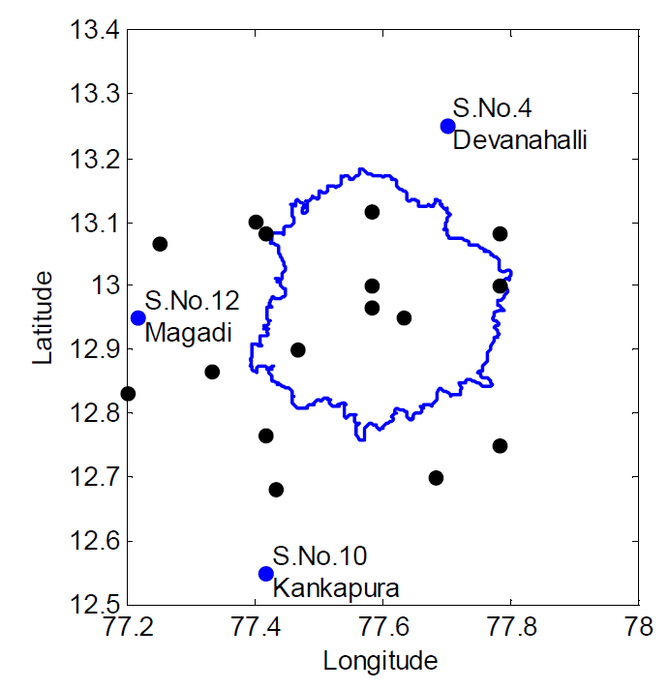
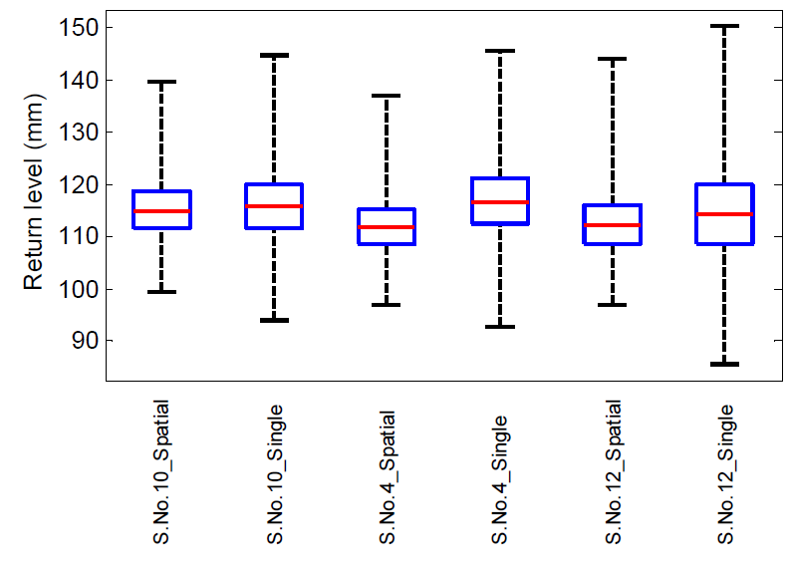
Validation
Comparison of return levels for 10 year return period obtained from the selected hierarchical model (Spatial) and from single station (Single) Bayesian analysis for Annual Maximum (AM) precipitation at three stations

Slide 57
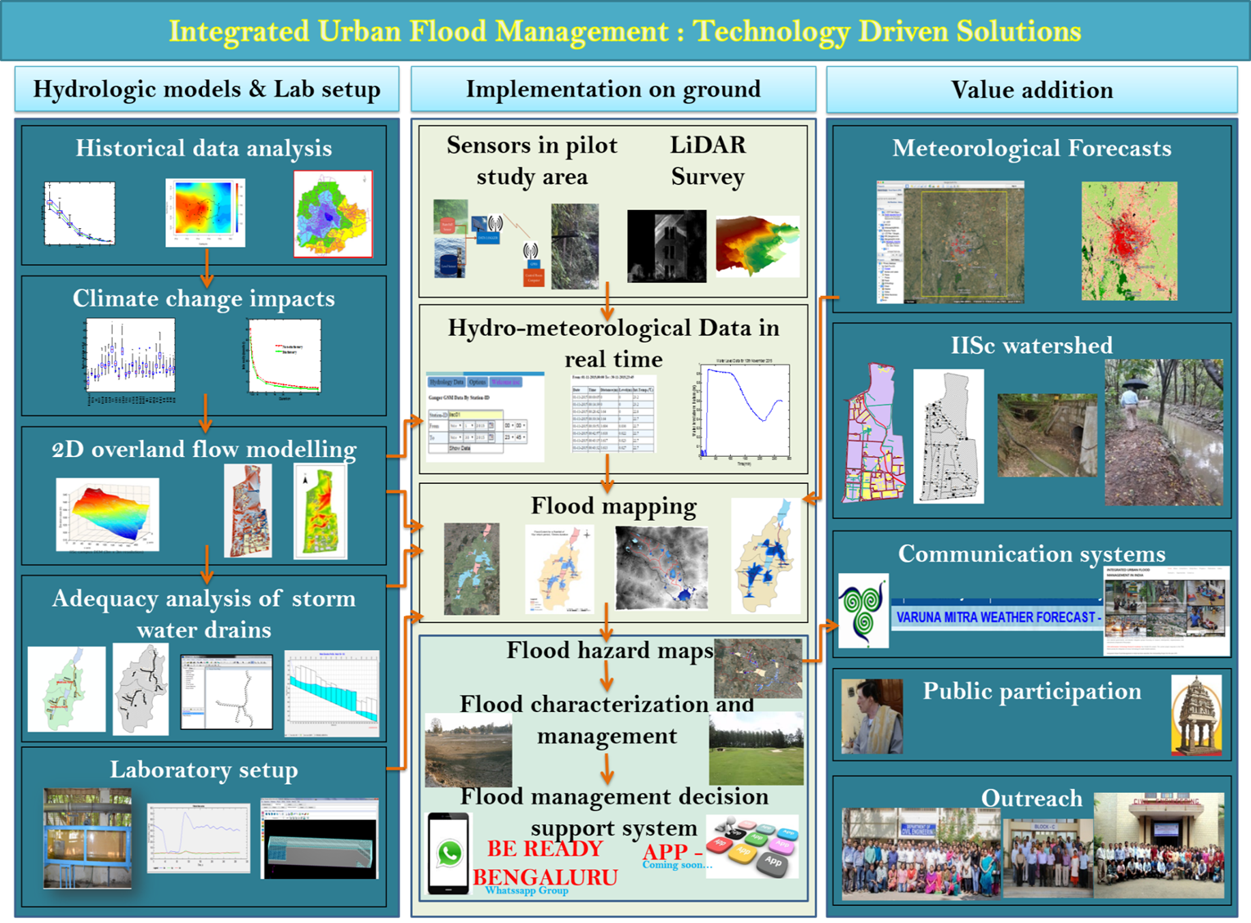

Slide 58
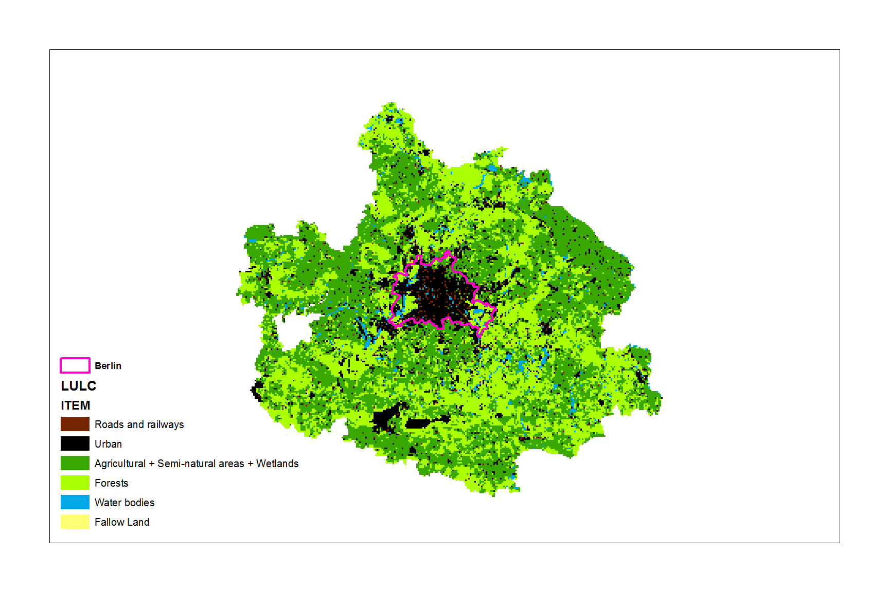
Case study – Berlin City, Germany
B3
B2
B1
city
Berlin City boundary
Understanding dependence structure of extreme precipitation within an urban area and its surroundings at various durations
Spatial dependence of precipitation analysed with different measures for examining dependence.
Model dependence using max-stable process
Notes:
Remove stations in the city
Check the surroundings

Slide 59
Case study – Berlin City, Germany
Hourly precipitation shows independence within the city even at small distances, whereas the daily precipitation shows dependence.
Both hourly and daily precipitation show dependence as more and more non-urban areas are included.
Geographical covariates are predominant within the city while climatological covariates prevail when non-urban areas are added for the case study.
Notes:
Remove stations in the city
Check the surroundings

Slide 60
Points to remember
Careful assessment of return levels
Propagate parameter uncertainty to obtain projected IDF relationships.
High uncertainty in short duration precipitation extremes.
Uncertainty introduced due to choice of GCM model is smaller than due to parameter uncertainty.
Spatial variation – important to consider
Geographic covariates dominate as drivers of precipitation extremes.
Hourly precipitation shows independence within the city even at small distances, whereas the daily precipitation shows dependence.
Geographical covariates are predominant within the city while climatological covariates prevail when non-urban areas are added for the case study.

Slide 61
Conclusions
Several uncertainties abound
  With data
  Different models
  Spatio-temporal variability
  Include as much information as possible in modelling
Predictions - consider uncertainty
Assessing flood resilience of a city or system
Better preparedness
Manage flood waters at the source naturally
  Low Impact Development (LID) - storage and reuse
  Sustainable Drainage Systems (SuDS) – permeable pavement, wetlands, green roof, detention basins

Slide 62
Challenges ahead
Changing climate
Introduces non-stationarity in the process

Slide 63
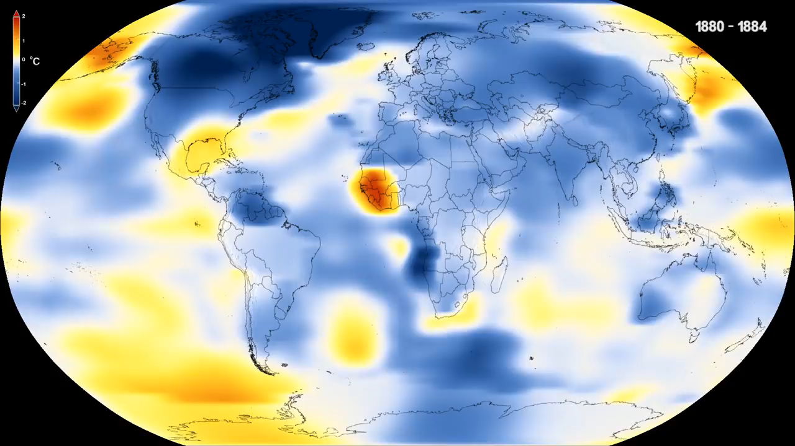
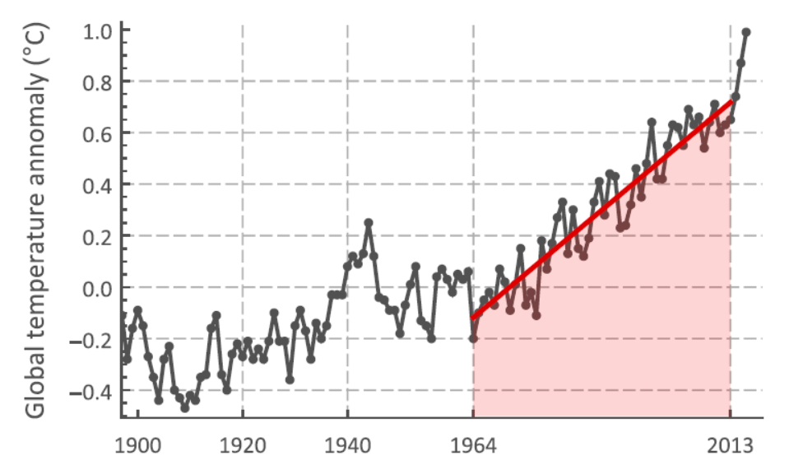
https://svs.gsfc.nasa.gov/cgi-bin/details.cgi?aid=3975

Slide 64
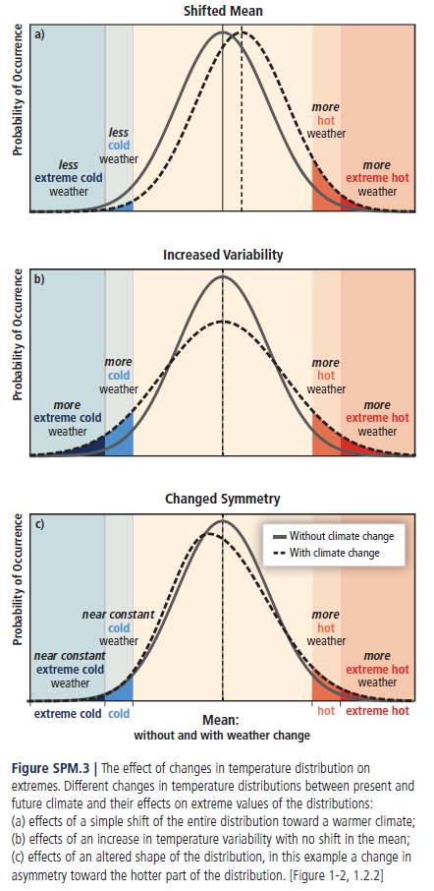
Effect of changes in temperature distribution
IPCC, 2012: Managing the Risks of Extreme Events and Disasters to Advance Climate
Change Adaptation.

Slide 65

Change in temperature distribution
Distribution of Northern Hemisphere summer temperature anomalies shifting toward an increase in hot summers
https://svs.gsfc.nasa.gov/cgi-bin/details.cgi?aid=3975

Slide 66

Increase in extreme precipitation
Annual mean extreme precipitation anomaly (mm)
Frequency of events
Source: Papalexiou and Montanari, 2019

Slide 67
Questions?
Contact Information:
chandra.rajulapati@usask.ca
https://twitter.com/ChandraRajulap1
Most Welcome!

