Slide 1


Predicting regulatory function from network structure
or
John Platig
Quackenbush Lab
Dana-Farber Cancer Institute
Harvard Chan School of Public Health

Slide 2

How do I avoid Monty Python’s Royal Society for putting things on top of other things in the era of “multi-omics”?
“The year has been a good one for the society”

Slide 3
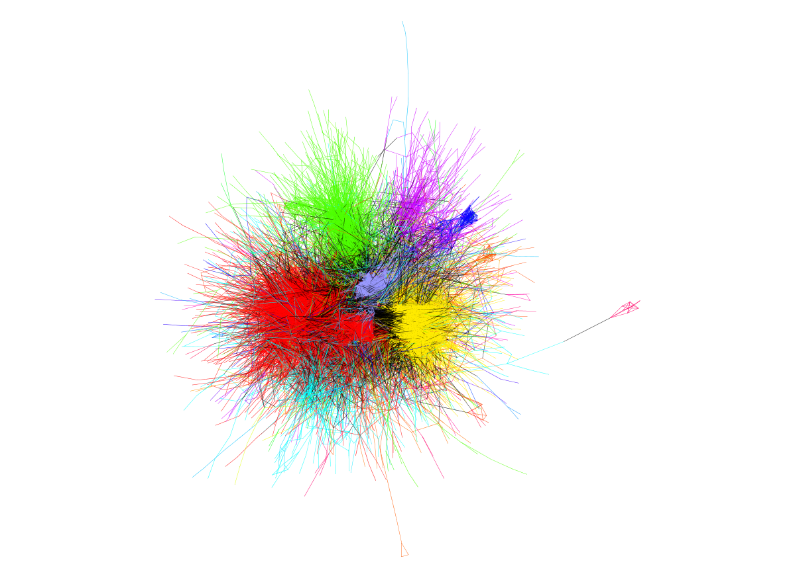
Build a regulatory network!
How can we use network structure as a predictive tool?
How do we build appropriate statistical models for testing results (randomly rewiring your network is not enough)?
What are the right questions for network methods to answer?
Beyond the hairball…
Notes:
Key: interpretability of networks
-

Slide 4
Modeling the regulatory impact of PknA/B inhibition in Mycobacterium tuberculosis

Slide 5
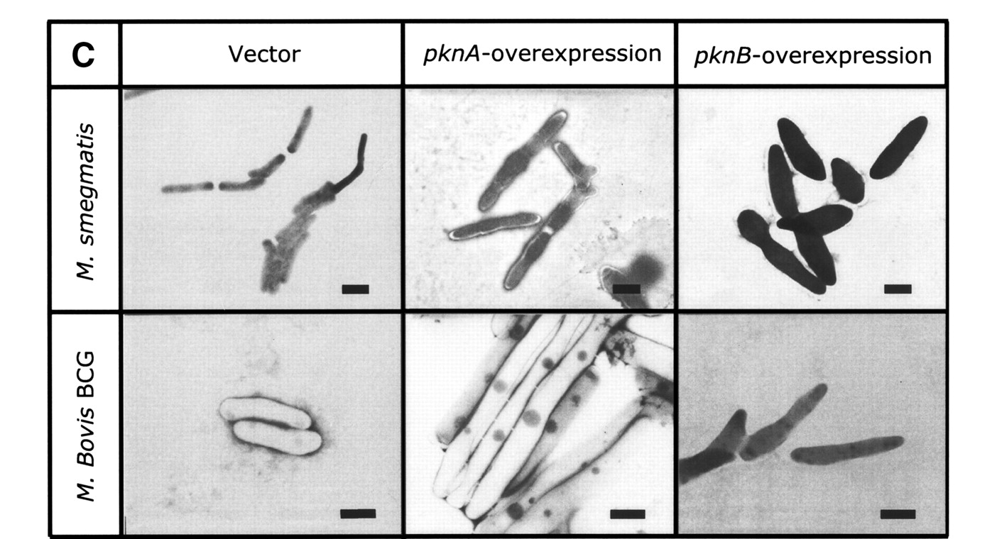
Background & experimental set-up
PknA/B are essential kinases
Transmembrane proteins, respond to extracellular signals
Important for cell growth, morphology and cell wall synthesis
Choong-Min Kang et al. Genes Dev. 2005;19:1692-1704
Goal: understand the downstream regulatory effects of PknA/B inhibition.
Experimental set-up:
Inhibit PknA/B signal transduction using a synthetic small molecule (developed by Vertex) in a virulent TB cell line (H37Rv)
Notes:
STPKs comprise a single transmembrane protein with an extracytoplasmic receptor domain and an intracellular kinase domain that is structurally similar to eukaryotic STPK kinase domains

Slide 6
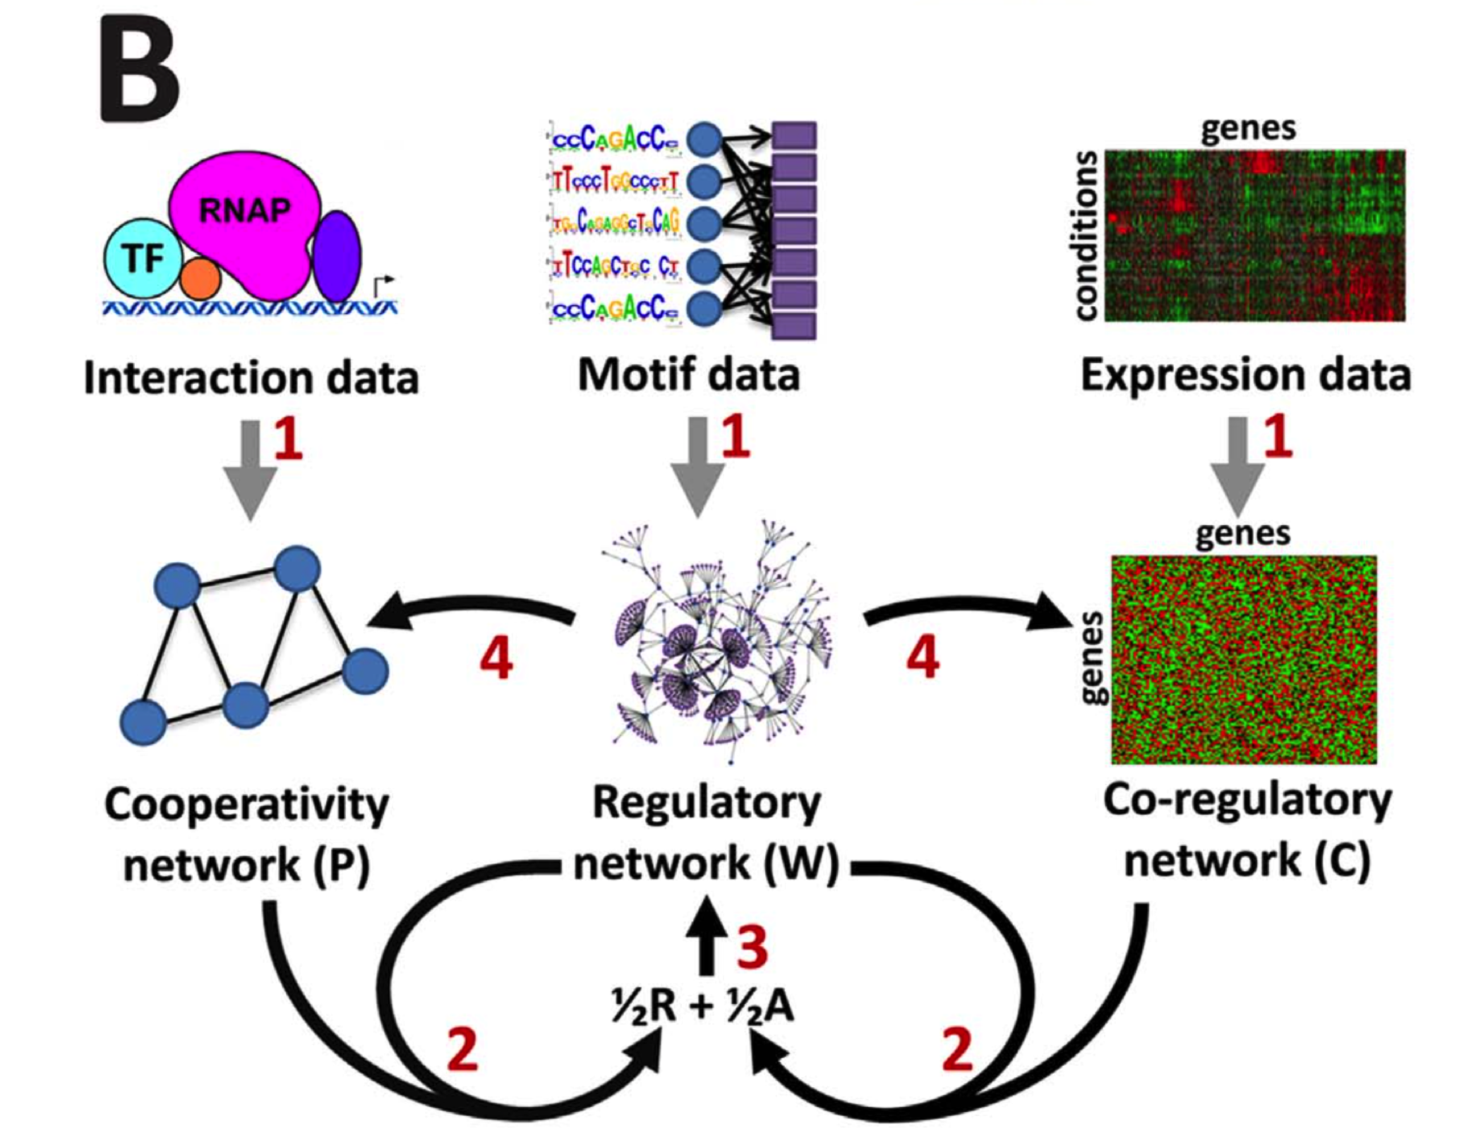
Regulatory Network Reconstruction
PANDA
ChIP-Seq
Albert Young, Xavier Carette, Bob Husson
Glass et. al. “Passing Messages Between Biological Networks to Refine Predicted Interactions.” PLoS One. 2013 May 31;8(5):e64832.
Code and related material available on sourceforge: http://sourceforge.net/projects/panda-net/
Notes:
Passing Attributes between Networks for Data Assimilation

Slide 7
Differences in TF out-degree
Compare the sum of outgoing edge weights for each TF in each condition
T4
T10
Albert Young, Xavier Carette, Bob Husson
Notes:
Negative values – suggests that the expression of genes in regulon of TF are less correlated

Slide 8
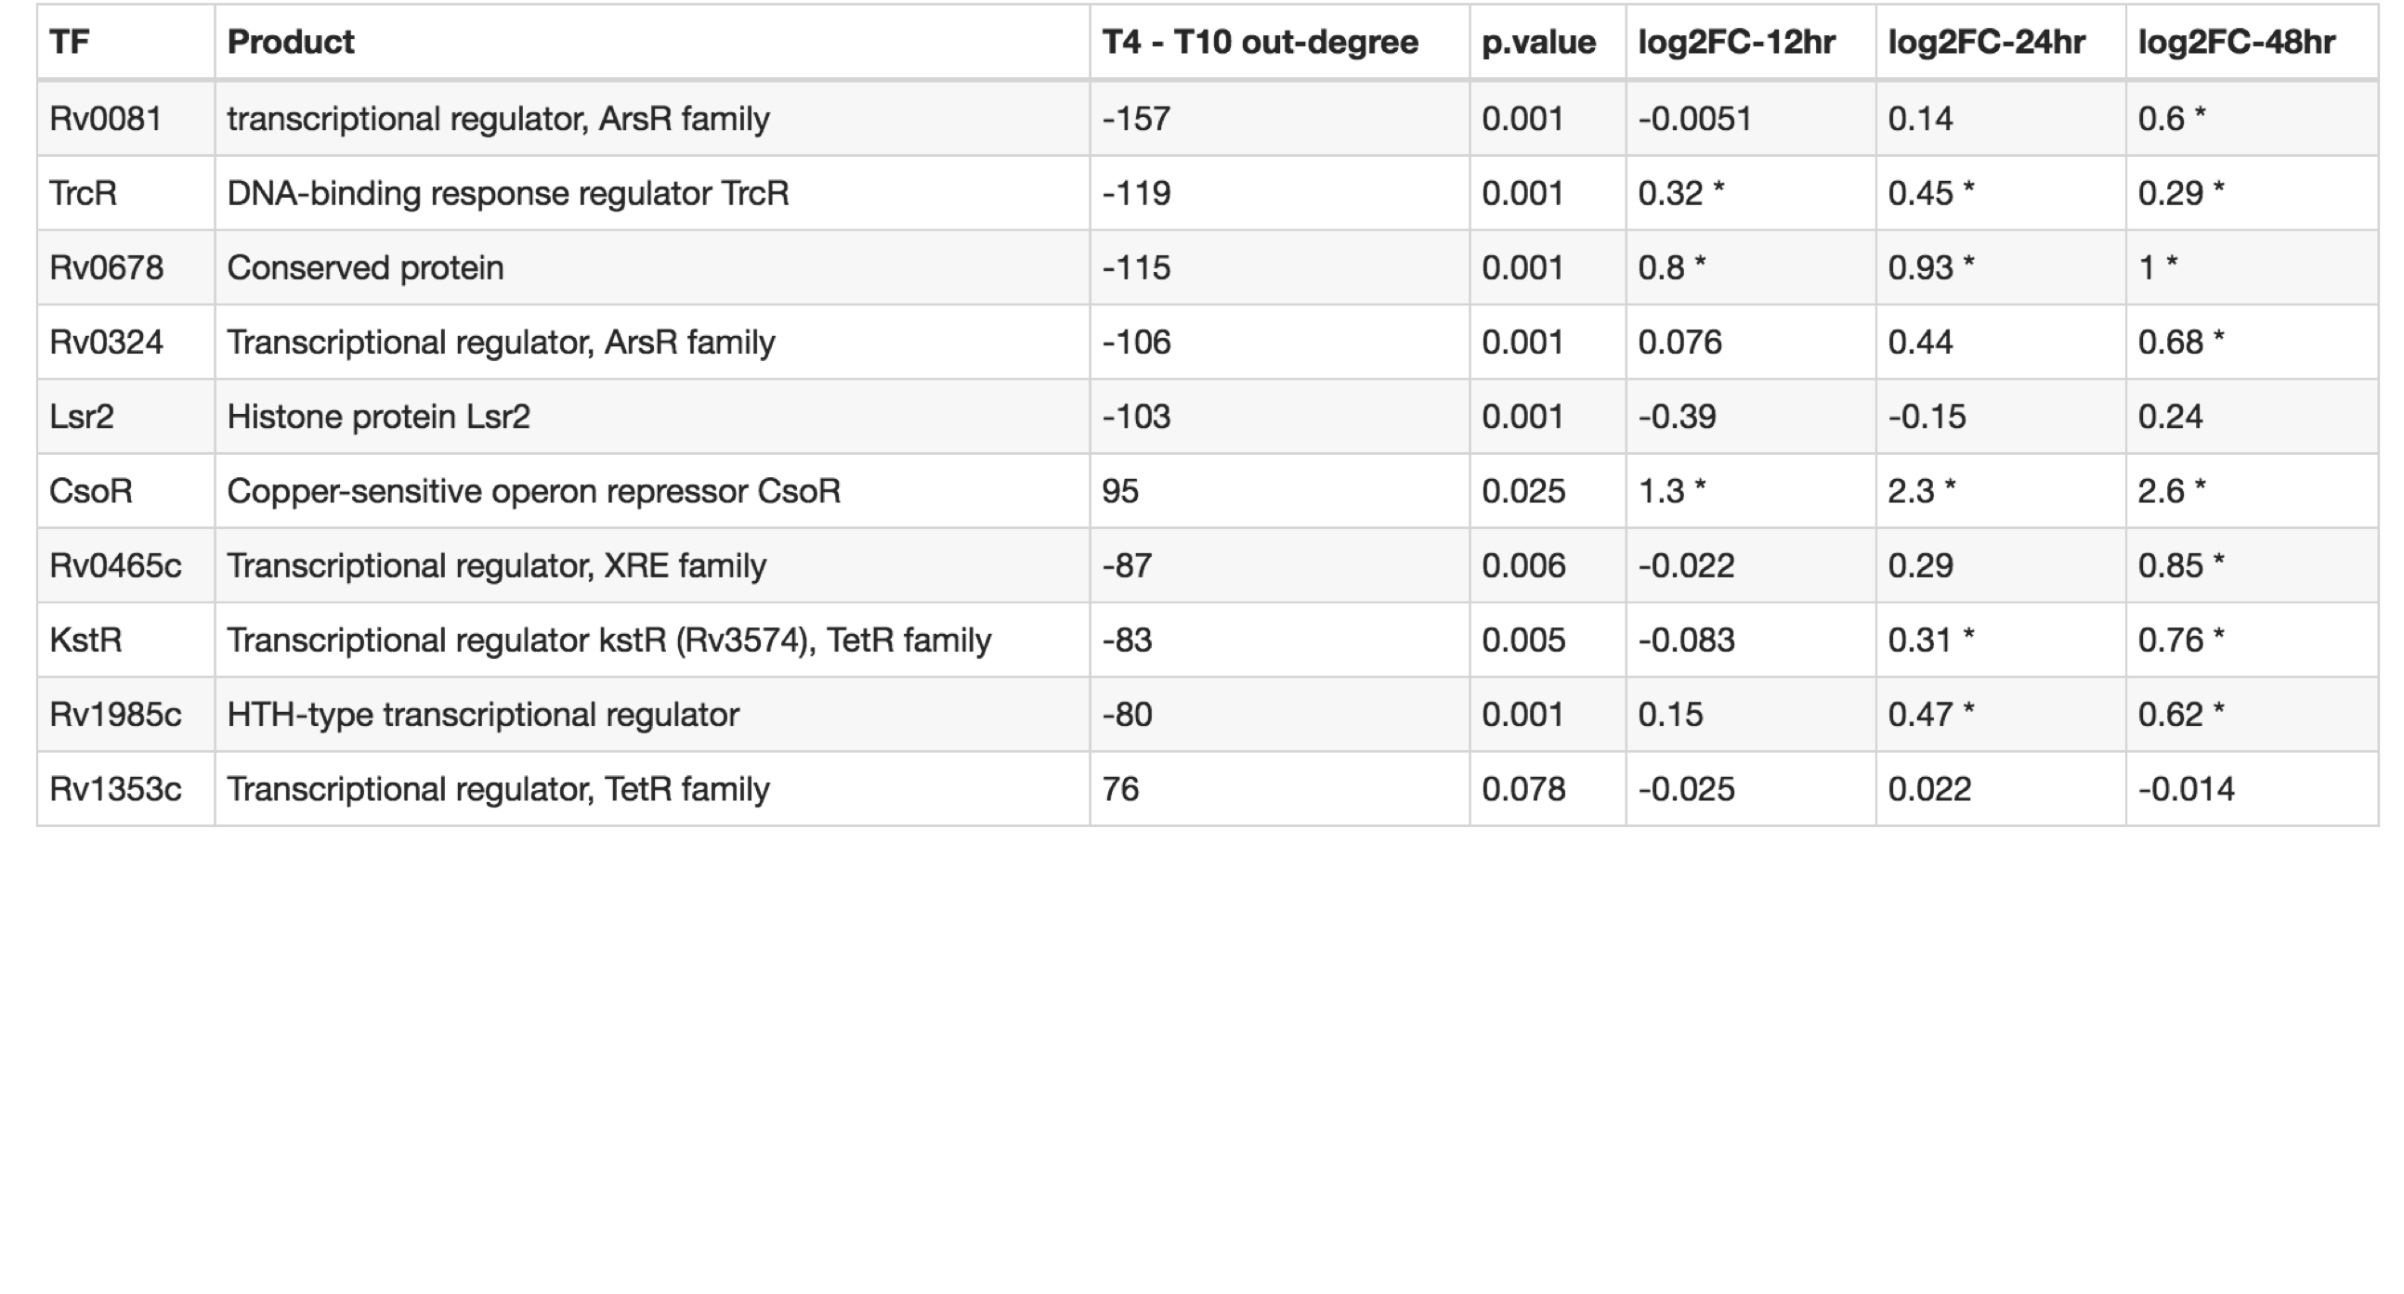
Differences in TF out-degree
Compare the sum of outgoing edge weights for each TF in each condition
Regulatory hub in hypoxia
Regulator responsible for cell wall function
May mediate cell stress
Involved in cholesterol utilization (cell wall)
Albert Young, Xavier Carette, Bob Husson
Notes:
P-value – shuffled the labels on the genes and re-ran the whole network reconstruction 1000 times.
TFs with known gene symbols all involved in either signal transduction, cell wall function, or lipid metabolism
KstR – fatty acid catabolism and cholesterol
Lsr2 – cell wall function
CsoR – thought to mediate oxidative stress response

Slide 9
A network hypothesis: Does change in out-degree correspond to differential phosphorylation?
Reran T4 vs. T10 treatment of TB cell line, collected phosphoproteomics (18 T4, 18 T10 samples)
14 out of 143 TFs in our network were measured
11/14 were differentially phosphorylated (FDR < 0.05)
Change in phosphorylation corresponds to change in TF out-degree (P < 0.022)
logFC = -1.8
Albert Young, Xavier Carette, Bob Husson
Notes:
PknB has been previously suggested to be the receptor kinase, which activates multiple kinases, including PknA, by trans-phosphorylating their activation loop residues
CsoR has the greatest magnitude of log-fold-change of any peptide differentially phosphorylated

Slide 10
eQTL networks from 13 tissues
Maud Fagny

Slide 11
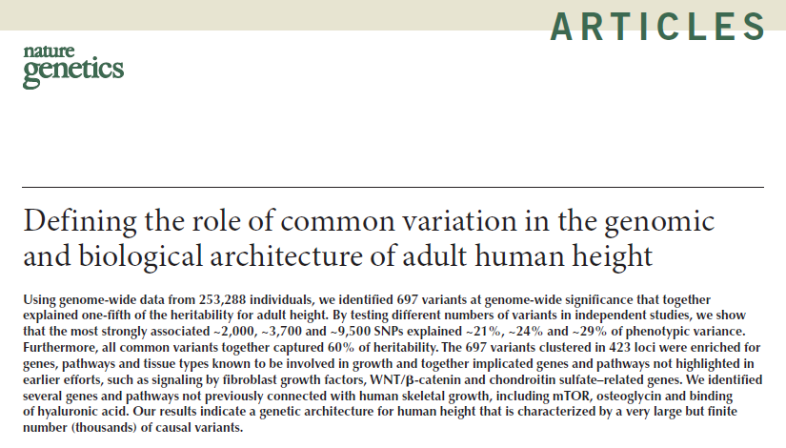
How many SNPs affect complex traits?
“By testing different numbers of variants in independent studies, we show that the most strongly associated ~2,000, ~3,700 and ~9,500 SNPs explained ~21%, ~24% and ~29% of phenotypic variance.”
Notes:
A few recent papers have identified a huge number of SNPs associated with complex traits
My take-away from this, is that a more comprehensive framework is needed to understand the impact of 10,000 SNPs, most of which have a weak effect on phenotype

Slide 12
Embrace the Complexity
Use a network approach to look for groups of SNPs working together to influence cellular function
Link SNPs to gene expression via eQTL analysis
Treat eQTLs as a network of links between SNPs and genes, apply CONDOR
SNPs
Genes
Maud Fagny
Notes:
Essentially, we want to agglomerate many weak signals

Slide 13
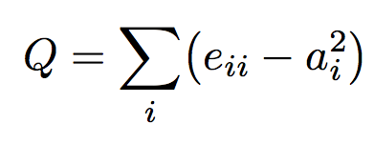
CONDOR
COmplex Network Description Of Regulators¹
Construct bipartite network
Bipartite Modularity Maximization²
Identify Community Cores
Regulators
Targets
Core score:
Community density contributed
by node i
Fraction of network links in community i
Fraction of links expected by chance
Platig et. al. Bipartite Community Structure of eQTLs. Plos Comp Bio 2016
Barber MJ. Modularity and community detection in bipartite networks. Physical Review E. 2007

Slide 14
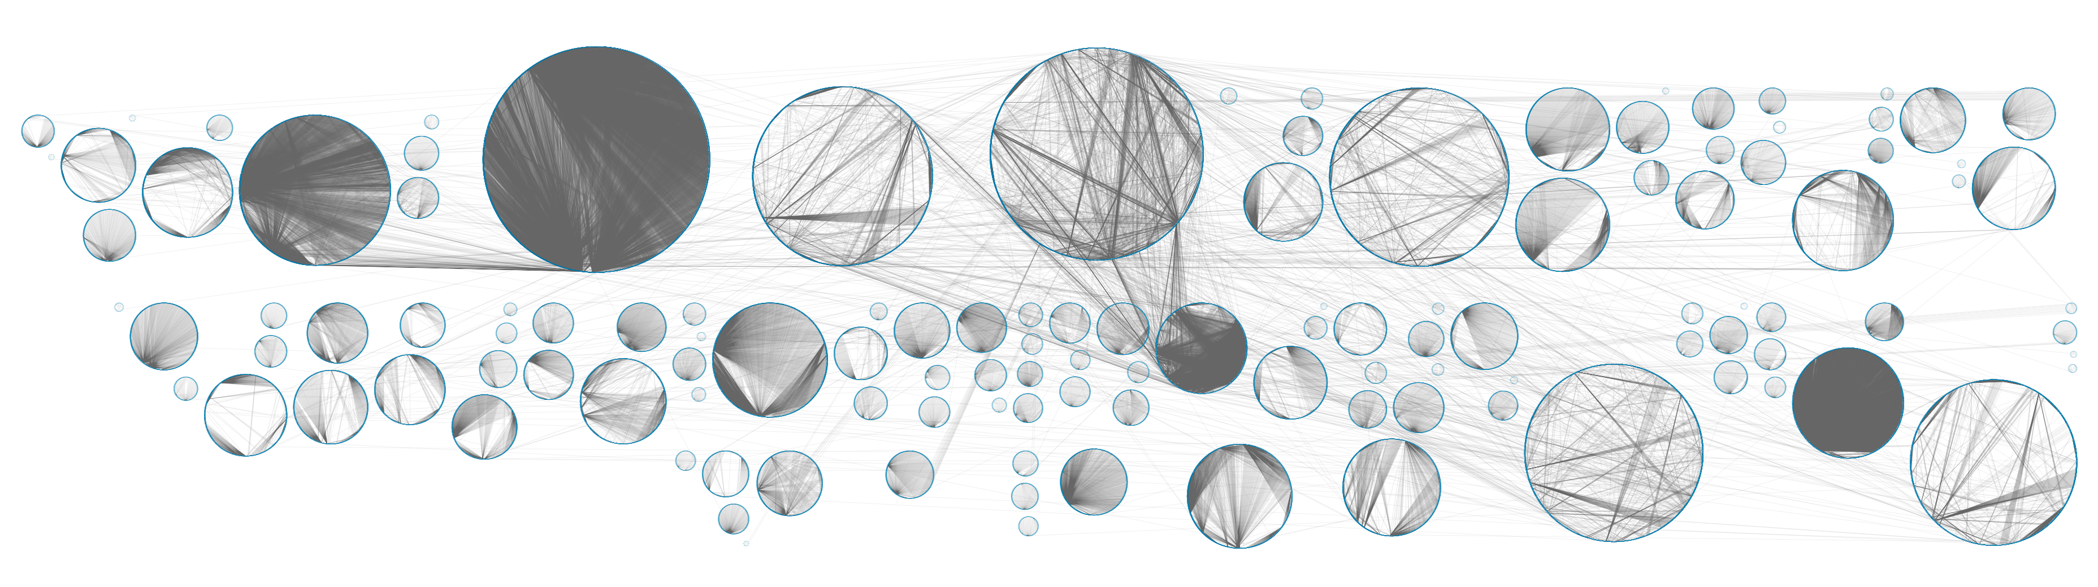
eQTL networks are highly modular

Slide 15
GWAS SNPs are absent in hubs
Autoimmune disease SNPs in whole blood
Maud Fagny
Notes:
Used Likelihood ratio test
Bars reflect standard error for coefficient
Controlled for LD (median core score per block), gene density
Permutation p-values shuffle, controlling for gene density

Slide 16
Core SNPs and high degree SNPs are enriched for different epigenetic states
High core score
High degree
Maud Fagny
Notes:
High degree -> greater than 10
Correct for gene density around the SNP
A
1a or 2a
TF binding + matched TF motif + matched DNase footprint + DNase peak
B
1b or 2b
TF binding + any motif + DNase footprint + DNase peak
C
1c or 2c
TF binding + matched TF motif + DNase peak
D
1d or 3a
TF binding + any motif + DNase peak
E
1e or 3b
TF binding + matched TF motif
F
1f or 5
TF binding + DNase peak
G
4
TF binding or DNase peak

Slide 17
eQTL communities reflect functional groups shared across tissues
Maud Fagny
Notes:
Only GO terms that were significant in at least ten tissues were included

Slide 18
Tissue relevant function in eQTL communities
Heart left ventricle
Heart left ventricle
Skeletal Muscle
Esophagus mucosa
Maud Fagny
Notes:
Heart left ventricle community 86 is enriched for genes involved in cellular respiration
community 30 is enriched for genes involved in cardiac muscle development and contraction

Slide 19
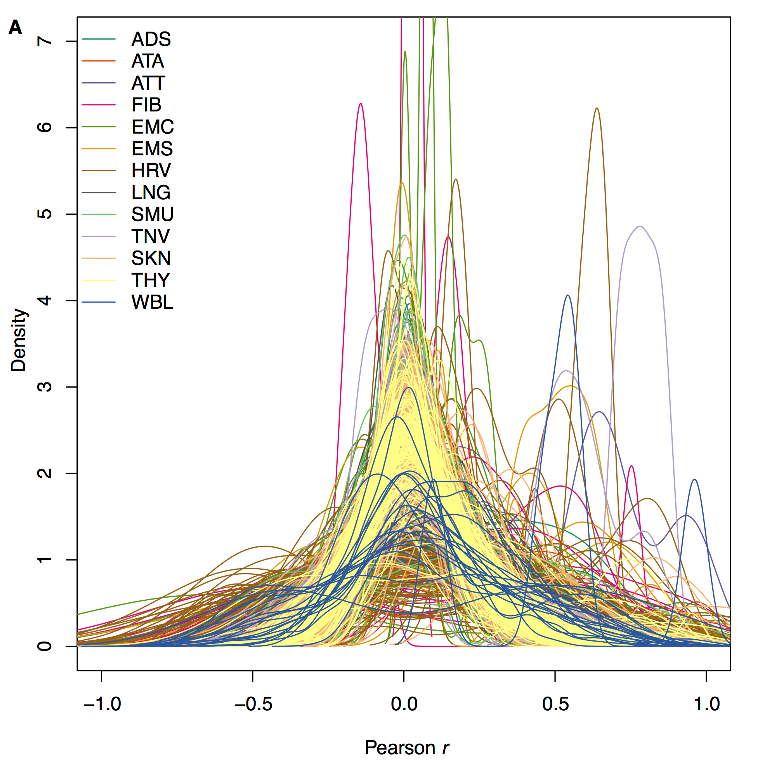
eQTL community structure ≠ coexpression clustering
eQTL communities cluster SNPs and genes based on the genetic component of the gene expression
Maud Fagny

Slide 20
Conclusions
Differentially phosphorylated TFs are more likely to be differentially targeting in our network model
This likely reflects the effect of PknA/B on phosphorylation of other proteins
GWAS SNPs are absent in eQTL network hubs
SNPs in community cores are more likely to be GWAS SNPs and in active epigenetic states

Slide 21
Acknowledgements
DFCI
John Quackenbush
Joe Paulson (eQTLs)
Maud Fagny (eQTLs)
Albert Young (TB)
Children’s Hospital
Bob Husson (TB)
Hanno Steen (TB)
Xavier Carette (TB)
Michaela Helmel (TB)

Slide 22
A quick digression
We need better systems level hypotheses and better statistical methods for testing network properties
  Especially if we’re going to use them in the context of multi-omics integration

Slide 23
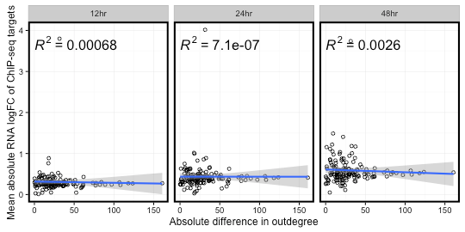
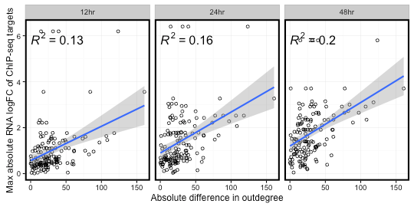
Differential targeting ≠ Differential expression
Notes:
Don’t just make your network out of differentially expressed genes!

Slide 24
Community Structure
Q = 0.504
Q = 0.495
Albert Young, Xavier Carette,
Bob Husson

Slide 25
Community cores are less likely to be affected by PknA/B inhibition
TF changes community
Albert Young, Xavier Carette,
Bob Husson
Notes:
Perturbed = TF is in a T4 community that doesn’t have the highest overlap with it’s T10 community

Slide 26
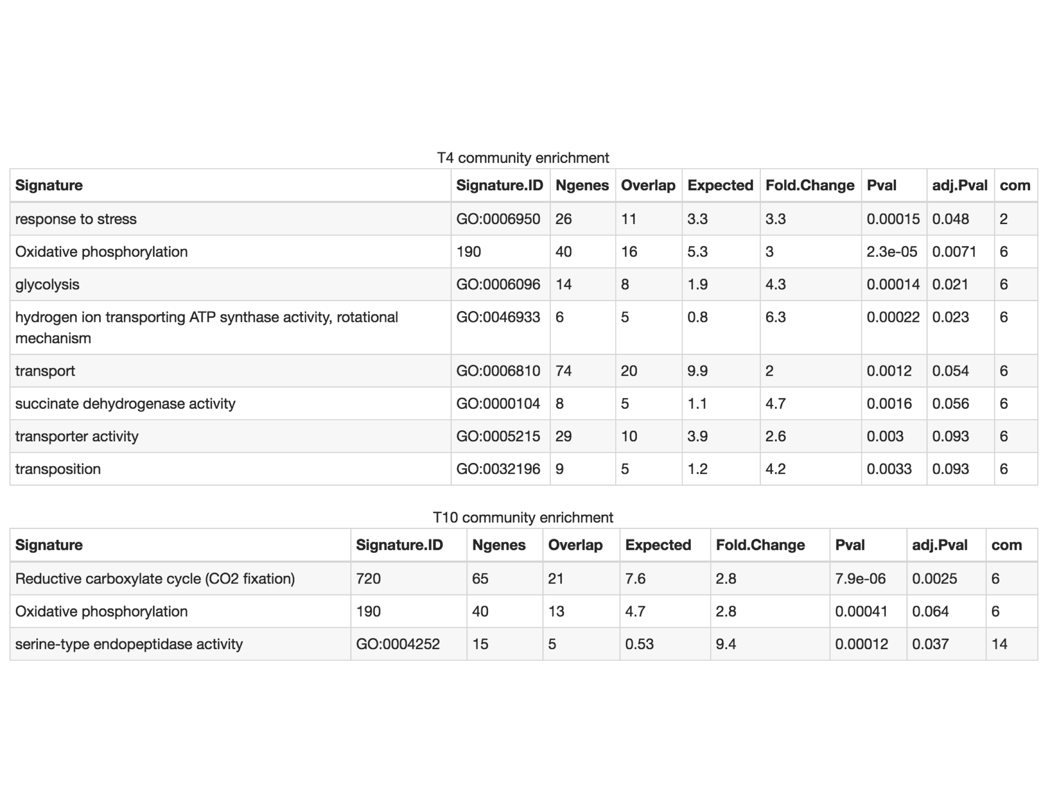
Drug-specific Community Enrichment
GroEL1 - Heat shock protein 60 family chaperone GroEL
Albert Young, Xavier Carette,
Bob Husson
Notes:
GroEL1, which is 168 upregulated in response to heat shock, oxidative stress response, and macrophage infection

Slide 27
Why make a network out of eQTLs?
Many of the traits we care about are polygenic
  Embrace the Pokémon problem (“gotta catch ‘em all!”)
Edges have a (loose) regulatory interpretation
Network methods are well suited to large numbers of edges
Notes:
~2,000, ~3,700 and ~9,500 SNPs explained ~21%, ~24% and ~29% of phenotypic variance in height

Slide 28
Building eQTL networks in 13 tissues from GTEx
SNP
Gene
Maud Fagny
Notes:
Network level hypothesis: what matters for phenotypes are functional pathways, not specific genes or SNPs.

