Slide 1
Bayesian matrix factorization with side information: Application to drug-target activity prediction
Yves Moreau
KU Leuven ESAT-STADIUS
SymBioSys Center for Computational Biology

Slide 2
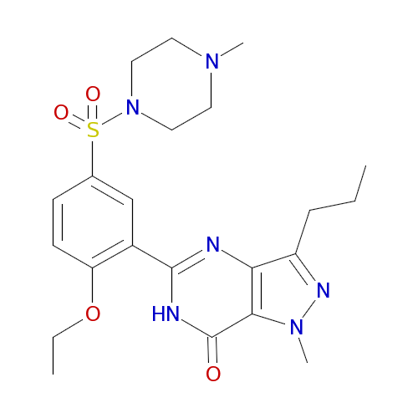
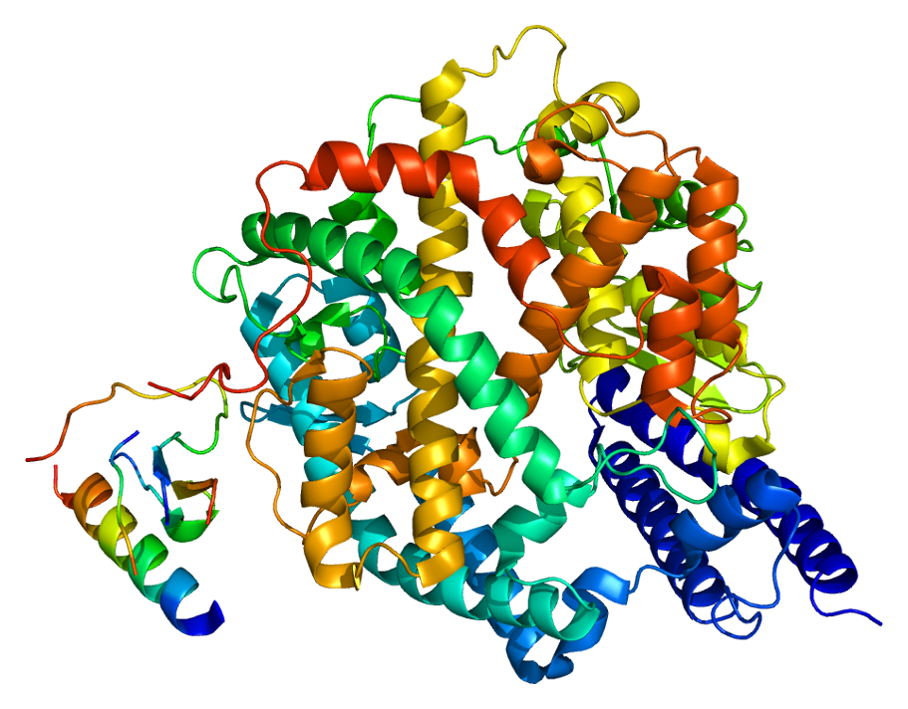
Chemogenomics
Hit discovery in early drug discovery
Identify compounds active against a protein drug target of interest
Activity measured by high-throughput screening
Pr_1
Pr_M
Comp1
7
2
Comp2
8
?
.
.
.
3
IC50
3M compounds
1-2% fill rate
Compound (ex: Viagra)
CompN
9
Enzyme
(ex: ACE2)
1500 targets

Slide 3
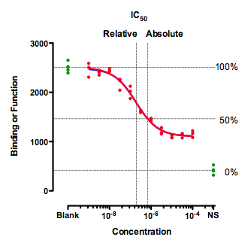
Drug–target activities
IC50 - amount of compound needed for half inhibition
pIC50 = -log10(IC50)
EC50 - amount of compound needed for half effect

Slide 4
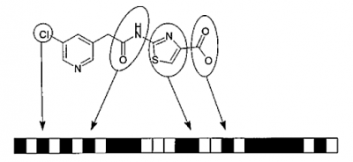
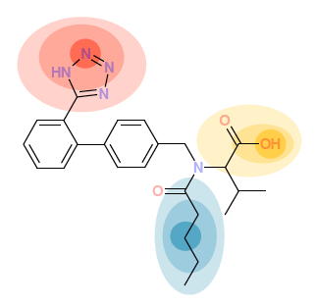
Molecular fingerprints
Path/key-based fingerprints
Circular fingerprints
FP2 & MACCS
MNA & MPD & ECFP
A bit string represents the presence or absence of particular substructures
each fingerprint represents a central atom and its neighbors
for each molecule, there is only one fingerprint
for each molecule, there are as many fingerprints as (heavy) atoms in the molecule

Slide 5
Predicting activities
From fingerprints and available activities, predict missing activities
Approaches
Supervised learning per target (QSAR)
Matrix factorization - Netflix style
MF + supervised
Pr_1
Pr_M
Features1
Comp1
7
2
00100010
Comp2
8
01000001
.
.
.
3
IC50
3M compounds
1-2% fill rate
FeaturesN
CompN
9
1500 targets

Slide 6
Quantitative Structure–Activity Relationship
Finds optimal model α based on predictive features
IC50(x) = α₁x₁ + α₂x₂ + … + α_{F}x_{F}
Minimize error loss
PLS, ridge regression
Does not share information across tasks
P1
Px
Pm
Features1
Comp1
7
2
00100010
Comp2
2
8
01000001
.
.
.
3
IC50
FeaturesN
CompN
9

Slide 7
The Netflix Challenge
Goal: predict user movie ratings
440K users, 18K movies
100 million ratings
1% fill rate
➔ Predict 99% missing
18K movies
1 | ? | 2 | ? | ? | ?
? | ? | ? | ? | ? | 1
? | ? | ? | 5 | ? | ?
? | ? | ? | ? | ? | 4
? | 5 | ? | ? | ? | ?
? | ? | ? | ? | 3 | ?
? | ? | 3 | ? | ? | ?
4 | ? | ? | ? | ? | ?
440K users

Slide 8
Factor analysis
Low-rank approximation of full matrix
*
Factors
≈
Loadings

Slide 9
Alternating least squares
*
Factors
≈
? | ? | ?
Loadings

Slide 10
Alternating least squares
If U were known, V could also be found by linear regression
? | ? | ? | ? | ? | ?
? | ? | ? | ? | ? | ?
? | ? | ? | ? | ? | ?
*
Factors
≈
Loadings

Slide 11
Matrix factorization
Only observed values are used in regressions
*
Factors
≈
Loadings

Slide 12
Sparsely observed matrix factorization
Once factors are obtained, other entries can be predicted
*
Factors
≈
Loadings

Slide 13
Uncertainty
Given sparse observations, can 1 solution be meaningful?
*
Factors
≈
Loadings

Slide 14
Bayesian modeling
Given incomplete data, a probabilistic approach might be more suitable
Instead of , we want to consider the Bayesian posterior distribution
The posterior predictive distribution is more informative than any optimal estimator

Slide 15
Ordinary least squares
ALS involves successive regressions solved by OLS
*
Factors
≈
? | ? | ?
Loadings

Slide 16
Ordinary least squares
Model
Solution

Slide 17
Bayesian linear regression
The distribution of β in function of the data X and y can be modeled as a multivariate Gaussian distribution over β
Likelihood
Prior
Gaussian prior for β and an inverse gamma prior for σ

Slide 18
Bayesian linear regression
Gaussian posterior distribution for β
If Λ₀=0 and μ₀=0, then solution for μ_{n} is identical to OLS!
Mean μ_{n} (= MAP solution) is similar to ridge regression
Precision matrix Λ_{n} characterizes variance of solution
=

Slide 19
GAMBLR trick for Gibbs sampler
MCMC for Bayesian inference by Gibbs sampler
Sampling repeatedly from posterior Gaussian distributions (which change every time U and V change)
Sampling from multivariate Gaussian distribution

Slide 20
GAMBLR trick for Gibbs sampler
For Bayesian linear regression
Sampling z has same form as OLS
Sample can be obtained by regression!

Slide 21
GAMBLR trick
This means that we can sample from the posterior Gaussian distribution by solving a linear regression on the original data plus injected noise.
Running the Gibbs sampler then only amounts to solving a sequence of linear regressions with variable noise injection!
Linear regression is one of the best studied problems in numerical analysis
Fast algorithms
Scalable code
One multivariate regression per row or column of Y at each iteration step, hence easy parallelization

Slide 22
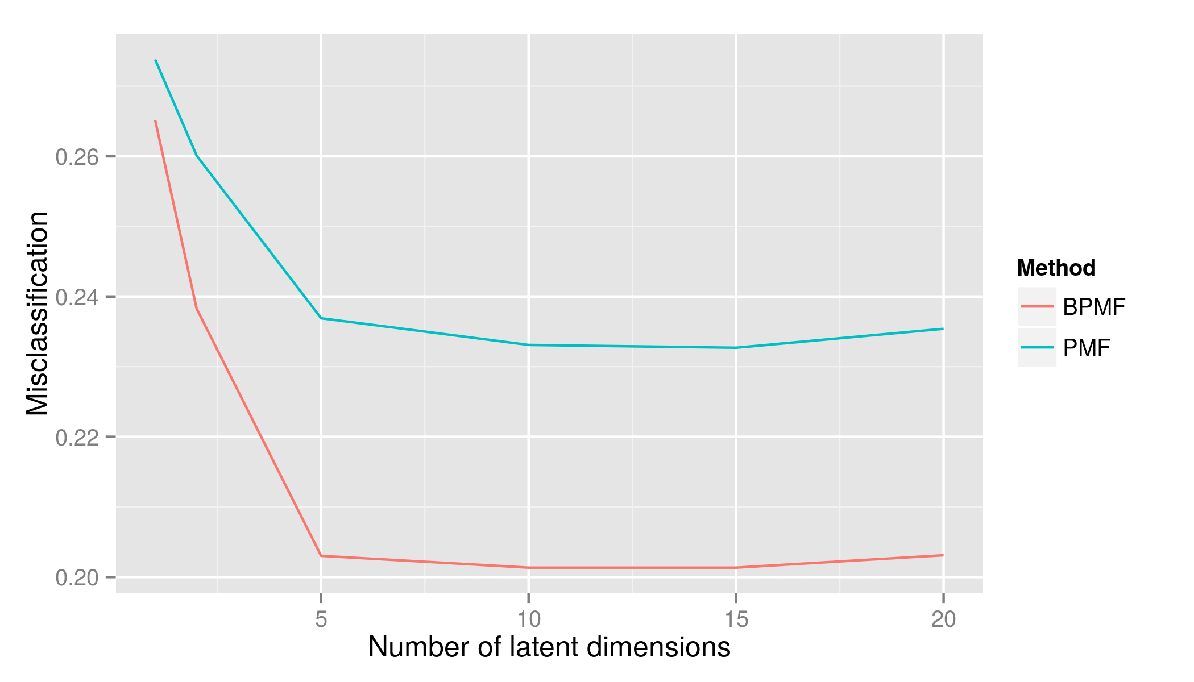
ChEMBL: PMF vs. Bayesian PMF
ChEMBL public data set of assay activities
Classified IC50
level 200nM
15 118 compounds
344 proteins
20% test
59 451 values
BPMF outperforms PMF
Test classification error

Slide 23
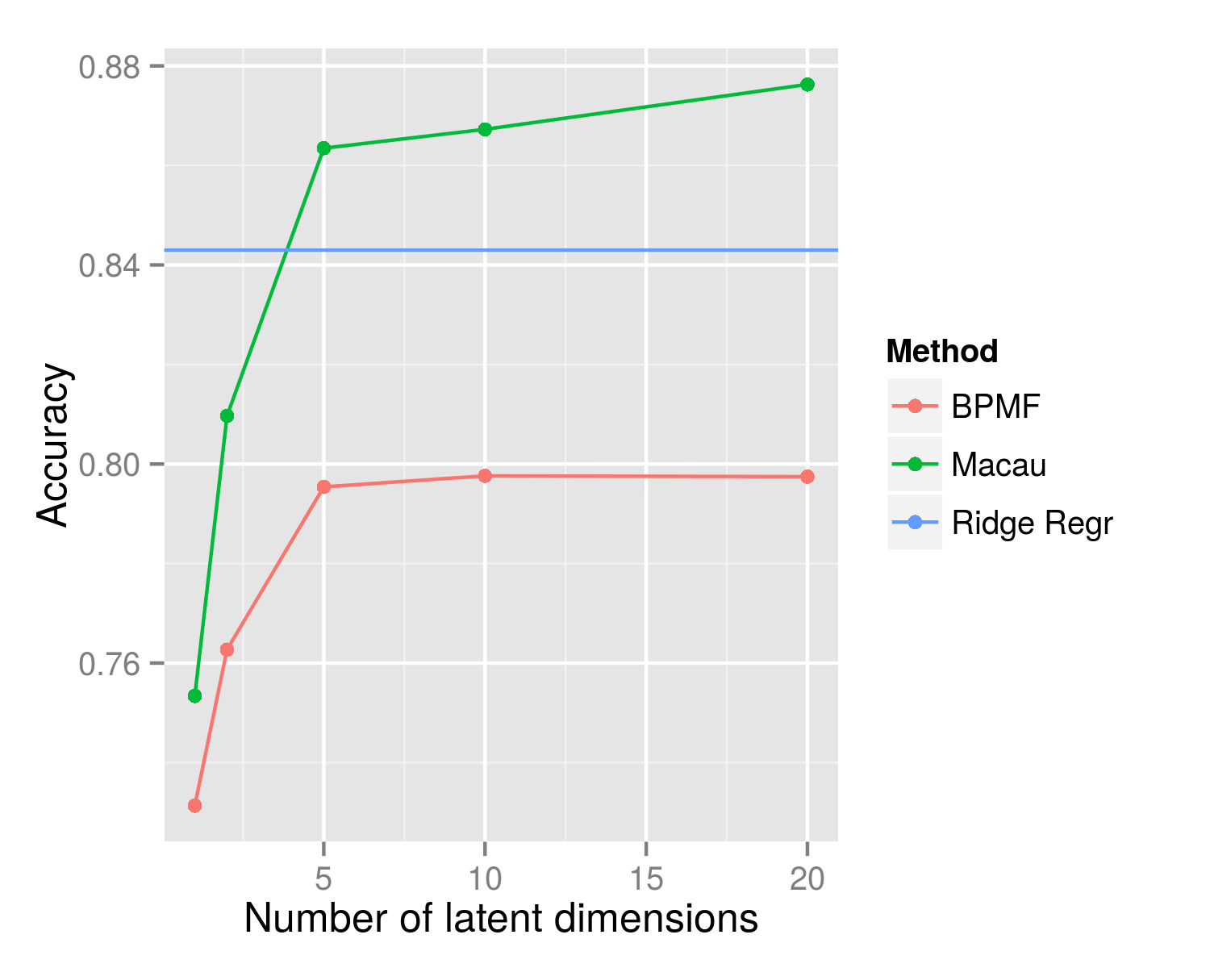
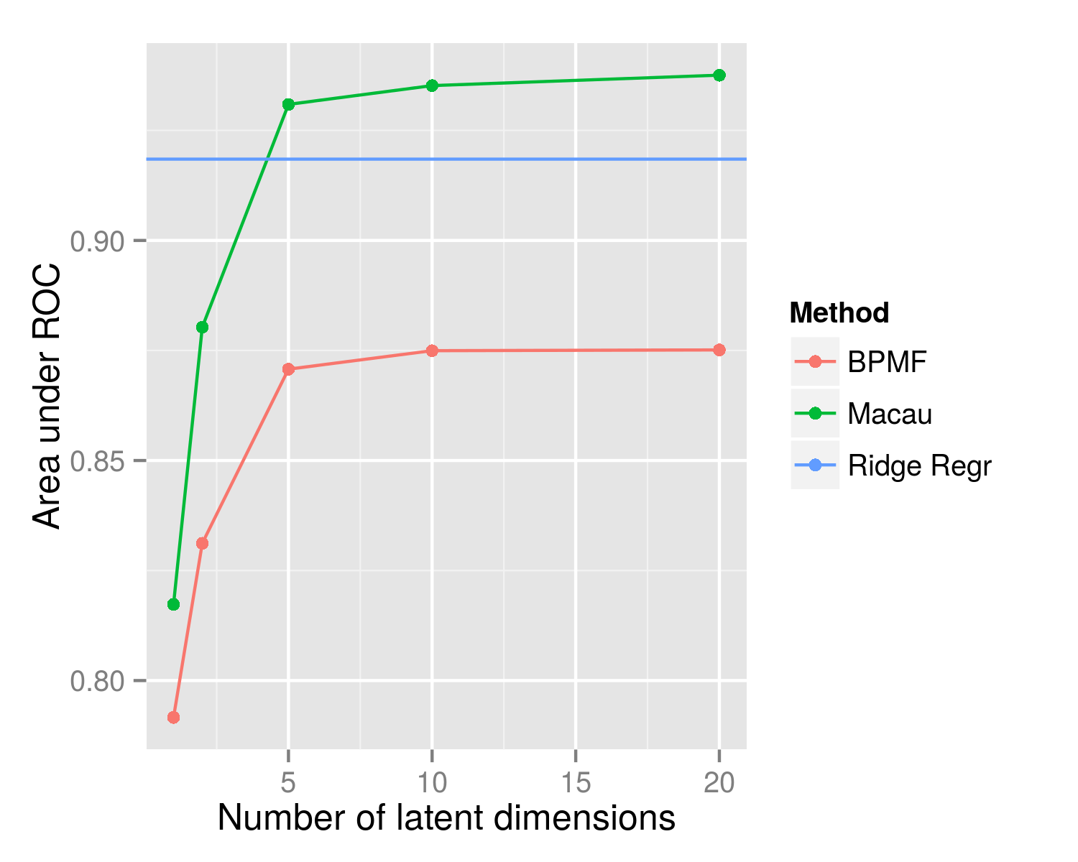
ChEMBL: BPMF vs. ridge regression
15K compounds
344 protein
200 nM threshold
20% for test set
Vary number of dimensions
Matrix factorization not as good as QSAR, but does capture information.

Slide 24
BPMF (relation view)
Model
2 entities, 1 relation
Latent variables (green) are learned from the IC50 data.
Comp.
Protein
IC50

Slide 25
MACAU
Model
2 entities, 1 relation, features for compounds
Latent variables are learned together with β_{comp}
Fingerprints
β_{comp}
Comp.
Protein
IC50

Slide 29
Results on ChEMBL
15K compounds
344 protein
200 nM threshold
20% for test set
Compound features improve performance
Multitask modeling improves performance

Slide 30
Variational Bayes
Hierarchical blindness
Ignored covariance between 𝛽 and latents u
Poor variance estimates
u_{i} covariance increases if side information

Slide 31
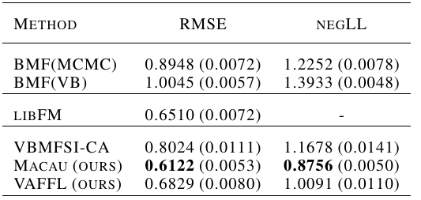
Empirical comparison: ChEMBL
15k compounds
346 proteins
~60k activity measurements
pIC50
20% test set
Sparse high-dimensional side information (#feat is ~100k)
Macau drastically outperforms VBMFSI

Slide 32
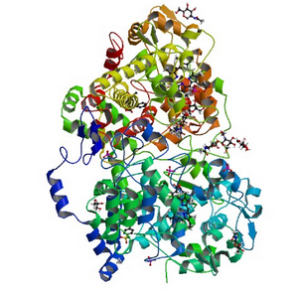
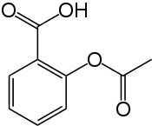
Deep Macau
Combine deep learning and matrix factorization
Deep learning allows to capture nonlinear effects
Matrix factorization allows item level reasoning
Activity
ID:1234
ID:5478

Slide 33
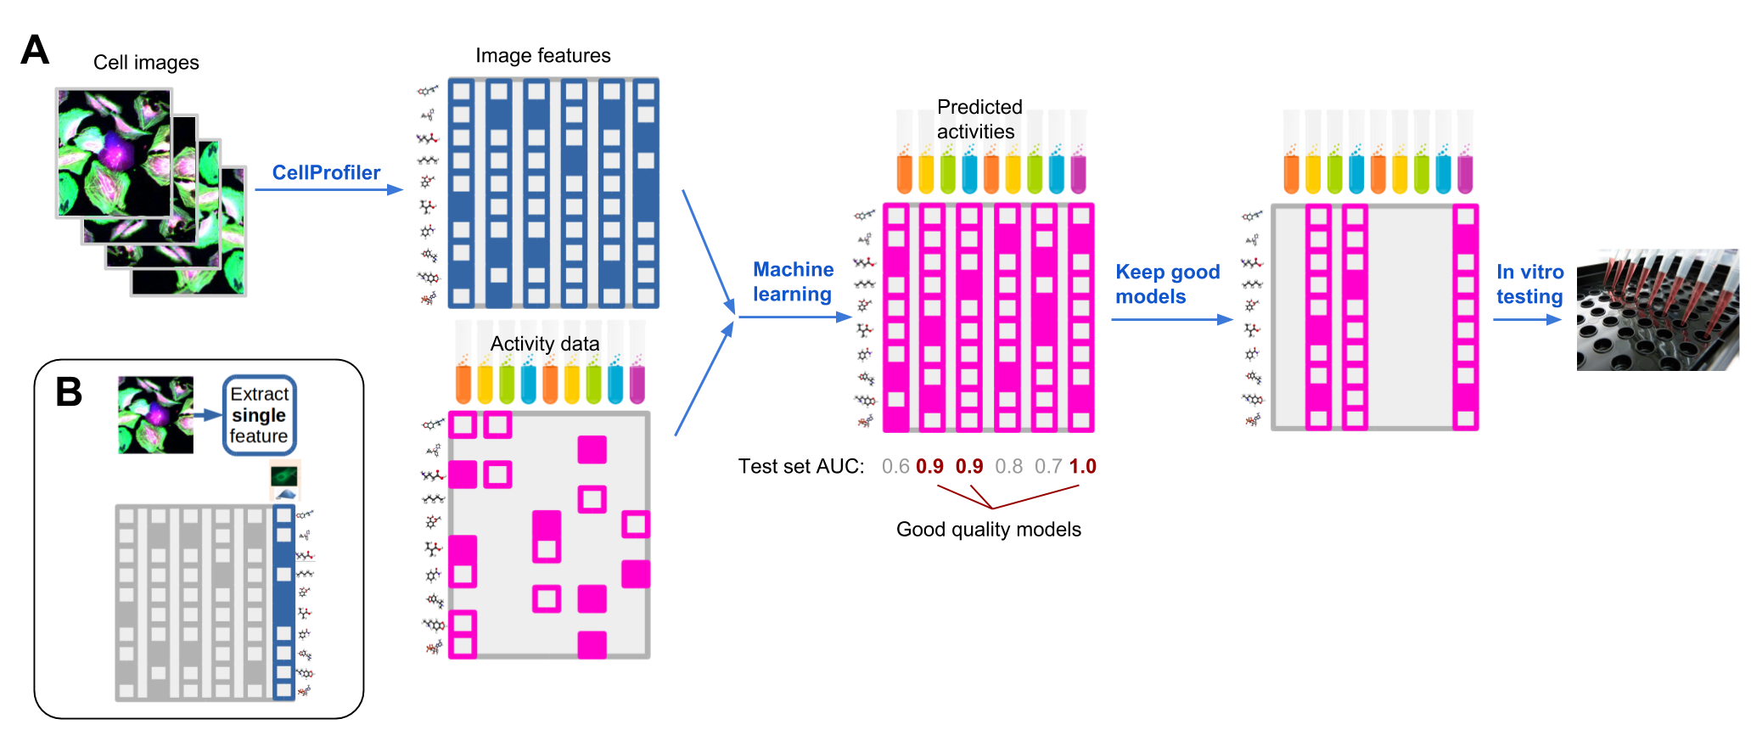
Repurposing imaging assays
500K compounds, 600 drug targets, 10M activities (30% fill rate)
Glucocorticoid receptor assay phenotypic screen
Feature extraction from images with CellProfiler
Macau predictive for 37% of assays (CV AUC>0.7), highly predictive for 5% of assays (CV AUC>0.9); assays not related to original screen
Validated on 1 enzyme target: 250x enrichment over baseline HTS

Slide 34
Macau
Generic package
Open source
OpenMP/C++ with Python wrapper library
https://github.com/jaak-s/macau
Factorization with and without side information
Real valued and binary matrices (normal and probit noise)
Univariate and multivariate Gibbs sampler
(Tensors soon …)

Slide 35
Conclusions
Fully Bayesian matrix factorization with side information
Multitask learning with tasks tied by matrix factorization
Scalable, parallelizable
Not only predictions, but also characterization of uncertainty
State-of-the-art performance on chemogenomic tasks

Slide 36
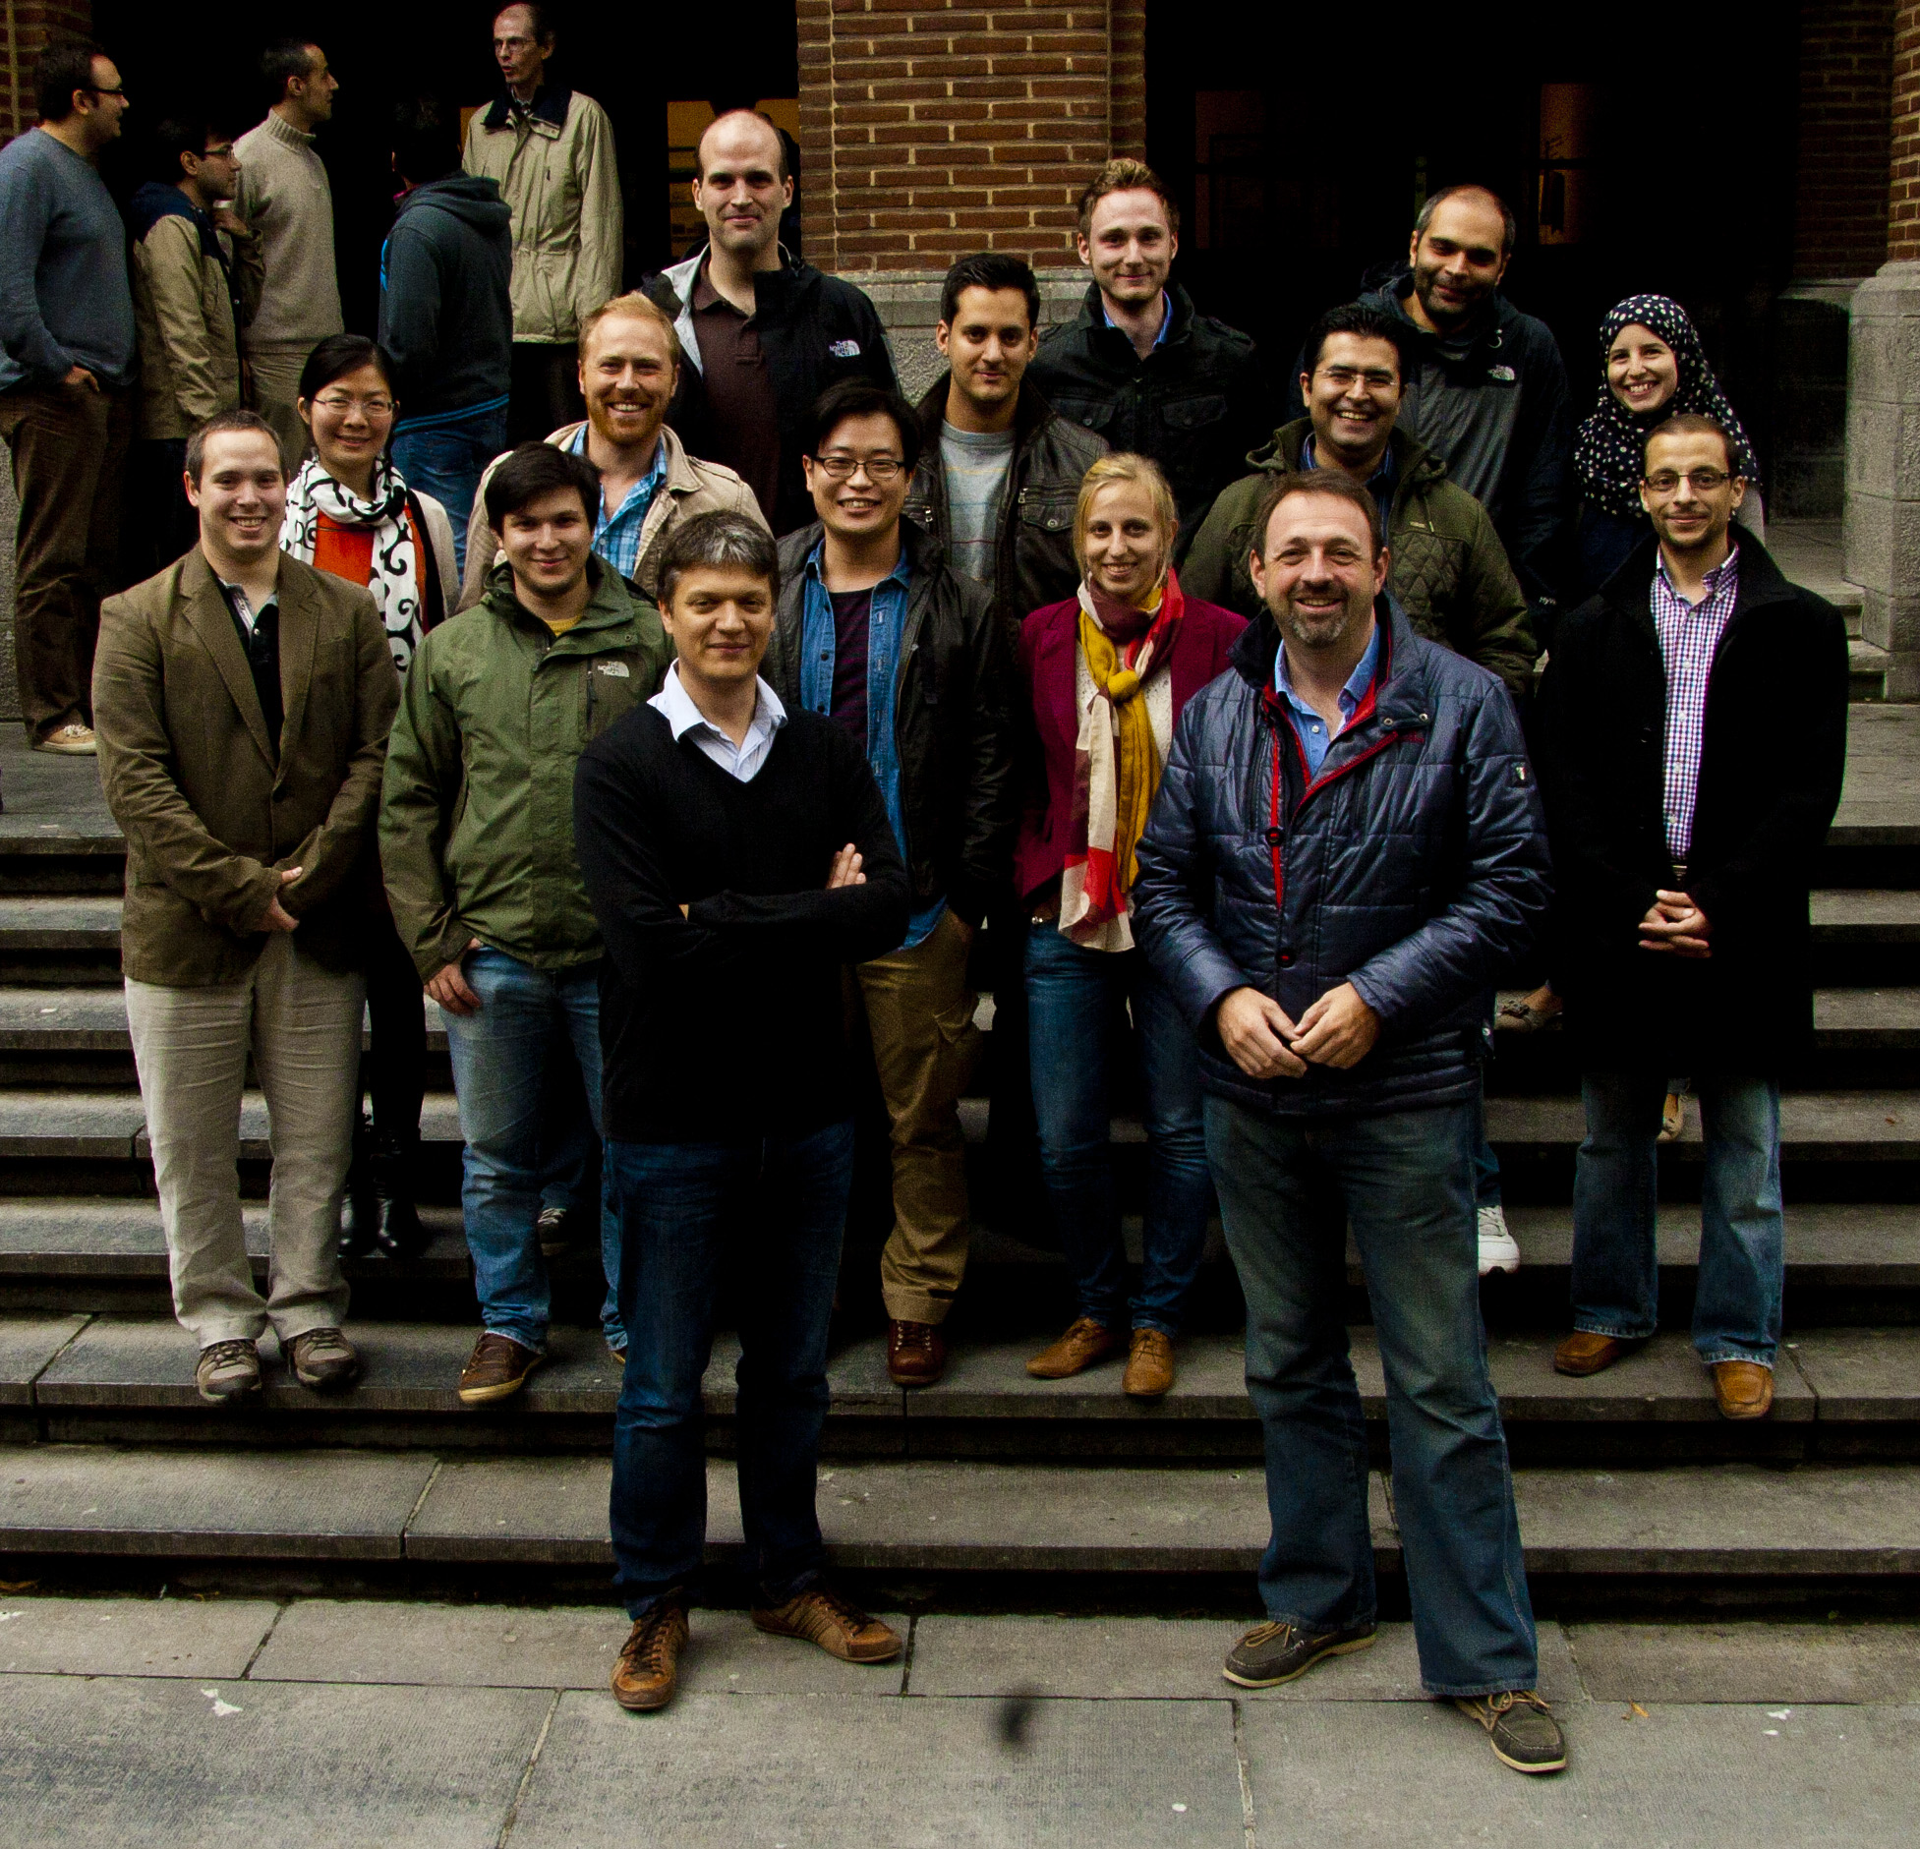
Jaak Simm
Adam Arany
Hugo Ceulemans
Jörg Wegner

Slide 37
Chemogenomics
Notes:
37

Slide 39
Number of new drugs per billion US$
100
1950
10
1
2010
0.1
Scannell et al. 2012

Slide 40
The curse of attrition…
Phase success rates
Hay et al. 2014

Slide 41
…mainly due to safety and efficacy issues
Efficacy
Causes of failure between Phase 2 and submission in 2011 and 2012
Arrowsmith & Miller 2013

Slide 42
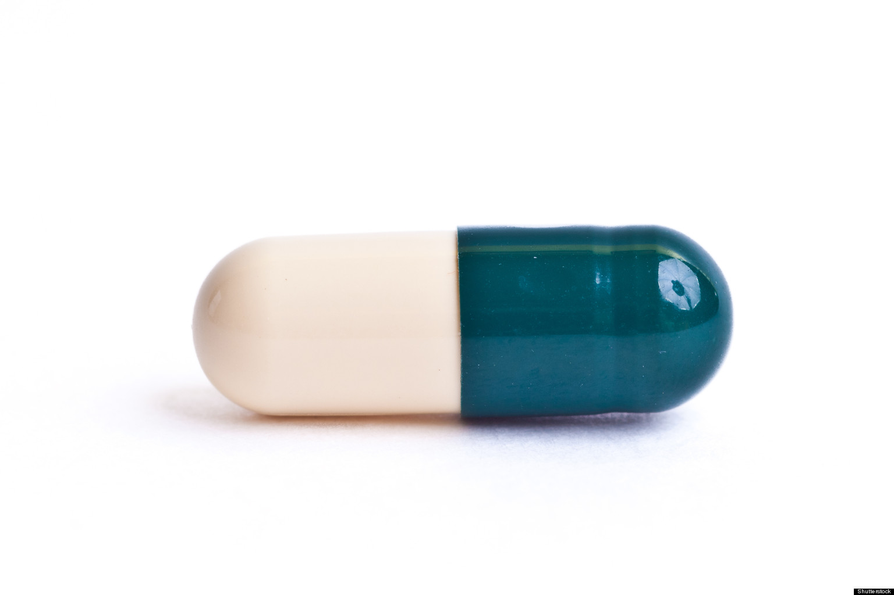
Need for a better knowledge of drugs’ MECHANISM OF ACTION
Protein
Protein
Protein
Protein
Targets?
Pathways?
Phenotypic effects?
Therapeutic effects
Off-target effects

Slide 43
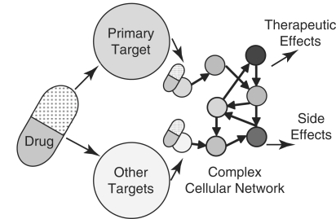
Side effect and efficacy prediction
allow safer and more efficacious drug candidates to be prioritized for further development
Notes:
speeds up drug development and reduces costs through elimination of toxicological and pharmacokinetic assessments

Slide 44
Chemogenomics
Goal: estimate interaction between compounds and protein targets
Activity measured by high-throughput screening
Early drug development: hit discovery
Activity depends on match between shape of compound and shape of protein
?
Compound (ex: Viagra)
Enzyme
(ex: ACE2)

Slide 45
Different types of activities
IC50 - amount of compound needed for half inhibition
EC50 - amount of compound needed for half effect

Slide 46
Molecular fingerprints
Path/key-based fingerprints
Circular fingerprints
FP2 & MACCS
MNA & MPD
bitstrings representing presence or absence of particular substructures
each fingerprint represents a central atom and its neighbors
for each molecule, there is only one fingerprint
for each molecule, there are as many fingerprints as (heavy) atoms in the molecule

Slide 47
Predicting activities
From fingerprints and already available assay measurements, predict missing measurements
Approaches
Supervised learning for each protein (QSAR)
Matrix factorization - Netflix style
MF + supervised
Pr_1
Pr_M
Features1
Comp1
7
2
00100010
Comp2
8
01000001
.
.
.
3
IC50
3M compounds
1-2% fill rate
FeaturesN
CompN
9
1500 targets

Slide 48
Supervised learning
Finds optimal model α based on predictive features
IC50(x) = α₁x₁ + α₂x₂ + … + α_{F}x_{F}
That minimizes squared error
Will be as good as the features are
Examples: SVM, Ridge Regression
Does not share information across tasks
P1
P2
PM
7
2
2
8
3
IC50
9

Slide 49
Predicting activities
From given data predict new values
Approaches
Supervised learning for each protein
Matrix factorization - Netflix style
MF + supervised
Pr_1
Pr_M
Features1
Comp1
7
2
00100010
Comp2
8
01000001
.
.
.
3
IC50
3M compounds
1-2% fill rate
FeaturesN
CompN
9
1500 targets

Slide 50
Supervised learning
Finds optimal model α based on predictive features
IC50(x) = α₁x₁ + α₂x₂ + … + α_{F}x_{F}
That minimizes squared error
Will be as good as the features are
Examples: SVM, Ridge Regression
Does not share information across tasks
P1
P2
PM
7
2
2
8
3
IC50
9

Slide 51
Matrix factorization
One of the best approaches for Netflix
Prediction of ratings for viewer-movie pairs
Does not use features, only matrix values
Two popular versions
Probabilistic Matrix Factorization (PMF)
Bayesian PMF

Slide 52
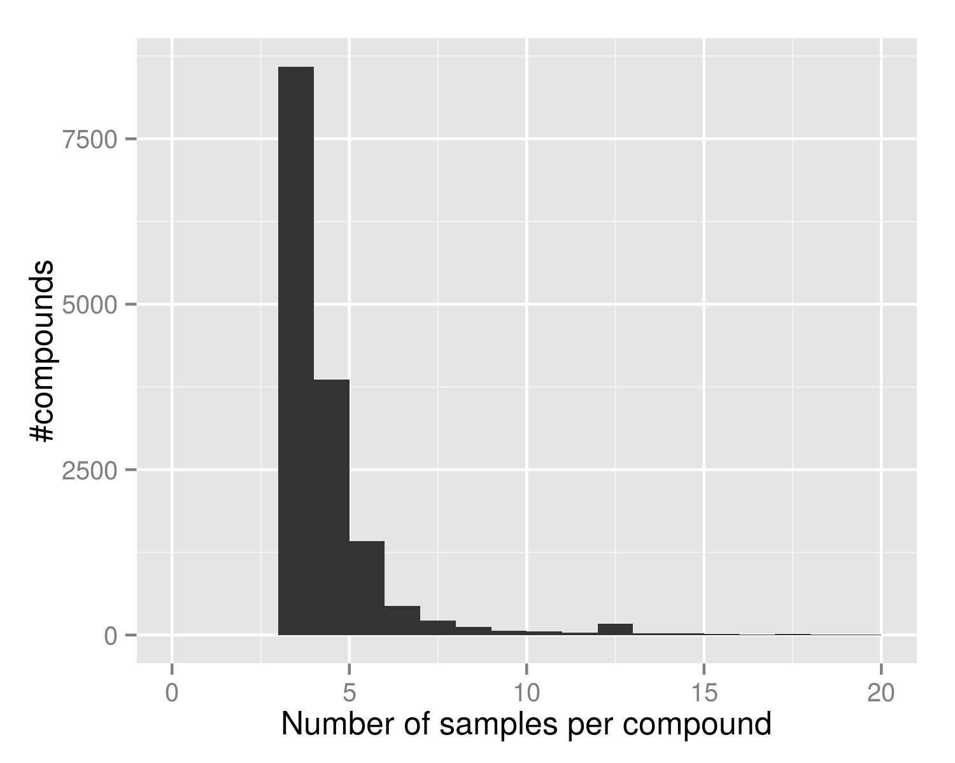
Motivation for Bayesian PMF
PMF gives point estimates
Problematic for compounds that have only few samples
We are interested in uncertainty of estimates
Example IC50 data set from CHEMBL with 15K compounds

Slide 53
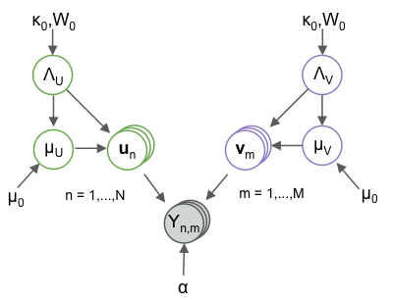
Bayesian PMF

Slide 54
Gibbs sampling
Iteratively samples each parameter
Obtains posterior samples of the model
e.g., sample 200 models after burn-in
Using the samples one can also measure uncertainty
Related to Alternating Least Squares
Blocked Gibbs sampler with large blocks, good sampling behavior

Slide 55
ChemoGen: PMF and Bayesian PMF
Classified IC50
level 200nM
15 118 compounds
344 proteins
20% test
59 451 values
BPMF outperforms PMF
Test classification error

Slide 56
MACAU: Extend BPMF for data fusion
BPMF uses one matrix, no features
One matrix with additional features for
Compounds (like fingerprints, toxicophores)
Proteins (sequence based)

Slide 57
Features
Compounds
Fingerprints of the molecule structure
3D shape information
Imaging of cellular assays
Bioassay measurements (phenotypic assays)
Gene expression data (L1000)
Proteins
Protein classification (e.g., kinases)

Slide 58
BPMF (relation view)
Model
2 entities, 1 relation
Latent variables (green) are learned from the IC50 data.
Comp.
Protein
IC50

Slide 59
MACAU
Model
2 entities, 1 relation, features for compounds
Latent variables are learned together with β_{comp} and β_{prot}
Fingerprints
β_{comp}
Comp.
Protein
IC50

Slide 65
Results on ChEMBL
15K compounds
344 protein
200 nM threshold
20% for test set
Compound features improve performance
Multitask modeling improves performance

Slide 66
Conclusions
Fully Bayesian matrix factorization with side information
Scalable, parallelizable
Not only predictions, but also characterization of uncertainty
State-of-the-art performance on chemogenomic task

Slide 67
Jaak Simm
Adam Arany
Hugo Ceulemans
Jörg Wegner

Slide 68
Side effect and efficacy prediction
allow safer and more efficacious drug candidates to be prioritized for further development
De novo drug discovery and development: 10-17 year process
Drug Repurposing
finding a new clinical use for an approved drug
Drug Rescue
finding a new clinical use for a stalled clinical development stage compound
Target identification
Discovery & screening
Lead optimization
ADMET
Development
Registration
Market
2-3 years 0.5-1 years 1-3 years 1-2 years 5-6 years 1-2 years
Drug repositioning: 3-12 year process
Compound identification
Compound acquisition
Development
Registration
Market
1-2 years 0-2 years 1-6 years 1-2 years
Notes:
speeds up drug development and reduces costs through elimination of toxicological and pharmacokinetic assessments

Slide 69
Conclusions
Many needles to find in ever increasing haystacks
Wide range of data science problems
Data fusion is an important and broadly relevant frontier in data science

Slide 70
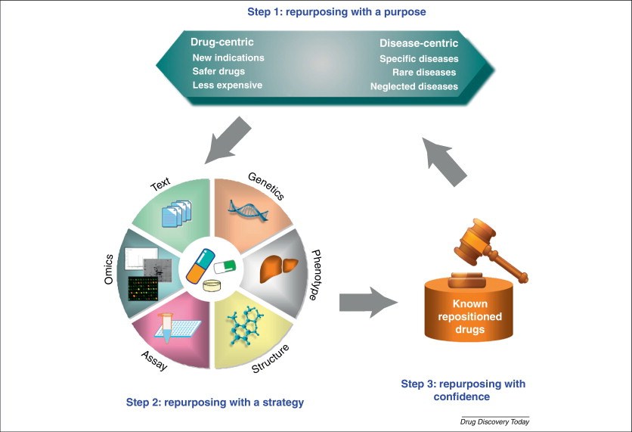

Slide 71
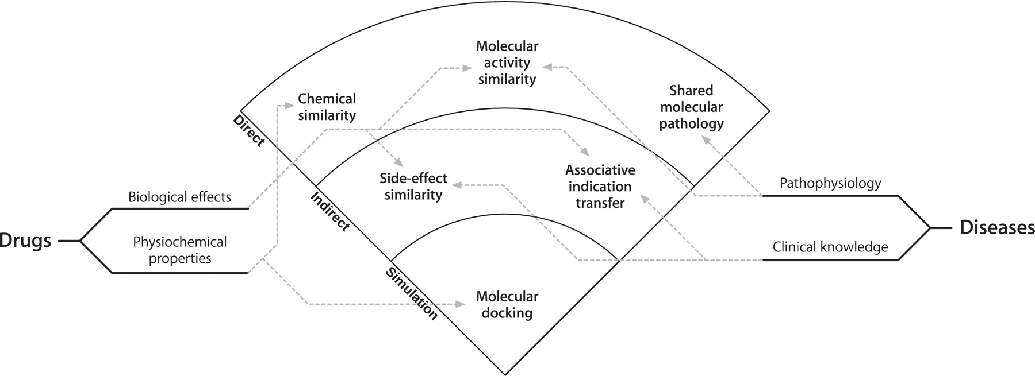
Dudley et al. Briefings in Bioinformatics. 2013

Slide 72
Factor analysis
*
Factors
≈
Loadings

Slide 73
Factor analysis
Individual response (= row) modeled as individual mixture (= loading) of a small number of latent responses (= factor)
*
+
≈
*
Factors
+
*
Loadings

Slide 74
Solving by Alternating Least Squares
If V were known, U could be found by linear regression
? | ? | ?
? | ? | ?
? | ? | ?
? | ? | ?
? | ? | ?
? | ? | ?
? | ? | ?
? | ? | ?
*
Factors
≈
Loadings

Slide 75
Alternating least squares
From initial condition, alternate least-square regressions…
? | ? | ?
? | ? | ?
? | ? | ?
? | ? | ?
? | ? | ?
? | ? | ?
? | ? | ?
? | ? | ?
? | ? | ? | ? | ? | ?
? | ? | ? | ? | ? | ?
? | ? | ? | ? | ? | ?
*
Factors
≈
Loadings

Slide 76
Alternating least squares
… till convergence
*
Factors
≈
Loadings

Slide 77
Matrix factorization
Factorization can be done on incompletely observed matrix
*
Factors
≈
Loadings

Slide 78
Optimality?
How do we know we converged to the optimal solution?
*
Factors
≈
Loadings

Slide 79
GAMBLR trick
In fully observed case, the Gibbs sampler for U and V is
σ can be sampled from inverse Gamma distribution
This breaks down in the incomplete case

Slide 80
GAMBLR
This Gibbs sampler by linear regression can be applied to any multilinear model where the parameters can be split in blocks such that the model is linear in each block of parameter when the other blocks are fixed
Gibbs Annealing for Multiway Bayesian Linear Regression
Bayesian Probabilistic Matrix Factorization
U fixed ➔ linear in V
V fixed ➔ linear in U

Slide 81
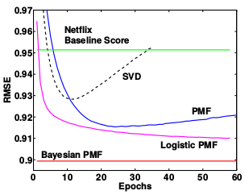
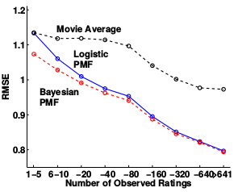
Netflix comparison (BPMF, 2009)
Data: 100M ratings from 480K users, 18K movies
BPMF has advantage for users with few ratings

