Slide 1


Yoav Gilad
University of Chicago

Slide 2
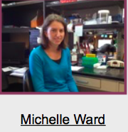

Slide 3
Transposable elements may not play a major role as drivers of regulatory differences in primates

Slide 4
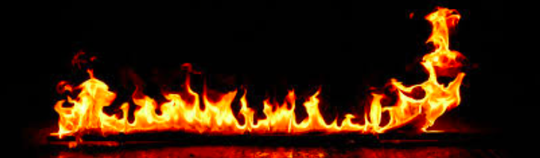
Transposable elements may not play a major role as drivers of regulatory differences in primates

Slide 5

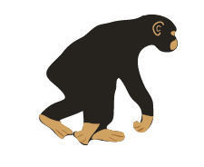

Experimental system: 10 human + 7 chimp iPSCs
10x
7x
H21194
H21792
H20682
H28126
H20961
H28815
C3647
C40280
C40210
C3651
C8861
C3649
C4955
Fibroblast-derived
F-iPSC
Caucasian
18489
18511
19098
19101
YRI
LCL-derived
L-iPSC
17 primate iPSC lines
H3K9me3 ChIP-seq
RNA-seq
a mark of transcriptional repression.

Slide 6
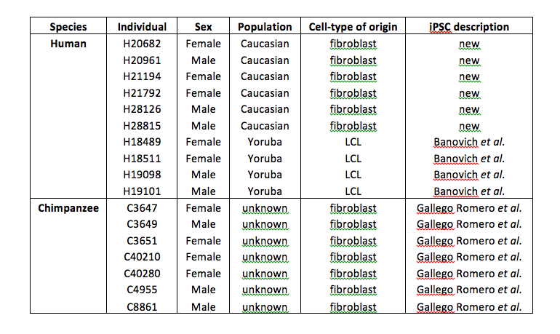
Balanced design with respect to all parameters we can think about

Slide 7
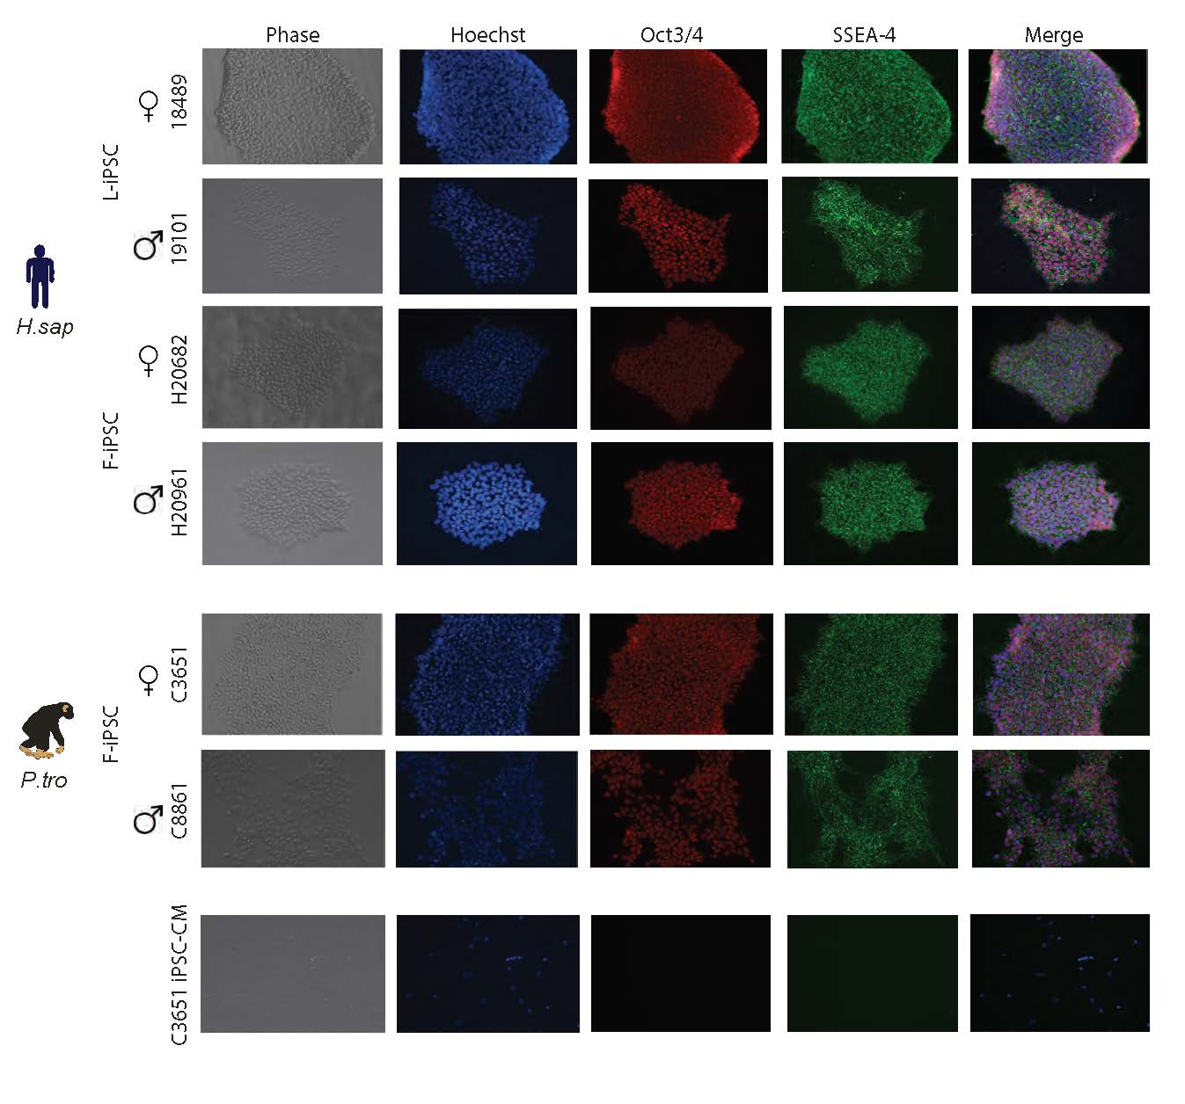
iPSCs are well characterized and functionally validated

Slide 8
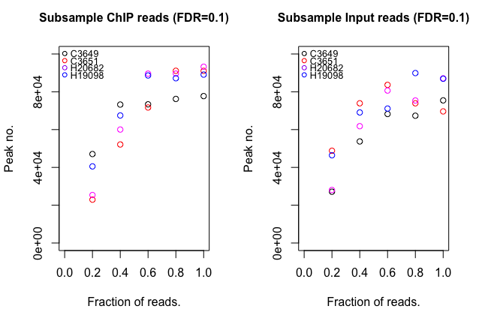
Read subsampling analysis reveals peak # saturation
~ 6 million ChIP , 12 million Input reads

Slide 9
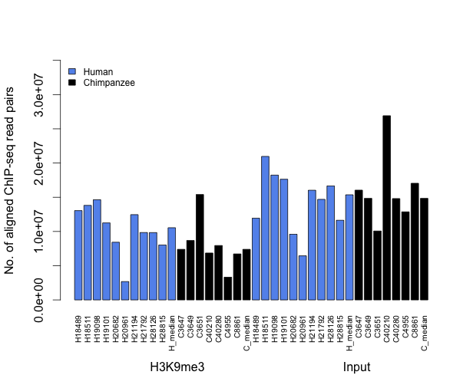
QC analysis of ChIP-SEQ data

Slide 10
How to compare ChIP-SEQ data across species?

Slide 11
H18489
H18511
H19098
H19101
H20682
H20961
H21194
H21792
H28126
H28815
C3647
C3649
C3651
C4955
C8861
C40210
C40280
H3K9me3
ZNF554
ZNF555
ZNF554
ZNF555

Slide 12
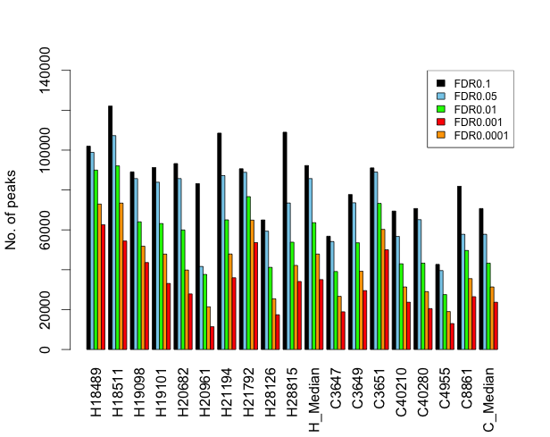
Classifying peaks using statistical cutoffs?

Slide 13
Compare reads in ChIP-seq ‘regions’

Slide 14
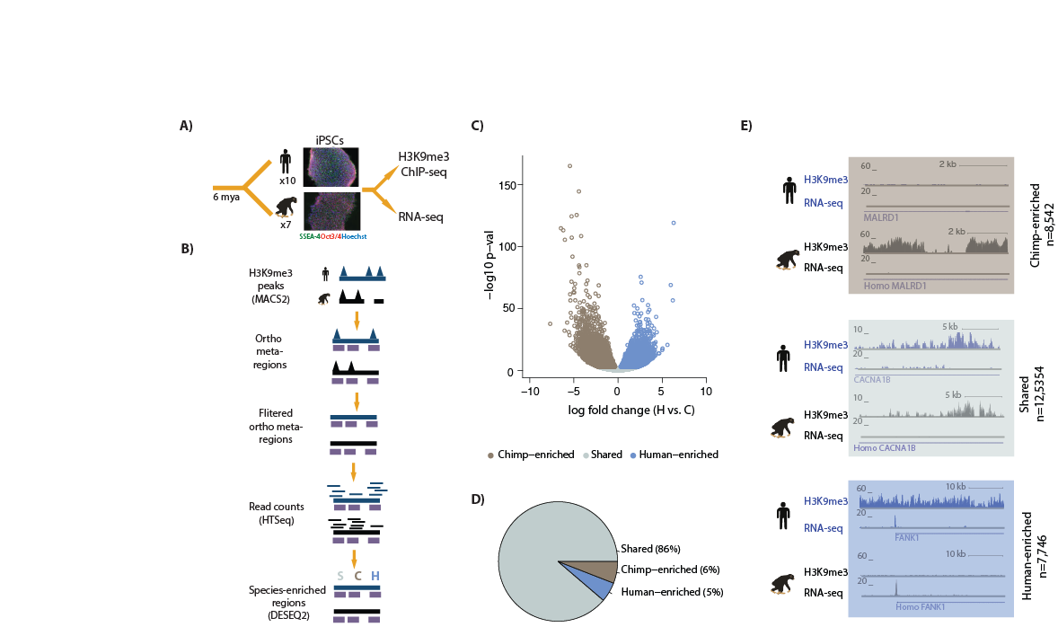
Call peaks in each individual at FDR=0.1
Concatenate lists of all peaks from each species
Overlap peaks with orthologous region file
(best reciprocal chain hg19-panTro3)
Map regions back to original genome
Map regions back to reciprocal chain file
Orthologous ChIP-seq ‘regions’

Slide 15
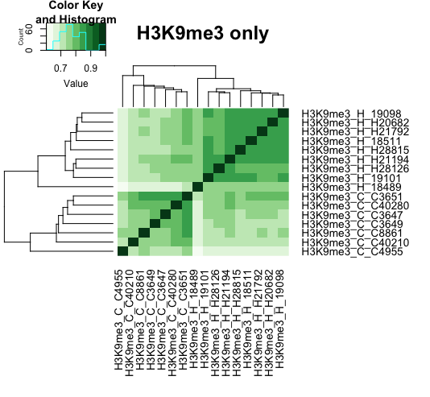
H3K9me3 ChIP-seq data (individuals) separate by species

Slide 16
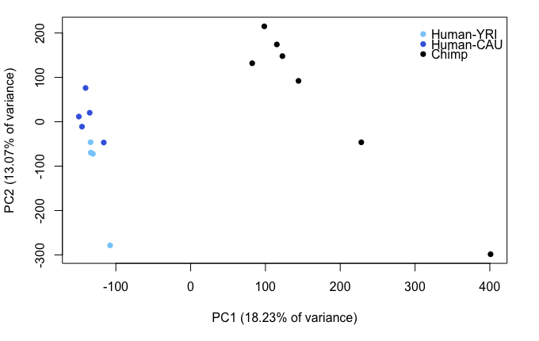
Most of variation between H3K9me3 ChIP samples explained by species
9 humans + 7 chimps log2 CPM

Slide 17
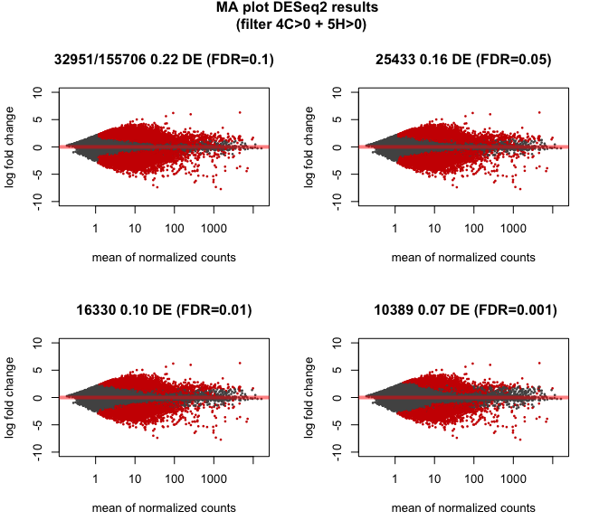
Proportion of differentially enriched regions using
different filtering strategies

Slide 19
Identifying orthologous TEs
Generate set of TEs in each genome
hg19 repeatmasker
5 298 130
panTro3 repeatmasker
5 309 904
liftOver
liftOver
4 838 696
4 886 537
Intersect panTro3rmsk
require 50% reciprocal overlap
Intersect hg19rmsk
require 50% reciprocal overlap
4 551 929
4 583 926
Retain only TEs with same name
Retain only TEs with same name
hg19rmsk_panTro3
4 261 653
panTro3rmsk_hg19
4 285 147

Slide 20
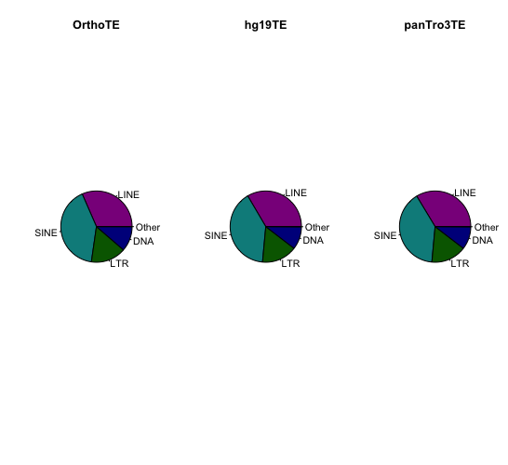
Combine TEs from both genomes on human genome
hg19rmsk_panTro3
4 261 653
panTro3rmsk_hg19
4 285 147
liftover hg19
hg19rmsk_panTro3_hg19
4 250 677
Intersect reciprocal file 50% overlap
4 250 256
Retain only TEs with same name
Orthologous_TEs_human
4 248 188
Ortho TEs
hg19 TEs
panTro3 TEs

Slide 21
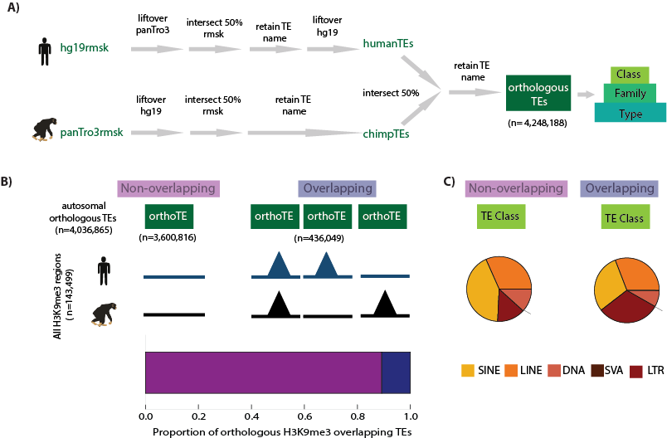
Classifying TE silencing

Slide 22
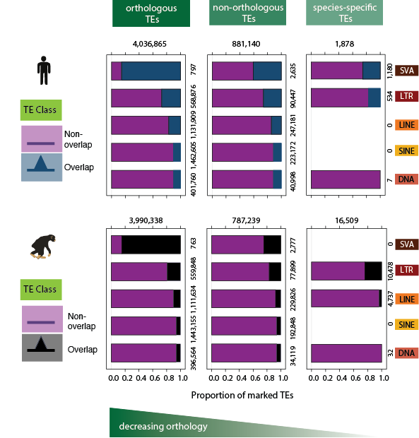

Slide 23
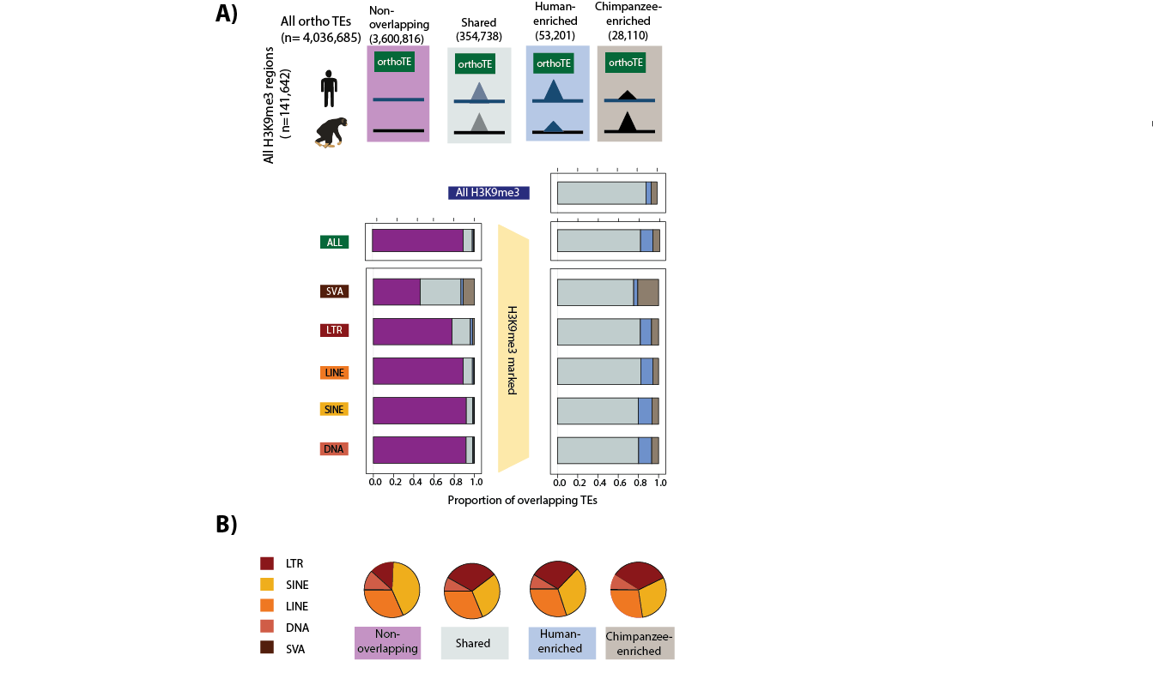

Slide 24
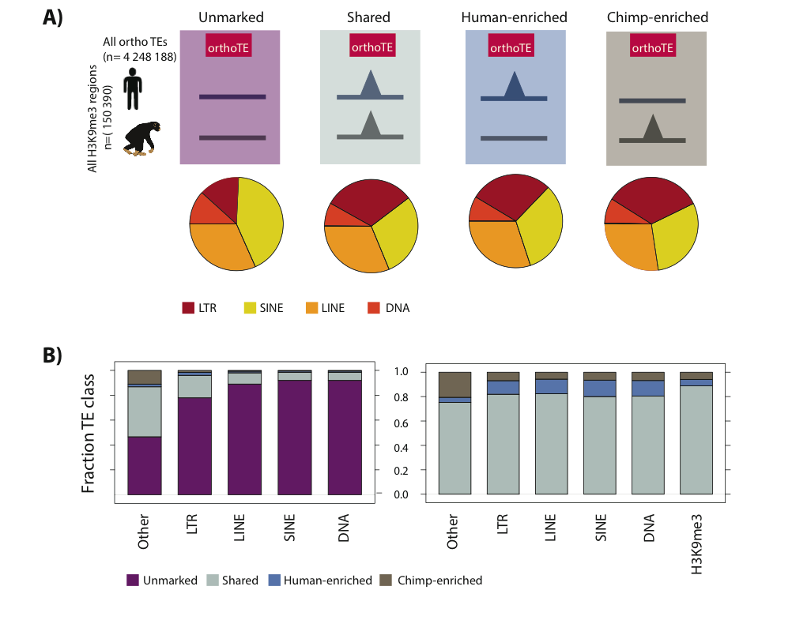
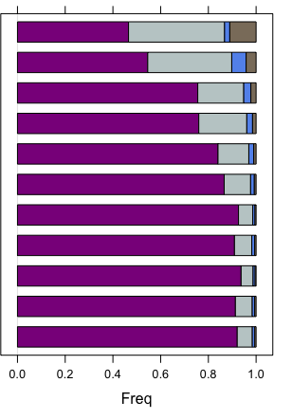
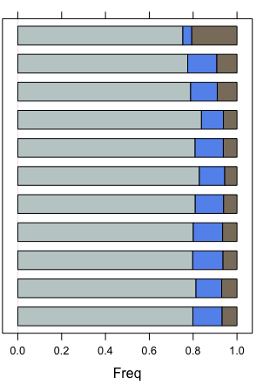
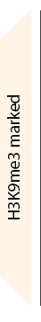
~20% of SVA, ERVK, ERV1 & ERVL-MaLR families marked by H3K9me3
Class
Family
Type
Family
Other
780
SVA
7 398
ERVK
127 525
ERV1
LTR
287 509
ERVL-MaLR
125 997
ERVL
697 436
L1
LINE
358 941
L2
957 972
Alu
SINE
500 317
MIR
113 275
TcMar
DNA
279 617
hAT

Slide 25
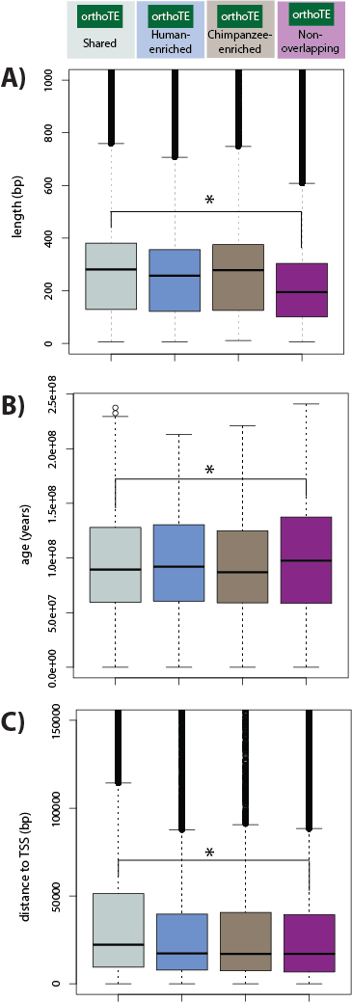
Properties of silenced TEs

Slide 26
Properties of silenced TEs

Slide 27
Properties of silenced TEs

Slide 28
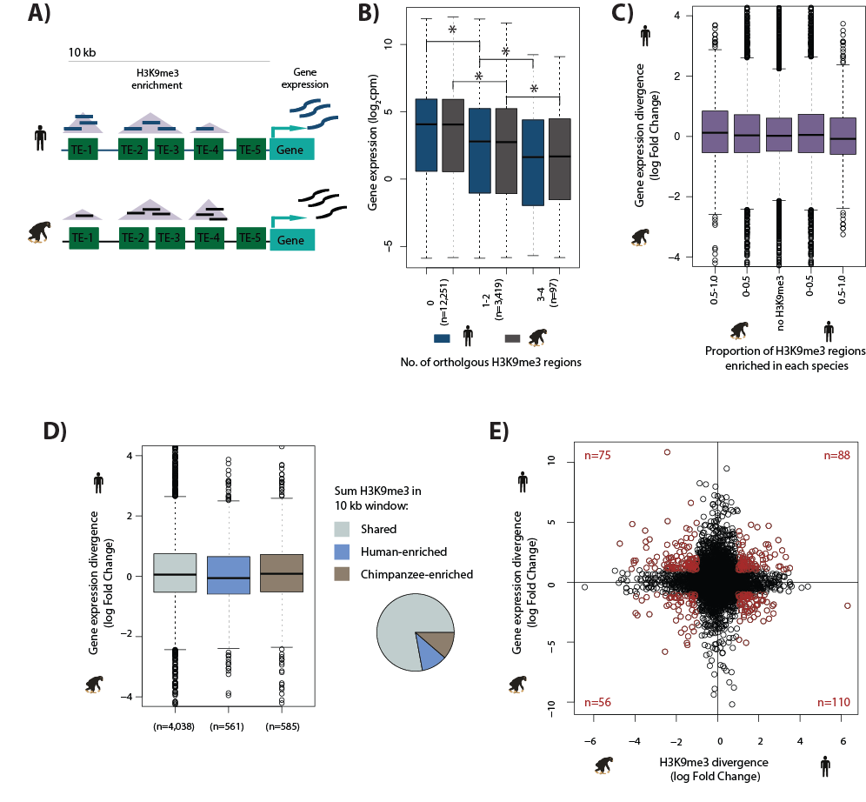
Effect of TE silencing on gene expression levels and divergence

Slide 29
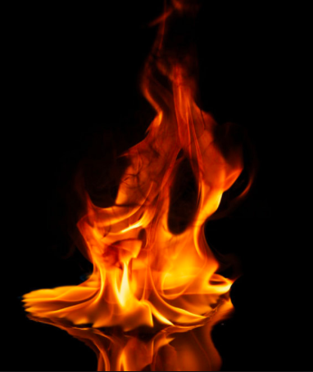
Effect of TE silencing on gene expression levels and divergence

Slide 30
Effect of TE silencing on gene expression levels (B) and divergence (C)

Slide 31
Effect of TE silencing on gene expression divergence

Slide 32
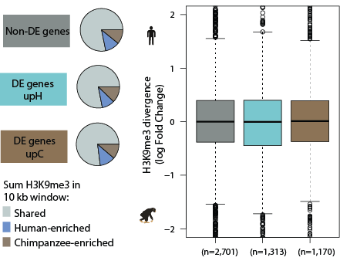

Slide 33
