Slide 1

Representing model uncertainty in ensemble data assimilation
Jeff Whitaker
NOAA Earth System Research Lab, Boulder, CO, USA
jeffrey.s.whitaker@noaa.gov
Within the DA itself (inflation)
Within the background forecast
  Multi-model ensemble
  Perturbed parameters
  Stochastic physics
Notes:
Can be treated within the DA (as inflation) or within the model itself.

Slide 2
Evaluating schemes for representing model uncertainity
Using an EPS
  Spread/error consistency, probabilistic scores.
  Hard to know whether improvement comes simply from reducing spread deficiency.
Using an EnKF
  Tougher test if multiplicative inflation used as baseline, since scheme must do more than increase variance.
  Evolution of all errors in DA cycle (not just model error) must be represented. Model error may not be dominant.
Notes:
To date, the most common method for evaluting model error schemes has been verification of EPS forecasts. Since EPS systems that do not attempt to represent model error will be under-dispersive, any increase in spread will result in improved prob. scores and better spread/error consistency. Since this is usually the dominant impact of a model error scheme in an EPS system, it’s hard to know whether there is any more going on, and whether the improvement goes beyond what could be had by simple postprocessing schemes (when a reforecast dataset is available).
In an EnKF system, model error must be represented in some way to avoid filter divergence. The simplest method is multiplicative inflation, which simply increases the amplitude of the ensemble perturbations. This provides a baseline for evaluating model error schemes, and sets the bar higher.
However, the use of multiplicative inflation in EnKF systems is often necessary even when the model is perfect, since it has to account for all sources of error in the DA system, including sampling error. In fact, model error may not even be the dominant source of un-represented errors in the first-guess forecast.

Slide 3


Un(der)-represented error sources in an EnKF ensemble
Model error
Sampling error
Observation error
Boundary condition error
Forward operator error
Notes:
An EnKF background ensemble is supposed to represent the range of possibitlies given the observations, the model and the limitations in the sub-optimal implementation of the KF that the EnKF represents. Therefore in addition to model error, the first-guess ensemble should represent sampling error, errors associated with mis-representation of the observation error, errors in the boundary conditions (i.e SST), and errors in the forward operator (i.e the radiative transfer model for satellite obs).

Slide 4
Experiences with Env. Canada system
(Houtekamer, Mitchell and Deng, MWR July 2009)
Operational EnKF tested with
  Multiple parameterizations
  SKEB (stochastic kinetic energy backscatter)
  SPPT (stochastically perturbed physics tend)
  Additive inflation (isotropic covariance structure)
  Multi-physics plus additive inflation
Notes:
Env Canada has been running an operational EnKF system for NWP for several years now, and a MWR article last year Peter H and collaborators looked at the impact of several different model error schemes on the performance of their EnKF system (as measured by fit of short-term ensemble mean forecasts to observations). Specifically, they tested the impact of using a multi-model ensemble (same dyn core, different parameterizations), SKEB, stochastically perturbed physics tendencies (both of which are now part of the operational ECMWF system), addiive inflation, and a combo of additive and multi-model.

Slide 5
Experiences with Env. Canada system
(Houtekamer, Mitchell and Deng, MWR July 2009)
configuration | O-F (energy norm) | Energy spread in ob space
Additive inflation | 3.1388 | 2.0622
Multi-physics | 3.2978 | 1.2773
SKEB | 3.4348 | 1.2671
SPPT | 3.3899 | 1.1670
Multi-physics + add. Infln. | 3.0846 | 2.1335
SKEB + SPPT | 3.3352 | 1.3608
SKEB+SPPT+Mult-physics+rescaled additive infln. | 3.0940 | 2.1092
Biggest impact from ad-hoc additive inflation.
Addition of multi-physics improves assimilation slightly.
SPPT and SKEB have less impact (tuned for EPS?, model error not dominant?)
Notes:
This table summarizes the results of their comparison in terms of the rms obs increments for the ensemble mean first guess, and the first-guess ensemble spread in observation space, in a total energy norm,
The best fit to observations was obtained with a combination of mult-physics + additive inflatio. Adding SKEB and STTP to the mix did not improve the scores.
Additive inflation by itself outperformed any of the other schemes used individually.
Additive inflation produced much more spread than the other schemes, and accounted for most of the spread in the experiment using all of the schemes together.
To be fair, the SKEB and STPT schemes were tuned to give the best results in the longer range EPS, and were not retuned for maximal impact in the DA cycle.
These results suggest that either:
Model error is not the dominant source of error in the DA system, and the additive inflation is accounting for all the other sources of error.
The schemes tested were not adequately representing model error, and either need to be retuned or reformulated.

Slide 6
Motivation for simple model expts
Sources of assimilation error can be controlled (obs. error know perfectly, sampling error can be controlled).
Access to truth aids in diagnostics, tuning of model error schemes.
Can run lots of experiments.
Notes:
There are difficulties in trying to perform this kind of evaluation using an operational system
The parameter space is large, and the expts expensive
The actual error sources are unknown – can’t control how much is coming from DA system and how much is coming from model.
In a simple model environment we can run lots of expts, and we can more easily control the sources of error. Having access to the truth is nice too.

Slide 7
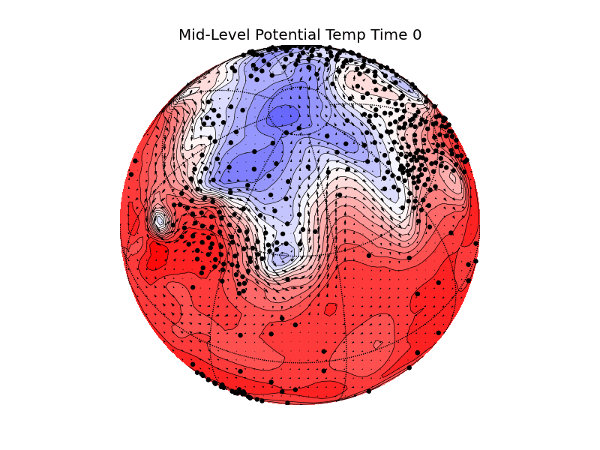

2-level PE model on a sphere
2-level PE model on a sphere (Lee and Held, 1993 with parameters as in Hamill and Whitaker, 2010).
511 12-hourly obs of geopotential height at sonde locations (error = 10 m)
  20 member ensemble, serial determinstic (i.e. square-root) EnKF.
  1000 assimilation cycles, 3500 km localization (none in vertical)
Truth from T42 nature run, assimilation with T31 model. Only sources of DA error are model error and sampling error.
Notes:
So, for the rest of this talk I’m going to be showing you results using a simple 2-level PE model. The model has linear mechanical damping in the lower layer, 8th order hyperdiffusion, and is forced by relaxation to a newtonian relaxation to a zonally symmetric equilibrium state consisting of a zonally symmetric mid-latitude upper layer jet. The observational network is defined by the operational NH radiosonde network, and is symmetric about the equator. A T42 nature run is used to define geoptential obs with an error of 10 m, and these are assimilated into a T31 20-member EnKF, with 3500 km horizontal covariance localization.
Since forward operator and obs error are perfectly known, the only sources of error in the DA come from the model and sampling error.

Slide 8
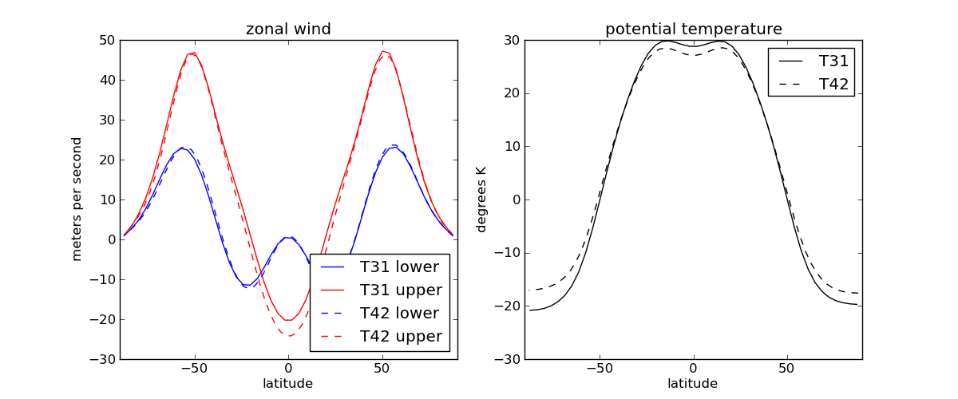
2-level PE model on a sphere
2-level PE model on a sphere (Lee and Held, 1993 with parameters as in Hamill and Whitaker, 2010).
511 12-hourly obs of geopotential height at sonde locations (error = 10 m)
  20 member ensemble, serial determinstic (i.e. square-root) EnKF.
  1000 assimilation cycles, 3500 km localization (none in vertical)
Truth from T42 nature run, assimilation with T31 model. Only sources of DA error are model error and sampling error.
Notes:
Errors in t31 mean climate are small in mid-lats
Upper level easterlies too weak in T31 tropics, temps too cold (warm) in tropics (polar regions).
No attempt to correct for mean bias in background forecast is done in the DA.

Slide 9
Methods for representing model error
Multiplicative Inflation
Simple constant inflation not suitable when observing network and dynamics vary in space and/or time.
Both sampling error and model error are expected to be a larger fraction of the total background error where observations have a larger impact (where σ_{b}/σ_{a} is large).
“relaxation” inflation is stronger where ensemble variance is reduced by the assimilation of observations.
Notes:
The simplest method for representing model error in ensemble DA is multiplicative inflation, which acts to increase the amplitude of ensemble perturbations, either in the first-guess ensemble (before assimlation) or in the analysis ensemble (after assimilation). However, with a model like this, where the observing network and the dynamics vary considerably in space, we can’t get away with a constant inflation factor for the whole globe. If we use constant inflation, we will overinflate in regions where the observations have little impact, and underinflate where they have a large impact. Even for a uniform network, if the dynamics are such that perts grow rapidly in some regions and not at all in other regions, we will may overinflate where the dynamics is weak and underinflate where the dynamics is strong. Therefore, we at least need to have an inflation algorithm that inflates more strongly where observations have a stronger impact, and in the limit that obs have no impact, doesn’t inflate at all. There are some sound theoretical reasons for using inflation that behaves like this:
- Daley and Menard showed in a very simple model that model tends to be a larger impact of the total B where observations are dense/accurate.
Sampling error is larger where obs have more impact, so even in the absence of model error inflation should be larger in regions of dense obs.
Jeff Anderson has developed a Bayesian adaptive algorithm for determining a spatially varying inflation factor – and when used with CAM/real obs the estimated inflation is large where obs are dense and accurate.
Basically, where obs are dense and accurate, the EnKF removes most of the variance in coherent, dynamically growing structures – so that un-represented sources of error such as model and sampling error are relatively larger fraction of what’s left.
Besides Jeff Anderson’s fully adaptive inflation, a relatively simple form of multiplicative inflation which we call relaxation inflation has this desirable property.

Slide 10



Methods for representing model error
Multiplicative Inflation
Relaxation to prior perturbations (RTPP, Zhang et al, 2004)
Relaxation to prior spread (RTPS)
which implies
Both inflate more where observations have a strong tendency to reduce ensemble variance.
Notes:
Fuqing Zhang and his collaborators first proposed this type of inflation in a 2005 paper. Their version, which I call ‘relaxation to prior perturbation’ inflation, relaxes the posterior perturbations back to the prior with a coefficient alpha, so that if alpha=1 the posterior perts are completely replace by the prior perts, and if alpha=0 nothing is done. Since the posterior perturbations are much smaller than the prior perturbations in regions of dense obs, for a given value of alpha, more inflation is applied where the obs have had a larger impact on the analysis.
Here we propose an alternative approach, which we call ‘relaxation to prior stdev, which relaxes the ensemble spread back to the prior spread. This can be expressed a multiplicative inflation where the inflation coefficient depends on the fractional reduction of the ensemble spread that results from assimlating observations.

Slide 11
Methods for representing model error
Additive Inflation
Add random samples from a specified distribution to each ensemble member after the analysis step.
Env. Canada uses random samples of isotropic 3DVar covariance matrix.
NCEP uses random samples of 48-h – 24-h forecast error (fcsts valid at same time).
Here we use a dataset of 12-h forecast errors with the T31 model in which the initial conditions are perfect (T31 truncated states from the T42 nature run).
Notes:
The first method we consider is additive inflation. As you may recall, this is the method that proved most effective in the Env. Canada operational EnKF. The basic idea is to add random samples from a specified distribution to each ensemble member after the analysis step. Ideally, the distribution you would draw from is the climatological distribution of background forecast model error.
Of course, in practice this is unknown, so Env Canada uses random samples of an isiotropic 3DVar cov matrix.
Here we have the luxury of knowing what the actual distribution of model error is. To build a distribution to sampe from, we create a dataset of T31 12-h forecasts errors, in which all the forecasts were initialized from the T31 truncated nature run (and hence have zero initial error at the T31 scale). By 12-h the errors are nonzero, due to the fact that the model cannot represent the full T42 dynamics.

Slide 12
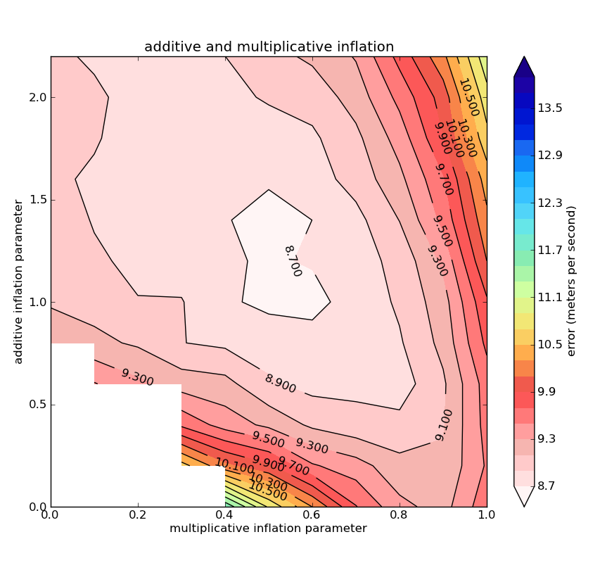
Imperfect Model (Additive + Multiplicative Inflation)
Additive inflation alone outperforms multiplicative inflation alone (compare values y-axis to values along x-axis)
A combination of both is better than either alone.
Multiplicative and additive inflation representing different error sources in the DA cycle?
Notes:
We have run the data assimilation for 1000 analysis times for various values of multiplicative and additive inflation. This contour plot summarizes the ensemble mean first-guess error (in the total E norm) as a function of multiplicative inflation (x-axis) and additive inflation (y-axis).
For very small values of inflation, the filter diverges (nothing plotted).
The values along the x-axis are pure multiplicative inflation, and correspond to what I showed in the previous graph.
The values along the y-axis are pure additive inflation.
Note that pure additive inflation outperforms pure mulitplicative inflation.
However, a combo of both is better than either alone (min error is a few (3?) percent less than additive inflation alone).
This suggest that the two approaches are complementary, and therefore sample different sources of error in the DA. Perhaps multiplicative inflation is best at capturing sources of error in the DA not related to model erorr, while the additive inflation is better at capturing model error? I will present the results of perfect model expts to test this hypothesis in a moment, but first

Slide 13
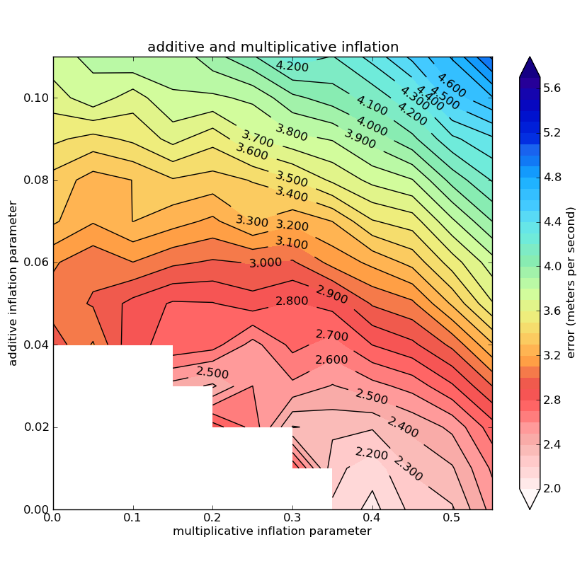
Perfect Model (Additive + Multiplicative Inflation)
6000 km localization, min error 4 times lower.
When model error is absent, multiplicative inflation alone outperforms combination of add+mult inflation.
Suggests that multiplicative inflation is better at capturing DA-related (i.e. sampling) error.
Notes:
To test this hypothesis that mult inflation is better at capturing DA-related errors not related to model, and additive inflation captures model error, we performed perfect model expts in which the forecast model used in the DA is the full T42 model (still 20 member ens, but optimal localization length scale is now 6000 km instead of 3500 km).

Slide 14
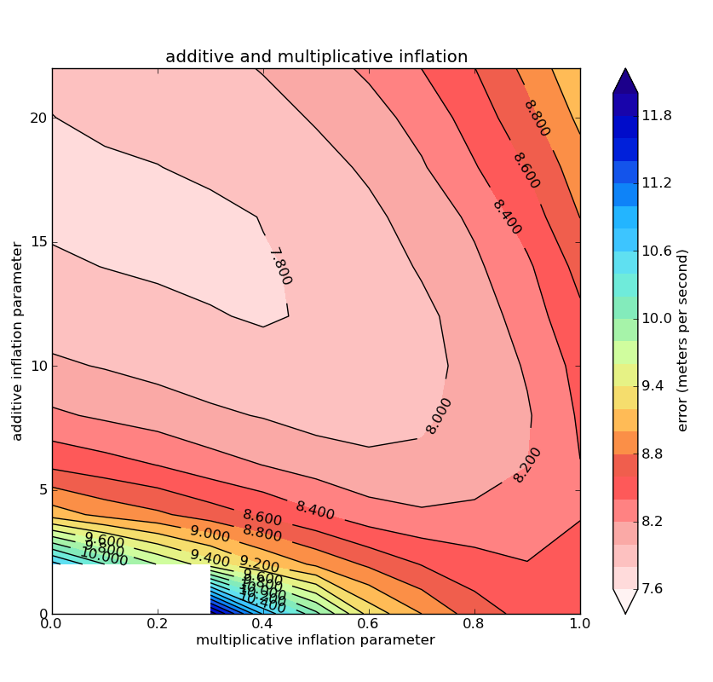
Imperfect model/Large ensemble(Additive + Multiplicative Inflation)
200 instead of 20 members, with model error. Min error reduced from 8.7 to 7.7.
When sampling error is reduced, additive inflation alone outperforms combination of add+mult inflation.
Suggests that additive inflation is better at capturing model-related errors.
Notes:
To test this hypothesis that mult inflation is better at capturing DA-related errors not related to model, and additive inflation captures model error, we performed perfect model expts in which the forecast model used in the DA is the full T42 model (still 20 member ens, but optimal localization length scale is now 6000 km instead of 3500 km).

Slide 15
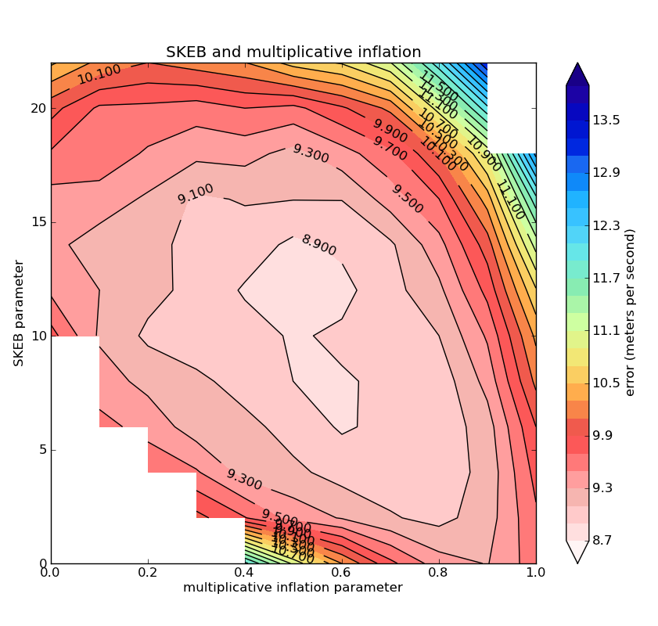
Replace Additive Inflation with
Stochastic Kinetic Energy Backscatter
A combination of SKEB and multiplicative inflation works better than either alone.
SKEB alone comparable to multiplicative inflation alone (compare values along x and y axes).
Results are slightly inferior to those obtained using additive + multiplicative inflation.
y-axis is amplitude of random pattern (σ) – results do not change much if p (power law) or time-scale (τ) are varied.

Slide 16
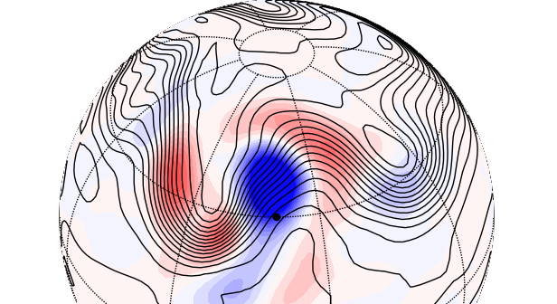
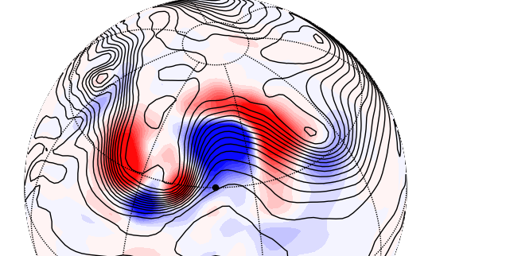
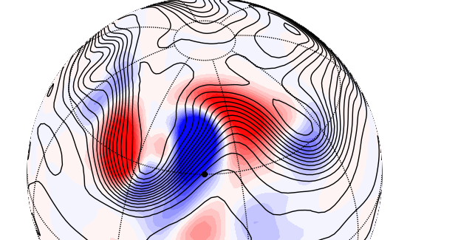
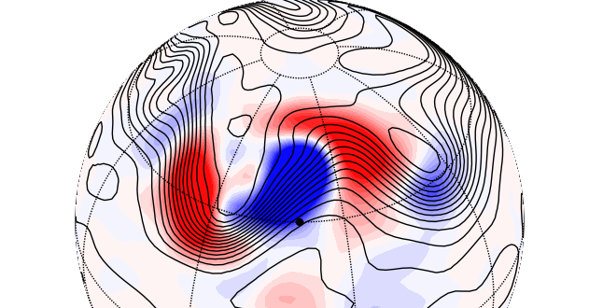
Single-Ob Increments
Background Mean – solid black, T increment for T ob at black dot – colors
10,000 km localization
Perfect Model
(100 members)
Mult Inf Only
Mult+Add Inf
Mult Inf+SKEB
Notes:
Biggest difference is in mean – T31 solutions are smoother. T31 increment more similar to each other than perfect assimilation. difference in increments tied to differences in mean.

Slide 17
Conclusions from simple model expts
Improving background-error covariances in an EnKF is a tough test for a model error scheme.
Multiplicative inflation and stochastic physics/additive inflation sample different sources of error in the DA
  One samples model error, is not sensitive to the observation network.
  One is sensitive to the observation network, samples other errors in the DA (sampling error, mis-specification of obs error, errors in forward operator etc.)
  Combination of both works better than either alone (when there are both sources of error).
Any of these methods can only do so much – improving the forecast model will usually have a larger impact on the data assimilation.
More details in Whitaker + Hamill (2012): DOI:10.1175/MWR-D-11-00276.1

Slide 18
NCEP operational 3D ensemble/Var system
Cycling EnKF (T254) provides an ensemble-based estimate of J_{b} term in 3DVar.
3DVar with ensemble J_{b} updates a T574 control forecast. The EnKF analysis ensemble is recentered around the high-res analysis.
A combination of multiplicative and additive inflation is used to represent missing sources of uncertainty in the EnKF ensemble.
Additive inflation: random draws from a database of 48-24 forecast differences (valid at same time), added to EnKF analysis ensemble.

Slide 19
Dual-Res Coupled 3D Ensemble/Var
member 1
forecast
member 1
analysis
member 2
forecast
EnKF
member update
recenter analysis ensemble
member 2
analysis
member 3
analysis
member 3
forecast
GSI
Hybrid Ens/Var
high res
forecast
high res
analysis
Previous Cycle
Current Update Cycle

Slide 20
Can we replace the additive inflation by adding stochastic physics to the model?
Schemes tested:
  SPPT (stochastically perturbed physics tendencies)
  SKEB (stochastic KE backscatter)
  VC (vorticity confinement) – not shown since it increased ensemble mean error.
  SHUM (perturbed boundary layer humidity, based on Tompkins and Berner 2008, DOI: 10.1029/2007JD009284)
All use stochastic random pattern generators to generate spatially and temporally correlated noise.

Slide 21
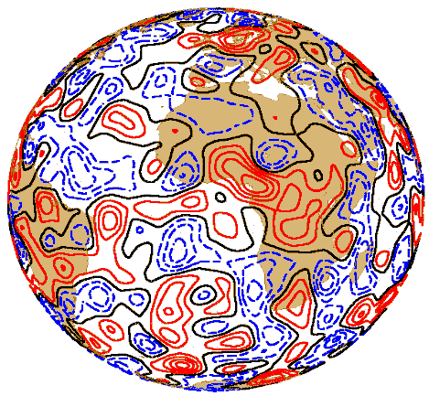
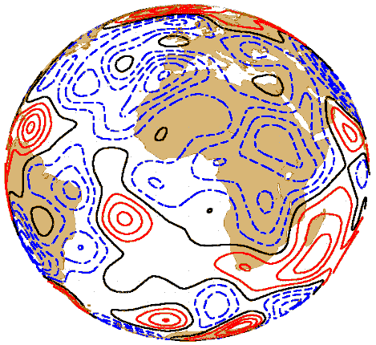
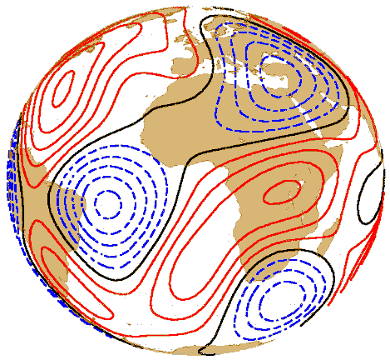
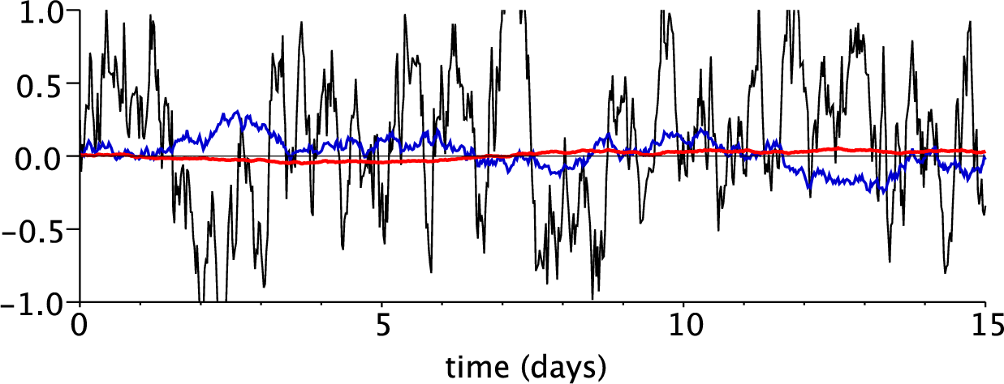
Examples of stochastic patterns
1000 km
3 d
2000 km
30 d
500 km
6 h
(from M Leutbecher)

Slide 22
ECMWF method (SPPT)
Stochastically Perturbed Physics Tendency
Perturbed Physics tendencies
Original physics tendencies
μ: vertical weight: 1.0 between surface and 100 hPa, decays to zero between 100 hPa and 50 hPa.
r: horizontal weights: range from -1.0 to 1.0, a red noise process with a
  temporal timescale of 6 hours
  e-folding spatial scale of 500 km

Slide 23
Stochastic boundary-layer humidity
SPPT only modulates existing physics tendency (cannot change sign or structure, trigger new convection).
Triggers in convection schemes very sensitive to BL humidity.
Vertical weight r decays exponentially from surface. Added every time step after physics applied. Random pattern μ has a (very small) amplitude of 0.0015, horizontal/temporal scales same as SPPT.

Slide 24
Stochastic Kinetic Energy Backscatter
Algorithm described in Shutts (2005), Berner et al (2009)
  Designed to represent the effects of dissipated motions near truncation scale on resolved motions.
  Random patterns are modulated by amplitude of KE dissipation (numerical, possibly other sources like convection – we only consider numerical dissipation here).
Notes:
SKEB aims to represent the impact of unresolved or heavily dampes scales on resolved scales through the inverse cascade.

Slide 25
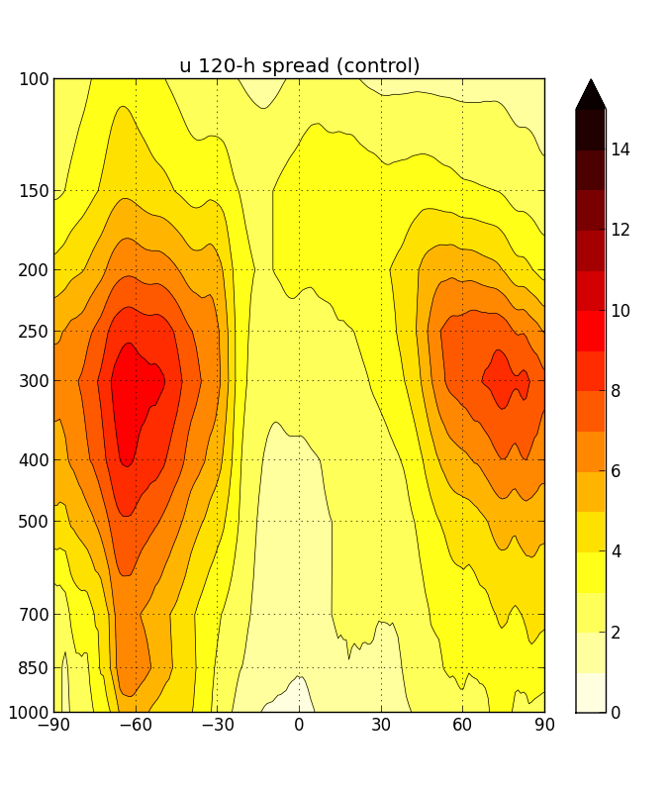
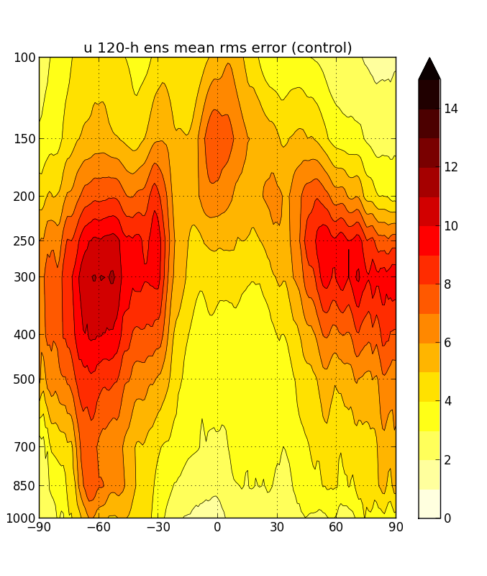
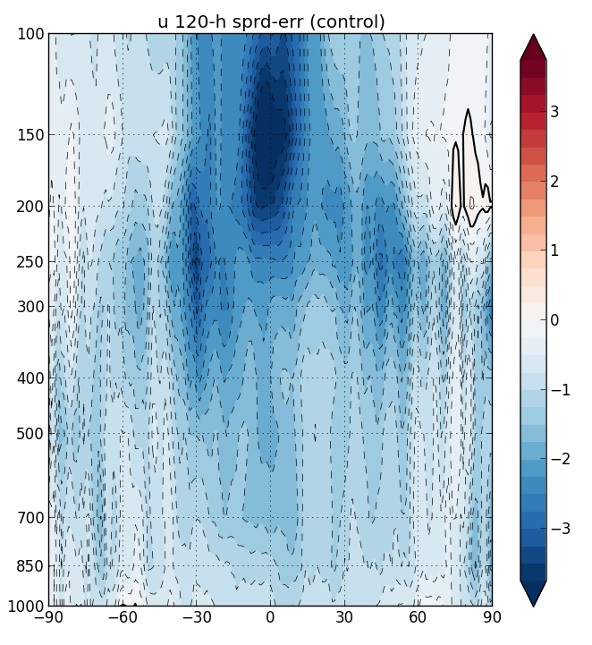
120-h Control U (no stochastic physics)
SPREAD
ERROR
SPRD-ERR

Slide 26
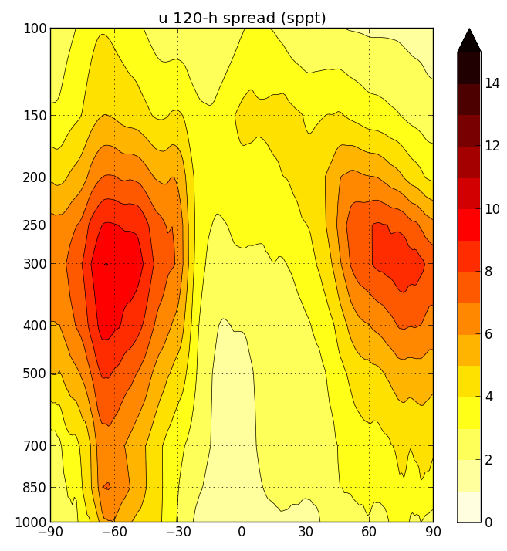
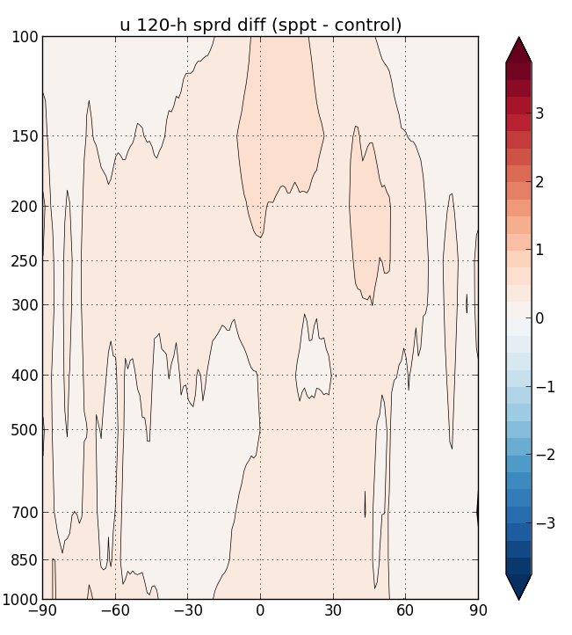
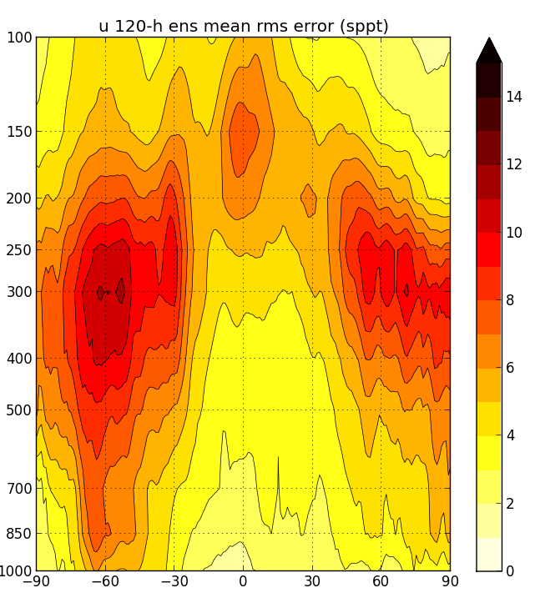
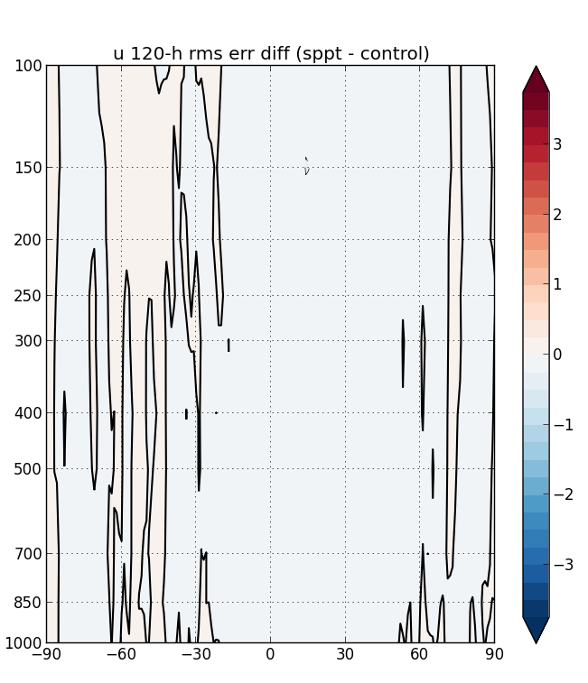
SPPT U
Slight increase in spread, mostly in tropics. All in all, very little effect.
Ens mean error unchanged.
SPREAD
SPRD – SPRD CTL
ERROR
ERR – ERR CTL

Slide 27
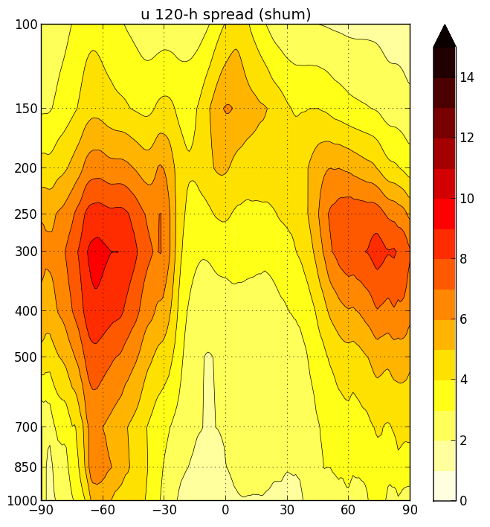
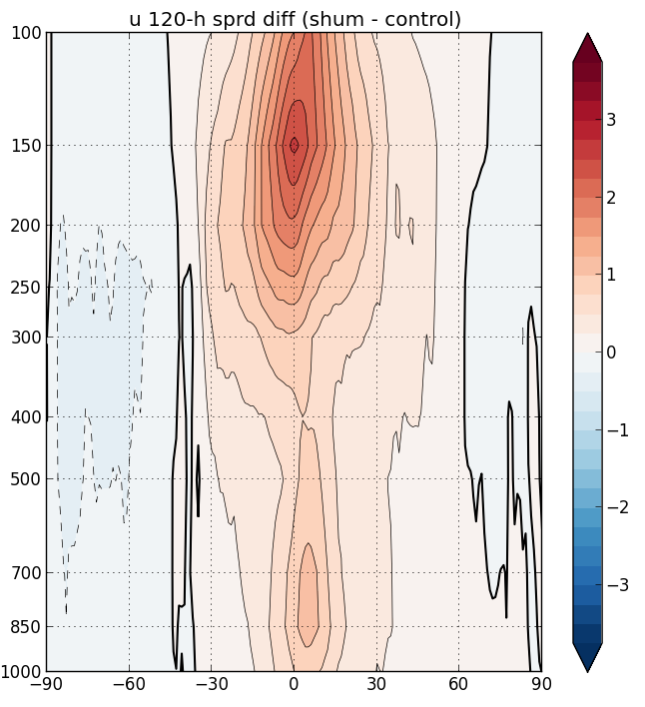
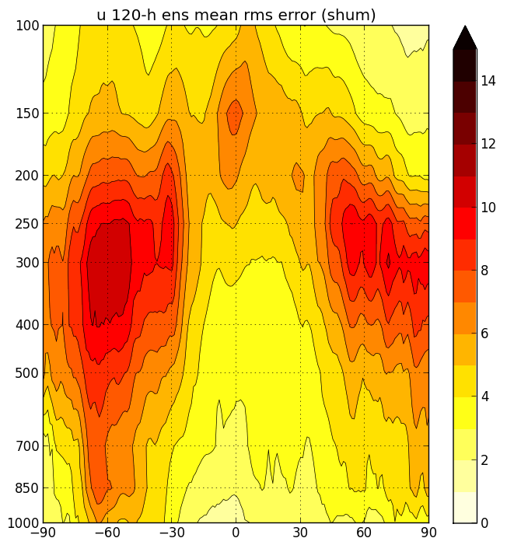
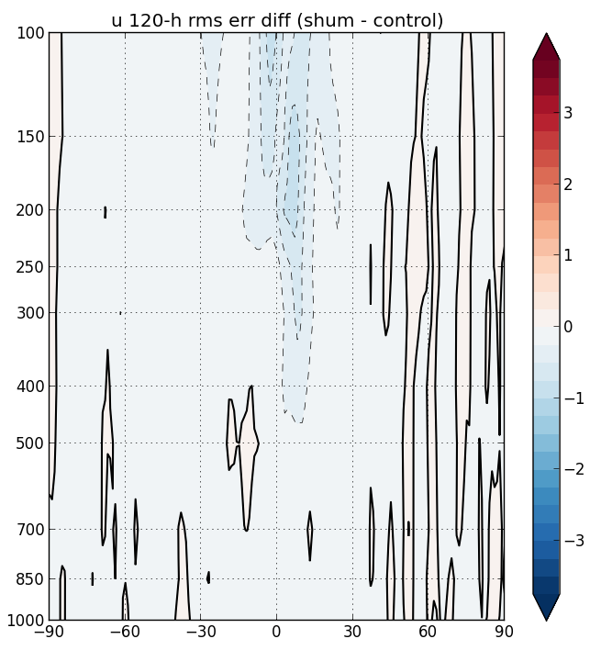
SHUM U
Spread/error consistency improved in tropics, esp. in upper trop (max in error near tropopause reproduced in spread).
Little or no effect in winter hemisphere poleward of 30.
Ens mean error reduced in tropical upper trop.
SPREAD
SPRD – SPRD CTL
ERROR
ERR – ERR CTL

Slide 28
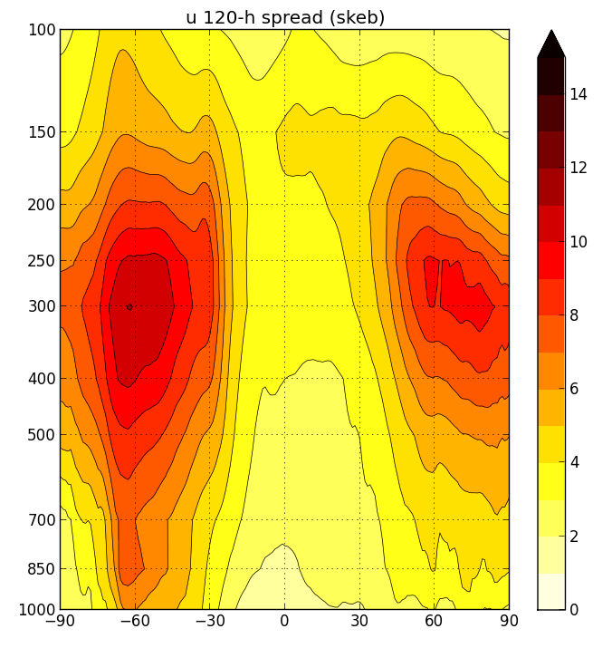
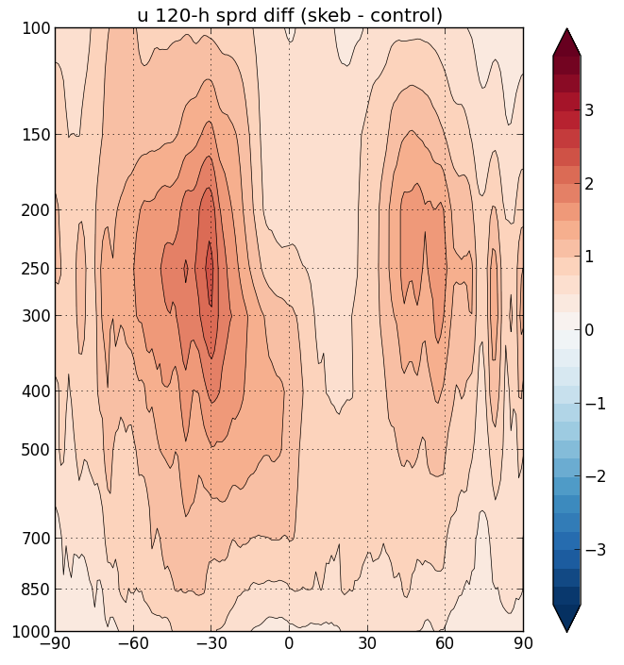
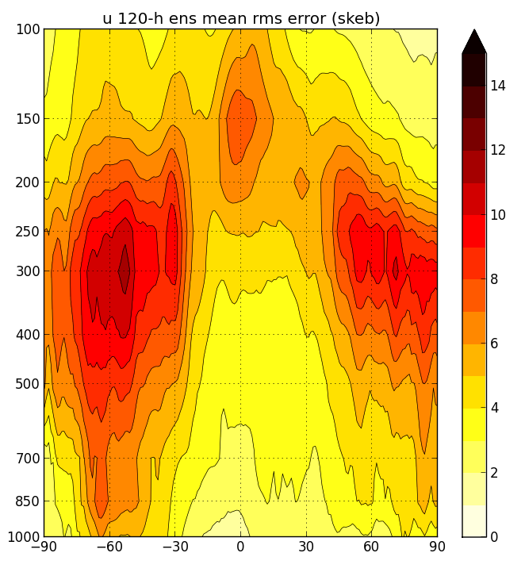
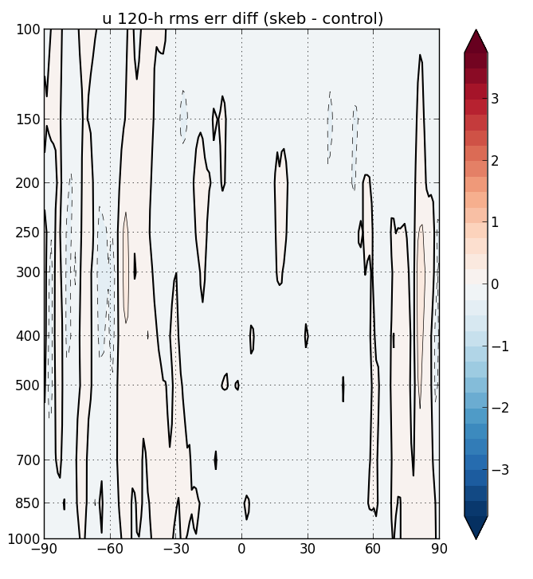
SKEB U
Spread increased in mid-latitude jets (where numerical dissipation is active)
Little effect in tropics (convective dissipation not included).
Neutral impact on ens mean error.
SPREAD
SPRD – SPRD CTL
ERROR
ERR – ERR CTL

Slide 29
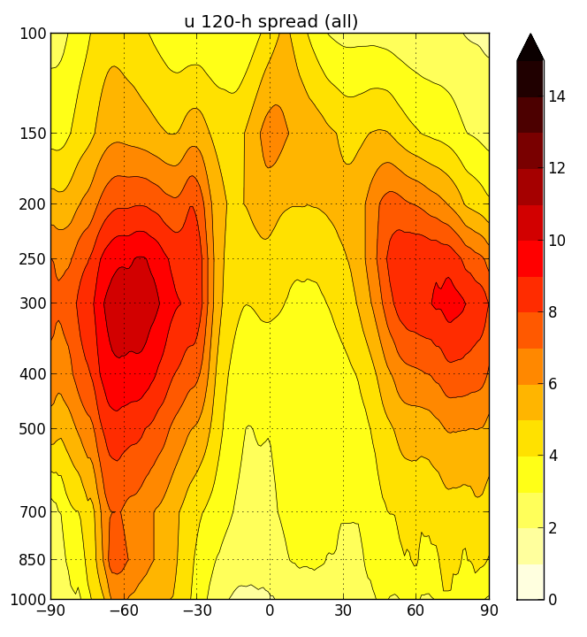
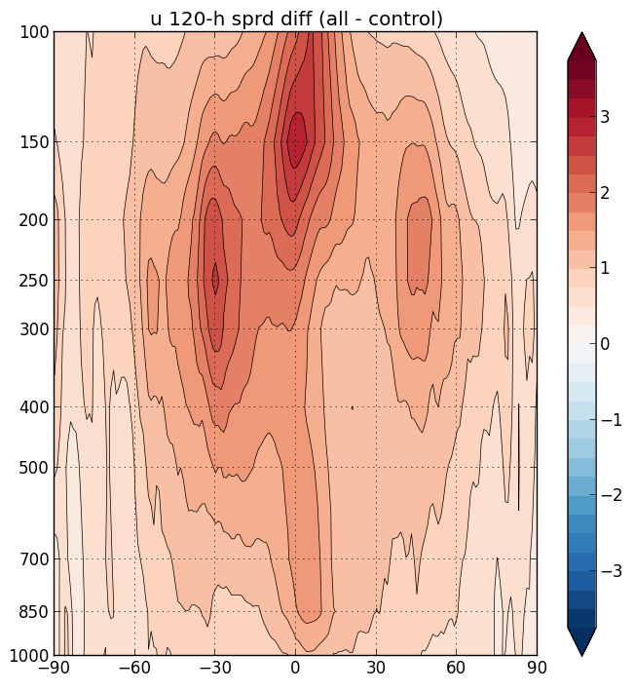
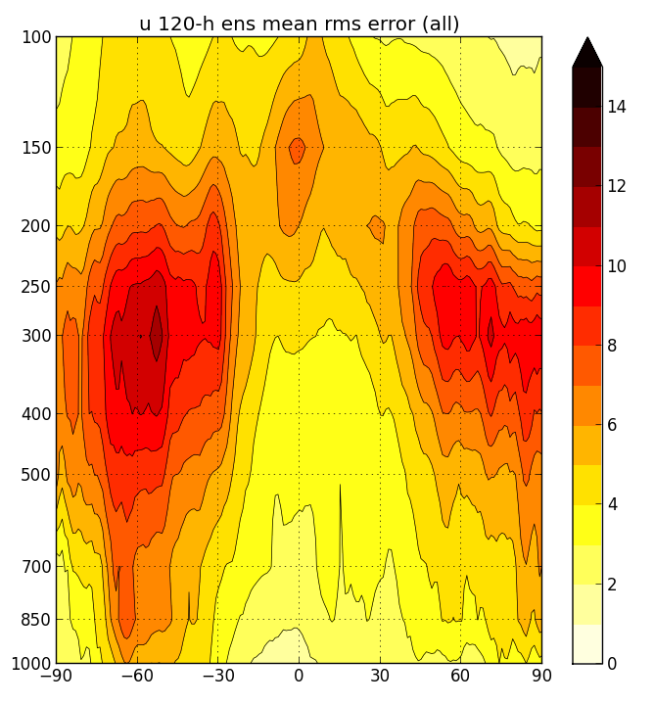
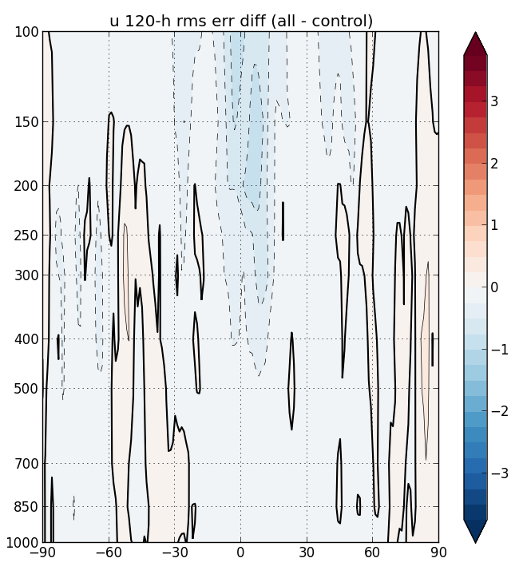
SPPT+SHUM+SKEB U
Spread/error almost consistent. With a bit of tuning, should be able to get near perfect consistency.
SKEB adds spread in mid-latitude jets.
Ens mean error slightly reduced.
SPREAD
SPRD – SPRD CTL
But is it “good” spread? Does it improve covariances in EnKF?
ERROR
ERR – ERR CTL

Slide 30
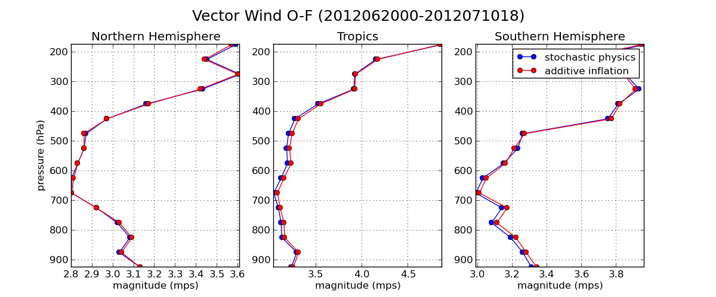
Replacing additive inflation with stochastic physics (preliminary) red: control (EnKF with additive inflation) blue: Turn off additive inflation, include stochastic physics in model (only in ensemble forecast).
Should be able to replace additive inflation with stochastic physics in the EnKF. Further progress likely as stochastic physics schemes improve representation of model uncertainty in the ensemble.

Slide 31
Conclusions from experiments with NCEP GFS
As in simple model, it’s hard to improve upon ad-hoc inflation.
We have progressed to the point where state-of-the-art stochastic schemes can perform as well as additive inflation in DA.
Hopefully, we can do better by treating model uncertainty the process level in each parameterization scheme.
  See proceedings of model uncertainty workshop athttp://www.ecmwf.int/newsevents/meetings/workshops/2011/Model_uncertainty/).
Notes:
Ensemble DA systems a good way to tell if we’re doing better (covariances improve). Also need to account for model bias

Slide 32
Extra Slides

Slide 33
Reference
sampling error largest where σ_{b}/σ_{a} is large (Sacher and Bartello 2008 MWR, 1640-1654).
model error is a larger fraction of background error in regions of dense/accurate obs where σ_{b}/σ_{a} is large (Daley and Menard 1993 MWR, 1554-1565).
adaptively estimated inflation looks like σ_{b}/σ_{a} (Anderson et al 2009 BAMS, 1283-1296, Fig. 13).
Additive inflation does most of the work in the Env Canada EnKF (Houtekamer, Mitchell and Deng, MWR July 2009).
Notes:
The simplest method for representing model error in ensemble DA is multiplicative inflation, which acts to increase the amplitude of ensemble perturbations, either in the first-guess ensemble (before assimlation) or in the analysis ensemble (after assimilation). However, with a model like this, where the observing network and the dynamics vary considerably in space, we can’t get away with a constant inflation factor for the whole globe. If we use constant inflation, we will overinflate in regions where the observations have little impact, and underinflate where they have a large impact. Even for a uniform network, if the dynamics are such that perts grow rapidly in some regions and not at all in other regions, we will may overinflate where the dynamics is weak and underinflate where the dynamics is strong. Therefore, we at least need to have an inflation algorithm that inflates more strongly where observations have a stronger impact, and in the limit that obs have no impact, doesn’t inflate at all. There are some sound theoretical reasons for using inflation that behaves like this:
- Daley and Menard showed in a very simple model that model tends to be a larger impact of the total B where observations are dense/accurate.
Sampling error is larger where obs have more impact, so even in the absence of model error inflation should be larger in regions of dense obs.
Jeff Anderson has developed a Bayesian adaptive algorithm for determining a spatially varying inflation factor – and when used with CAM/real obs the estimated inflation is large where obs are dense and accurate.
Basically, where obs are dense and accurate, the EnKF removes most of the variance in coherent, dynamically growing structures – so that un-represented sources of error such as model and sampling error are relatively larger fraction of what’s left.
Besides Jeff Anderson’s fully adaptive inflation, a relatively simple form of multiplicative inflation which we call relaxation inflation has this desirable property.

Slide 34
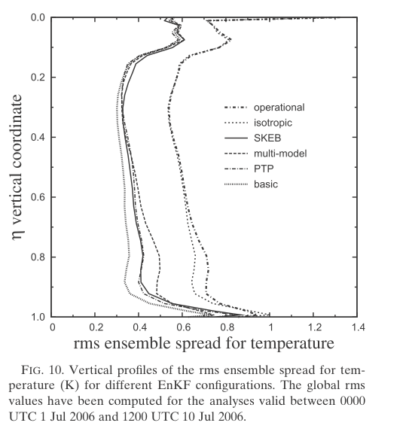
Experiences with Env. Canada system
(Houtekamer, Mitchell and Deng, MWR July 2009)
Most of spread comes from additive inflation.
Multi-physics adds some variance, esp in lower trop.
SPPT and SKEB do not provide much variability to background ensemble.
Are other sources of assimilation error (non-model) dominant, or do stochastic schemes need to be developed/tuned specifically for DA systems?
Notes:
Examing the results in more detail (as a function of vertical level), it becomes clear that most of the spread in the EnKF comes from additive inflation, except in the lower trop where there is a significant contribution fromk the multi-physiscs ensemble.

Slide 35
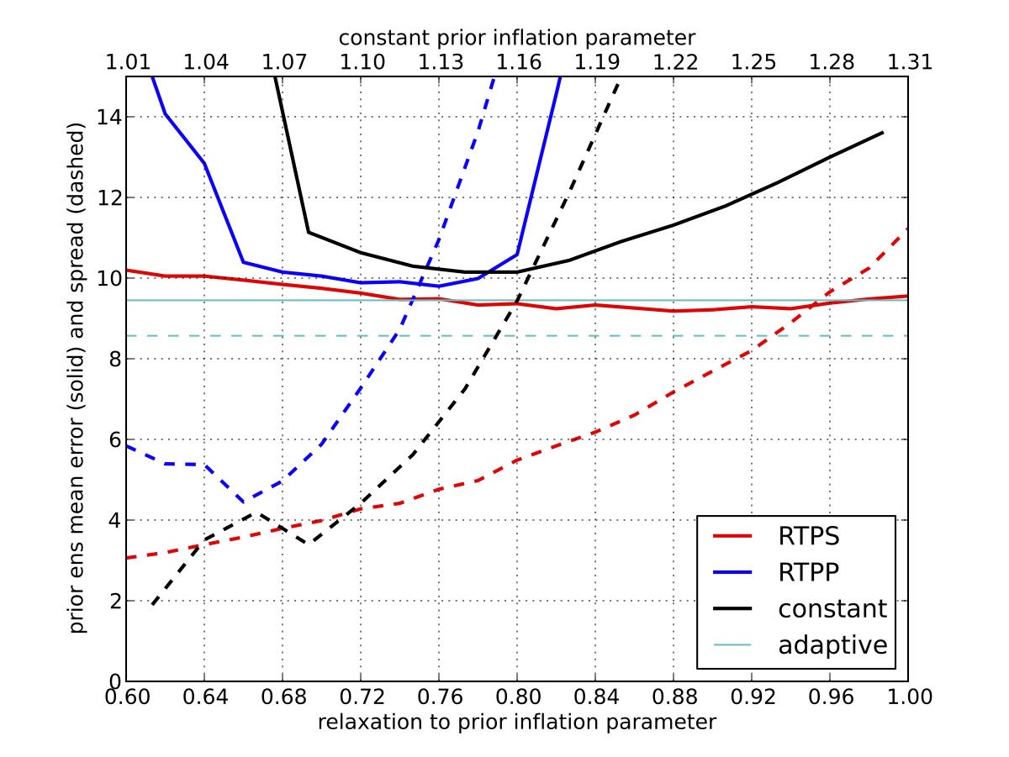
Methods for representing model error
Multiplicative Inflation
Relaxation to prior spread works best, is less sensitive to choice of relaxation parameter.
Jeff Anderson’s Bayesian adaptive inflation method performs similarly.
ens mean first-guess error (solid), spread (dashed)
Notes:
This graph shows the ensemble mean first-guess error and first-guess spread as a function of the relaxation coefficent for these two methods. The error and spread and expressed in a total energy norm. Red is our version, blue is Fuqing’s version. For reference, constant inflation is shown in black, and JLA’s adaptive inflation is cyan. RTPS works best (has the lowest error), and is less sensitive to the choice of the relaxation parameter.
Min error achieved when spread is slightly less than error.
Hence, we use RTPS inflation as a baseline for assessing other methods of representing model error.

Slide 36
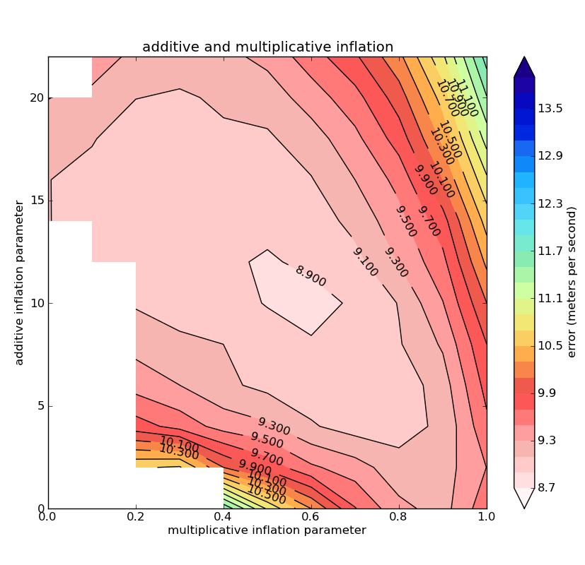
Methods for representing model error
Additive Inflation
Using random samples of actual model error is unrealistic.
Instead, try random samples of 12-h differences from T31 run.
Not quite as good as using actual model error, but still an improvement over multiplicative inflation alone.
Additive inflation alone still better than multiplicative inflation alone (compare values along x and y axes).

Slide 37
Methods for representing model uncertainty in ensembles
Multi-model ensembles
  Pros
    Everybody gets to keep working on their own model.
    Seems to work well for seasonal predictions
  Cons
    Heavy maintenance burden – hard to keep all models equally skillful.
    Addresses uncertainties in model formulation – but not the effects of sub-grid scale variability.
    Hard to deal with different grids/orography within DA.
Notes:
There are basically tthree approaches, the simplest

Slide 38
Methods for representing model uncertainty in ensembles
Parameter perturbations
  Pros
    Relatively simple to create (no need to develop new schemes).
  Cons
    How to determine the sensitive parameters, what a reasonable parameter range is?
    Nonlinear interactions between processes (radiation/convection/boundary layer). Easy to push model into an unrealistic regime.
Notes:
Another approach (used mostly in regional models)

Slide 39
Methods for representing model uncertainty in ensembles
Stochastic parameterization
  Pros
    Potentially a more rigorous approach.
    They have a deterministic limit – can maintain a single model for deterministic and ensemble prediction.
  Cons
    Hard to find observations to inform development (use LES simulations instead?)
    Should be done from the ground-up, at the process level (see above).
Notes:
The third approach is to add stochastic terms to the model to explicitly represent the uncertainty.

Slide 40
Vorticity confinement
(Sanches, Williams and Shutts, 2012 QJR doi 10.1002)
ε=0.6 in our experiments

Slide 41
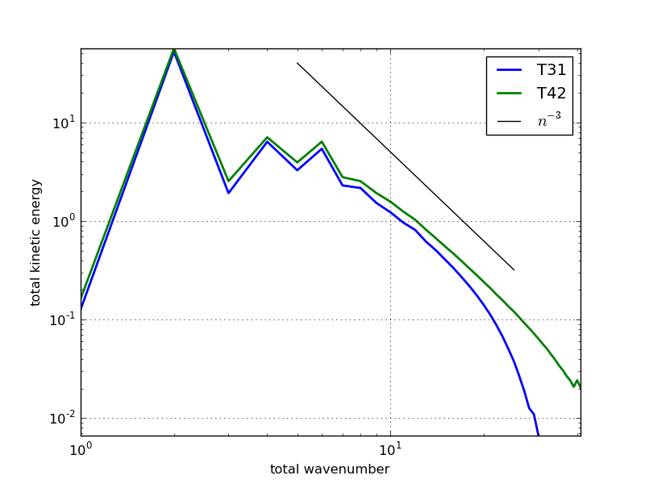
Methods for representing model error
Stochastic Kinetic Energy Backscatter
Insufficient resolution causes KE spectra to fall off too rapidly – missing upscale transfer to resolved scales.

Slide 42
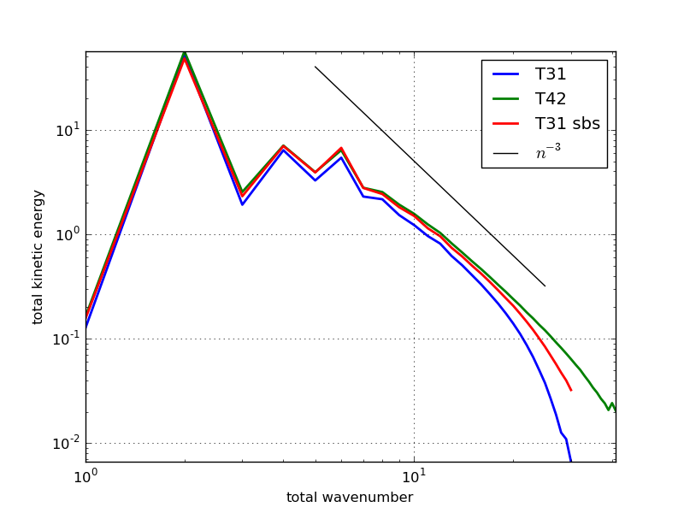
Methods for representing model error
Stochastic Kinetic Energy Backscatter
Adding SKEB to T31 model makes KE spectrum look similar to T42 model.
SKEB parameters: p=0, σ=15, τ=6−h

