Slide 1
A dynamic graph model of kidney exchange
Yashodhan Kanoria
Microsoft Research New England & Columbia
Joint work with Ross Anderson, Itai Ashlagi and David Gamarnik
MIT

Slide 2
Kidney transplants
Over 90,000 patients on the waiting list for cadaver kidneys in the U.S. today
In 2011:
33,581 patients were added to the kidney waiting list, and 28,625 patients were removed from the list.
11,043 transplants of cadaver kidneys performed.
4,697 patients died while on the waiting list and 2,466 others removed from the list as “Too Sick to Transplant”.
5,771 transplants of kidneys from living donors in the US.
Notes:
Incompatibility -> opens door for exchange

Slide 3
Kidney exchange
Donor 1
Blood type X
Recipient 1
Blood type Y
Donor 2
Blood type Y
Recipient 2
Blood type X
2-way kidney exchange

Slide 4
3-pair exchange (6 simultaneous surgeries)
Donor 1
Recipient 1
Pair 1
Donor 3
Recipient 3
Donor 2
Recipient 2
Pair 3
Pair 2

Slide 5
Compatibility graph
4
7
9
6
1
2
3
5
8

Slide 6
Multi-way exchanges
4-way and larger exchanges have been successfully demonstrated
However, significant challenges in conducting very large exchanges

Slide 7
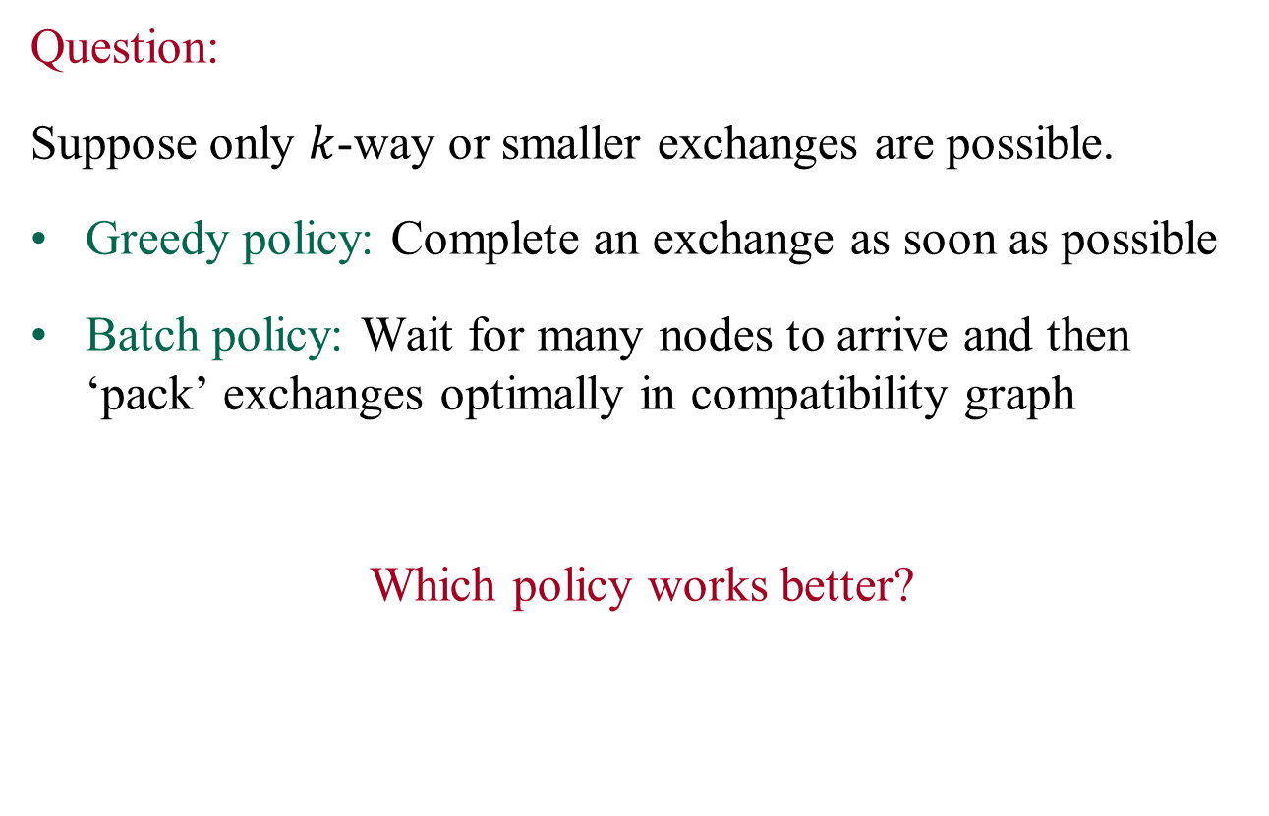
Question:
Suppose only $k$-way or smaller exchanges are possible.
Greedy policy: Complete an exchange as soon as possible
Batch policy: Wait for many nodes to arrive and then ‘pack’ exchanges optimally in compatibility graph
Which policy works better?

Slide 8
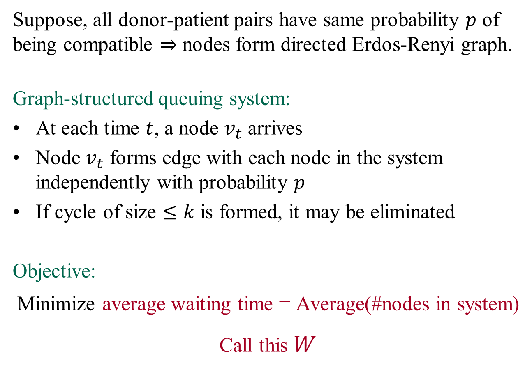
Suppose, all donor-patient pairs have same probability $p$ of being compatible $⇒$ nodes form directed Erdos-Renyi graph.
Graph-structured queuing system:
At each time $t$, a node $v_{t}$ arrives
Node $v_{t}$ forms edge with each node in the system independently with probability $p$
If cycle of size $≤k$ is formed, it may be eliminated
Objective:
Minimize average waiting time = Average(#nodes in system)
Call this $W$

Slide 9
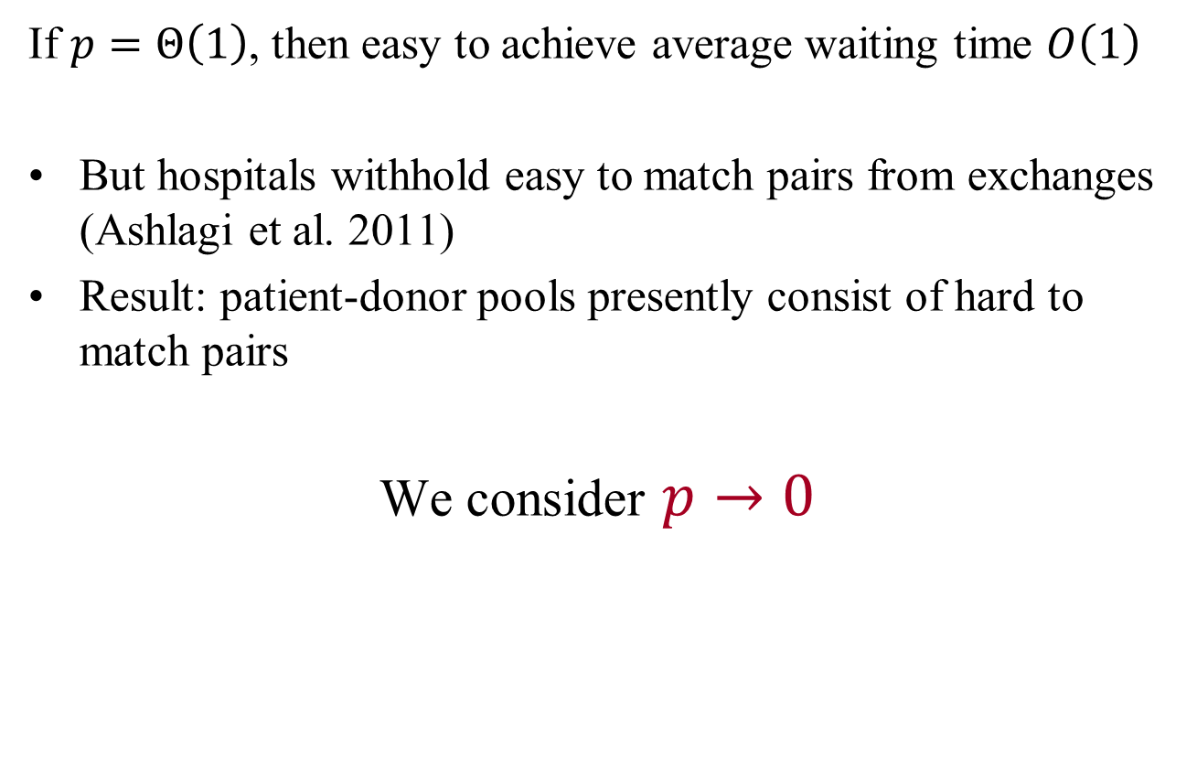
If $p=Θ\left(1\right)$, then easy to achieve average waiting time $O\left(1\right)$
But hospitals withhold easy to match pairs from exchanges (Ashlagi et al. 2011)
Result: patient-donor pools presently consist of hard to match pairs
We consider $p→0$

Slide 10
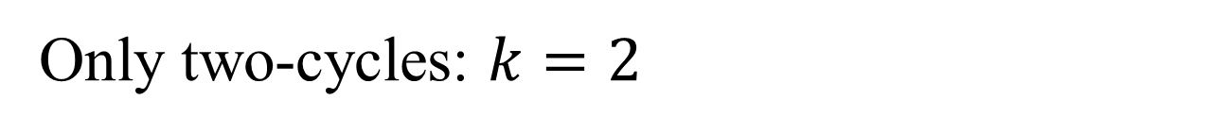

Only two-cycles: $k=2$
Two-cycle formed between any two nodes w.p. $1/p^{2}$
Greedy exchange achieves $W=Θ\left(\frac{1}{p^{2}}\right)$
Not hard to show that for any policy $W=Ω\left(\frac{1}{p^{2}}\right)$
Hence, greedy achieves order optimal $W$
Proposition: Greedy is optimal up to constants for $k=2.$

Slide 11

What about $k=3?$

Slide 12
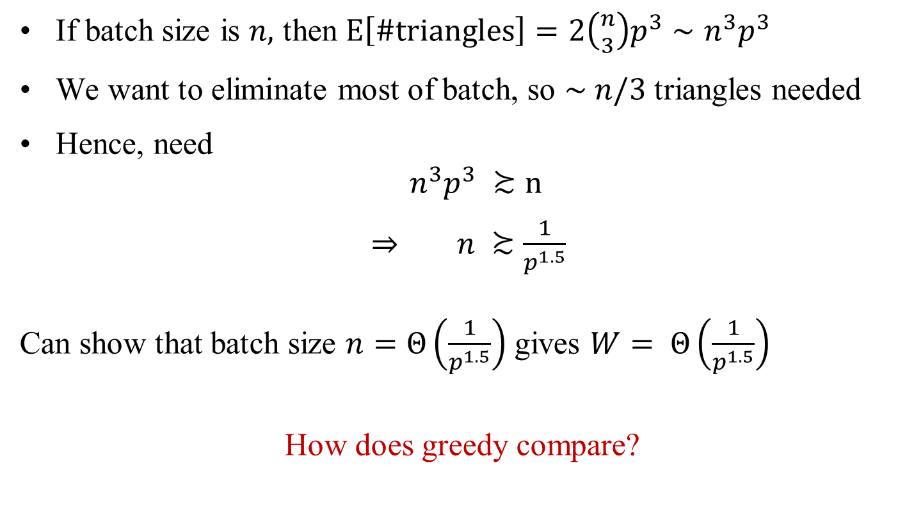
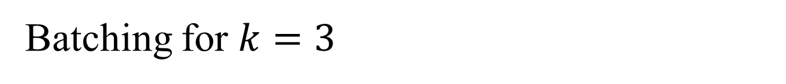
Batching for $k=3$
If batch size is $n,$ then $E\left[\#triangles\right]=2\left({n \atop 3}\right)p^{3}∼n^{3}p^{3}$
We want to eliminate most of batch, so $\sim n/3$ triangles needed
Hence, need
$$n^{3}p^{3} ≿n$$
$⇒ n ≿\frac{1}{p^{1.5}}$
Can show that batch size $n=Θ\left(\frac{1}{p^{1.5}}\right)$ gives $W= Θ\left(\frac{1}{p^{1.5}}\right)$
How does greedy compare?

Slide 13
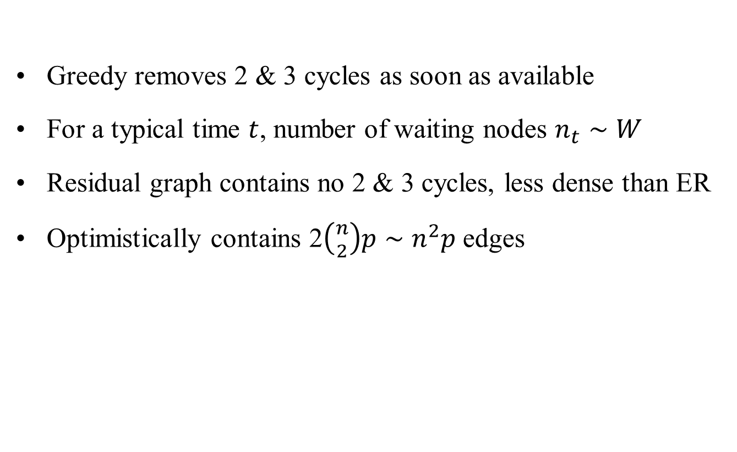
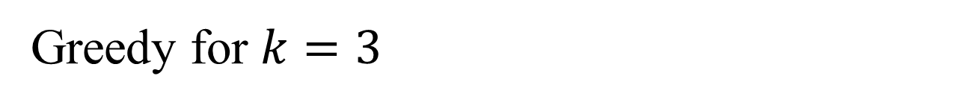
Greedy for $k=3$
Greedy removes 2 & 3 cycles as soon as available
For a typical time $t$, number of waiting nodes $n_{t}∼W$
Residual graph contains no 2 & 3 cycles, less dense than ER
Optimistically contains 2$\left({n \atop 2}\right)p∼n^{2}p$ edges

Slide 14
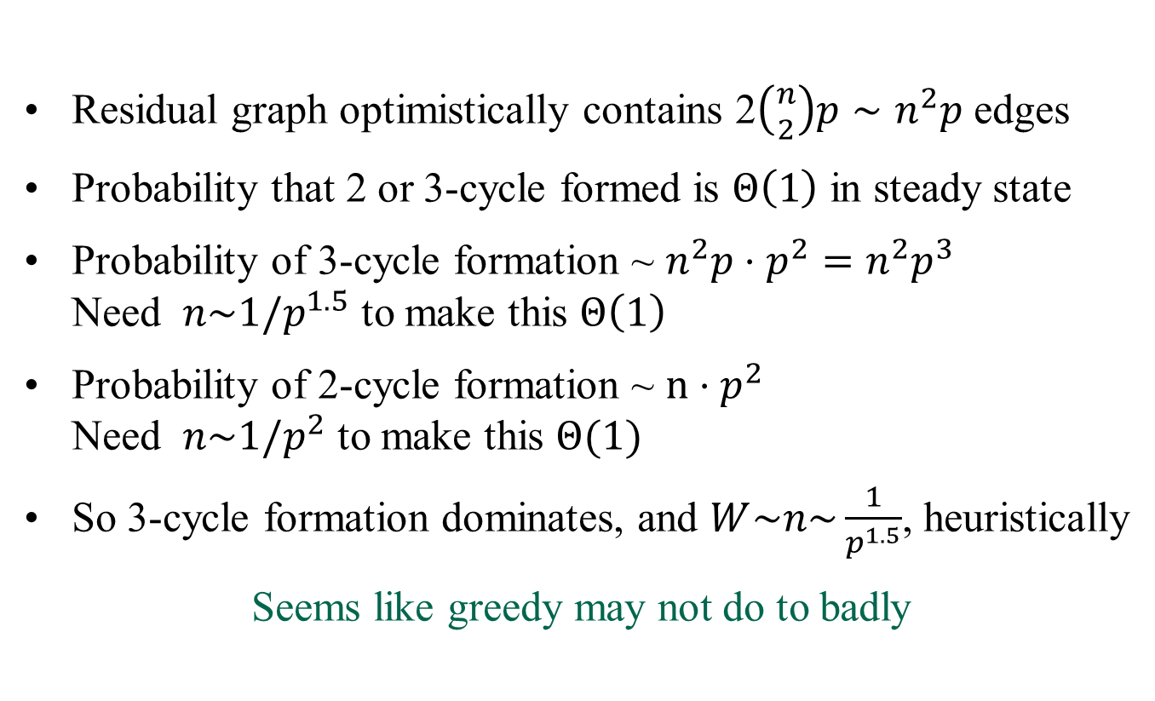
Greedy for $k=3$
Residual graph optimistically contains 2$\left({n \atop 2}\right)p∼n^{2}p$ edges
Probability that 2 or 3-cycle formed is $Θ\left(1\right)$ in steady state
Probability of 3-cycle formation ~ $n^{2}p⋅p^{2}=n^{2}p^{3}$
Need $n\sim 1/p^{1.5}$ to make this $Θ\left(1\right)$
Probability of 2-cycle formation ~ $n⋅p^{2}$
Need $n\sim 1/p^{2}$ to make this $Θ(1)$
So 3-cycle formation dominates, and $W\sim n\sim \frac{1}{p^{1.5}}$, heuristically
Seems like greedy may not do to badly

Slide 15

Simulation results: p = 0.08
$$\frac{1}{p^{1.5}}≈44.2$$

Slide 16

Simulation results: p = 0.05
$$\frac{1}{p^{1.5}}≈90$$

Slide 17

Simulation results: p = 0.02
$$\frac{1}{p^{1.5}}≈350$$

Slide 18

Summary of simulation results
Optimal batch size is 1 (i.e., greedy beats batching)
Under greedy $W≈\frac{0.65}{p^{1.5}}$ for small $p$
What can we prove?

Slide 19
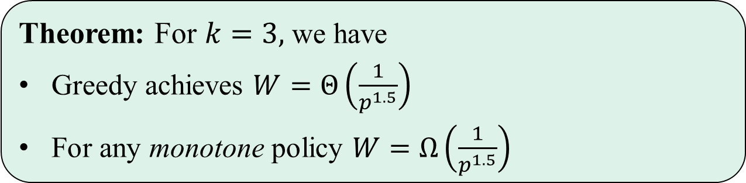
Main result
Theorem: For $k=3,$ we have
Greedy achieves $W=Θ\left(\frac{1}{p^{1.5}}\right)$
For any monotone policy $W=Ω\left(\frac{1}{p^{1.5}}\right)$
Batching with maximal packing of cycles is monotone
Shows that greedy is optimal up to a constant factor
Open problem: get rid of the constant factor slack, and consider all possible policies

Slide 20
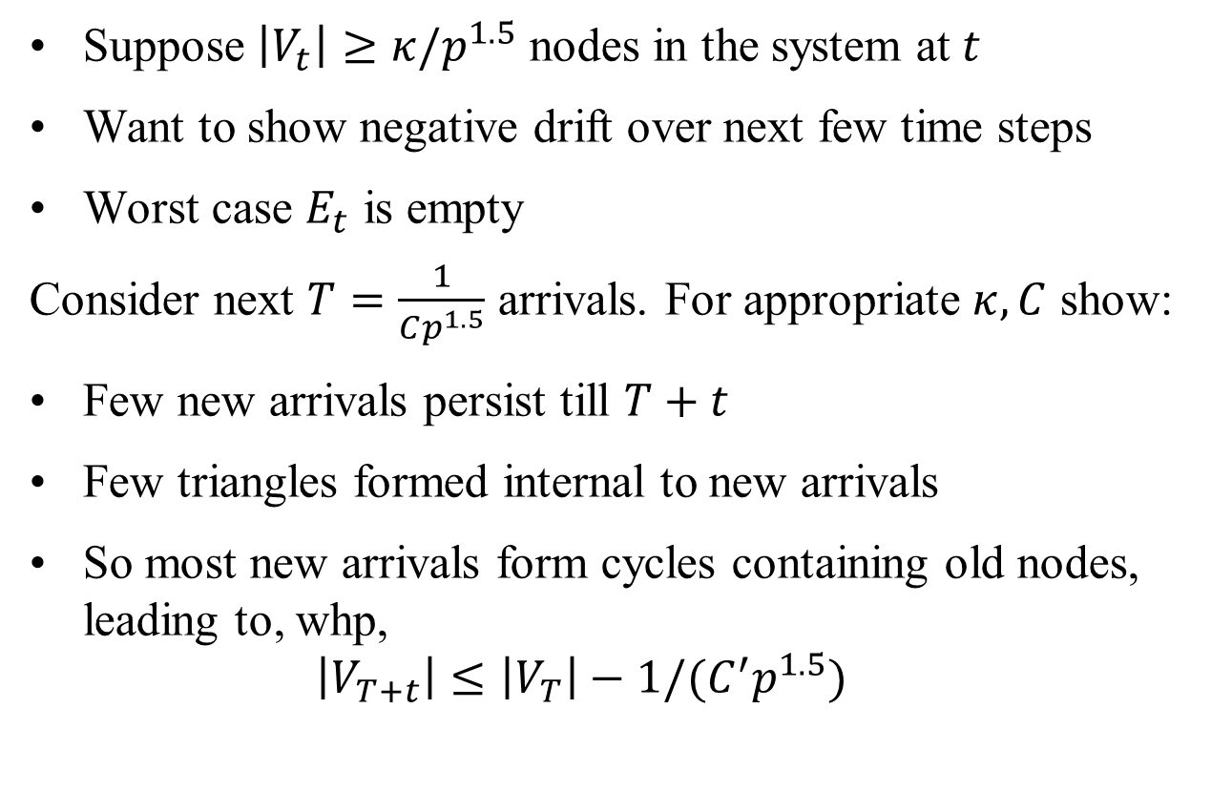
Proof idea: greedy is good
Suppose $\left|V_{t}\right|≥κ/p^{1.5}$ nodes in the system at $t$
Want to show negative drift over next few time steps
Worst case $E_{t}$ is empty
Consider next $T=\frac{1}{Cp^{1.5}}$ arrivals. For appropriate $κ, C$ show:
Few new arrivals persist till $T+t$
Few triangles formed internal to new arrivals
So most new arrivals form cycles containing old nodes, leading to, whp,
$\left|V_{T+t}\right|≤\left|V_{T}\right|−1/(C^{′}p^{1.5})$

Slide 21
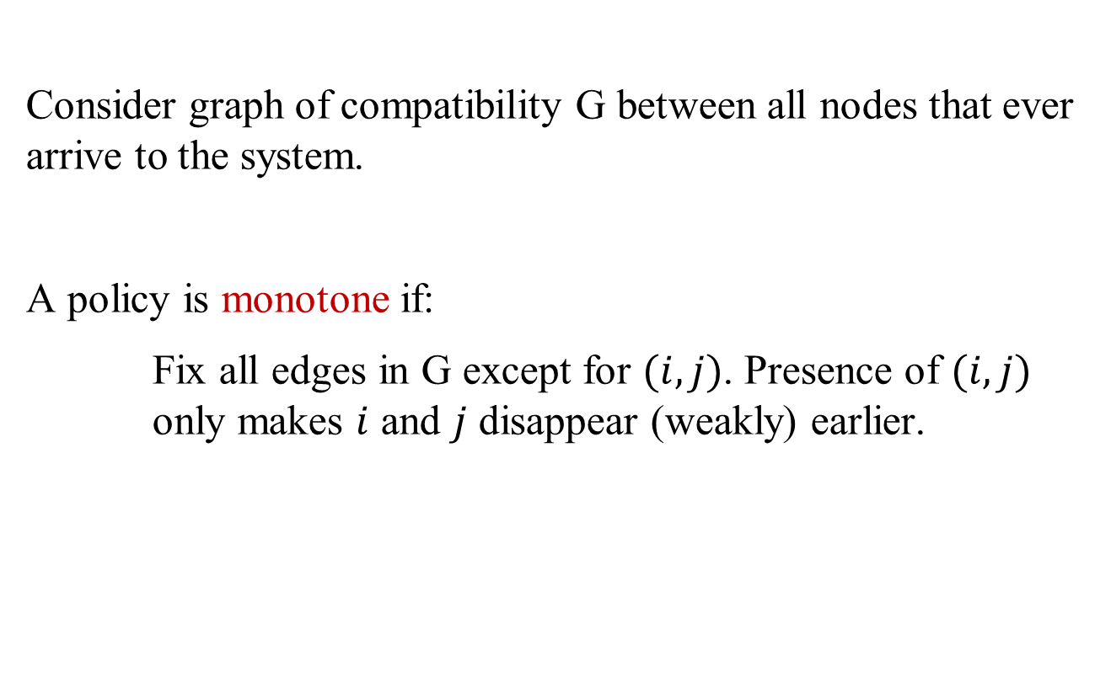
Definition: monotone policies
Consider graph of compatibility G between all nodes that ever arrive to the system.
A policy is monotone if:
Fix all edges in G except for $(i,j)$. Presence of $(i,j)$ only makes $i$ and $j$ disappear (weakly) earlier.

Slide 22
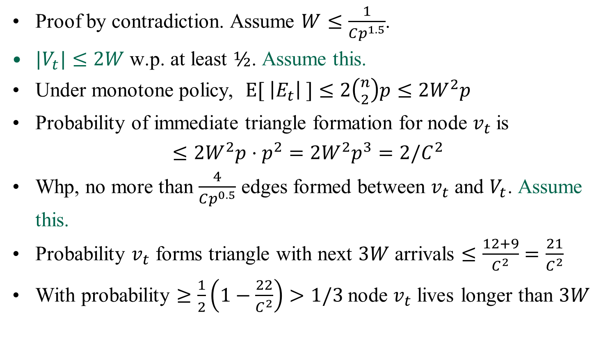
Proof that no monotone policy can beat greedy
Proof by contradiction. Assume $W≤\frac{1}{Cp^{1.5}}$.
$|V_{t}|≤2W$ w.p. at least $½$. Assume this.
Under monotone policy, $E[ \left|E_{t}\right| ]≤2\left({n \atop 2}\right)p≤{2W}^{2}p$
Probability of immediate triangle formation for node $v_{t}$ is
$$≤{2W}^{2}p⋅p^{2}={2W}^{2}p^{3}=2/C^{2}$$
Whp, no more than $\frac{4}{Cp^{0.5}}$ edges formed between $v_{t}$ and $V_{t}$. Assume this.
Probability $v_{t}$ forms triangle with next $3W$ arrivals $≤\frac{12+9}{C^{2}}=\frac{21}{C^{2}}$
With probability $≥\frac{1}{2}\left(1−\frac{22}{C^{2}}\right)>1/3$ node $v_{t}$ lives longer than $3W$

Slide 23
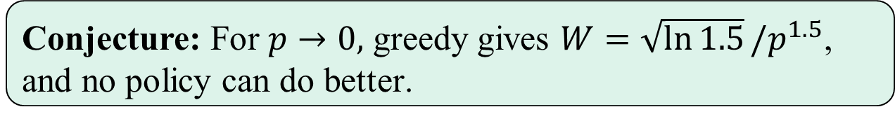
Conclusion
We analyzed a dynamic graph/graph structured queue:
showed that greedy is nearly optimal. Suggests that greedy should work well in kidney exchanges.
Caveats:
Greedy proved optimal only up to constant factors
Only consider monotone policies
Conjecture: For $p→0,$ greedy gives $W=\sqrt{\ln{1.5}}/p^{1.5}$,
and no policy can do better.

Slide 24
Future work
General result on ER-type graph structured queues with removal of given constant sized substructures?
Kidneys:
Multitype model with only some hard-to-match patients?
Can we do better than greedy?

Slide 25
Thank you!

Slide 26
Altruistic donors: cycles plus chains
Pair 1
Pair 4
Pair 3
Pair 5
Pair 2
Pair 6
Altruistic donor
Pair 7

Slide 27
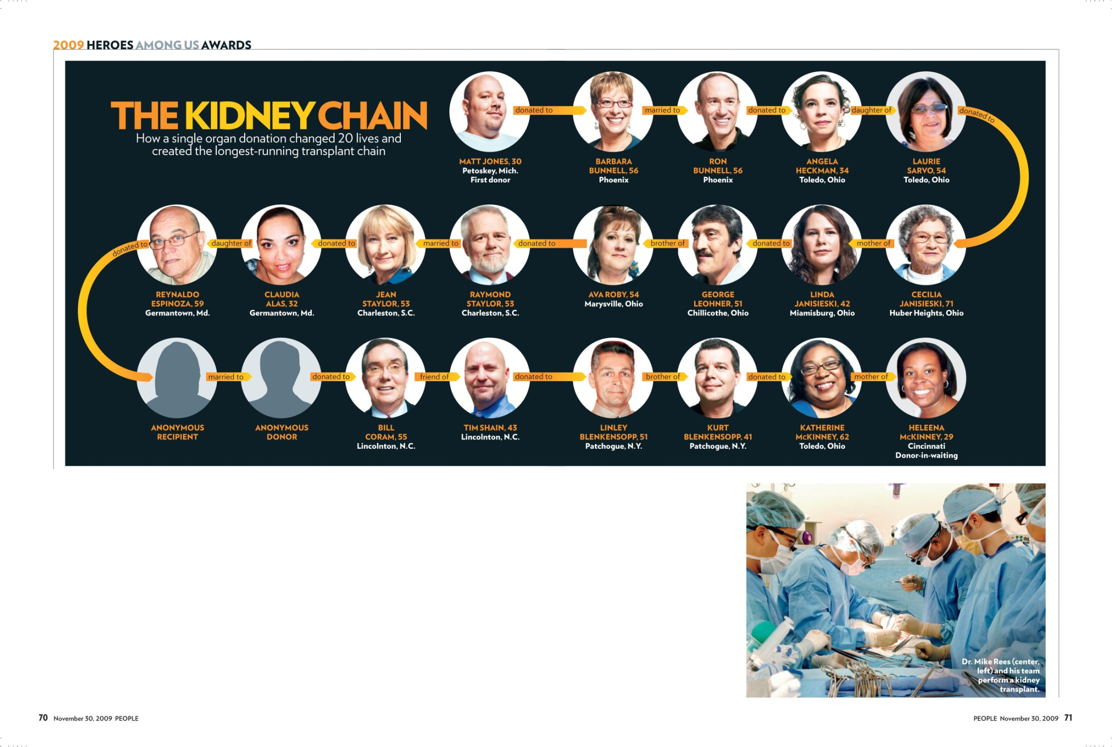

Slide 28
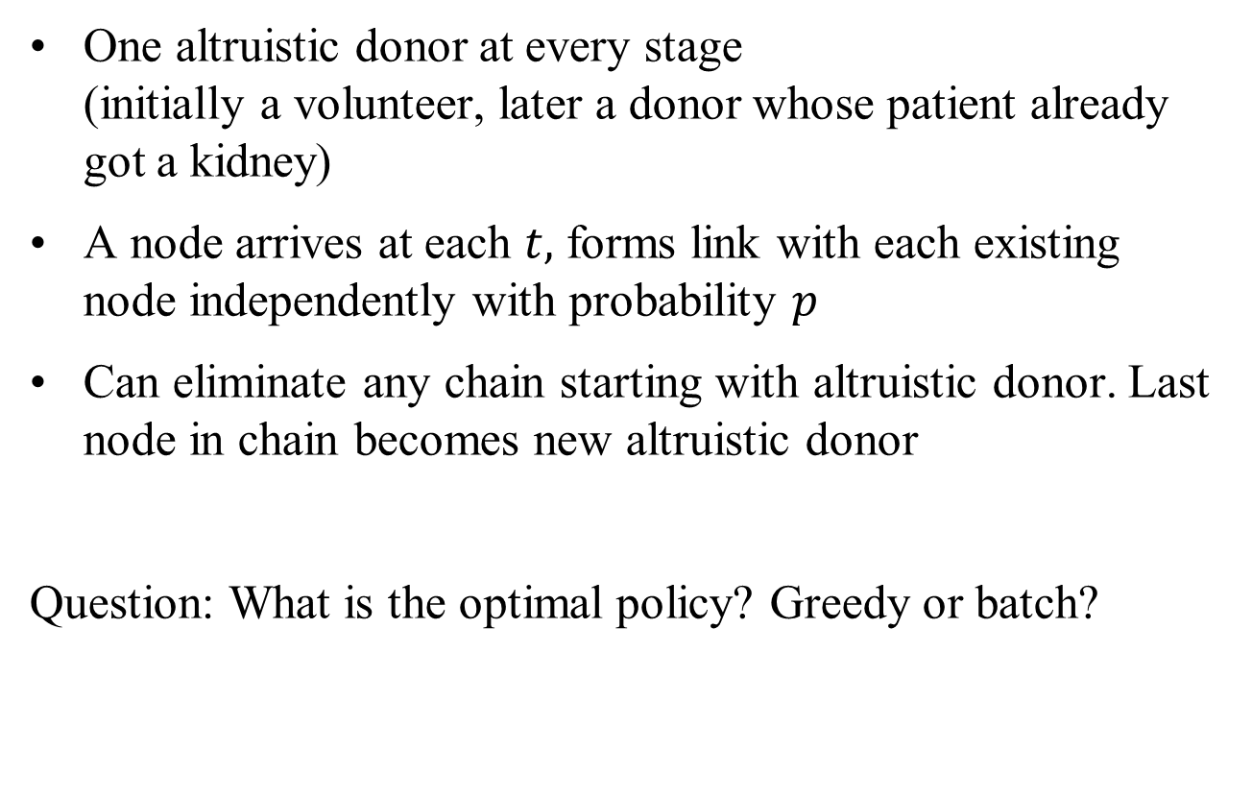
Model
One altruistic donor at every stage
(initially a volunteer, later a donor whose patient already got a kidney)
A node arrives at each $t,$ forms link with each existing node independently with probability $p$
Can eliminate any chain starting with altruistic donor. Last node in chain becomes new altruistic donor
Question: What is the optimal policy? Greedy or batch?

Slide 29
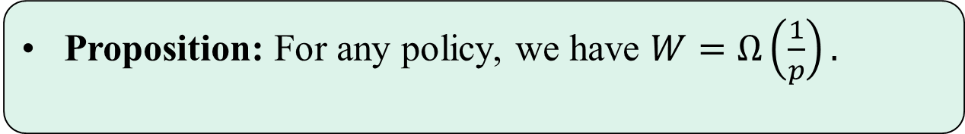

Lower bound
Proposition: For any policy, we have $W=Ω\left(\frac{1}{p}\right).$
Proof is simple: Takes time $Geometric(1/p)$ to form outgoing edge from

Slide 30
Batch produces matching upper bound
d

Slide 31
Ongoing work: what about greedy?

Slide 32
Future work

Slide 33
Altruistic donors: cycles plus chains
Pair 1
Pair 4
Pair 3
Pair 5
Pair 2
Pair 6
Altruistic donor
Pair 7

Slide 34
What are the design issues?
Initial design efforts were for startup kidney exchange
  Focused on individual surgeons and their patients (Roth et al.)
Now, hospitals have become players
  Withholding easy to match pairs (Ashlagi et al. 2011)
Result: patient-donor pools presently consist of hard to match pairs
In this environment, non-simultaneous chains become increasingly important (this talk)
Kidney exchange over time and space - waiting and pooling (this talk)

Slide 35
Factors determining transplant opportunity
O
Blood compatibility
So type O patients are at a disadvantage in finding compatible kidneys—they can only receive O kidneys.
And type O donors will be in short supply.
Tissue type compatibility. Percentage reactive antibodies (PRA)
    Low sensitivity patients (PRA < 79)
    High sensitivity patients (80 < PRA < 100)
A
B
AB

Slide 36
A. Patient ABO Blood Type | Frequency
O | 48.14%
A | 33.73%
B | 14.28%
AB | 3.85%
B. Patient Gender | Frequency
Female | 40.90%
Male | 59.10%
C. Unrelated Living Donors | Frequency
Spouse | 48.97%
Other | 51.03%
D. PRA Distribution | Frequency
Low PRA | 70.19%
Medium PRA | 20.00%
High PRA | 9.81%

Slide 37
Previous efficiency results
In a really large market efficiency is gained with short cycles:
Roth, Sonmez & Ünver, AER 2007 – if there are no tissue type incompatibilities, no need for exchanges of size >4
Ünver, ReStud 2009 - efficient dynamic kidney exchange assuming no tissue type incompatibilities - exchanges of size > 4 are not needed
Ashlagi & Roth 2010, in large random exchange pools, no need for exchanges of size>3
Toulis and Parkes 2011, similar results

Slide 38
Random Compatibility Graphs
n hospitals, each of a size c>0
D(n) - random compatibility graph:
n pairs/nodes are randomized –compatible pairs are disregarded
Edges (crossmatches) are randomized
Random graphs will allow us to ask two related questions:
What would efficient matches look like in an “ideal” large world?

Slide 39

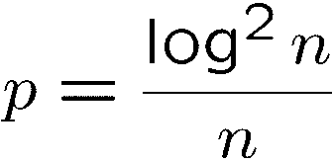
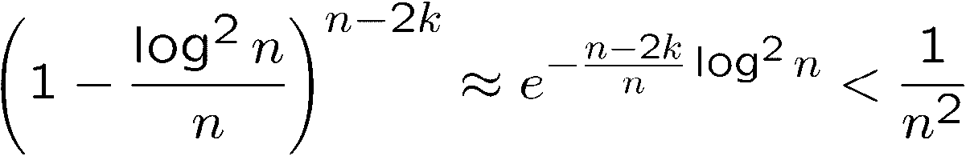
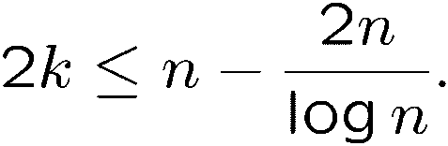
Matchings in random graphs
- Random graph on n nodes with edge probability p
Theorem (Erdos-Renyi) G(n,p) contains a perfect matching with probability approaching 1 as n grows for even n when p>log n/n.
“Proof”: Say . Use Use greedy algorithm. Probability of failure in step k is
As long as Probability of failure at any step is

Slide 40
Efficiency in a large pool
Theorem (Ashlagi and Roth, 2011): In almost every large random graph (directed edges are created with probability p) there is an efficient allocation with exchanges of size at most 3.
O-O
A-A
B-A
B-B
AB-AB
AB-B
AB-A
A-O B-O
AB-O
A-B
  V_{A-B}
B-AB A-AB
O-B
O-A
O-AB
“Under-demanded” pairs

Slide 41
Non-simultaneous extended altruistic donor chains (reduced risk from a broken link)
Since non-directed donor chains don’t require simultaneity, they can be longer…

Slide 42
The First NEAD Chain (Rees, APD)
July
July
Sept
Sept
Feb
Feb
Feb
Feb
March
March
2007
2007
2007
2007
2008
2008
2008
2008
2008
2008
MI
AZ
OH
OH
OH
MD
MD
MD
NC
MD
OH
1
2
3
4
5
6
7
8
9
10
O
O
A
A
B
A
A
A
AB
A
AB
O
O
A
A
B
A
#
A
A
A
*
A
Recipient PRA
62
0
23
0
100
78
64
3
100
46
Recipient Ethnicity
Cauc
Cauc
Cauc
Cauc
Cauc
Hisp
Cauc
Cauc
Cauc
AA
Relationship
Husband
Wife
Mother
Daughter
Daughter
Mother
Sister
Brother
Wife
Husband
Father
Daughter
Husband
Wife
Friend
Friend
Brother
Brother
Daughter
Mother
* This recipient required desensitization to Blood Group (AHG Titer of 1/8).
# This recipient required desensitization to HLA DSA by T and B cell flow cytometry.

Slide 44
Are NEAD chains effective?
In a really large market efficiency is gained with short cycles…

Slide 45
Efficiency in a large pool
O-O
A-A
B-A
B-B
AB-AB
AB-B
AB-A
A-O B-O
AB-O
A-B
  V_{A-B}
B-AB A-AB
O-B
O-A
O-AB
altruistic donor
An altruistic donor can increase the match size by at most 3

Slide 46
A disconnect between model and data:
The large graph model with constant p (for each kind of patient-donor pair) predicts that only short chains are useful.
But we now see long chains in practice.
They could be inefficient—i.e. competing with short cycles for the same transplants.
But this isn’t the the case when we examine the data.

Slide 47
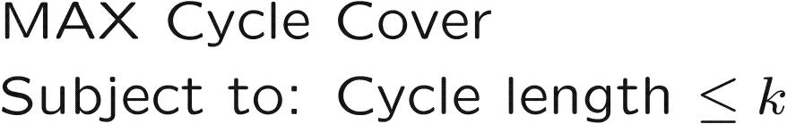
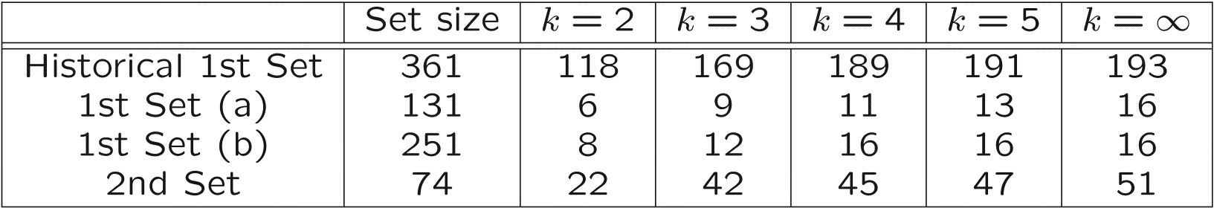
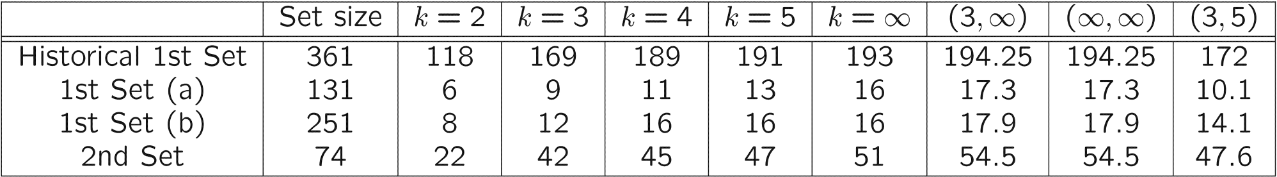
Long cycles and altruistic donors help!
We have formulated and solved on real data
One donor added

Slide 48
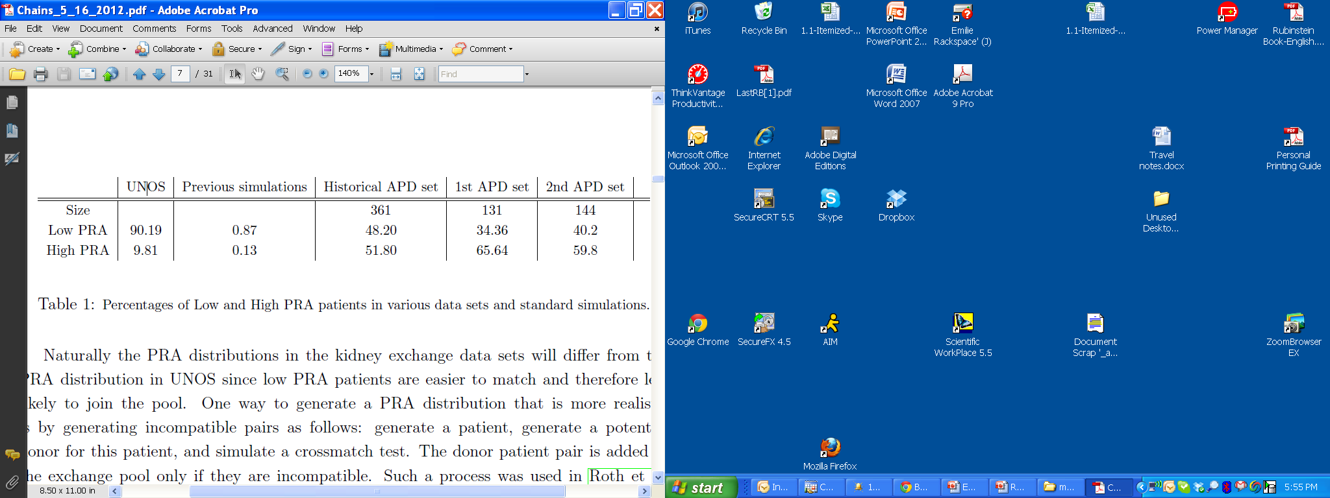
Why? many very highly sensitized patients
Previous simulations: sample a patient and donor from the general population, discard if compatible (simple live transplant), keep if incompatible. This yields 13% High PRA.
The much higher observed percentage of high PRA patients means compatibility graphs will be sparse

Slide 49
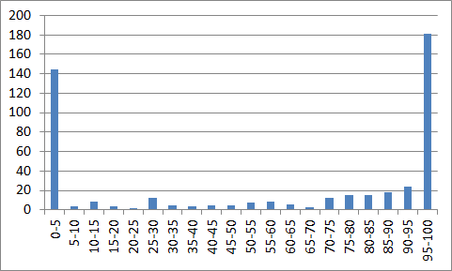
PRA distribution in historical data
PRA – “probability” for a patient to pass a cross-match test (tissue type) with a random donor

Slide 50
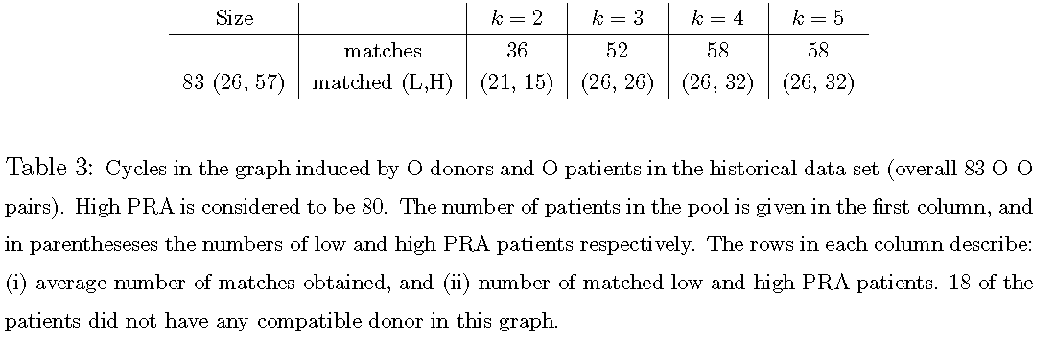
Short cycles leave many highly sensitized patients unmatched

Slide 51
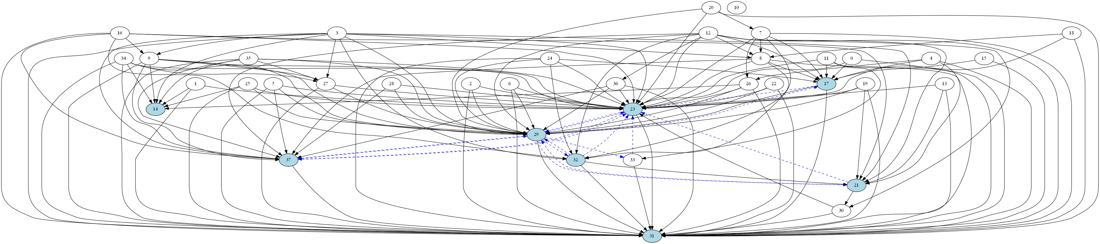
A real graph
Graph induced by pairs with A patients and A donors 38 pairs, only 5 can be covered by some cycle

Slide 52
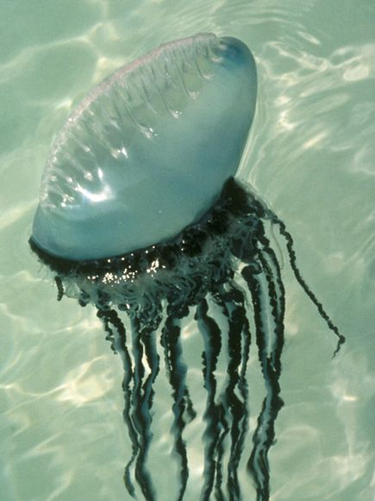
Jellyfish structure of the compatibility graph: highly connected low sensitized pairs, sparse hi-sensitized pairs

Slide 53
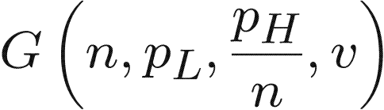


Cycles and paths in random dense-sparse graphs
n nodes. Each node is L w.p. q<1/2 and H w.p. 1-q
incoming edges to L are drawn w.p.
incoming edges to L are drawn w.p.
L
H

Slide 54
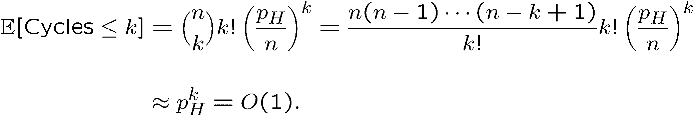
Cycles and paths in random sparse (sub)graphs (v=0, only highly sensitized patients)
Theorem.
The number of cycles of length O(1) is O(1).
But when p_{H} is a large constant there is cycle with length O(n)
“Proof” (a):
H
To be logistically feasible, a long cycle must be a chain, i.e. contain a NDD

Slide 55
Cycles and paths in random sparse graphs (v=0)
Theorem.
The number of cycles of length O(1) is O(1).
But when p_{H} is a large constant there is path with length O(n)
Since cycles need to be short (as they need to be conducted simultaneously) but chains can be long (as they can be initiated by an altruistic donor,) the value of a non-directed donor is very large!
H

Slide 56
Case v>0. Why increasing cycle bound helps?
Theorem. Let C_{k} be the largest number of transplants achievable with
cycles · k. Let D_{k} be the largest number of transplants achievable with
cycles · k plus one altruistic donor. Then for every constant k there exists ½>0
Furthermore, C_{k} and D_{k} cover almost all L nodes.
L
H

Slide 57
Some more on random graphs
Fact: in almost every random directed random graph D(n,c/n) every tree of constant size appears linearly many times and there are no constant size cycles
Lemma: Let p(n)=c/n. Almost every random bipartite graph G(qn,(1-q)n,p(n)) has a maximum matching of a linear size z(c,q)qn, 0<z(c,q)<1
qn nodes
(1-À)n nodes

Slide 58

$$C_{k+1}≥C_{k}+ρn+o(n)$$
Definition: u,v₁,v₂,…,v_{k} is a good cycle if:
u is L and all other nodes are H
the only L node that has an edge to v₁,v₂,…,v_{k} is u
the only H node that u has an edge to is v₁
No edges from v₁,v₂,…,v_{k} to other H nodes
No edges from v₂,…,v_{k} to u
L
u
v₁
H
v₃
v₂
Claim: there are linearly many good cycles of length k+1

Slide 59
$$C_{k+1}≥C_{k}+ρn+o(n)$$
Claim: there are linearly many good cycles of length k+1
Step 1: there are linearly many isolated paths of length k in the H graph
L
k=3
H

Slide 60
$$C_{k+1}≥C_{k}+ρn+o(n)$$
Claim: there are linearly many good cycles of length k+1
Step 1: there are linearly many isolated paths of length k in the H graph
L
k=3
H

Slide 61
$$C_{k+1}≥C_{k}+ρn+o(n)$$
Claim: there are linearly many good cycles of length k+1
Step 1: there are linearly many isolated paths of length k in the H graph
Step 2: find maximum number of disjoint edges from L to beginnings of paths
L
k=3
H

Slide 62
$$C_{k+1}≥C_{k}+ρn+o(n)$$
Claim: there are linearly many good cycles of length k+1
Step 1: there are linearly many isolated paths of length k in the H graph
Step 2: find maximum number of disjoint edges from L to beginnings of paths
L
k=3
H

Slide 63
$$C_{k+1}≥C_{k}+ρn+o(n)$$
Claim: there are linearly many good cycles of length k+1
Step 1: there are linearly many isolated paths of length k in the H graph
Step 2: find maximum number of disjoint edges from L to beginnings of paths
Step 3: there is a linear number of edges that close good cycles from the last nodes of the established paths
L
k=3
H

Slide 64
$$C_{k+1}≥C_{k}+ρn+o(n)$$
Claim: there are linearly many good cycles of length k+1
Step 1: there are linearly many isolated paths of length k in the H graph
Step 2: find maximum number of disjoint edges from L to beginnings of paths
Step 3: there is a linear number of edges that close good cycles from the last nodes of the established paths
L
k=3
H

Slide 65
$$C_{k+1}≥C_{k}+ρn+o(n)$$
So far: linearly many good cycles of length k+1
Final step: Start from an allocation Q_{k} and construct from it a Q_{k+1}
allocation that adds a linear term (using the good cycles of length k+1)
L
k=3
H

Slide 66
$$C_{k+1}≥C_{k}+ρn+o(n)$$
So far: linearly many good cycles of length k+1
Final step: Start from an allocation Q_{k} and construct from it a Q_{k+1}
allocation that adds a linear term (using the good cycles of length k+1)
Add a good cycle if it is disjoint from Q_{k} or delete the cycle that contains u in Q_{k} and add it …
L
u
k=3
v₁
v₂
H
v₃

Slide 67
$$C_{k+1}≥C_{k}+ρn+o(n)$$
So far: linearly many good cycles of length k+1
Final step: Start from an allocation Q_{k} and construct from it a Q_{k+1}
allocation that adds a linear term (using the good cycles of length k+1)
Add a good cycle if it is disjoint from Q_{k} or delete the cycle that contains u in Q_{k} and add it …
L
u
k=3
v₁
v₂
H
v₃

Slide 68
$$C_{k+1}≥C_{k}+ρn+o(n)$$
So far: linearly many good cycles of length k+1
Final step: Start from an allocation Q_{k} and construct from it a Q_{k+1}
allocation that adds a linear term (using the good cycles of length k+1)
Add a good cycle if it is disjoint from Q_{k} or delete the cycle that contains u in Q_{k} and add it …
L
u
k=3
v₁
v₂
H
v₃

Slide 69
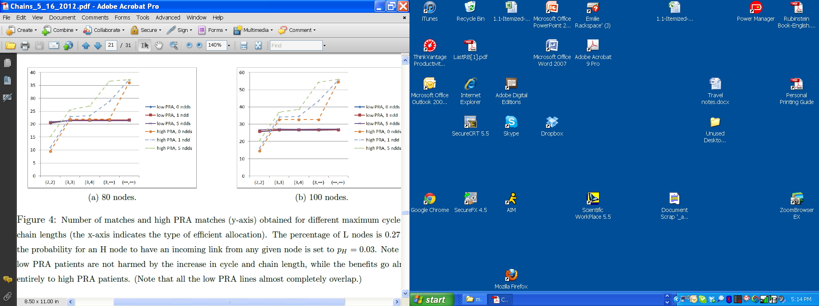
Long chains benefit highly sensitized patients (without harming low-sensitized patients)

Slide 70

NYTimes February 18, 2012. 60 lives, 30 kidneys

Slide 71
What about dynamics?
What is the tradeoff between waiting and number of matches?
Dynamic matching in dense graphs (Unver, ReStud,2010).

Slide 72
Matching over time
Simulation results using 2 year data from NKR*
Matches
In order to gain in current pools, we need to wait probably “too” long
*On average 1 pair every 2 days arrived over the two years

Slide 73
Matching over time
Simulation results using 2 year data from NKR*
Matches – high PRA
In order to gain in current pools, we need to wait probably “too” long
*On average 1 pair every 2 days arrived over the two years

Slide 74
Matching over time
Simulation results using 2 year data from NKR*
In order to gain in current pools, we need to wait probably “too” long
*On average 1 pair every 2 days arrived over the two years

Slide 75
Matching over time
Simulation results using 2 year data from NKR
*On average 1 pair every 2 days arrived over the two years

Slide 76
Match the pair right away?
A H-node forms an edge with each
node u of U with probability ξ/n.
A L-node forms an edge with each
node u of U with probability π
Online:
match the arrived node to a neighbor; remove cycles when formed.
Lemma: the online algorithm matches almost all pairs when p is a constant and n is large enough (even with just 2-way cycles)
Arriving pair
Either a sparse finite horizon model
or an infinite horizon model and analyze steady state
Notes:
Number of pairs in the pool at time t is more than i, drops exp with i

Slide 77
Dynamic matching in dense-sparse graphs
n nodes. Each node is L w.p. q<1/2 and H w.p. 1-q
incoming edges to L are drawn w.p.
incoming edges to L are drawn w.p.
L
H

Slide 78
Dynamic matching in dense-sparse graphs
n nodes. Each node is L w.p. q<1/2 and H w.p. 1-q
incoming edges to L are drawn w.p.
incoming edges to L are drawn w.p.
At each time step 1,2,…, n, one node arrives.
L
H

Slide 79
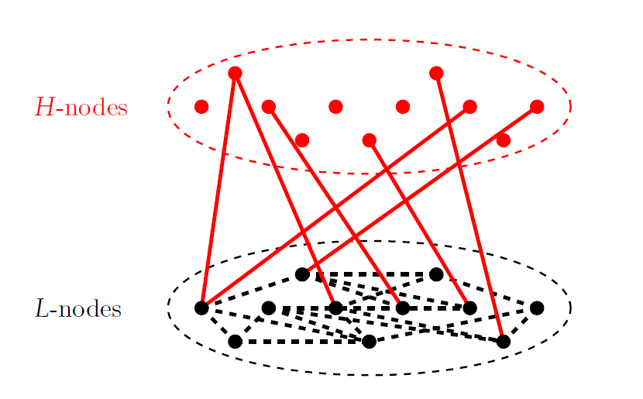

Heterogeneous Dynamic Model
(PRA).
PRA determines the likelihood that a patient cannot receive a kidney from a blood-type compatible donor.
PRA < 79: Low sensitivity patients (L-patients).
80 < PRA < 100: High sensitivity patients (H-patients).
  Most blood-type compatible pairs that join the pool have H-patients.
  Distribution of High PRA patients in the pool is different from the population PRA.
pc/n
$$p^{2}$$

Slide 80
  Chunk Matching in a heterogeneous graph
At time steps Δ, 2Δ, …, n:
Find maximum matching in H-L; remove the matched nodes.
Find maximum matching in L-L; remove the matched nodes.

Slide 81
  Chunk Matching in a heterogeneous graph
Chunk matching finds a maximum matching at time steps Δ, 2Δ, …, n.
M(Δ) - expected number of matched pairs at time n
.
Theorem (Ashlagi, Jalliet and Manshadi): When matching only 2-way or 2+3-way cycles:
1. If Δ = o(n),
M(Δ) = M(1) + o(n)
2. Δ = αn, then
M(Δ) = M(1) + f(q)n
for strictly increasing f()>0.

Slide 82

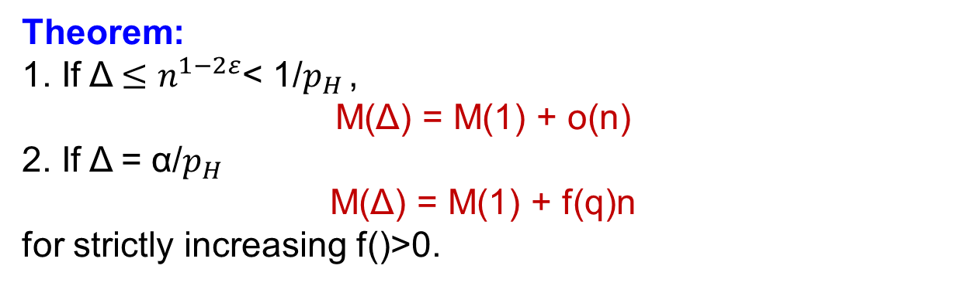
Denser Pools
$p_{H }=$ξ$n^{−1+ε}$:
Theorem:
1. If Δ $≤n^{1−2ε}$< 1/$p_{H }$,
M(Δ) = M(1) + o(n)
2. If Δ = α/$p_{H }$
M(Δ) = M(1) + f(q)n
for strictly increasing f()>0.
Need to wait less time to gain…
If the graph is dense (large) – no need to wait at all…

Slide 83
Proof Ideas
Special structure: Sparse H-L and dense L-L.
(PRA).
PRA determines the likelihood that a patient cannot receive a kidney from a blood-type compatible donor.
PRA < 79: Low sensitivity patients (L-patients).
80 < PRA < 100: High sensitivity patients (H-patients).
  Most blood-type compatible pairs that join the pool have H-patients.
  Distribution of High PRA patients in the pool is different from the population PRA.
Compare the number of H-L matchings.
pξ/n
$$p^{2}$$

Slide 84
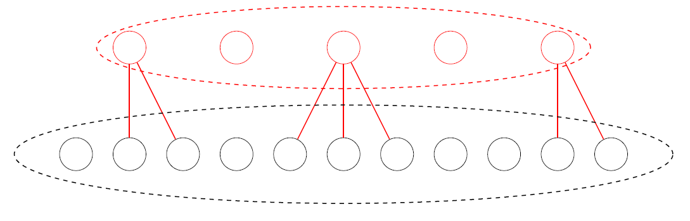
Proof Ideas
In H-L graph, Δ = o(n):
No edge in the residual graph.
Tissue-type compatibility: Percentage Reactive Antibodies (PRA).
PRA determines the likelihood that a patient cannot receive a kidney from a blood-type compatible donor.
PRA < 79: Low sensitivity patients (L-patients).
80 < PRA < 100: High sensitivity patients (H-patients).
  Most blood-type compatible pairs that join the pool have H-patients.
  Distribution of High PRA patients in the pool is different from the population PRA.
Decision of online and chunk matching are the same on depth-one trees. M(Δ) = M(1) + o(n).
arrived chunk
residual graph

Slide 85
Proof Ideas
In H-L graph, Δ = αn:
Find f(α)n augmenting paths to the matching obtained by online.
Given M the matching of the online scheme:
Chunk matching would choose
(l1,h1) and (l2,h2).
M(Δ) = M(1) + f(α)n,
h1
h2
l1
l2

Slide 86
  Chunk Matching in a heterogeneous graph
Chunk matching finds a maximum matching at time steps Δ, 2Δ, …, n.
M(Δ) - expected number of matched pairs at time n when matching only 2-ways
MC(Δ) - expected number of matched pairs at time n when matching 2-ways and allowing one unbounded chain
.
Theorem (Ashlagi, Jalliet and Manshadi):
MC(1) = M(1) + f(q)n

Slide 87
Merging NKR and APD

Slide 88
Merging KPD programs
Simple merge - pool only those that cannot match within each program
Individually rational merge – guarantee each KPD program to match the pairs it can internally match
Complete merge
* Data from SA, NKR, APD, and a Korean exchange (Historical data only from NKR and APD)

Slide 89
Conclusions
Current pools contain many highly sensitized patients and (long) chains are very effective.
(Partially since hospitals don’t share all their easy to match pairs.)
In those highly sensitized pools, number of matches increase significantly only when waiting “for a long” time between match runs -> use more chains!
Many more matches from pooling, especially highly sensitized patients.

Slide 90
Merging exchange programs
 | NKR | Korea | APD | Korea | SA | Korea | APD | NKR | APD | SA
pairs | 222 | 81 | 196 | 81 | 173 | 81 | 196 | 222 | 196 | 173
matched | 30 | 16 | 49 | 16 | 59 | 16 | 49 | 30 | 49 | 59
Average PRA | 61.9 | 7.1 | 57.8 | 7.1 | 59.1 | 7.1 | 57.8 | 61.9 | 57.8 | 59.1
PRA OD | 75 | 43 | 85.6 | 43 | 75.2 | 43 | 85.6 | 75 | 85.6 | 75.2
Pairs | 192 | 65 | 147 | 65 | 114 | 65 | 147 | 192 | 147 | 114
matched | 6,6 | 4,5 | 4,8 | 3,7 | 0,5 | 0,1 | 0,13 | 0,15 | 2,13 | 4,22
PRA>80 | 5,5 | 1,1 | 3,6 | 0,0 | 0,5 | 0,0 | 0,11 | 0,9 | 2,11 | 2,18
OD | 4,4 | 1,1 | 1,4 | 0,0 | 0,5 | 0,0 | 0,9 | 0,8 | 2,9 | 2,15
O donors | 2,2 | 0,0 | 1,4 | 0,0 | 0,3 | 0,0 | 0,8 | 0,6 | 2,9 | 1,9
PRA OD | 95,95 | 97,97 | 100,96.8 | -,- | -,98.8 | -,- | -,97.7 | -,96.8 | 100,97.9 | 97.5,97.3

Slide 91
Kidney exchange is progressing, but progress is still slow☹
 | 2000 | 2001 | 2002 | 2003 | 2004 | 2005 | 2006 | 2007 | 2008 | 2009 | 2010
#Kidney exchange transplants in US* | 2 | 4 | 6 | 19 | 34 | 27 | 74 | 121 | 240 | 304 | 422 (+203 +139)*
Deceased donor waiting list (active + inactive) in thousands | 54 | 56 | 59 | 61 | 65 | 68 | 73 | 78 | 83 | 88 | 89.9
In 2011: 11,043 transplants from deceased donors
5,769 transplants from living donors
s
*http://optn.transplant.hrsa.gov/latestData/rptData.asp Living Donor Transplants By Donor Relation
UNOS 2010: Paired exchange + anonymous (ndd?) + list exchange

