Slide 1
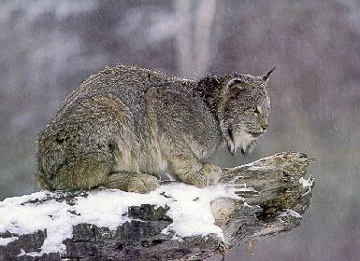
Anatomy of a population cycle:
A case study using Canada lynx
Dennis Murray
Trent University

Slide 2




Collaborators
S. Abele (TNC)
A. Borlestean (Trent U.)
J. Bowman (OMNR)
S. Boutin (U. Alberta)
K. Chan (Trent U.)
R. Gau (NWTG)
C. Krebs (UBC)
M. O’Donoghue (YTG)
J. Roth (U. Manitoba)
J. Row (Trent U.)
T. Steury (Trent U.)
C. Szumski (U. Manitoba / Trent U.)
D. Thornton (Trent U.)
P. Wilson (Trent U.)
A. Wirsing (U. Washington)

Slide 3
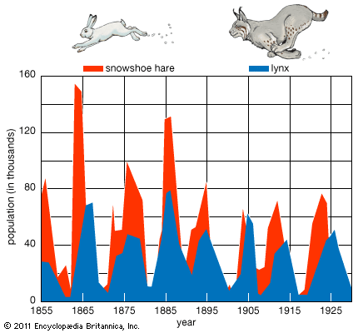
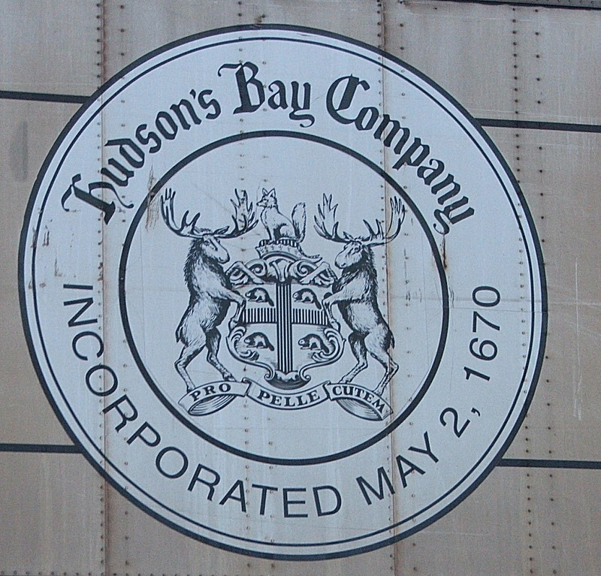
The lynx-hare population cycle

Slide 4
More recent lynx harvest statistics
Lynx numbers
Harvest statistics continue to be collected and reveal high spatio-temporal variability.
Differentiating between signal vs. noise remains challenging

Slide 5
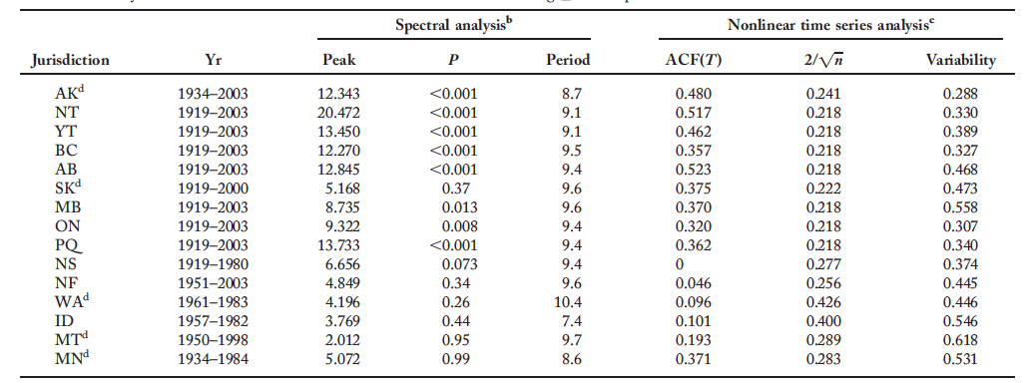
Cyclic propensity in lynx harvest time series
Murray et al (2008)
Most northern populations are cyclic, southern populations are less likely to cycle
All cyclic populations exhibit 9-10 year periodicity
Population variability is higher in the southern range

Slide 6
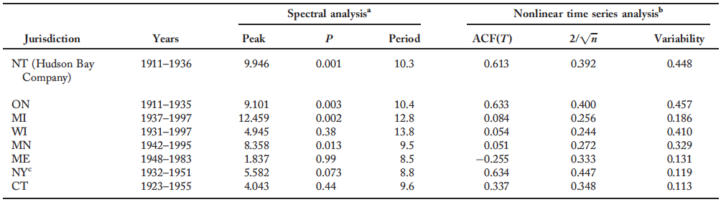
Cyclic propensity in hare harvest time series
Murray et al (2008)
Northern snowshoe hare populations are cyclic
Cyclic populations exhibit 9-13 year periodicity
Southern hare populations have dampened fluctuations

Slide 7
Lynx and hare densities are closely associated
Field studies reveal a close association between lynx and hare numbers
Steury & Murray (2004)

Slide 8
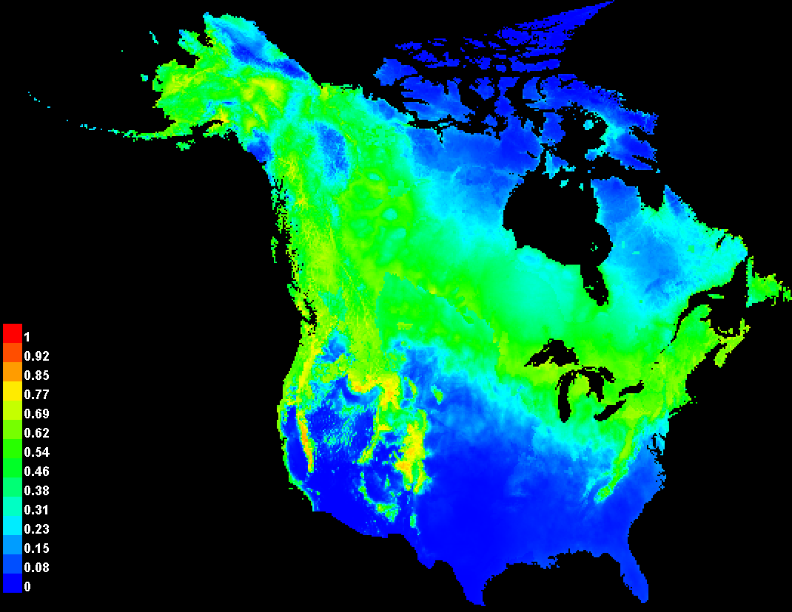
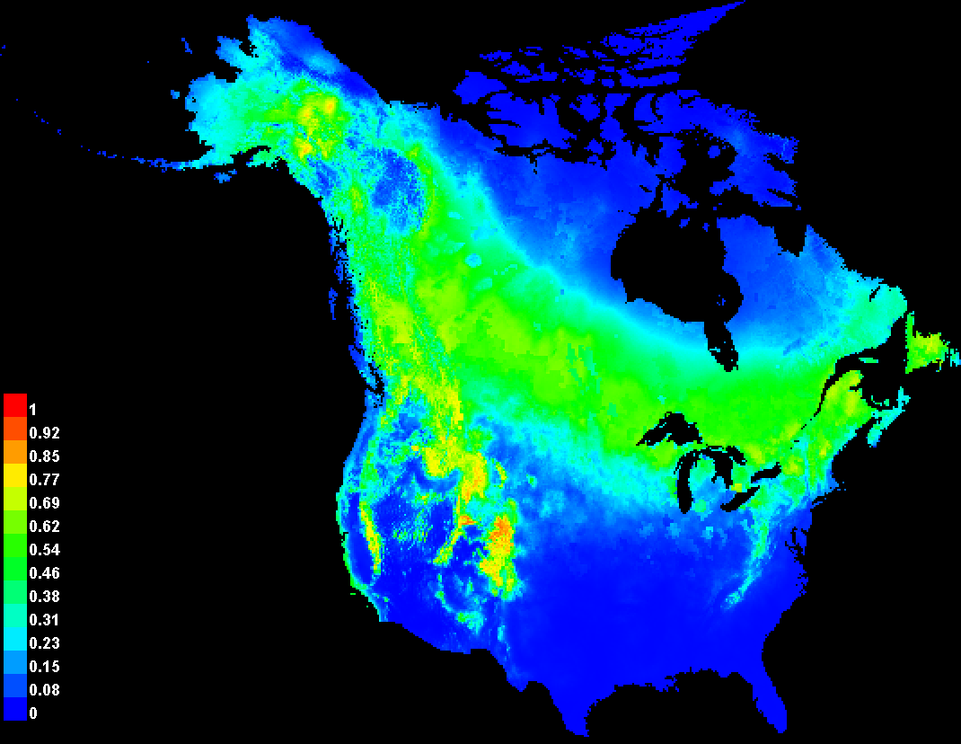
Lynx and hare distributions are closely matched
Snowshoe hare Canada lynx
M. M. Wehtje (unpubl) Peers et al (2012)

Slide 9
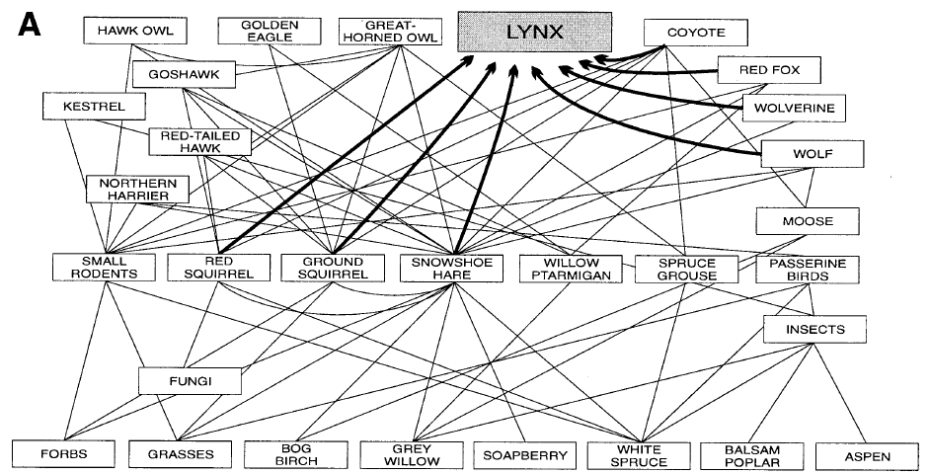
Trophic interactions in the boreal forest
Stenseth et al (1997)

Slide 10
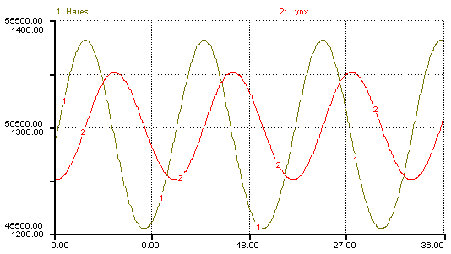


Do alternate prey stabilize
predator-prey population cycles?
Hare
Lynx

Slide 11
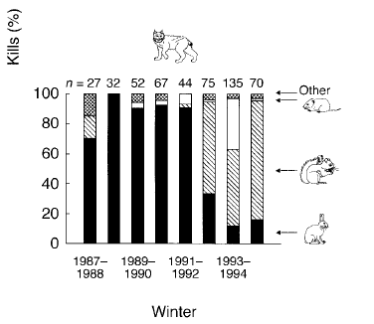
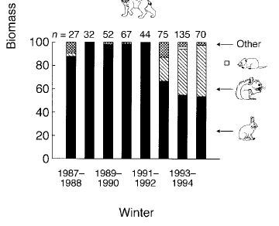

Lynx diet through a population cycle
Kills (%)
Biomass (%)
O’Donoghue et al. (1998)
At increasing/high hare densities, lynx eat mainly hares
At low hare densities, almost 50% of lynx prey biomass is red squirrel

Slide 12
Lynx prey have distinct isotopic signatures
Roth et al. (2007)

Slide 13
Lynx have distinct isotopic signatures
across portions of their range
N15
C13
C13 is higher in southwestern range, indicating a generalized diet
Roth et al. (2007)

Slide 14
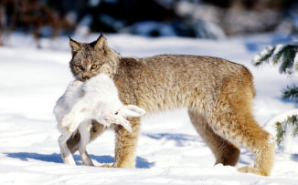
Lynx diet influences cyclic amplitude
Lynx populations have a higher cyclic propensity when they rely heavily on snowshoe hares
Roth et al. (2007)

Slide 15
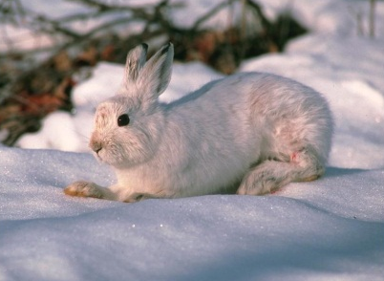
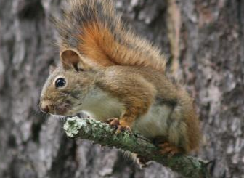
Snowshoe hare in diet
drives higher lynx recruitment
P_{1-tailed} = 0.04
R² = 0.86
P_{1-tailed} = 0.04
R² = 0.86
Prop. juveniles in harvest
Diet specialization
C. Szumski (unpubl)

Slide 16
LV model including alternate prey
dN₁/dt = r₁ N₁ (1 – N₁ / k₁) – P f₁ (N₁) – δ₁ N₁ (Hare)
dN₂/dt = r₂ N₂ (1 – N₂ / k₂) – P f₂ (N₂) - δ₂ N₂ (Squirrel)
dP/dt = P (Χ₁ • f₁ (N₁) + Χ₂ • f₂ (N₂) - δ_{p} ) (Lynx)
where,
N : prey numbers (1 = hare; 2 = squirrel)
P : lynx numbers
r : rate of increase
k : carrying capacity
f : functional response
δ : death rate
Χ : conversion efficiency

Slide 17
Lynx-Hare functional response
K. Chan (unpubl.)

Slide 18
Lynx-Squirrel functional response
K. Chan (unpubl.)

Slide 19
Revised Lynx-Squirrel functional response
K. Chan (unpubl.)

Slide 20
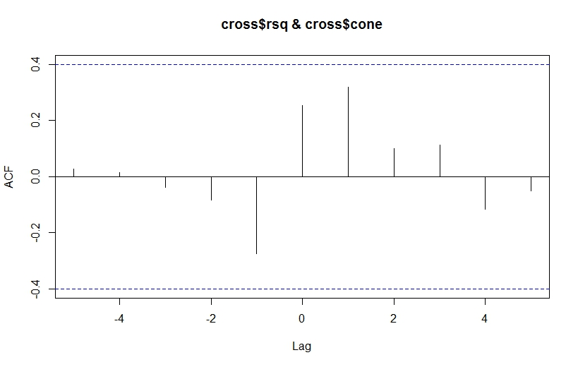
Correlation between squirrel numbers and mast crop
Cones
Squirrels
S. Boutin (unpubl.)
time lag =
1 year
Notes:
Red squirrel densities and cone crop densities showing a lagged cross correlation.

Slide 21
Revised model
dN₁/dt = r₁ N₁ (1 – N₁ / k₁) – P f₁ (N₁) – δ₁ N₁ (Hare)
dN₂/dt = r₂ N₂ (1 – N₂ / k₂) – P f₂ (N₁) - δ₂ N₂ + ε (Squirrel)
dP/dt = P (Χ₁ • f₁ (N₁) + Χ₂ • f₂ (N₁) - δ_{p} ) (Lynx)
The revised model forces the lynx-squirrel functional response to reflect change in hare rather than change in squirrel densities.
Because squirrels are influenced by annual cone crop, stochasticity was included.

Slide 22
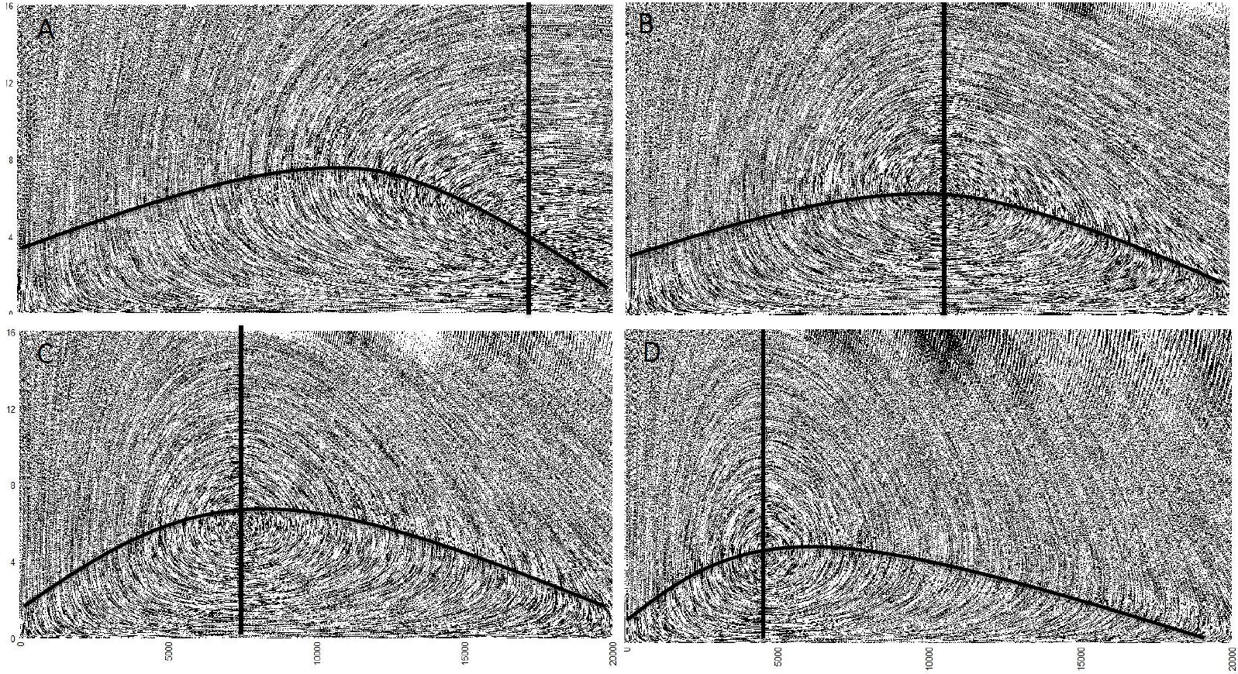
Rosenzweig-Macarthur model
Prey
Predator
As the prey isocline shifts to the left, the system becomes increasingly unstable.
Notes:
This just shows that as the predator isocline is moved to the left that the system becomes increasingly unstable.

Slide 23
Increased instability when squirrels are included
Squirrel
No Squirrel
Alternate prey consistently destabilize predator-prey cycles by moving the prey isocline to the left, not right
Hares per 100 km2
K. Chan (unpubl.)
Notes:
The addition of prey always leads to increased instability.

Slide 24
Simulations using case studies
Parameter | Hanski and Korpimaki 1995 | Messier et al. (2004) | Fryxell et al. 2007
r₁ | 5.4 y⁻¹ | 0.2 y⁻¹ | 0.10512 y⁻¹
k₁ | 100 N₁ | 2 N₁ | 49.6 N₁
c | 600 N⁻¹·P⁻¹·y⁻¹ | 12.3 N ·P⁻¹·y⁻¹ | 250.3 N⁻¹·P⁻¹·y⁻¹
h | 10 N₁ | 0.47 N₁ | 0.3 N₁
a | 1400 N₂·N₁⁻¹·P⁻¹·y⁻¹ | 25 N₂·N₁⁻¹·P⁻¹·y⁻¹ | 1199 N₂·N₁⁻¹·P⁻¹·y⁻¹
b | -2 N₂ | -1 N₂ | -8 N₂
χ₁ | 0.0047 N₁⁻¹ | 0.0141N₁⁻¹ | 0.0141N₁⁻¹
χ₂ | 0.002 N₂⁻¹ | 0.0134 N₂⁻¹ | 0.0134 N₂⁻¹
δ₁ | 0 y⁻¹ | 0.0856 y⁻¹ | 0 y⁻¹
δ_{p} | 7.49 y⁻¹ | 7.49 y⁻¹ | 24.28 y⁻¹
K. Chan (unpubl.)
Notes:
I’m not sure if you can decipher these I will have the manuscript for you hopefully Thursday. These are the case studies where I found equivalencies using other studies and their model parameters. I used voles and weasels from hanski, wolves and moose on isle royal (case study in Turchin book), and lions and wildebeest in the serengettii

Slide 25
Functional responses from case studies
beaver
moose
Case studies also reveal increased instability with alternate prey
K. Chan (unpubl.)
Notes:
I created hypothetical functional responses that had different rates of decline and different maximum capture rates. The voles I had the same maximum and it decreases about the same as the primary prey increases. The wolves I used beavers as the alternate prey and they have a much higher capture efficiency but it quickly drops if moose densities are high. The lion example I had a gradual slow decline with a maximum capture rate much lower than that of the wildebeest.
All the models show the same thing, that increasing increasing the half saturation point, the predator or primary prey morality rate and the inverse parameter constant b increased stability, where as all the other parameters decrease stability as they increase. This mostly has to do with the 4 factors identified in the other slide. Also as stated in another slide the addition of prey always decreases stability.

Slide 26
Increased numerical stability of lynx is driven by
Lowered capture efficiency of lynx on hare
    - Maybe the case in southern populations
Increased lynx mortality rate
  - Likely the case in southern populations
Increased in hare mortality rate
  - Likely the case in southern populations
Reduced carrying capacity of hares
  - Likely the case in southern populations

Slide 27
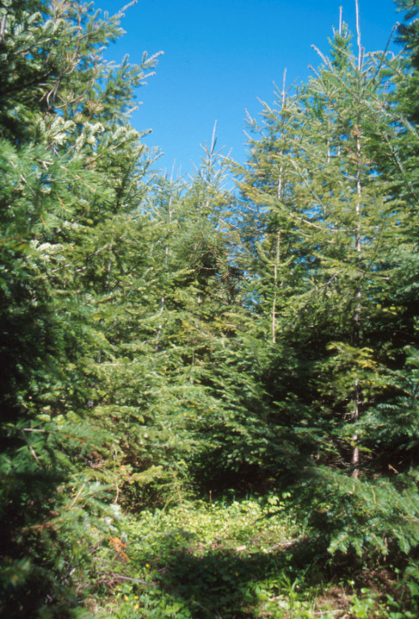
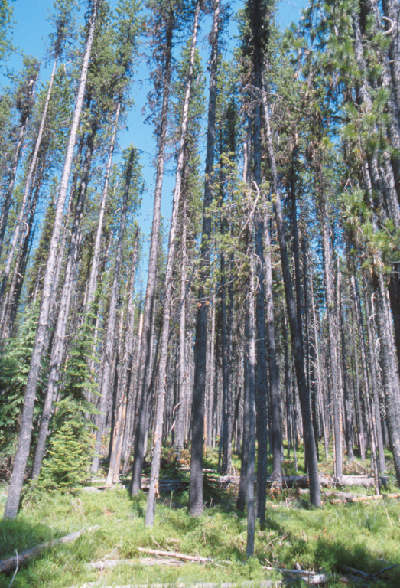
Southern snowshoe hares occupy variegated landscapes

Slide 28
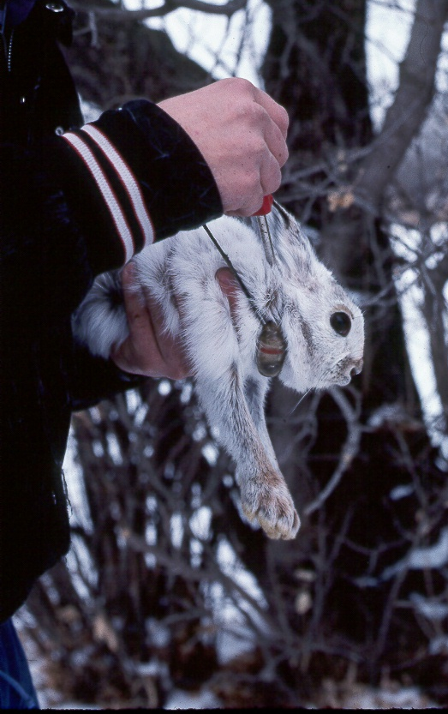
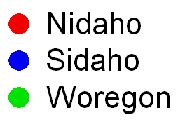
Evidence of density-dependent predation in southern hares
A. Wirsing (unpubl)

Slide 29


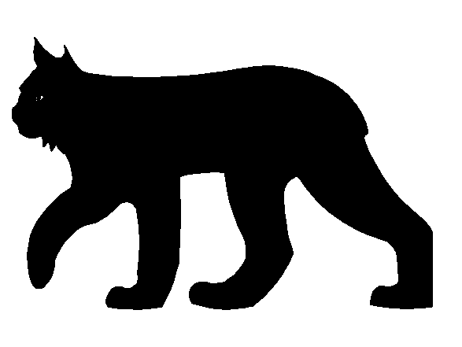
Density-dependent predation in southern hare populations

Slide 30
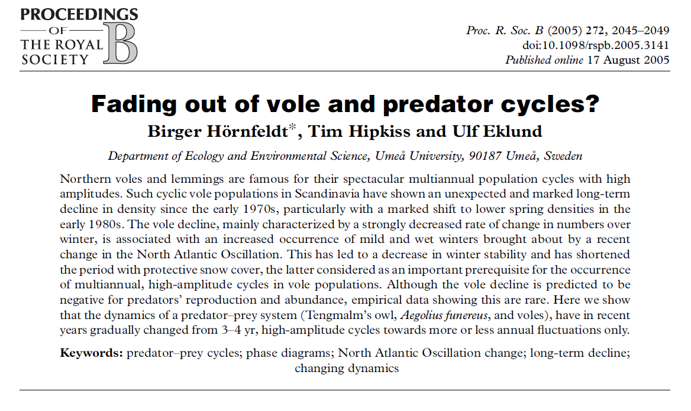
Cyclic attenuation in natural populations

Slide 31
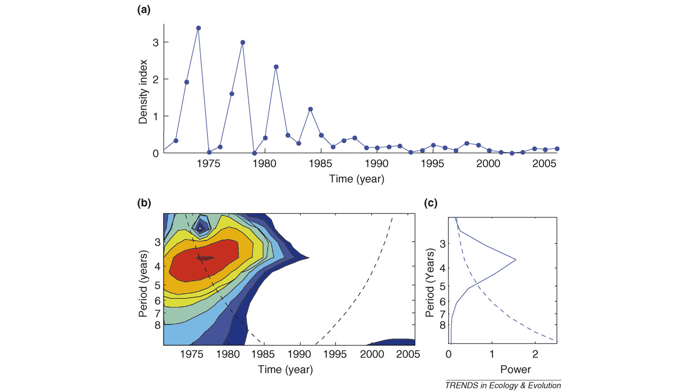
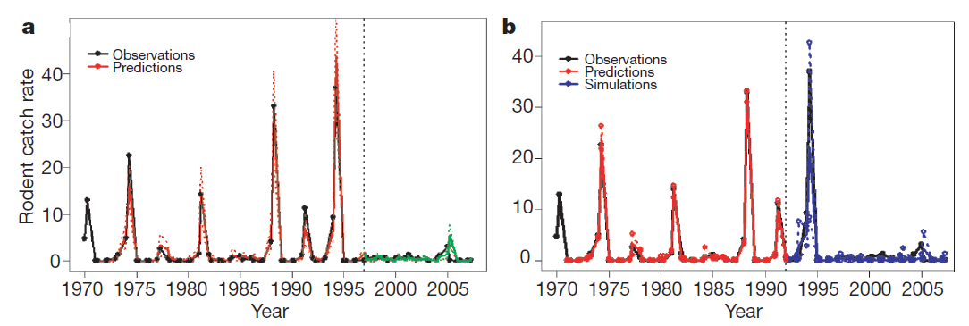
Cycle attenuation in Fenoscandian voles
Population cycles are becoming attenuated
Statistical detection of cyclic attenuation is challenging given data quality
Ims et al (2006)

Slide 32
Are lynx cycles attenuating?
Lynx numbers
Attenuation?
Robust statistical methods for detecting cyclic attenuation are lacking

Slide 33
Modeling cyclic attenuation in lynx
Climate change
Competition
Harvest regime
M. Hornseth (unpubl)

Slide 34
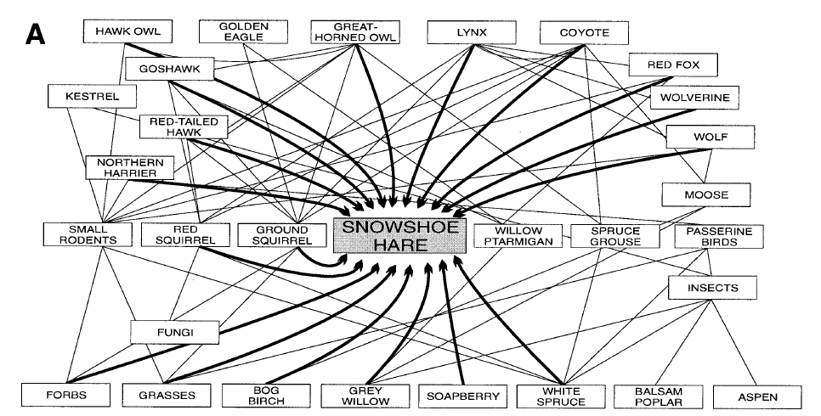
The snowshoe hare is the keystone
of the boreal forest ecosystem
Krebs (2011)

Slide 35
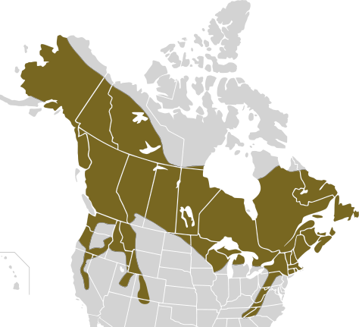
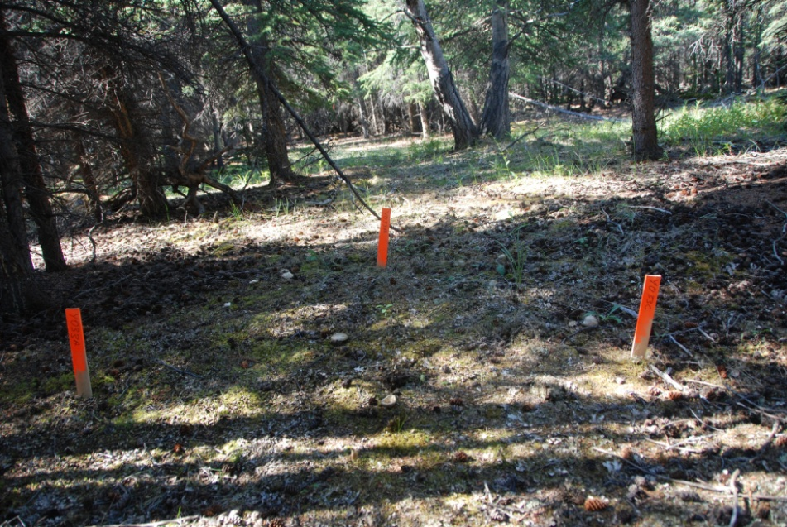
Robust field data are essential
for detecting attenuation
Are snowshoe hare population Are hare cycles collapsing?
Are hare populations becoming increasingly asynchronous?
.
.
.
.
.
.
.
.
.

Slide 36
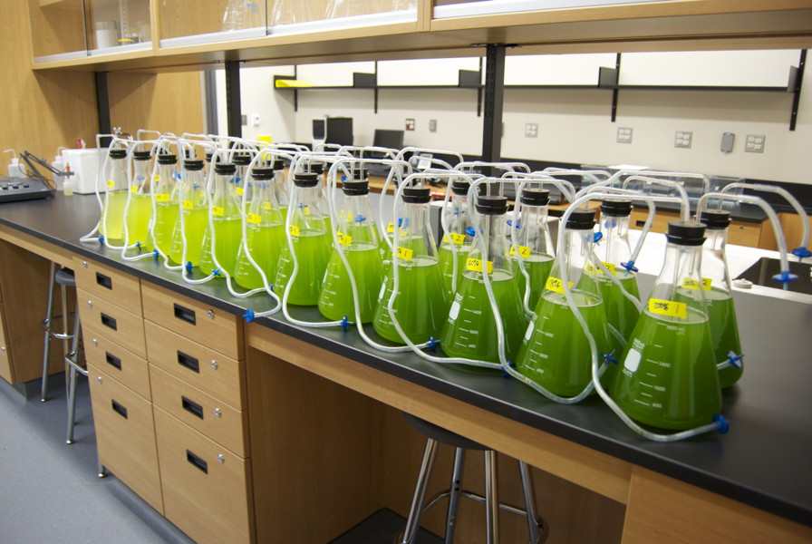
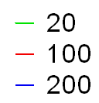
Model systems for understanding
cyclic attenuation
Model systems serve to develop a mechanistic understanding of density dependence and cyclic attenuation
A. Borlestean (unpubl)
A. Borlestean (unpubl)

Slide 37
Conclusion
Alternate prey destabilize predator-prey cycles
Southern lynx have lower cyclic propensity likely due to latitudinal changes in the lynx-hare relationship itself
Lynx population cycles may be attenuating due to factors like climate change, increased competition, and overharvest

Slide 38
Current needs & challenges in understanding population cycles
Good long-term empirical data (experimental and observational)
Clarity between statistical methods
Mechanistic & modeling studies
Methodology for detecting occurrence and underlying causes of cyclic attenuation

