Slide 1
BIRS – Geometry of Anatomy – Sept. ‘11
OODA of Tree Structured Objects
(e.g. Data on Stratified Manifolds)
J. S. Marron
Univ. of North Carolina, Statistics & O. R.
September 1, 2011

Slide 2

Special Thanks
OODA SAMSI Program
2010-2011
Led by Hans Georg Müller & Jane-Ling Wang
Many Active Participants & Fun Research

Slide 3
Object Oriented Data Analysis
What is the “atom” of a statistical analysis?
First Course: Numbers
Multivariate Analysis: Vectors
Functional Data Analysis: Curves
OODA: More Complicated Objects
  Images
  Movies
  Shapes
  Tree Structured Objects

Slide 4
Euclidean Data Spaces
Data are vectors, in
Effective (and Traditional) Analysis:
Linear Methods
Mean
Covariance
Principal Component Analysis
Gaussian Distribution

Slide 5
Euclidean Data Spaces
Data are vectors, in
Challenges:
High Dimension, Low Sample Size
(Classical Methods Fail)
Visualization:
  Find Structure (Expected & Unknown)
  Understand range of “normal cases”
  Find anomalies

Slide 6
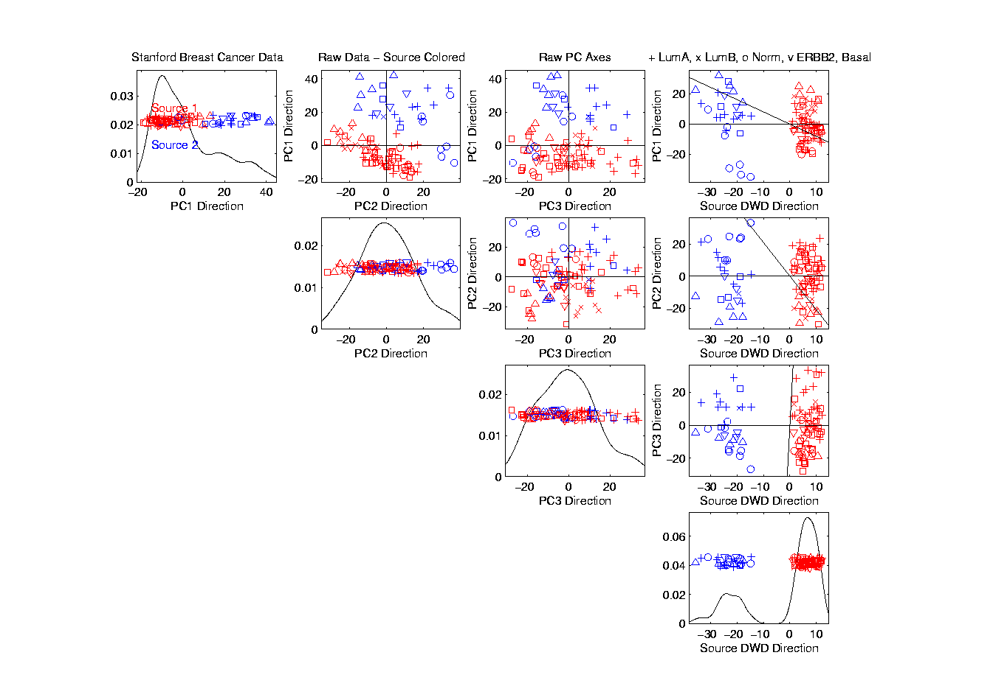
Euclidean Data - Visualization

Slide 7
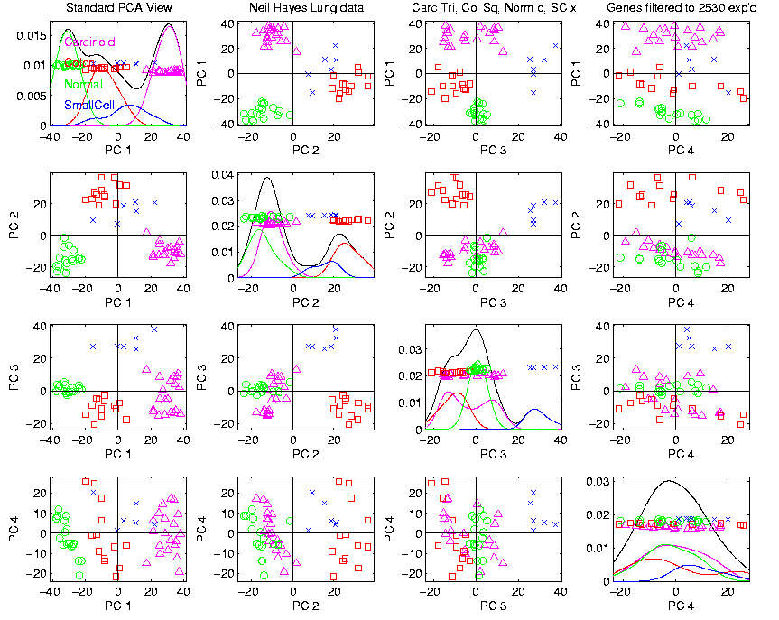
Euclidean Data - Visualization

Slide 8
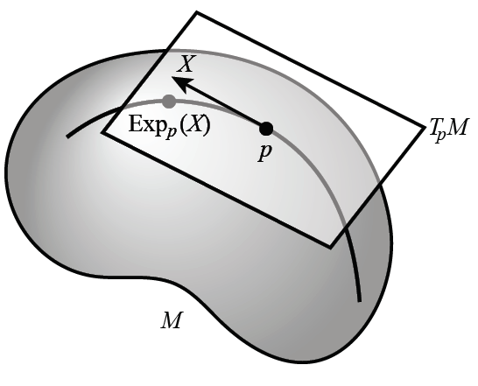
Non - Euclidean Data Spaces
“Simple” Example:
Shapes as Data Objects
Data lie in “manifold”
i.e. “curved feature space”
Typical Approach:
Tangent Plane Approx.
Personal Terminology:
“Mildly non-Euclidean”
Thanks to Tom Fletcher

Slide 9
Non - Euclidean Data Spaces
What is “Strongly Non-Euclidean” Case?
Trees as Data
Special Challenge:
No Tangent Plane
Must Re-Invent
Data Analysis

Slide 10
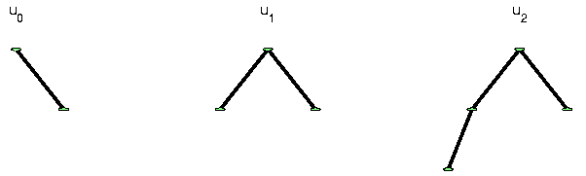
Strongly Non-Euclidean Spaces
Trees as Data Objects
From Graph Theory:
Graph is set of nodes and edges
Tree has root and direction
Data Objects: set of trees
Thanks to Burcu Aydin
Notes:
FIGp8correct.eps

Slide 11
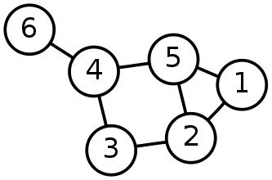
Strongly Non-Euclidean Spaces
General Graph:
Thanks to Sean Skwerer

Slide 12
Strongly Non-Euclidean Spaces
Special Case Called “Tree”
Directed
Acyclic
5
3
4
1
2
Graphical note:
Sometimes “grow up”
Others “grow down”
0

Slide 13
Strongly Non-Euclidean Spaces
Motivating Example:
From Dr. Elizabeth Bullitt
  Dept. of Neurosurgery, UNC
Blood Vessel Trees in Brains
Segmented from MRAs
Study population of trees
Forest of Trees

Slide 14
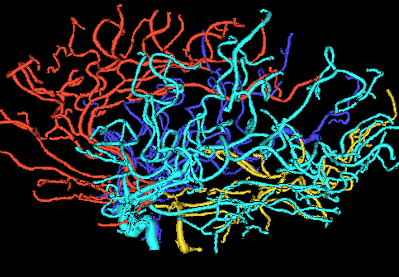
Blood vessel tree data
Marron’s brain:
From MRA
Reconstruct trees
in 3d
Rotate to view

Slide 15
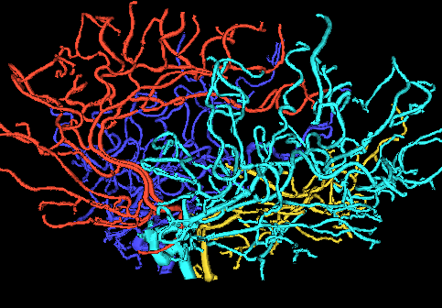
Blood vessel tree data
Marron’s brain:
From MRA
Reconstruct trees
in 3d
Rotate to view

Slide 16
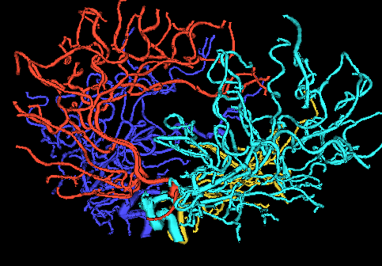
Blood vessel tree data
Marron’s brain:
From MRA
Reconstruct trees
in 3d
Rotate to view

Slide 17
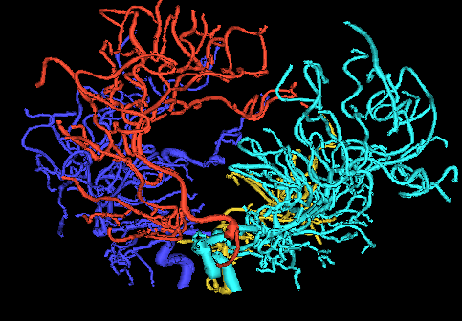
Blood vessel tree data
Marron’s brain:
From MRA
Reconstruct trees
in 3d
Rotate to view

Slide 18
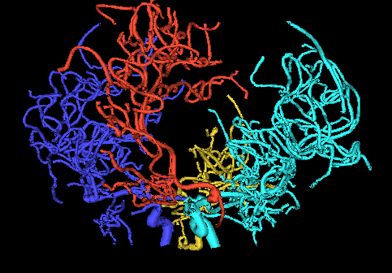
Blood vessel tree data
Marron’s brain:
From MRA
Reconstruct trees
in 3d
Rotate to view

Slide 19
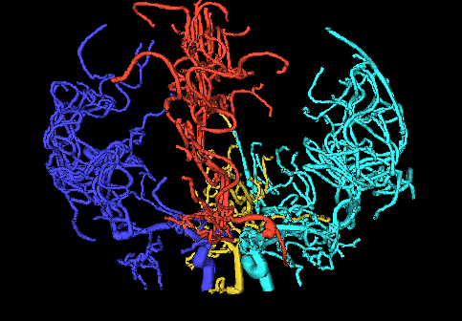
Blood vessel tree data
Marron’s brain:
From MRA
Reconstruct trees
in 3d
Rotate to view

Slide 20
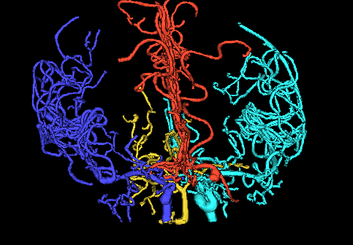
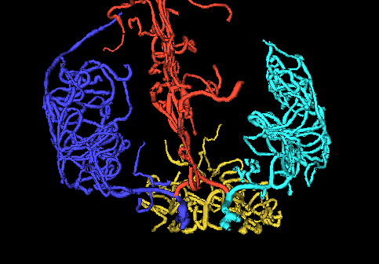
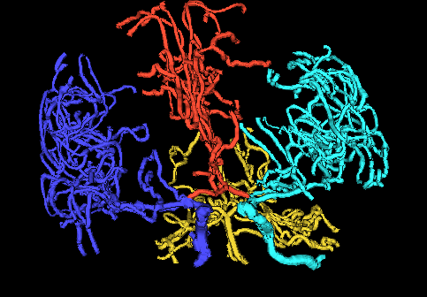
Blood vessel tree data
,
, ... ,
Now look over many people (data objects)
Structure of population (understand variation?)
PCA in strongly non-Euclidean Space???

Slide 21
Blood vessel tree data
,
, ... ,
Examples of Potential Specific Goals
(not accessible by traditional methods)
Predict Stroke Tendency (Collateral Circulation)
Screen for Loci of Pathology
Explore how age affects connectivity

Slide 22
Blood vessel tree data
Big Picture: 3 Approaches
Purely Combinatorial
Euclidean Orthant
Dyck Path

Slide 23
Blood vessel tree data
Big Picture: 3 Approaches
Purely Combinatorial
Euclidean Orthant
Dyck Path

Slide 24
Euclidean Orthant Approach
People:
Scott Provan
Sean Skwerer
Megan Owen
Ezra Miller
Martin Styner
Ipek Oguz

Slide 25
Euclidean Orthant Approach
Setting: Connectivity & Length
Background: Phylogenetic Trees

Slide 26
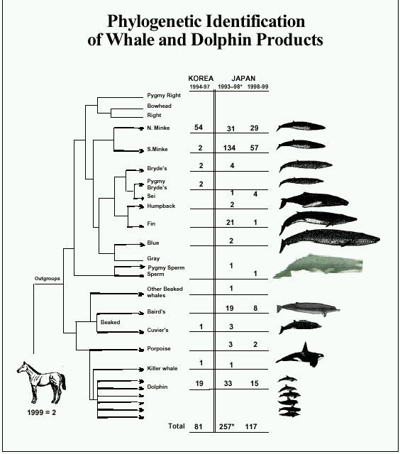
Phylogenetic Trees
Idea: Study
“Common
Ancestry”
Via a tree
Species are leaves
thanks to Susan Holmes

Slide 27
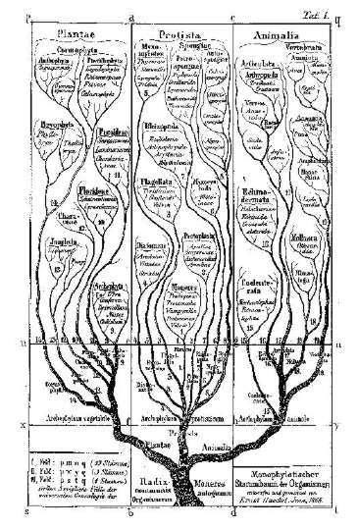
Phylogenetic Trees
Very Early Reference:
E. Schröder (1870),
Zeit. für. Math. Phys.,
15, 361-376.
thanks to Susan Holmes

Slide 28
Phylogenetic Trees
Important Reference:
Billera L, Holmes S, & Vogtmann K (2001)
"A Grove of Evolutionary Trees", Advances in Applied Mathematics 27, 733–767.

Slide 29
Euclidean Orthant Approach
Setting: Connectivity & Length
Background: Phylogenetic Trees
Major Restriction: Need common leaves
Big Payoff: Data space nearly Euclidean
sort of Euclidean

Slide 30
Euclidean Orthant Approach
Major Restriction: Need common leaves
Approach:
Find common cortical landmarks (Oguz)
corresponding across cases
Treat as pseudo – leaves
by projecting to points on tree
(draw pic)

Slide 31
Blood vessel tree data
Marron’s brain:
From MRA
Reconstruct trees
in 3d
Rotate to view

Slide 32
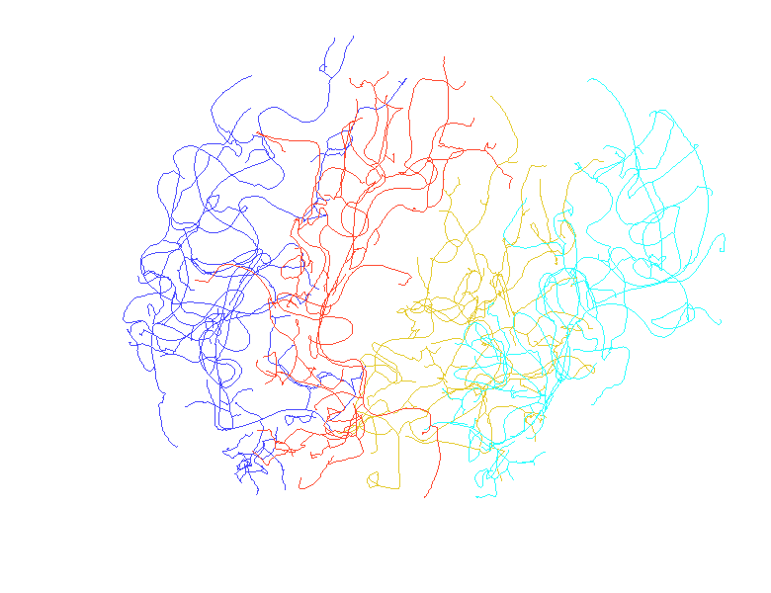
Vessel Locations
(thanks to Sean Skwerer)

Slide 33
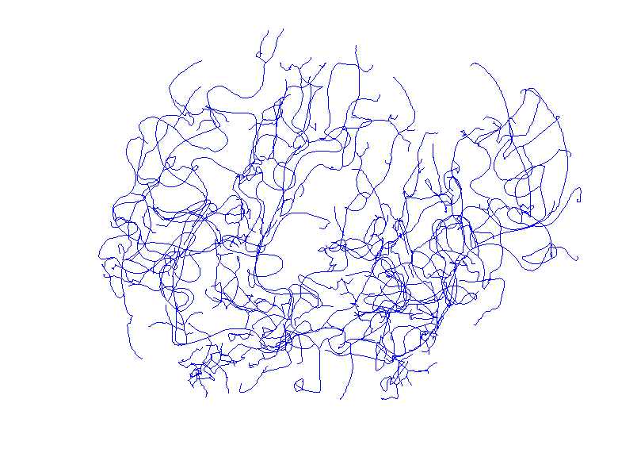
Common Color

Slide 34
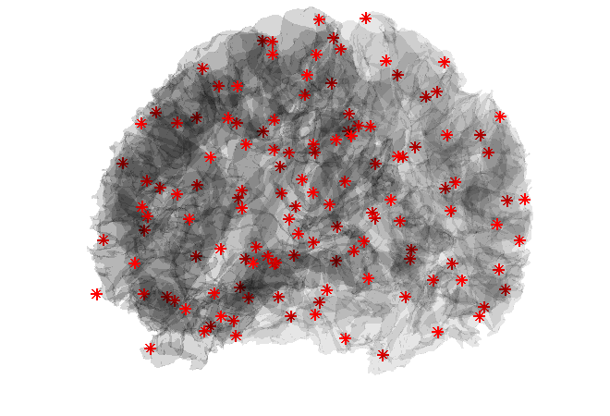
Cortical Surface & Landmarks
Corresponding Landmarks Courtesy of Ipek Oguz

Slide 35
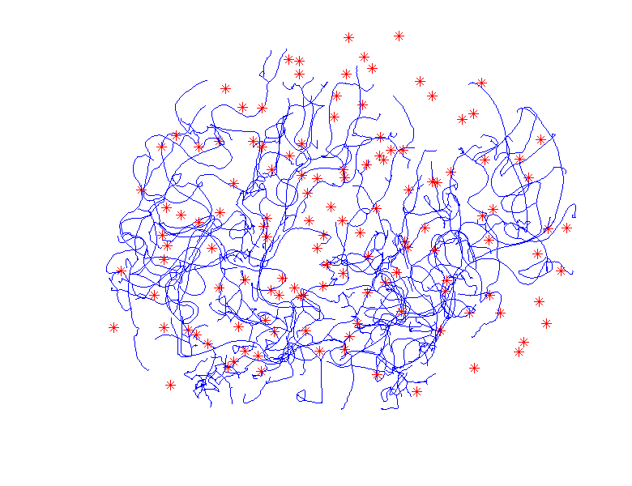
Landmarks and Vessels

Slide 36

Attach Landmarks & Subtrees

Slide 37
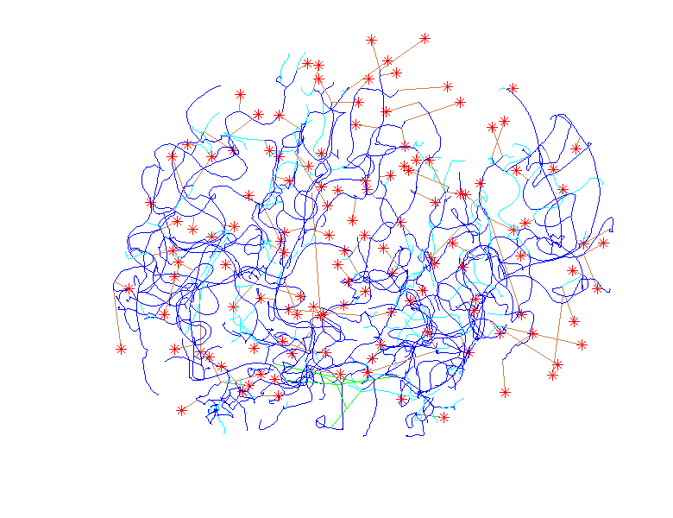
Highlight Orphans

Slide 38
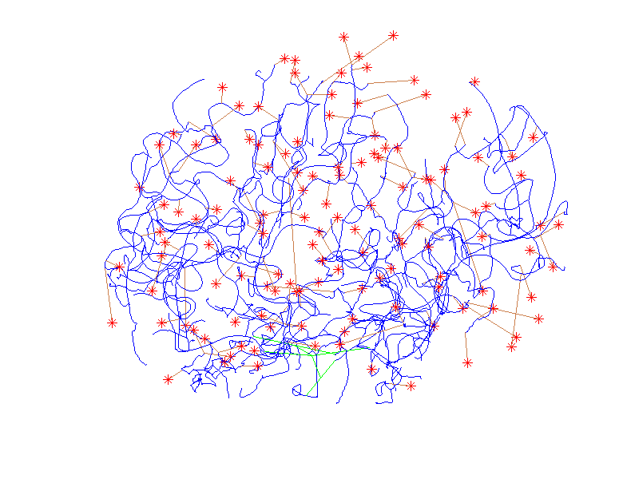
Trim Orphans

Slide 39
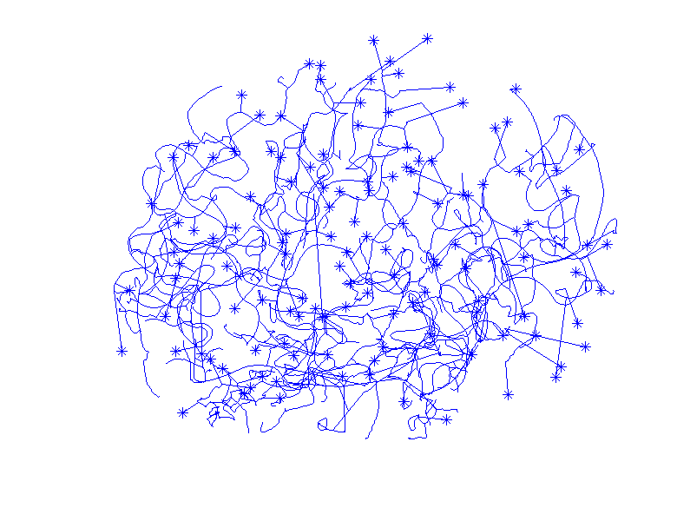
Final Tree (common leaves)

Slide 40
Euclidean Orthant Approach
Setting: Connectivity & Length
Background: Phylogenetic Trees
Major Restriction: Need common leaves
Big Payoff: Data space nearly Euclidean
sort of Euclidean

Slide 41
Paths Between Trees
5
10
4
4
3
2.5
2.5
5
3
10
Compare trees by “how far apart” they are:
Use “continuous” path between them
Based upon changing edge lengths

Slide 42
Geodesic Paths
  Given 2 trees,
  Shortest path between is called a
  geodesic

Slide 43
Geodesic Paths
  Given 2 trees,
  Shortest path between is called the
  geodesic
  Some math:
  Can show unique in this space
  (non-positive curvature)

Slide 44
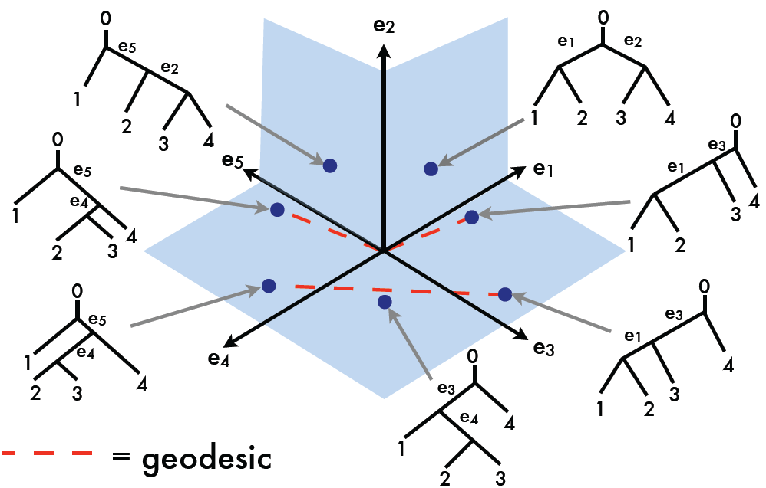
Geodesic Examples, T-4
Thanks to Megan Owen

Slide 45
Geodesic Paths
  Given 2 trees,
  Shortest path between is called the
  geodesic
  Fast Computation (polynomial time):
Owen M &, Provan JS (2011) IEEE/ACM Transactions on Computational Biology and Bioinformatics, 8, 2-13.

Slide 46
Metric in Euclidean Orthant Space
Given 2 trees:
Can (quickly) find geodesic between
Use length of path as “distance”
Can check “metric” properties
Called “Geodesic Distance”

Slide 47
Metric in Euclidean Orthant Space
Consequences of metric:
Useful for statistical analyses
Fréchet (Geodesic) Mean
Multi-Dimensional Scaling

Slide 48
Fréchet Mean
Given data:
Define:

Slide 49
Fréchet Mean
Notes:
In Euclidean space gives usual mean
(easy exercise)
Works in any metric space
Modifications give “robust means”
Also called
  Geodesic mean
  Intrinsic mean

Slide 50
Fréchet Mean
Given data:
Define:
Major Challenge in Euclidean Orthant Space:
Fast Computation
Because of combinatorial complexity

Slide 51
Fréchet Mean
Useful Notation (for Objective Function):
Define the Fréchet Sum of Squared Distances:
So Fréchet mean becomes:

Slide 52
Sturm Algorithm
Simple approach:
Based on fast geodesic computation
Available for any pair of data points
Iterate to find

Slide 53
Sturm Algorithm
Raw Data
X₁
X₂
X₃
X₄

Slide 54
Sturm Algorithm
Raw Data
1st Sturm step
X₁
X₂
X₃
X₄

Slide 55
Sturm Algorithm
Raw Data
1st Sturm step
2nd Sturm step
X₁
X₂
X₃
X₄

Slide 56
Sturm Algorithm
Raw Data
1st Sturm step
2nd Sturm step
3rd Sturm step
X₁
X₂
X₃
X₄

Slide 57
Sturm Algorithm
Raw Data
1st Sturm step
2nd Sturm step
3rd Sturm step
In Euclidean Space,
can show:
convergence to
in n-1 steps
X₁
X₂
X₃
X₄

Slide 58
Sturm Algorithm
Application to brain artery data:
Didn’t converge after 50,000 steps
(for n = 85 trees, d = 128 leaves)

Slide 59
Sturm Algorithm
Application to brain artery data:
Didn’t converge after 50,000 steps
(for n = 85 trees, d = 128 leaves)
Trees live in diverse orthants
Not well “traversed” by Sturm Algorithm
Will revisit this in a moment

Slide 60
Fréchet Mean in T-3
Now study “very simple” special case, T-3
Only 3 topological cases:
e₁ > 0, e₂ = e₃ = 0 e₂ > 0, e₁ = e₃ = 0 e₃ > 0, e₁ = e₂ = 0
0
0
0
1
2
3
3
2
1
3
1
2

Slide 61
Fréchet Mean in T-3
Now study “very simple” special case, T-3
Interesting Structure determined by
Just one of 3 lengths:
e₁ e₂ e₃

Slide 62
Fréchet Mean in T-3
So each tree is a point on “3-spider”:
e₁
e₂ e₃

Slide 63
Fréchet Mean in T-3
Two versions of mean:
Empirical – Based on Data
Theoretical – Based on Prob. Dist’n, P
Both need geodesic metric d

Slide 64
Fréchet Mean in T-3
Metric (distance) on “3-spider”:
e₁
Length of
Geodesic
e₂ e₃

Slide 65
Fréchet Mean in T-3
Probability Distribution on “3-spider”:
e₁
Mixture, with
Propor’ns w₁ w₂ w₃
And Components
P₁ P₂ P₃
e₂ e₃

Slide 66
Fréchet Mean in T-3
Probability Distribution on “3-spider”:
e₁
Define three “wt’d
leg-wise means”:
e₂ e₃

Slide 67
Fréchet Mean in T-3
Can show: For (e.g.) m₂ > m₁ + m₃
e₁
Geodesic mean
is on e₂ and =
m₂ – (m₁ + m₃)
e₂ e₃

Slide 68
Fréchet Mean in T-3
Can show: When no m_{i} is dominant
e₁
Geodesic mean = 0
the “Star Tree”
e₂ e₃

Slide 69
Fréchet Mean in T-3
Note: For no dominant m_{i}
e₁
Can “perturb P”
And still have
Geodesic mean = 0
e₂ e₃

Slide 70
Fréchet Mean in T-3
Note: For no dominant m_{i}
Can “perturb P” and still have
Geodesic mean = 0
Very unusual behavior:
Not true in Euclidean space
(where mean “non-robust”)
(very sensitive to perturbations)
Phenomenon is called “stickiness”

Slide 71
Sturm Algorithm
Application to brain artery data:
Didn’t converge after 50,000 steps
(for n = 85 trees, d = 128 leaves)

Slide 72
Sturm Algorithm
Application to brain artery data:
Didn’t converge after 50,000 steps
How good was it?

Slide 73
Sturm Algorithm
Application to brain artery data:
Didn’t converge after 50,000 steps
How good was it?

Slide 74
Sturm Algorithm
Application to brain artery data:
Didn’t converge after 50,000 steps
How good was it?
So tree at origin (“star tree”) is best seen

Slide 75
Sturm Algorithm
Application to brain artery data:
Didn’t converge after 50,000 steps
How good was it?
So tree at origin (“star tree”) is best seen
Very consistent with stickiness at origin

Slide 76
Multi-Dimensional Scaling
Idea: Variation of PCA
Not based on covariance matrix
Instead on Pairwise distances
Solves STRAIN optimization problem
Works on any metric space
Matrix of Euclidean Distances → PCA

Slide 77
Multi-Dimensional Scaling
Application: Brain Artery Trees
Pairwise Geodesic Distances
Color code for age (as before)
Displays distribution
Include Star tree (best guess at mean)

Slide 78
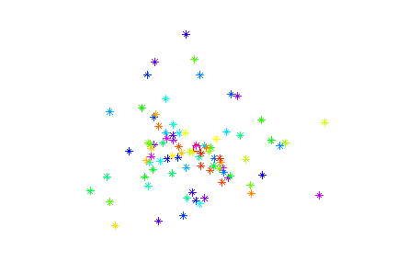
Multi-Dimensional Scaling

Slide 79
Multi-Dimensional Scaling
Shows variation
Not easy to interpret
Star Tree near center
Next study “curvature”

Slide 80
Multi-Dimensional Scaling
Next study “curvature” of space, by:
Adding points into MDS
That lie along triangle
Equally spaced along 3 geodesics
Between triple of data points
Choose triple as “median curvature”

Slide 81
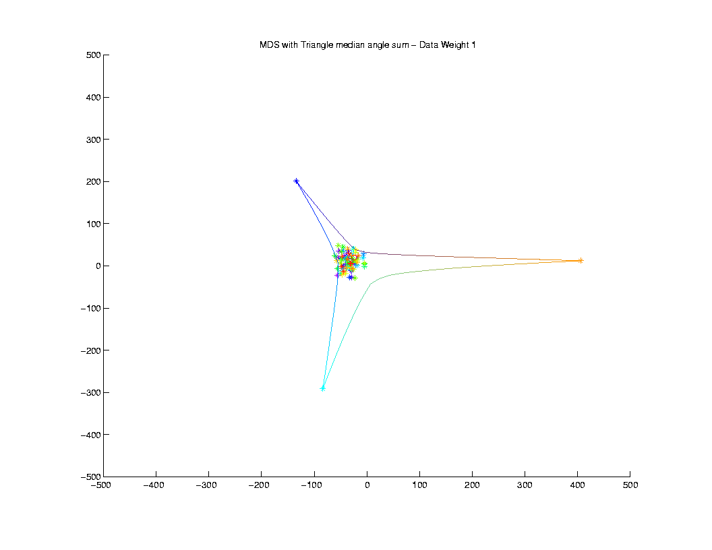
Multi-Dimensional Scaling
Thanks to Sean Skwerer

Slide 82
Multi-Dimensional Scaling
Adding Triangle gives triple “more weight”
So they take over MDS directions
Triangle shows “negative curvature”
Consistent with Euclidean Orthant Space

Slide 83
Multi-Dimensional Scaling
Could Tell Longer Story
But Time is too short

Slide 84
Euclidean Orthant Approach
Next tasks: Statistical Analysis, e.g.
  Calculation of Mean
  PCA (“Backwards” approach???)
  Classification (“linear method” ???)
Work in Progress
  Heavy & Specialized Optimization

Slide 85
Concept to Watch
Stratified Manifolds

Slide 86
Concept to Watch
Stratified Manifolds
People:
Vic Patrangenaru, Statistics, Florida S. U.
Ezra Miller, Mathematics, Duke U.
Stephan Huckemann, U. Göttingen

Slide 87
Concept to Watch
Stratified Manifolds
People:
Vic Patrangenaru, Statistics, Florida S. U.
Ezra Miller, Mathematics, Duke U.
Stephan Huckemann, U. Göttingen
More Precise Mathematics:
“Whitney Stratification”

Slide 88
Concept to Watch
Stratified Manifolds
Idea:
Manifolds of Different Dimension
i. e. “Strata”
Glued Together

Slide 89
Concept to Watch
Stratified Manifolds
Example 1: Phylogenetic Trees
Orthants = Highest Dim’al Strata
Glued at Edges
Edges are Lower Dim’al Strata
{Star Tree} = 0 Dim’al Stratum

Slide 90
Concept to Watch
Stratified Manifolds
Example 2: Covariance Matrices
{Pos. Def.} = Highest Dim’al Stratum
{k non-0 E.V.s} = Lower Dim’al Strata
Glue: lim as smallest E.V. → 0
{0 Matrix} = 0 Dim’al Stratum

Slide 91
Concept to Watch
Stratified Manifolds
At this meeting

Slide 92
Concept to Watch
Stratified Manifolds
At this meeting:
As Data Space: this talk

Slide 93
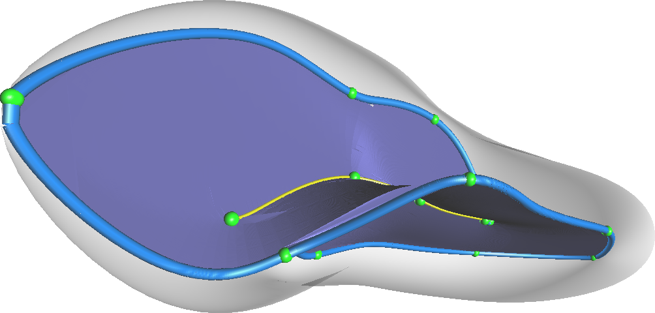
Concept to Watch
Stratified Manifolds
At this meeting:
As Data Space: this talk
As Data Objects: Jim Damon

Slide 94
Concept to Watch
Stratified Manifolds
At this meeting:
As Data Space: this talk
As Data Objects: Jim Damon
As Parameter Space: Peter Kim

