Slide 1
Shape Characterization with Network Analysis
Leo Grady
Principal Research Scientist
Image Analytics and Informatics
Siemens Corporate Research, Princeton NJ

Slide 2
Analytics – Why geometry and shape?
Improve diagnosis and personalize medicine through quantification
Quantification can identify
Normal from pathological conditions
Pathology type
Patient populations that respond to specific treatments
Surgical
Pharmaceutical
Treatment effectiveness
Patient demographics
Imaging
Pathology
Watchful waiting
Measurements
In Vitro diagnostics
Diagnosis
Medication
Treatment
Molecular
Interventional

Slide 3
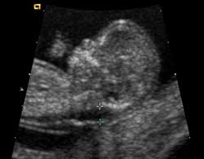
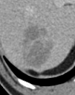
Quantification – Yesterday/Today
Limited to quantities that can be measured easily
RECIST
Diameter
WHO
Nuchal translucency
- Determine Downs Syndrome
Lesions
- Plan treatment
- Monitor treatment
Aortic Aneurysm
- Determine rupture risk
Typically 1D measurements:
Diameter
Length

Slide 4
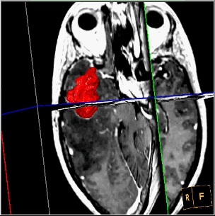
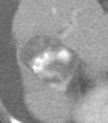
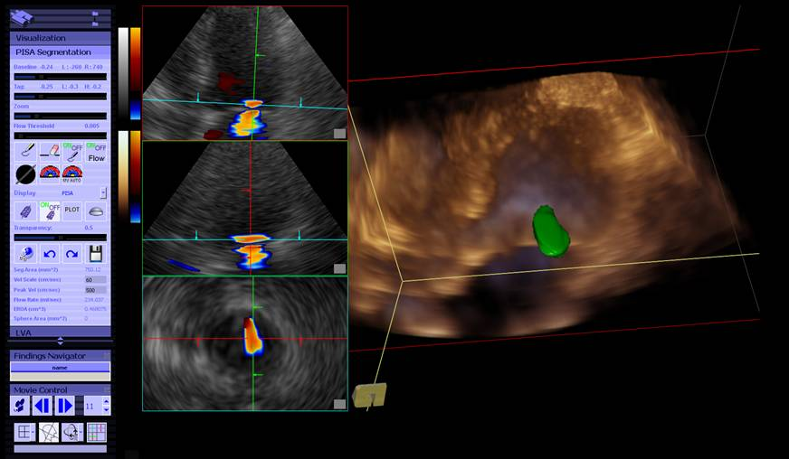
Quantification – Today/Tomorrow
Even slightly more complex features require segmentation/detection
Tumor Volume
- Better predictor for treatment response
Aneurysm curvature
- Calculate rupture risk
Necrosis quantification
- Monitor treatment
Surface area
- PISA used to quantify valvular regurgitation
2D and 3D measurements:
Area
Volume
Surface area
Curvature
Intensity composition
Appearance

Slide 5
Quantification – Next week
We know that more complex features are meaningful
Mercedes-Benz
Bear Paw
Stenosis
- Plan treatment
Radiological signs
- Complex shapes or features
Advanced measurements:
Simulation of underlying phenomenon
Complex appearance

Slide 6
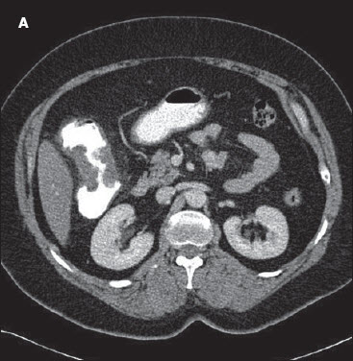
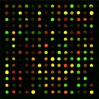
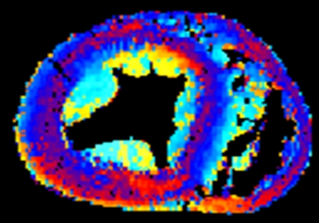
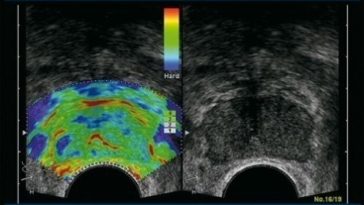
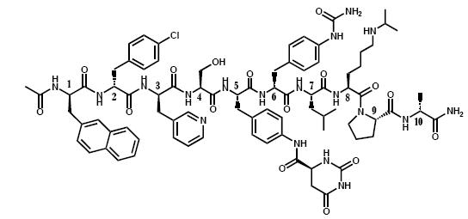
Quantification
Even more properties need to be captured
Connectivity
- Plan treatment
- Monitor treatment
Multiscale systems
- Complex shapes or features
Complex measurements:
Multiscale interaction
Connectivity – Global and local
Functional analytics

Slide 7
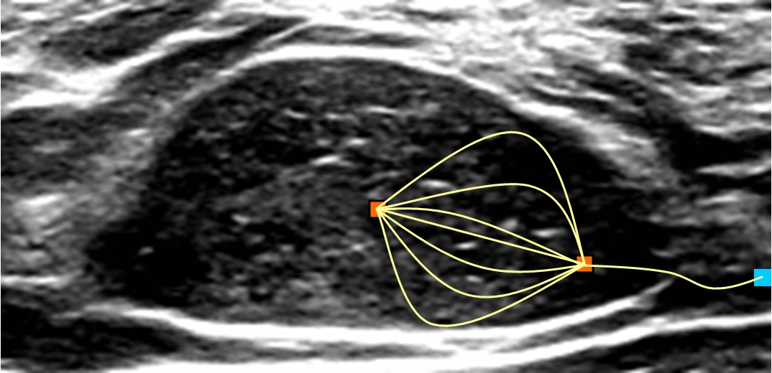
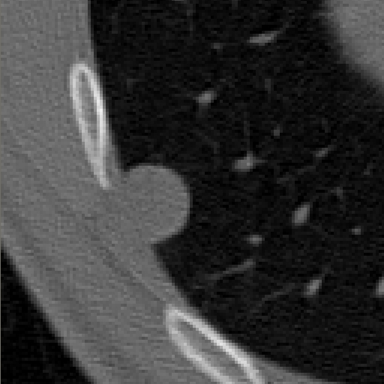
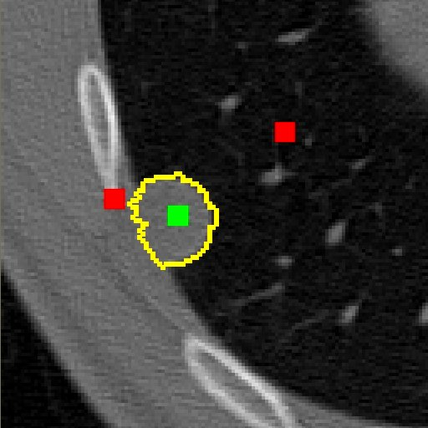
Network analytics
Networks capture relationships between elements of a system
Generalizes concepts of geometry and shape
Ideas used in segmentation

Slide 8
Network analytics
Network features have been widely used outside medicine and imaging

Slide 9
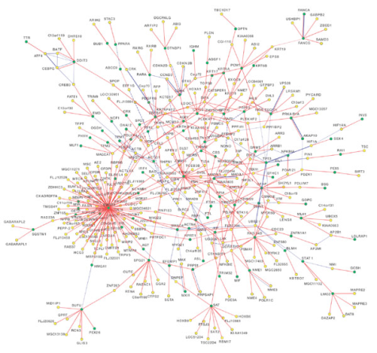
Network analytics
Following introduction of small-world model (Watts and Strogatz, Nature 1998), researchers used networks to model and characterize everything from epidemiology and vulnerability of computer networks to spread of obesity and protein/gene interactions
Reprinted from Christakis et al, “Spread of Obesity in a Large Social Network over 32 years”, 2007
Reprinted from Jenelius et al, “Importance
and exposure in road network vulnerability analysis”, 2006
Reprinted from Barabasi, “Linked: The New Science of Networks “, 2003
Reprinted from Rual et al, “Toward a proteome-scale map of the human protein-protein interaction networks” , 2005

Slide 10
Common network measures

Slide 11
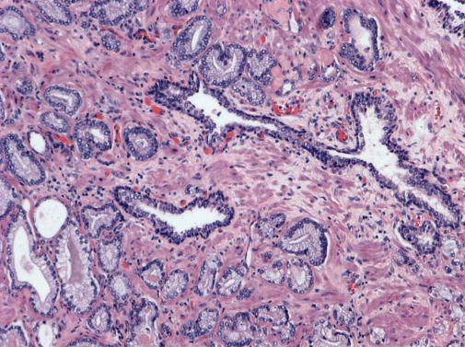
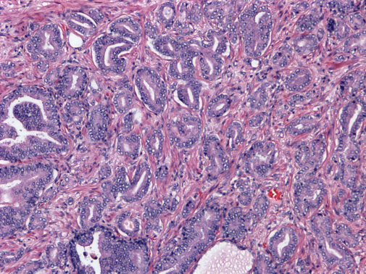
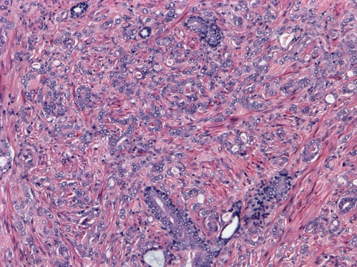
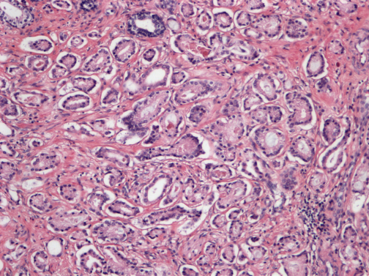
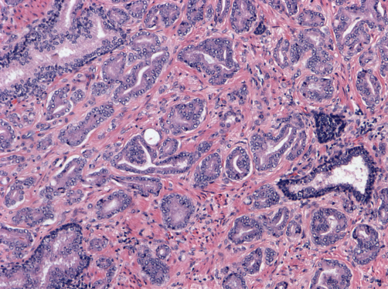
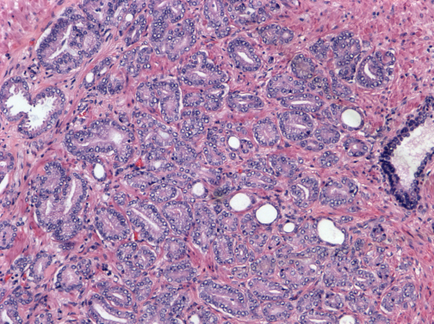
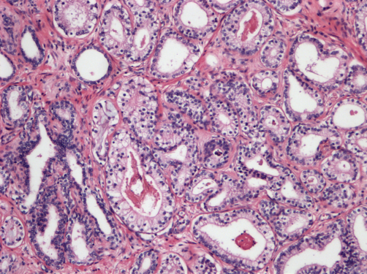
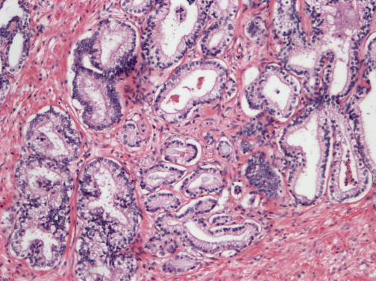
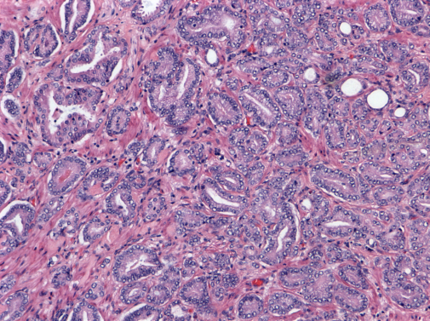
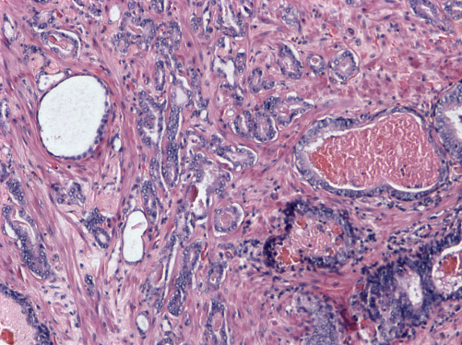
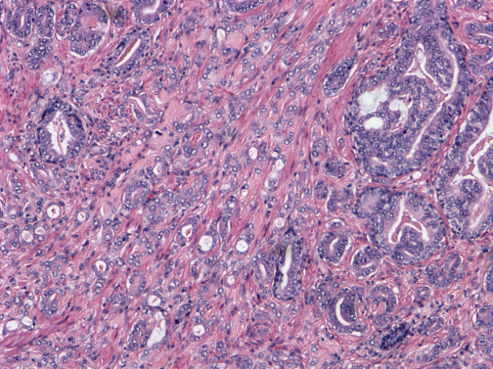
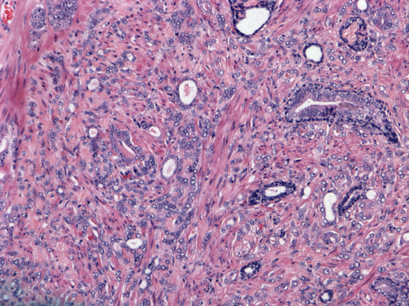
Case Study 1 – Tissue Characterization
75 cases of prostate cancer patients exhibiting stage 3 or 4 cancer (Gleason grading), graded by a pathologist at Beth Israel Deaconess in Boston
Gleason Grade 3
Gleason Grade 4

Slide 12
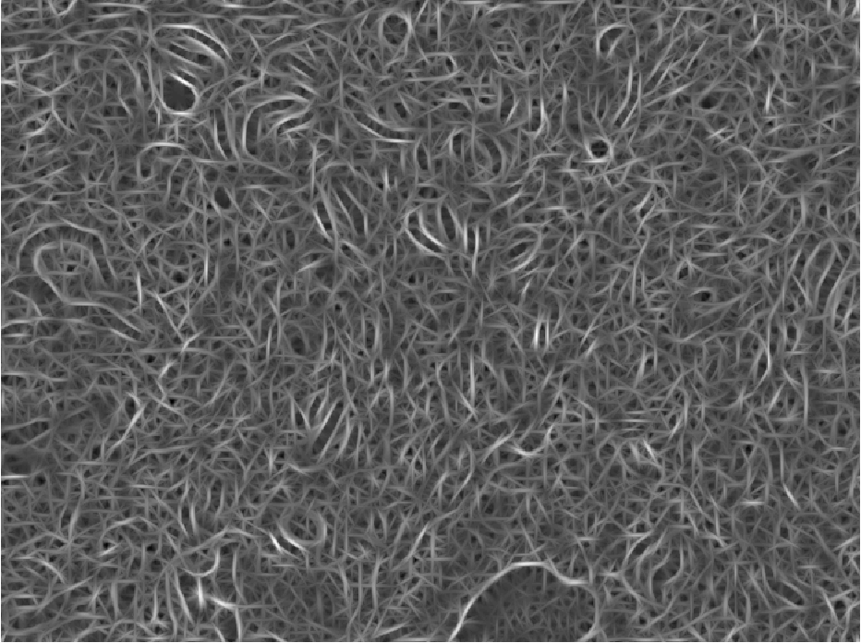
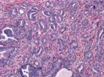
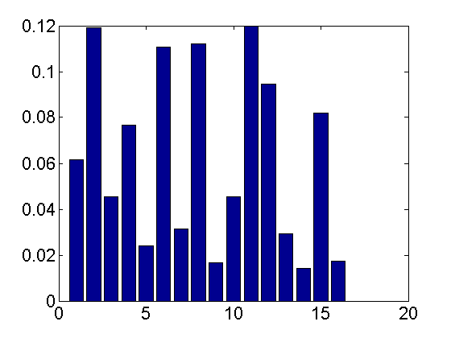
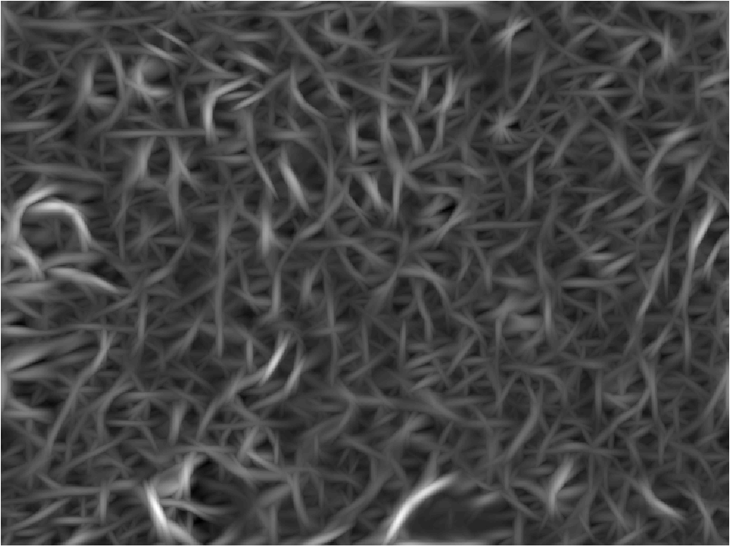
Case Study 1 – Tissue Characterization
Previous approaches used fractals (Huang and Lee, 2009)
Performance: 80% accuracy
We also applied texton/appearance features to characterize pathology (Khurd et al., 2010)
Performance: 93% accuracy
Filter response clustering per class
Original H&E
Filter responses
Texton map
Texton histogram

Slide 13
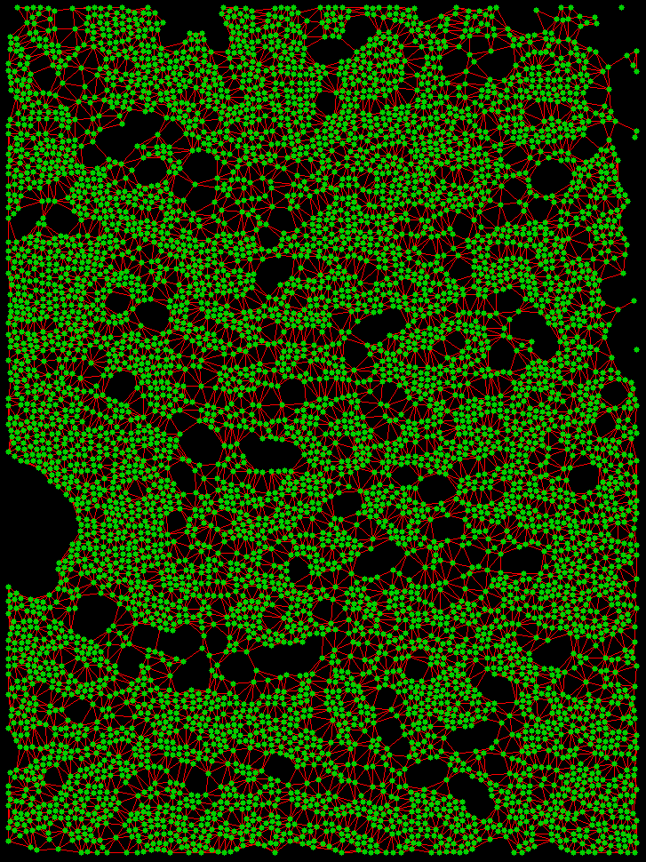
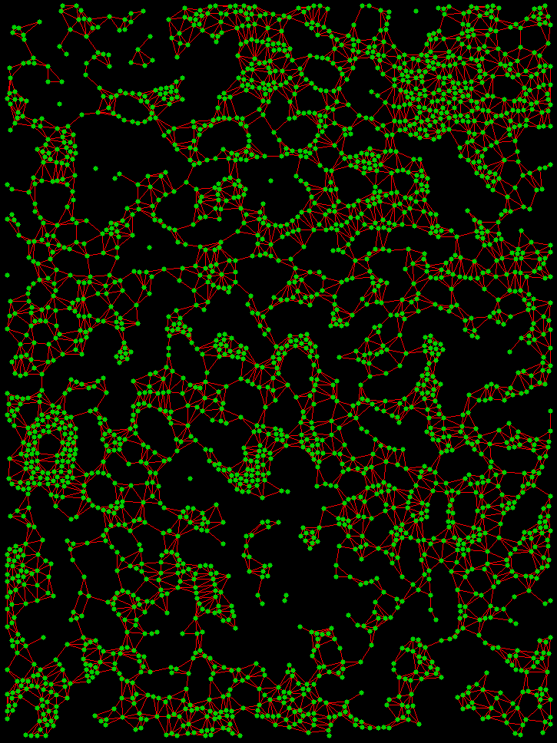
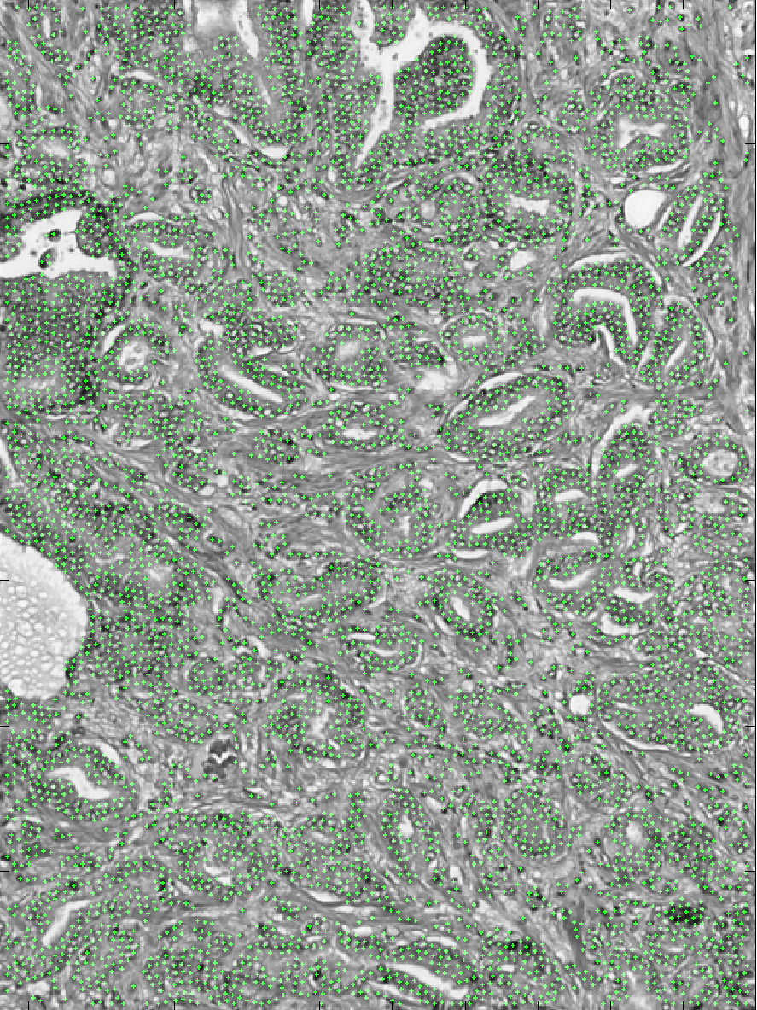
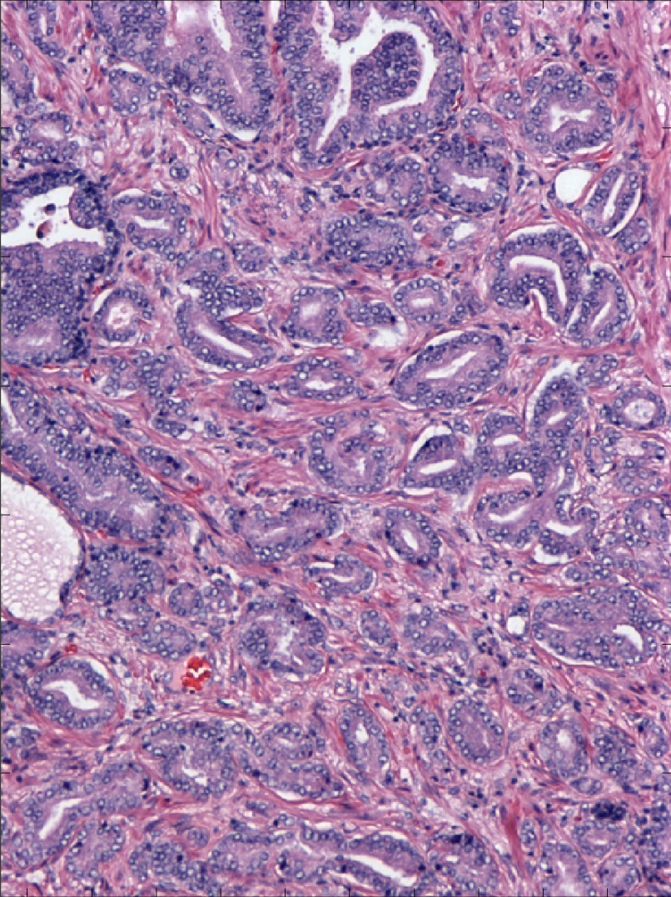
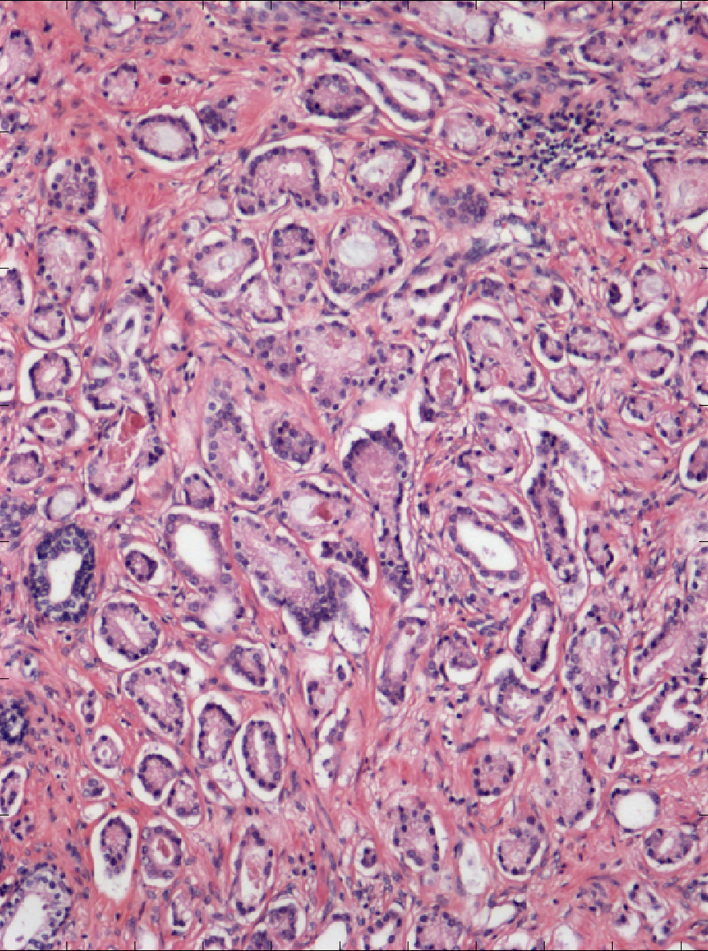
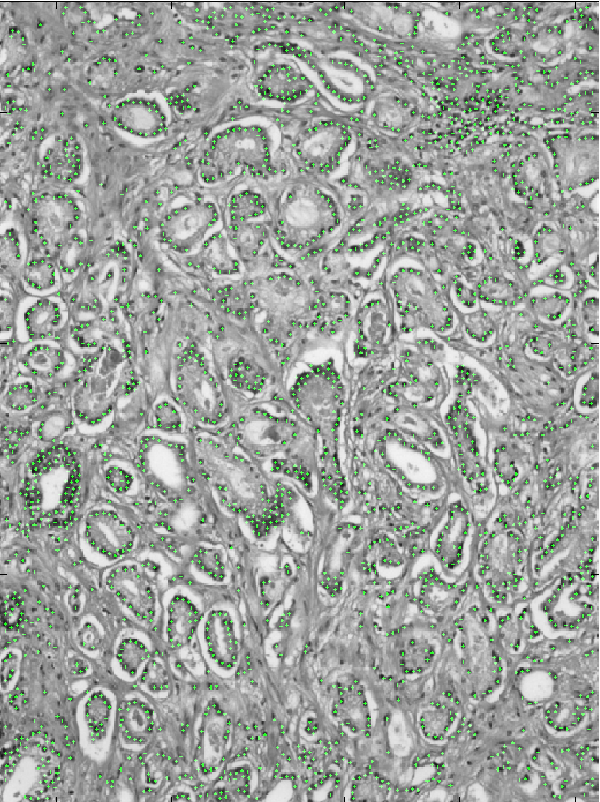
Case Study 1 – Tissue Characterization
Texton features fail to capture structural arrangement of cells in the tissue
Solution – Detect cells and create a cell network
Gleason Grade 3
Gleason Grade 4

Slide 14
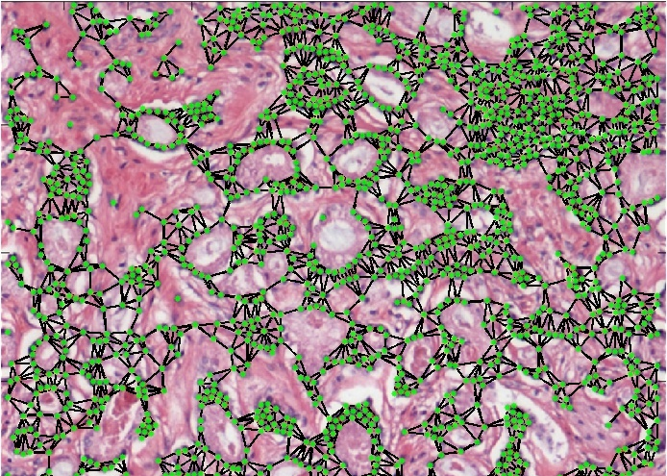
Case Study 1 – Tissue Characterization
Texton features fail to capture structural arrangement of cells in the tissue
Solution – Detect cells and create a cell network

Slide 15
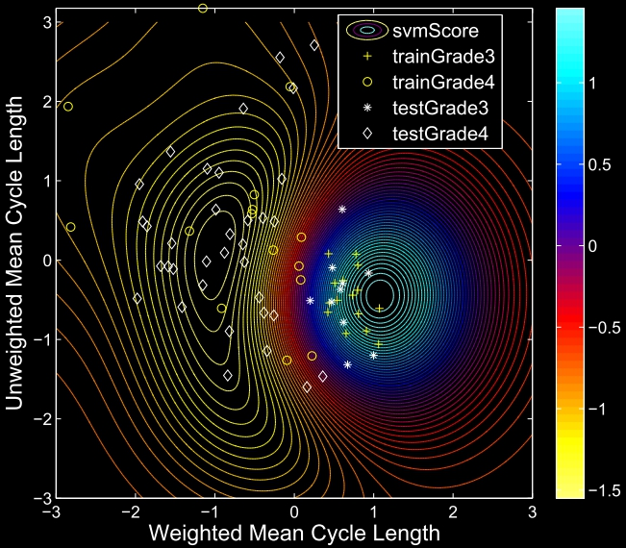
Case Study 1 – Tissue Characterization
Using just two network features gave perfect discrimination
Later learned that these cycles are called cribriform patterns and are used as a sign of cancer grade, but are difficult to quantify

Slide 16
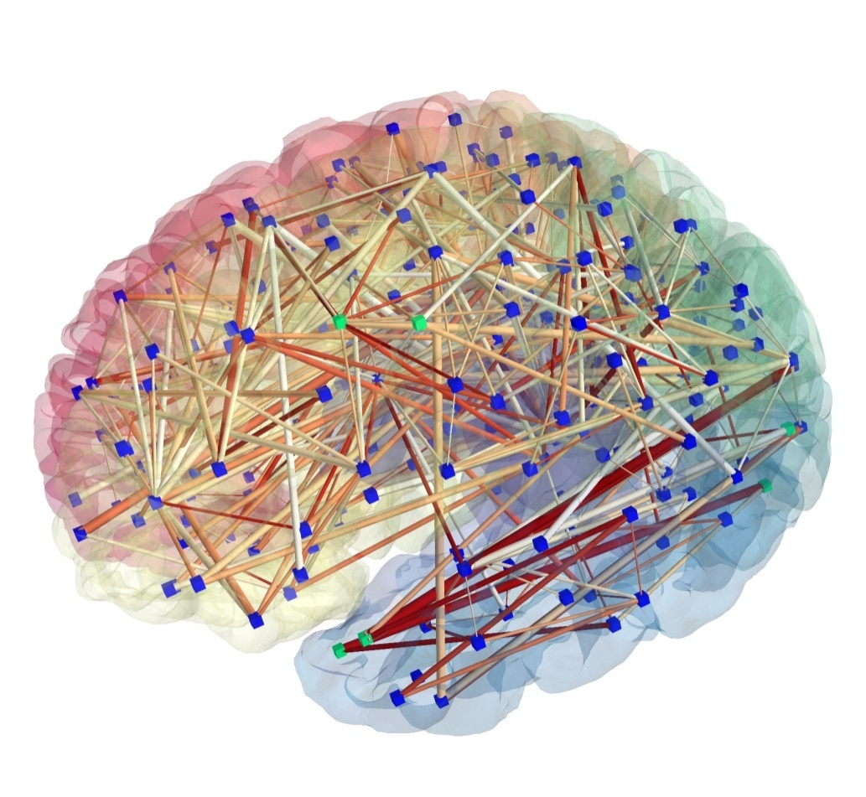
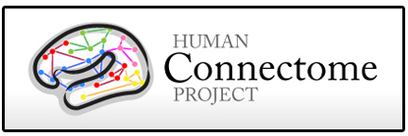
Case Study 2 – Psychological disorders
Psychological testing used today to determine diagnosis
Limited reproducibility
Limited quantification
Imaging studies find little diagnostic power in shape and volumetrics
Recent focus on use of network models to determine pathology

Slide 17
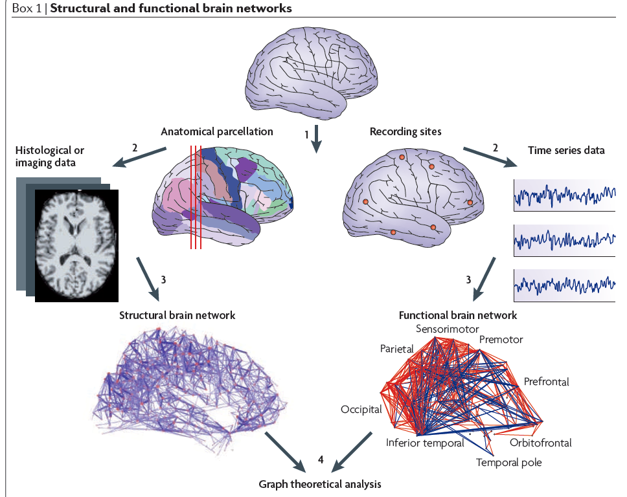
Case Study 2 – Psychological disorders
Different ways to define circuits in the brain:
Bullmore and Sporns, 2009

Slide 18
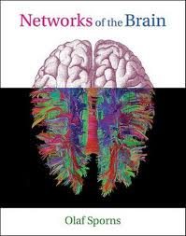
Case Study 2 – Psychological disorders
Some differences in networks have been detected between
Age groups
Schizophrenia and Alzheimer’s disease
Most focus has been measuring similarity to small-world and scale-free network models

Slide 19
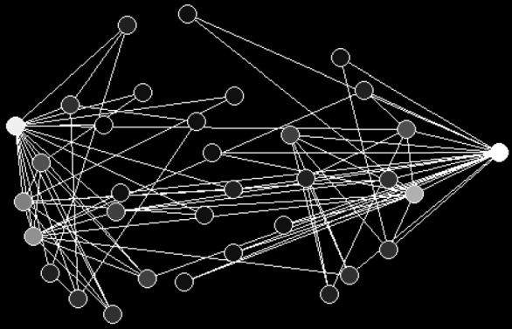
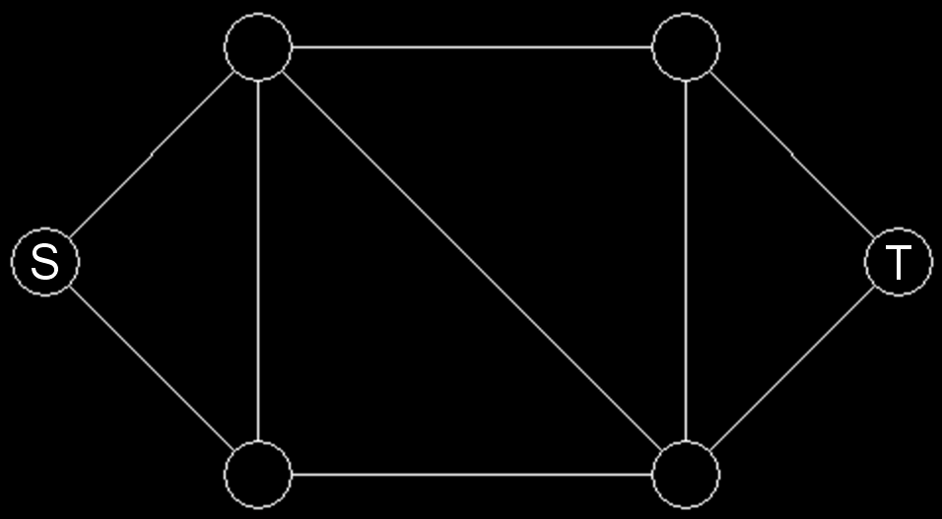
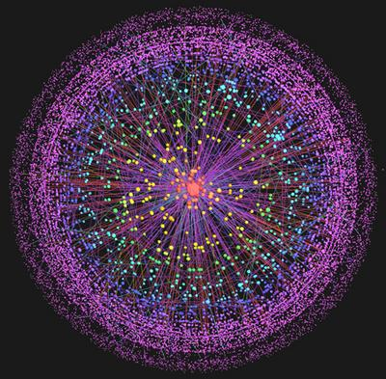
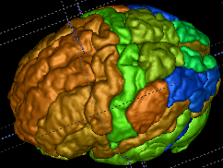
Case Study 2 – Psychological disorders
ADHD Challenge
~750 training subjects, ~60% normal, ~40% ADHD
Obtained from multiple sites
~200 test subjects
Structural MR and fMRI
Separability
Connectivity
Centrality
Cycle
Graph motifs
Volumetrics and thickness
Sparsity
Current: 85% discrimination. Solution due Sept. 9th

Slide 20
Conclusion
Networks provide a general-purpose mechanism to model complex interactions between parts of an object or system
Global and local network features allow us to quantify the structure of these interactions and characterize differences between patients or systems
More Information
My webpage:
http://cns.bu.edu/~lgrady
Digital pathology paper:
http://cns.bu.edu/~lgrady/khurd2011network.pdf
Book :
Leo Grady and Jonathan R. Polimeni, Discrete Calculus:
Applied Analysis on Graphs for Computational Science,
Springer, 2010.

