Slide 1
Isomagnetovortical perturbations and wave energy of MHD flows
Rong Zou
Hawaii Pacific University
Yasuhide Fukumoto
Kyushu University
Vortex Dynamics: the Crossroads of Mathematics, Physics and Applications at IASM, China

Slide 2
Outline
MHD instability and energy
Kinematically accessible (isomagnetovortical) perturbations
Energy formulas of ideal MHD

Slide 3
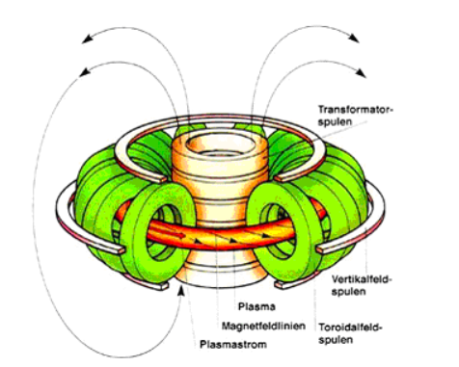
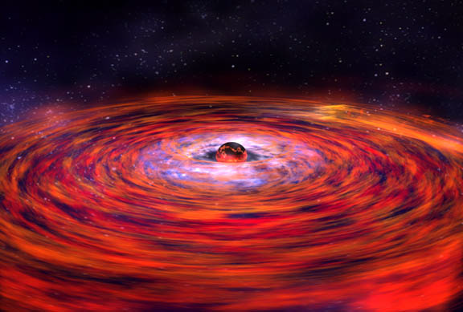
Applications of MHD instability
Instabilities need to be controlled
in Tokamaks (e.g. Instability of
a static equilibrium )
Magnetorotational instability triggers
the formation of stars
Accretion disk star
http://www:nasa:gov/centers/goddard/images=content/96714mainDiskPreBurstlgweb: jpg
http://ipp.cas.cn/kxcb/hjbzs/201210/t20121004_99692.html

Slide 4
Energy and MHD instability
Sufficient condition for instability：
Theorem (Arnold). If the energy of the disturbance is positive deﬁnite, then the equilibrium state is spectrally stable.

Slide 5


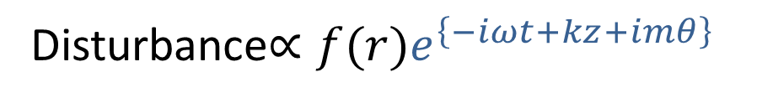






Krein’s theory of Hamiltonian spectra
Energy and MHD instability
Disturbance$∝f(r)e^{\left\{−iωt+kz+imθ\right\}}$
Hamiltonian pitchfork bifurcation
Hamiltonian Hopf bifurcation
Im[$ω$]
Energy
$$0/0$$
$$+/−$$
Im[$ω$]
Re[$ω$]
Re[$ω$]
Re[$ω$]
Re[$ω$]
Coexistence of two modes with opposite signed energy or of zero-energy modes is necessary for triggering instability

Slide 6
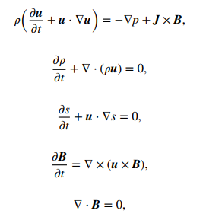


The basic equations in ideal MHD
Magnetic field is frozen into the fluid $u$
where $ρ, p,s, u,B$represent the density, the pressure, the entropy per unit mass, the fuid velocity and the magnetic field, respectively, and J =∇× B is the electric current density.

Slide 7
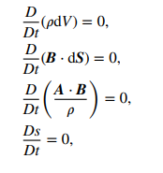


Advected quantities
For the ideal MHD, the local mass, magnetic 2-form, helicity per unit mass and entropy per unit mass are preserved with the flow
where A is the vector potential of B,
Is the Lagrangian derivative

Slide 8
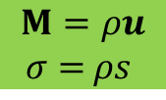

Hamiltonian structure of ideal MHD
Morrison & Greene, Phys. Rev. Lett. 45 (1980) 790, 48 (1982) 569
$$M=ρu$$
$σ=$ $ρs$
$$w = (M, B, ρ,σ)$$
$F, G$ are functionals of
Webb, Dasgupta, McKenzie, Hu & Zank: J. Math. Theor. 47 (2014) 095502

Slide 9
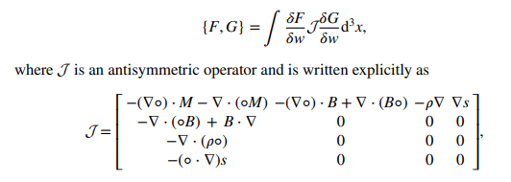

Lie-Poisson bracket by using antisymmetric operator
The ideal MHD basic equations can be written as
$$w = (M, B, ρ,s)$$

Slide 10

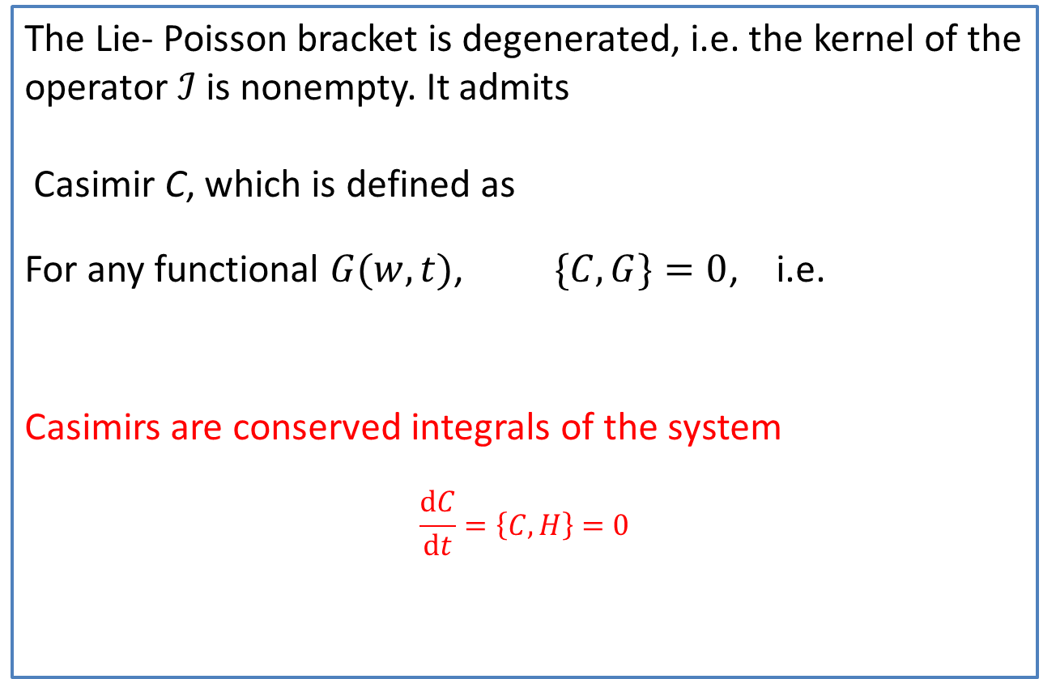
Casimir
The Lie- Poisson bracket is degenerated, i.e. the kernel of the operator $ℐ$ is nonempty. It admits
Casimir C, which is defined as
For any functional $G(w,t)$, $\{C, G\}=0$, i.e.
Casimirs are conserved integrals of the system
$$\frac{dC}{dt}=\left\{C, H\right\}=0$$

Slide 11


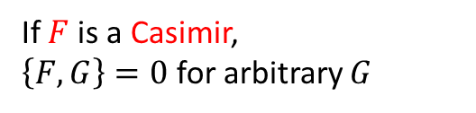




Kinematically (Dynamically) accessible disturbance
If $F$is a Casimir,
$\left\{F,G\right\}=0$ for arbitrary $G$
Basic equations
$$K$$
Equations for disturbance (expanded over a virtual time)
$$∂s$$
$${δu}_{ }=$$
$${δB}_{ }=$$
$${δρ}_{ }=$$
$${δs}_{ }=$$
If F is a Casimir, then it is conserved after the disturbance is added

Slide 12








Kinematically (Dynamically) accessible disturbance
$$w$$
$$ζ$$
$${δu}_{ }=$$
$$ζ$$
$$δB=$$
$${δρ}_{ }=$$
$${δs}_{ }=$$
Eliezer Hameiri, Physics of Plasmas 10, 2643 (2003)

Slide 13
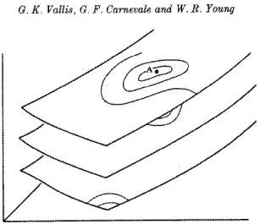
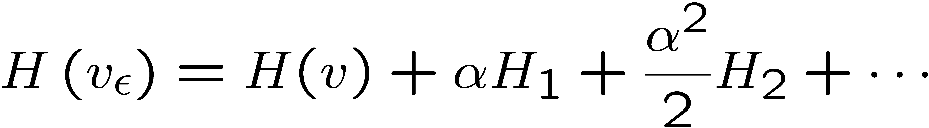

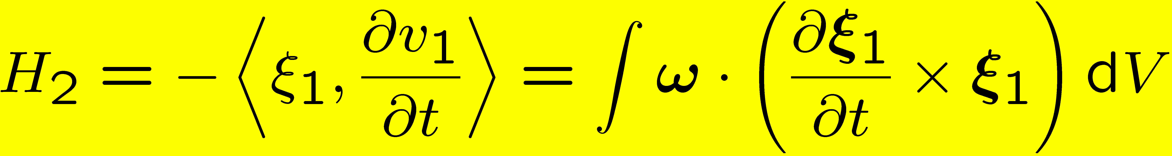

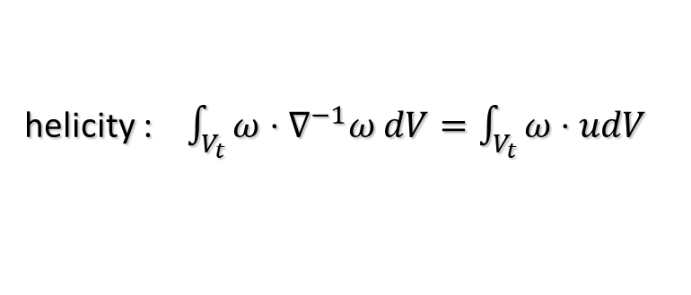


Isovortical disturbance on a steady Euler flow
Helicity is a Casimir for an Euler flow
Energy
helicity : $\int_{V_{t}}^{ }{ω⋅∇^{−1}ω dV=\int_{V_{t}}^{ }{ω⋅udV}}$
${δu}_{ }=ξ×(∇×u$)
$ω=$ $∇×u$
$${δω}_{ }=∇×(ξ×ω_{ })$$
Theorem (Kelvin, Arnold ’65) A steady Euler flow is a
conditional extremum of energy H on an isovortical sheet (preservation of vorticity two form and helicity)
(= w.r.t. kinematically accessible variations).
isovortical sheets
For steady flow
Kop’ev &Chernyshev ‘00
Hirota & Fukumoto’08
For MHD, helicity is no longer invariant by Lorenz force, which is not a potential force.
Energy??? for MHD

Slide 14



Isomagnetovortical sheets
For ideal MHD, Magnetic field is frozen into the fluid and Magnetic two form is conserved.
For ideal MHD, Magnetic helicity and cross Helicity are Casimir
’99Vladimirov & Moffat
where $h=b$
$$δ^{n}C=$$
isomagnetovortical sheets

Slide 15

Kinematically (Dynamically) accessible disturbance
For kinematically accessible disturbances, the first-order energy of disturbance is zero (Arnold theorem)
=0 at equilibrium

Slide 16
Isomagnetovortical disturbances
Energy
isomagnetovortical sheets: Magnetic two form is conserved after disturbance
Kelvin-Arnold Theorem in MHD A steady ideal MHD is a
conditional extremum of energy H on an isomagnetovortical sheet
(= w.r.t. kinematically accessible variations).
Theorem (Arnold). If there exists such real ω that the energy is positive deﬁnite, then the equilibrium state is spectrally stable. (Sufficient condition for instability)

Slide 17


Energy formula for incompressible isentropic MHD
Fukumoto & Zou (2023)
what are the evolution equations of $ξ, ζor η\left(=∇×ζ\right)$

Slide 18
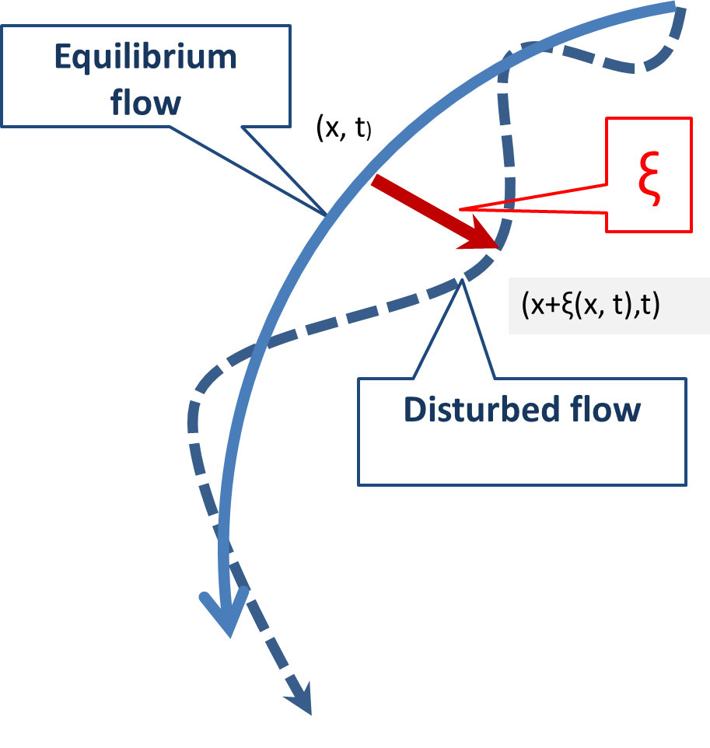

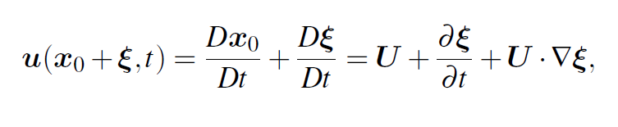





Lagrangian displacement
(Compared to Eulerian view point)
($x_{0},t$)
$$u=U+{δu}_{ }, b=B+{δb}_{ }$$
($x_{0}+ξ,t$)
$$0$$

Slide 19
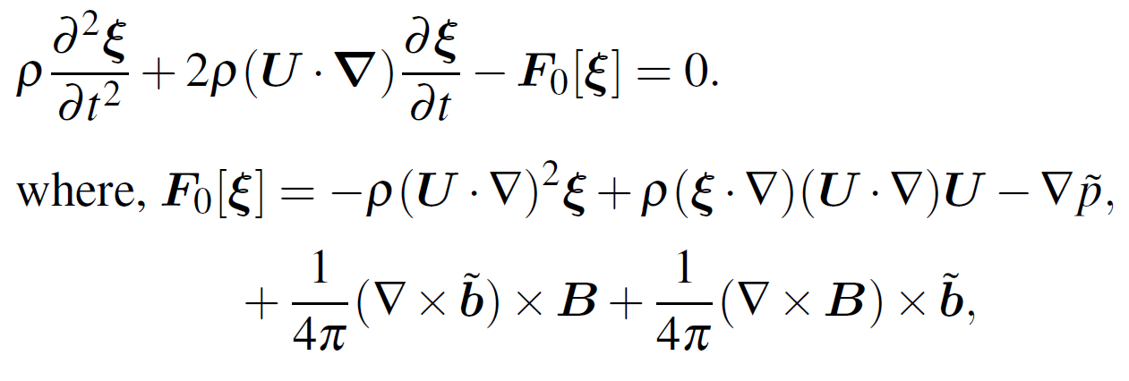
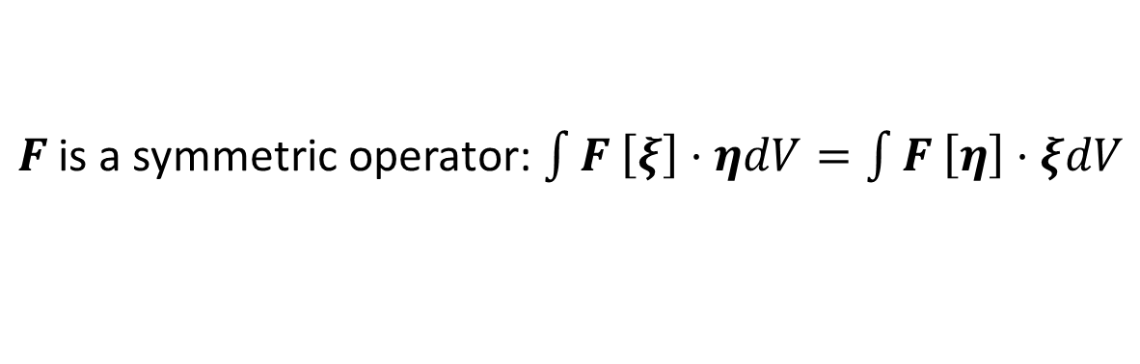
Energy formula from the Friman-Rotenberg equation for ideal MHD:
Frieman-Rotenberg equation
$F_{ }$is a symmetric operator: $\int{F_{ }\left[ξ\right]⋅ηdV=\int{F_{ }\left[η\right]⋅ξdV}}$

Slide 20



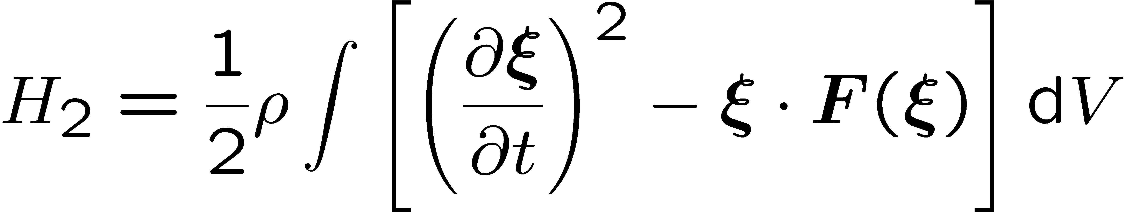






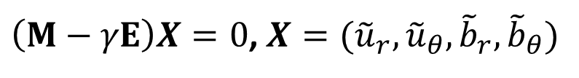
Energy formula from the Friman-Rotenberg equation (Ideal MHD)
Frieman-Rotenberg equation:
Goedblod et. al `10
Kinetic energy
For stable wave
$$ρ$$
Potential energy
$$ρ$$
Zou & Fukumoto (2013)
Unstable wave
$$H_{2}=0$$
‘08 Khalzov, Smolyakov & Ilgisonis
If no basic flow, i.e. $U=0 and real ω$
$H_{2}$(ξ) $≥$ 0 for any ξ,

Slide 21



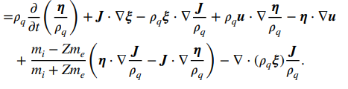





What is $η(=∇×ζ)$
Evolution equation for $η$: (‘99 Vladimirov, Moffat&Ilin)
$$u$$
$$ξ$$
(‘23 Fukumoto & Zou)
(’06 Hirota, Yoshida&Hameiri)

Slide 22


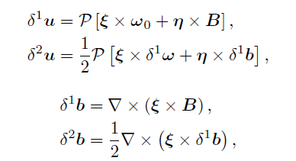

Energy formula for incompressible isentropic MHD
$$H_{2}$$
Fukumoto & Zou (2023)
Part from hydrodynamic formula
Vlamimirov, Moffatt &Ilin ‘99

Slide 23

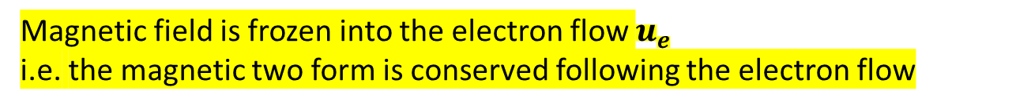

Basic equations and energy formula in Hall MHD
$|u−u_{e}|$≪ $|u|$
Magnetic field is frozen into the electron flow $u_{e}$
i.e. the magnetic two form is conserved following the electron flow

Slide 24

Merit of the new energy formula
$$H_{2}$$
The formula simplifies calculation of the energy of waves when the vorticity and/or the magnetic fled of the basic flow is localized in a thin region.

Slide 25
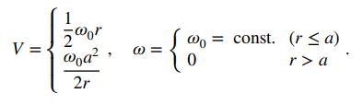
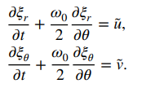
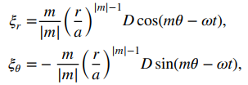

Example: An Energy of waves on a circular vortex patch
Fukumoto (2003)
Suppose that the boundary of the vortex patch is perturbed to

Slide 26
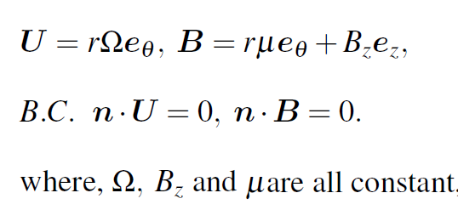
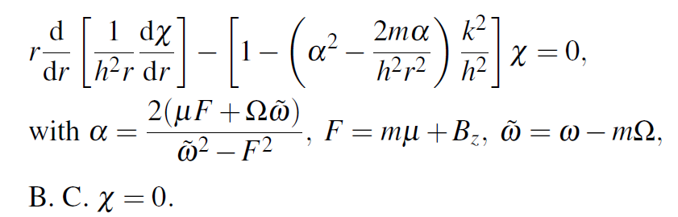


Example: a rigidly rotating flow
θ
0
r
V
B
$$Disturbance{∝f(r)e}^{\left\{−iωt+kz+imθ\right\}}$$
Substituted into Frieman- Rotenberg equation
Hain-Lüst equation
Goedblod et. al `10
$$χ=rξ_{r}$$

Slide 27
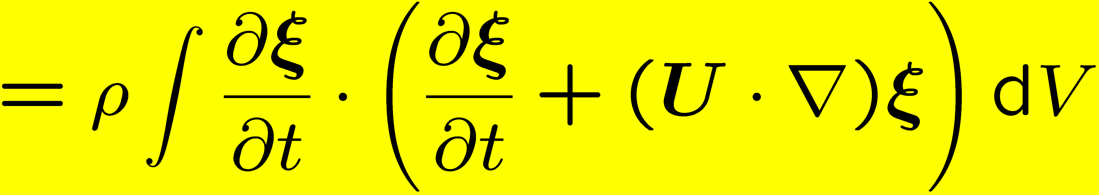
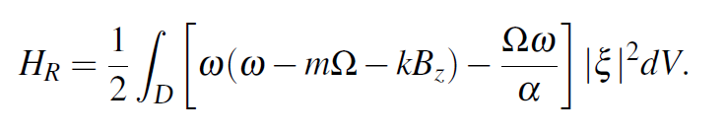

Energy
$$H_{2}$$
Dispersion relation
Wave energy

Slide 28
Conclusion
Properties of the isomagnetovortical disturbance are discussed.
Energy formulas for kinematically accessible disturbance for ideal MHD, especially for incompressible isentropic MHD are derived.
Future work:
Application of the energy formula and the extension to compressible and baroclinic flows

