Slide 1
IASM-BIRS Workshop
Vortex Dynamics: the Crossroads of Mathematics, Physics and Applications
December 3-8, 2023 (Dec. 4)
Organized by B. Protas, S. Boatto, E. Luca and T. Sakajo
Lecture Hall-Academic Island, Institute for Advanced Study in Mathematics (IASM), Hangzhou, China
Topological invariants and Nambu bracket
for ideal fluid dynamics
and magnetohydrodynamics
Yasuhide Fukumoto
Institute of Mathematics for Industry,
Kyushu University, Japan
Rong ZOU
Hawaii Pacific University, USA

Slide 2
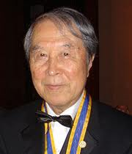
Nambu Mechanics
Nambu: Phys. Rev. D 7 (1973) 2405
Yoichiro Nambu 1921-2015

Slide 3
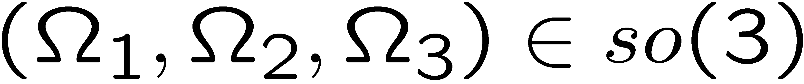


Euler equations for a free rigid body
Motion of a free rigid body
Angular velocity viewed from the body frame
Angular momentum viewed from the body frame
Euler equations
Lie-Poisson bracket
Euler equations

Slide 4
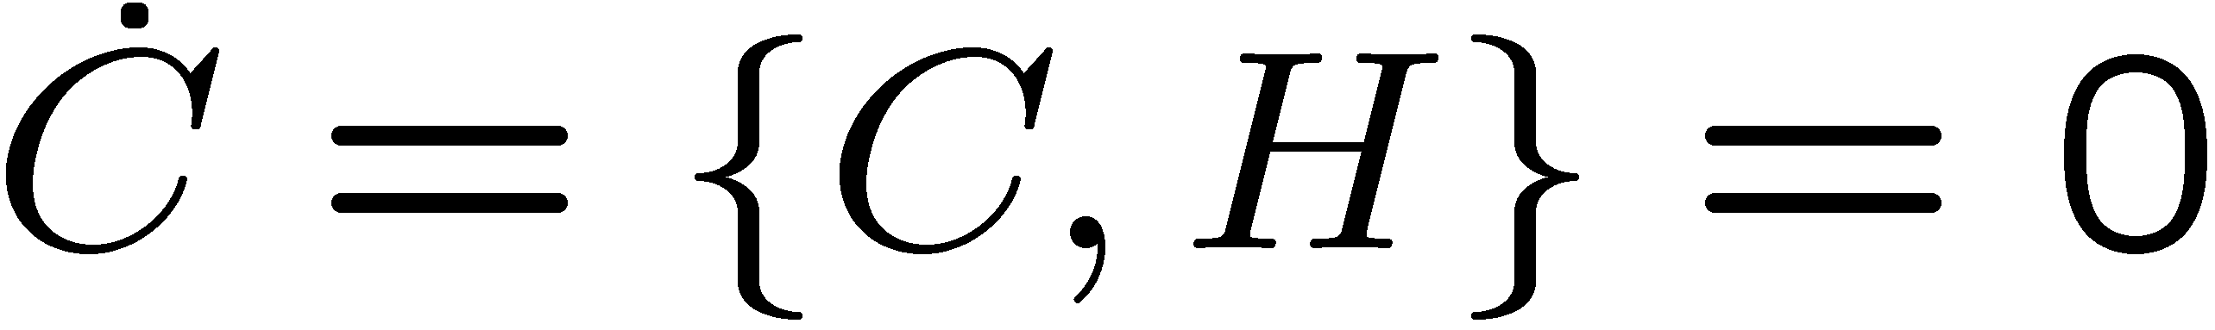
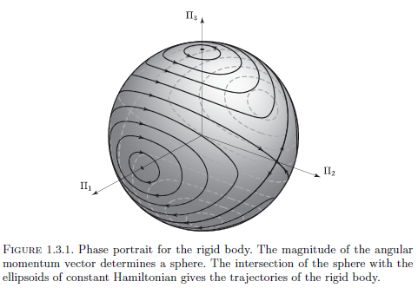


Nambu dynamics for a free rigid body
Casimir invariants
for any H
Casimir invariants
Take
Marsden (1992）

Slide 5
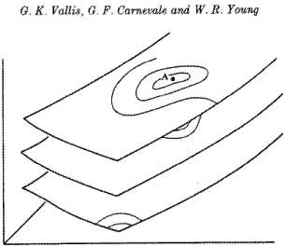
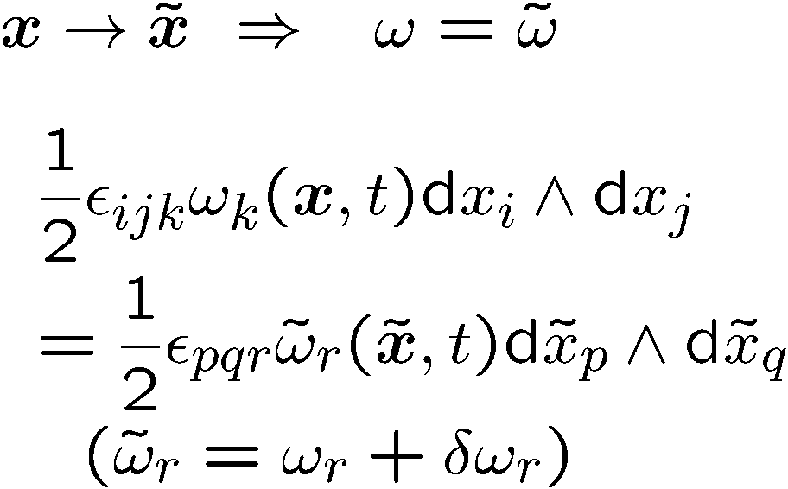
Steady Euler flows
Vallis, Carnevale & Young: J. Fluid Mech.
J. Fluid Mech. 207 (1989) 133
Kinematically accessible variation
(= preservation of circulation)
Energy contour
isovortical sheets
Theorem A steady Euler flow is a coditional extremum of
energy H w.r.t. isovortical perturbations
(kinematically accessible perturbations).
V. I. Arnold: Ann. Inst. Fourier Grenoble 16 (1966) 319

Slide 6

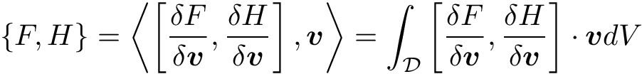

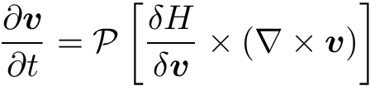

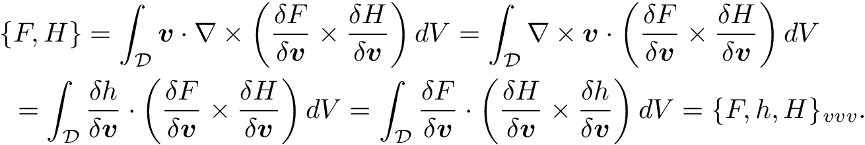
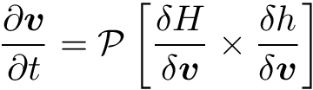
Nambu bracket for incompressible flow
Lie-Poisson bracket
Helicity
Nambu bracket
Fukumoto: Nagare 28 (2009) 499
Euler equation

Slide 7

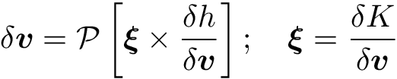

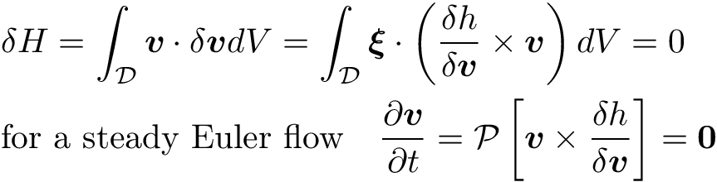
Arnold’s theorem
Euler equation
Energy contour
Isovortical perturbation
isovortical sheets
Arnold’s theorem
Kelvin
(1887)

Slide 8
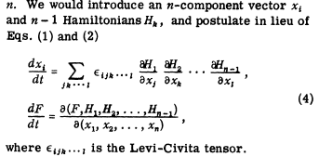
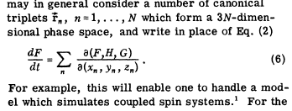
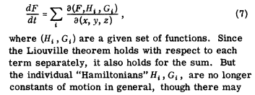
Generalization of Nambu bracket
Nambu: Phys. Rev. D 7 (1973) 2405
Yoneya: Monthly J. of JPS (2017) 231

Slide 9
Contents
Introduction to Nambu bracket
Motion of an ideal barotropic fluid
Motion of a free rigid body
2. Lie-Poisson bracket for MHD
a difficulty
3. Casimir=Topological invariants by Noether’s 1st theorem
Particle relabeling symmetry
cross-helicity
Nambu-bracket for MHD
A remark on Motion of a vortex filament
Localized induction hierarchy

Slide 10
Magnetohydrodynamics (MHD) of a compressible adiabatic conducting fluid
Baroclinic effect
Lorentz force

Slide 11
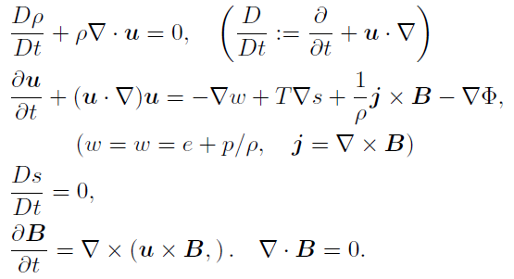

Equations of MHD
Conservation of helicity is destroyed
by the baroclinic effect and the Lorentz force

Slide 12
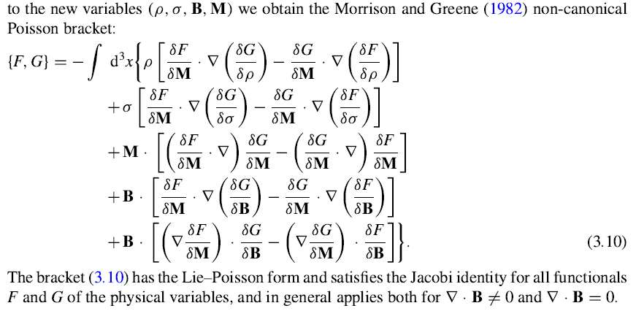
Magnetohydrodynamics of a compressible adiabatic conducting fluid
Morrison & Greene, Phys. Rev. Lett. 45 (1980) 790, 48 (1982) 569
Webb, Dasgupta, McKenzie, Hu & Zank: J. Math. Theor. 47 (2014) 095502

Slide 13
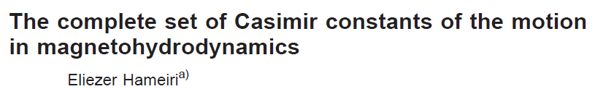
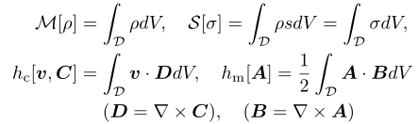
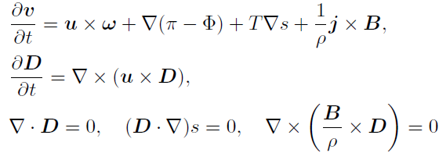
E. Hameiri: Phys. Plasmas 11 (2004) 3423
Cross-helicity

Slide 14
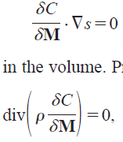
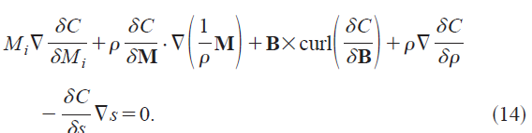
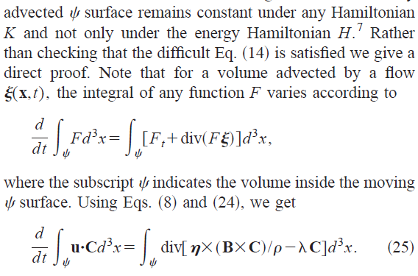

A difficulty
The cross-helicity is not a Casimir (???)
E. Hameiri: Phys. Plasmas 11 (2004) 3423

Slide 15
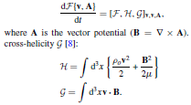


J. Phys. A: Math. Theo.43 (2010) 305501
incompressible
cf. Never & Sommner: Am. Met. Soc. 66 (2009) 2073-2084

Slide 16
Casimir = Topological invariant

Slide 17
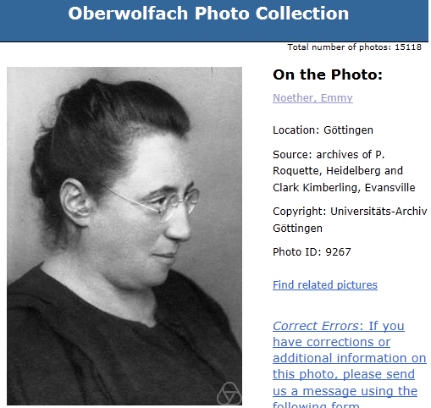
Emmy Amalie Noether
1882-1935

Slide 18
Topological Invariants of magnetohydrodynamics from Noether’s Theorem

Slide 19
A unified View of Topological Invariants of magnetohydrodynamics from
Noether’s Theorem
Barotropic fluids:
A. Yahalom: J. Math. Phys. 36 (1995) 1324
Y. Fukumoto: Topologica 1 (2008) 003
Baroclinic (non-isentropic) fluids:
N. Padhye & P. J. Morrison: Phys. Lett. A 219 (1996) 287
N. Padhye & P. J. Morrison: Plasma Phys. Rep. 22 (1996) 960
Y. Fukumoto & H. Sakuma: Procedia IUTAM 7 (2013) 213
C. J. Cotter & D. D. Holm: Found Comput Math.13 (2013) 457
MHD:
Webb, Dasgupta, McKenzie, Hu & Zank: J. Math. Theor. 47 (2014) 095501
Webb, Dasgupta, McKenzie, Hu & Zank: J. Math. Theor. 47 (2014) 095502
Y. Fukumoto & Zou: Prog. Theor. Exp. Phys. (PTEP) (2023)

Slide 20
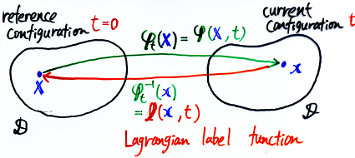
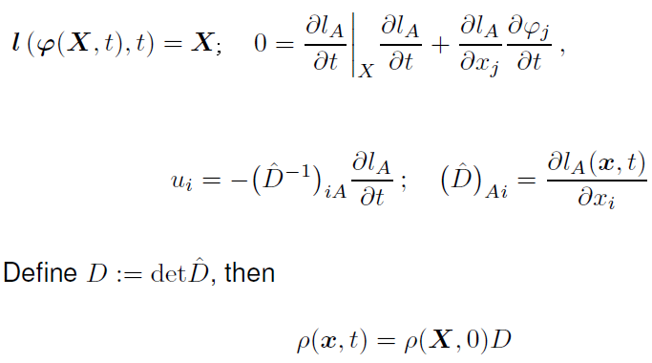
Lagrangian label function
Hamilton’s principle for Euler-Poincaré equation
for a non-homentropic flow
D. D. Holm

Slide 21
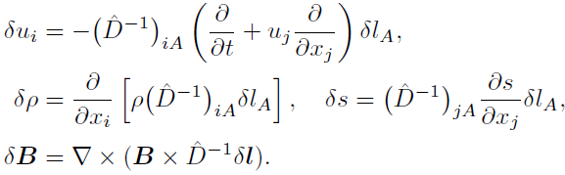
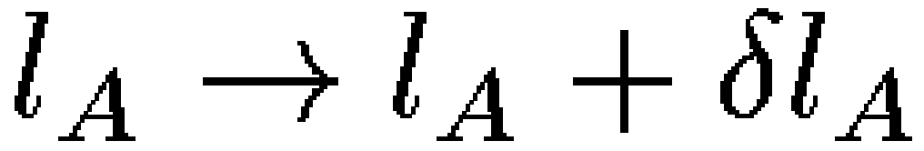


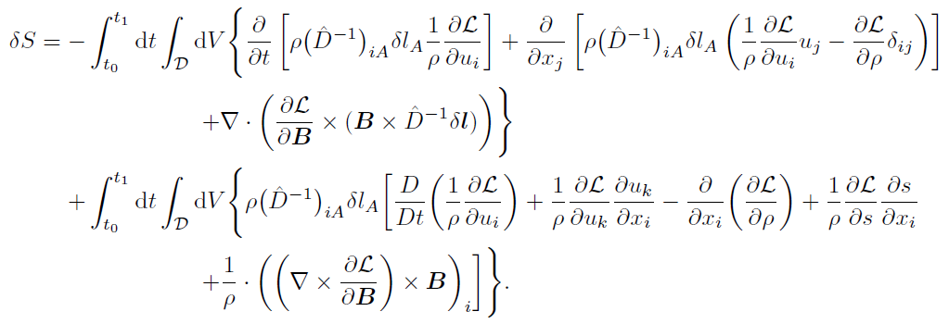

Variation of action: Baroclinic case
Euler-Poincarė equations

Slide 22
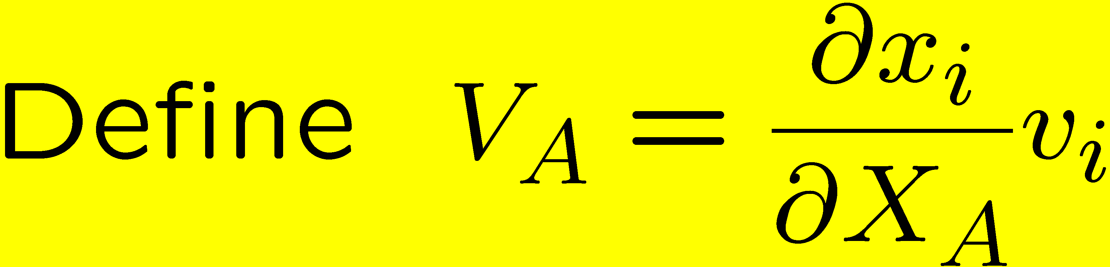
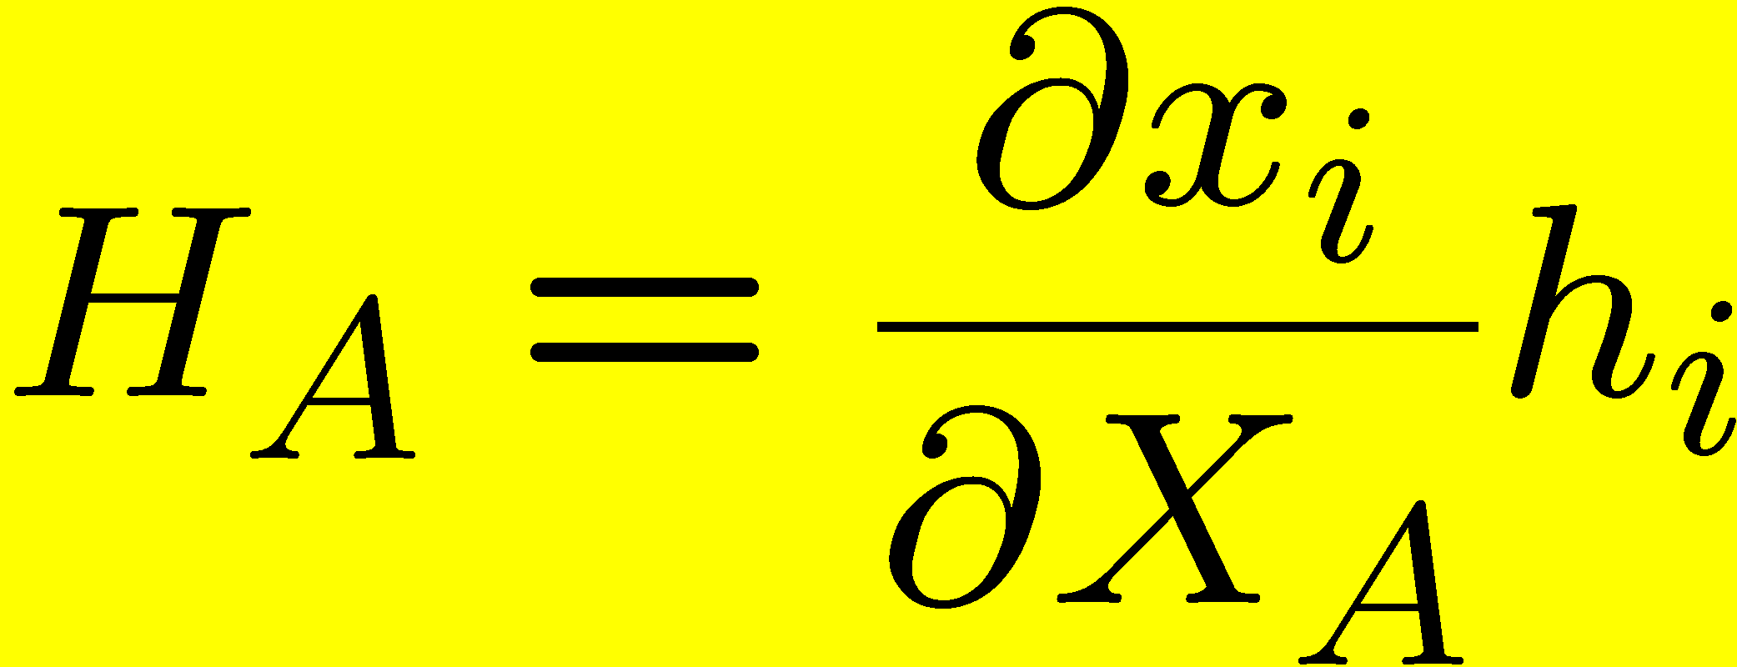
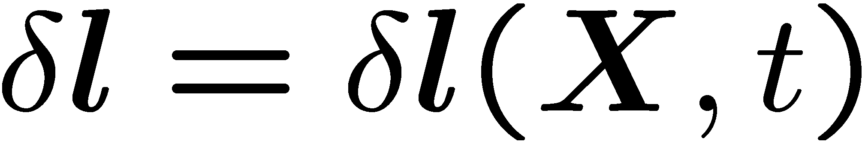
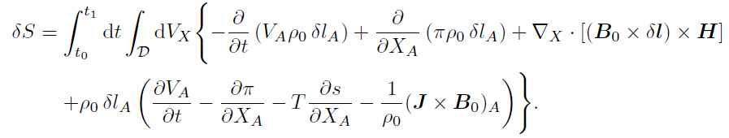
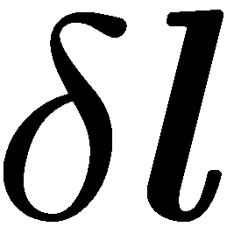

Hamilton’s principle in material coordinates
Rewrite the variation in terms of the Lagrangian variables X
for arbitrary variation subject to B.C. and I.C.
Euler-Poincaré equations in terms of the material coordinates

Slide 23
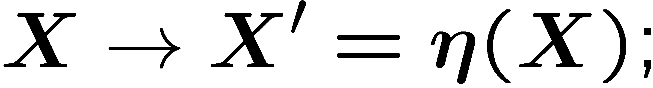
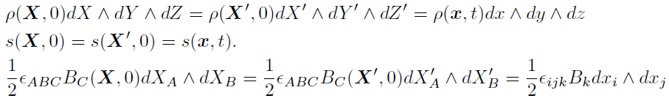

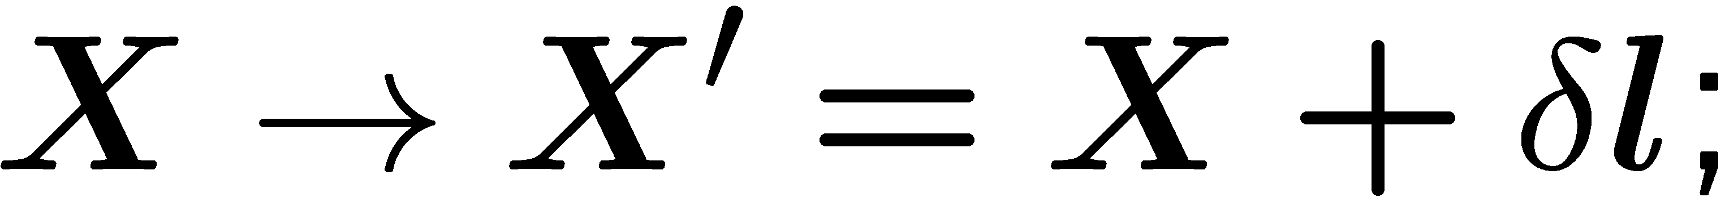
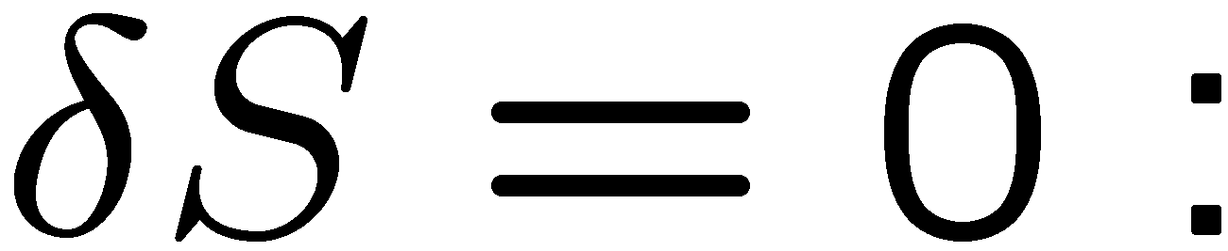
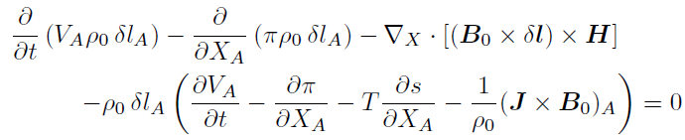
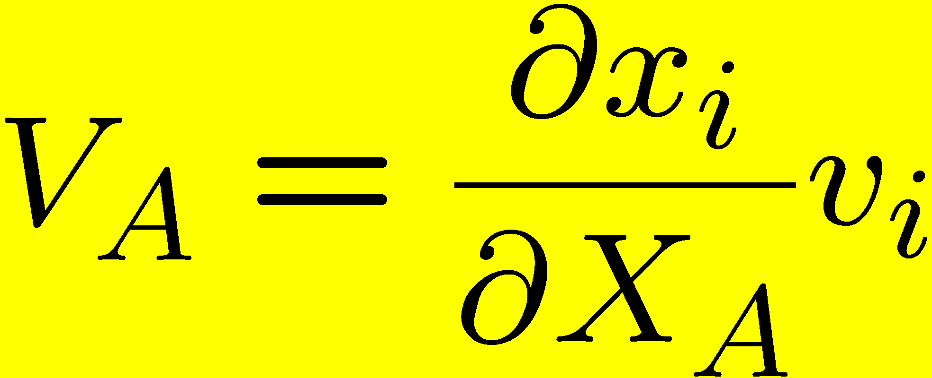

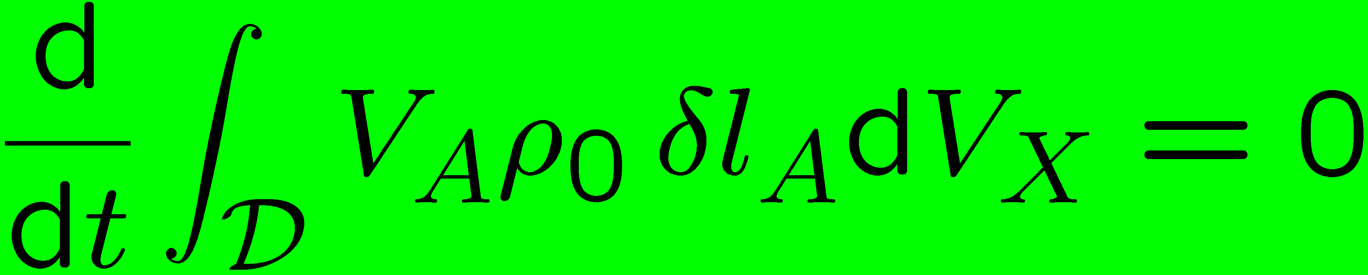
Particle relabeling symmetry
Time-independent change of particle labels
Infinitesimal particle relabeling
Under particle relabeling, the action is unchanged
Assume Euler-Poincaré equations, then
Noether’s charge

Slide 24




Noether’s theorem for particle relabeling symmetry
Noether’s charge
Baroclinic case
Utiyama
(1959)

Slide 25





Divergence symmetry
Mobbs ’81
Vladimirov & Moffatt ’95,
Beckenstein & Ooron ’00
Variational symmetry
Identity
Diverrgence symmetry

Slide 26
Nambu bracket for non-isentropic
adiabatic MHD

Slide 27


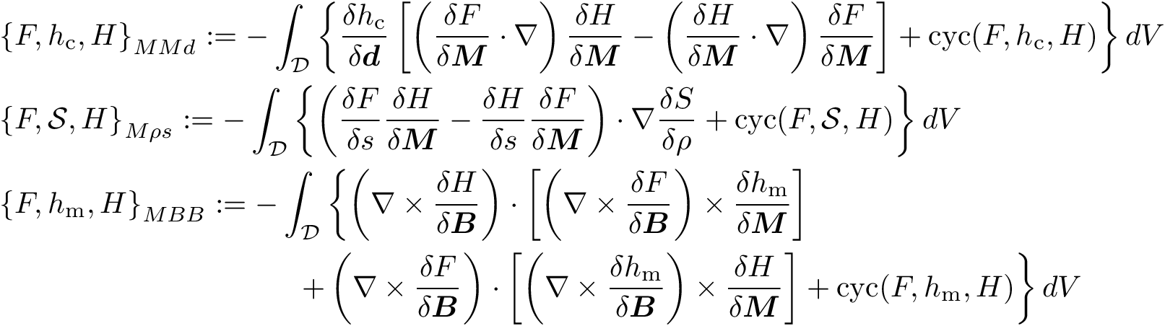
Compact Nambu bracket
Casimirs
Nambu-bracket representation for MHD equations

Slide 28
A difficulty associated with Lie-Poisson bracket
E. Hameiri: Phys. Plasmas 11 (2004) 3423

Slide 29
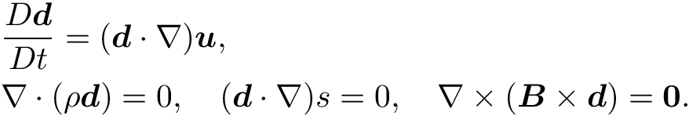
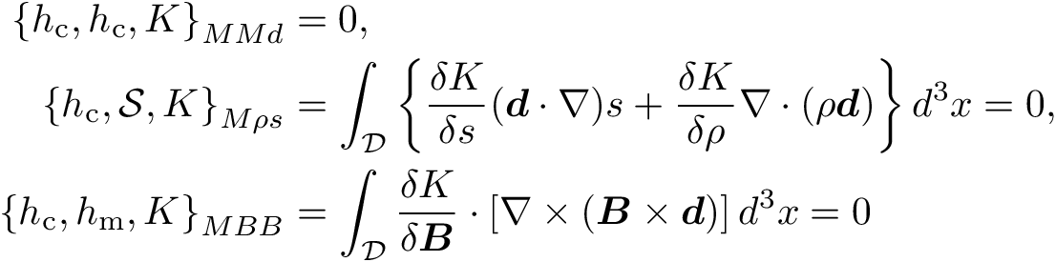

Proof that h_{c} is a Casimir invariant

Slide 30
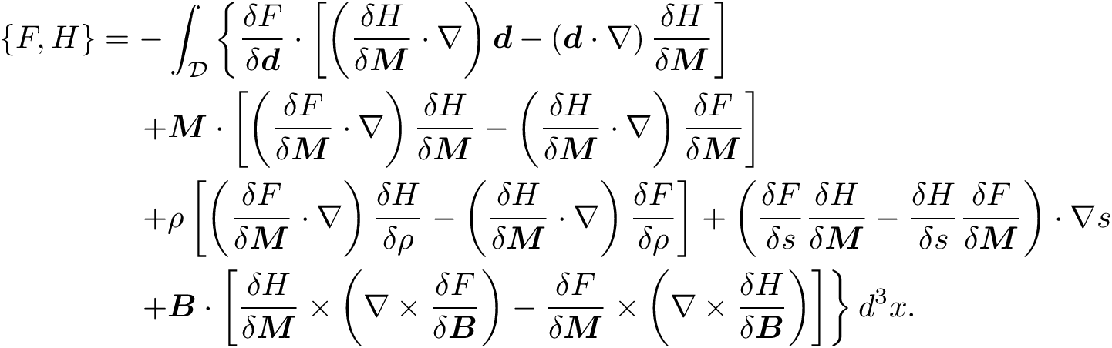
Poisson bracket induced from Nambu bracket

Slide 31

Summary
A unified view of topological invariants for a non-isentropic MHD
from Noether’s theorem
Casimirs
Nambu-bracket representation for Lie-Poisson equation
Compact form
Future directions
Integrable hierarchy
Nambu-bracket representations of isovortical perturbations
wave energy, mean flow
Structure-preserving numerical method Y. Suzuki
Noether’s second theorem

Slide 33
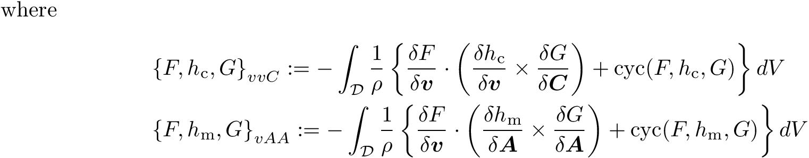
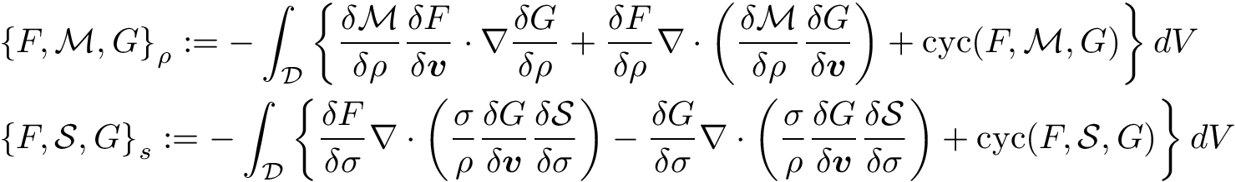

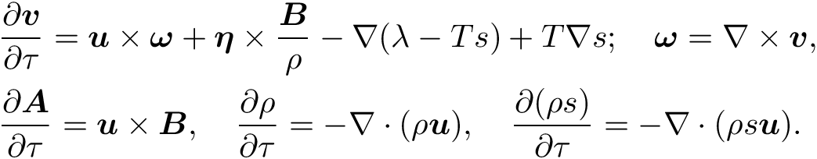
Iso-magnetovortical perturbations
arbitary vector fields
and functions
= iso-magnetovortical perturbations

Slide 34
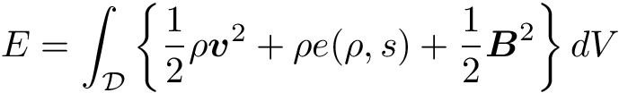


Extension of Arnold’s theorem to MHD
Total energy
Steady flow
Energy contour
isovortical sheets

Slide 35



Motion of a vortex filament
Aircraft trailing vortices
H. Higuchi: Phys. Fluids A 5 (1993) S5
Vortices in Naruto Channel
near Osaka, Japan

Slide 36




Motion of a vortex filament with axial flow
Fukumoto & Miyazaki: J. Fluid Mech. 222 (1991) 369
Localized induction approximation (LIA)
Hasimoto map
Hirota equation

Slide 37



Localized induction hierarchy (LIH)
F. Magri: J. Math. Phys. 19 (1978) 1156 (Nonliner Schrödinger hierarchy)
J. Langer & R. Perline: J. Nonlinear Sci. 1 (1991) 71
Hasimoto map
Recursion operator

Slide 38









Lie-Poisson brackets
Lie-Poisson bracket
A coadjoint orbit =an isovortical sheet
Theorem (Marsden & Weinsten ‘83)
The symplectic structure on is

Slide 39

Recursion operator
Helicity

Slide 41
Remark on
Noether’s 2nd Theorem

Slide 42






Variational symmetry
Variational
symmetry
Identity!
Noether’s 2nd
theorem

Slide 43
Lagrangian label function
Hamilton’s principle for Euler-Poincaré equation
for a non-homentropic flow
D. D. Holm

Slide 44


Particle relabeling symmetry
Particle relabeling
symmetry

Slide 45
Variation of action: nonisentropic MHD
Euler-Poincarė equations

Slide 46
Hamilton’s principle in material coordinates
Rewrite the variation in terms of the Lagrangian variables X
for arbitrary variation subject to B.C. and I.C.
Euler-Poincaré equations in terms of the material coordinates

