Slide 1
Genomic analysis tools for familial and case-control sequencing association studies
Chad D. Huff, PhD
Department of Epidemiology
The University of Texas MD Anderson Cancer Center

Slide 2
Sequencing association studies: Outline
Rare variant association tests
Family-based studies
Controlling for cross-platform stratification biases
Somatic-germline interaction

Slide 3
The genetics of breast cancer susceptibility
Identified from genome-wide linkage studies
BRCA1
BRCA2
Identified from genome-wide association studies
Identified from candidate gene studies
p53
PTEN
RAD51C
XRCC2
ATM
PALB2
BRIP1
CHEK2
Adopted from Chung and Chanock, 2011
and Tavtigian and Goldgar
Combined Allele Frequency

Slide 4
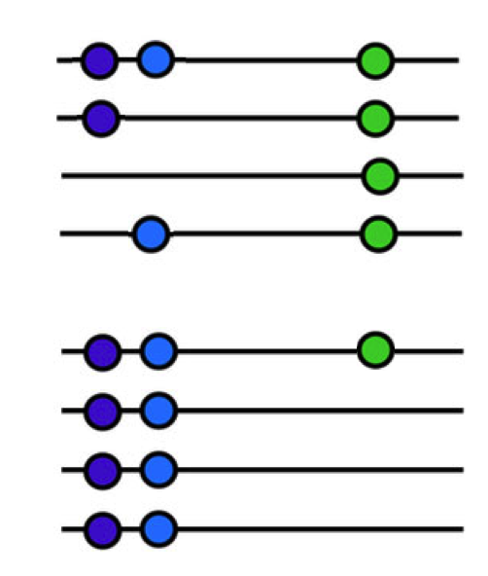
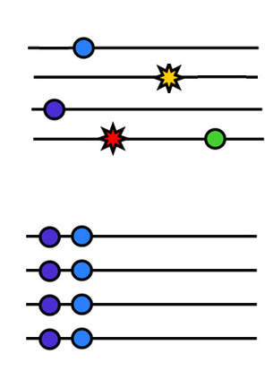
Single marker vs. gene-based association tests
Case genomes
Control genomes

Slide 5
Gene-based test in VAAST
(Variant Annotation, Analysis, and Search Tool)
VAAST employs a Composite Likelihood Ratio Test (CLRT_{v}) that combines:
  Case and control allele frequencies (effect sizes allowed to vary for each variant)
  Variant prioritization based on amino acid substitution and phylogenetic conservation (CASM score in VAAST2)
Variants included based on model selection (Akaike Information Criterion)
P-values estimated via permutation (covariates incorporated using a covariate adjusted permutation test)
Yandell M*, Huff CD*, Hu H*, et al. Genome Research, 2011.
Hu H*, Huff CD*, et al., Genetic Epidemiology, 2013.
Kennedy BJ, …, Huff CD, Current Protocols in Human Genetics, 2014.

Slide 6
Performance of gene-based association tests in simulation studies
Hu H*, Huff CD*, et al., Genetic Epidemiology, 2013.

Slide 7
Gene-based association tests applied to breast cancer case-control sequencing data in CHEK2
(α = 5x10⁻⁴)
-O
Required sample sizes nearly doubled when missense variants are excluded from the analysis.
Hu H*, Huff CD*, et al., Genetic Epidemiology, 2013.

Slide 8
Power gain/loss by combining missense and LGD variation
Unmatched TCGA-NDAR data with XQC
Power estimated from 1000 bootstraps, with 250 cases and 1,000 controls

Slide 9
New software to support gene-based association testing in large-scale datasets:
Recent whole-exome benchmarks from a 4 core MacBook Pro laptop on 50,000 cases and 50,000 controls
Test statistic | P-value calculation | Runtime
CMC | Analytic | 1.9 hours
RVT1 | Analytic | 2.1 hours
RVT2 | Analytic | 2.25 hours
VAAST | 10,000 permutations | 11.6 hours
SKAT-O | Analytic | 39.4 hours
WSS | 10,000 permutations | 19.1 hours
Ryan Bohlender

Slide 10
Familial sequencing studies with pVAAST
Designed to analyze whole-exome or whole-genome sequence data in families to identify variants causing disease risk or influencing disease risk.
pVAAST combines three techniques in a single integrated statistical test:
  Gene-based, rare-variant case-control association (VAAST)
  Functional variant prediction (VAAST)
  Linkage analysis (pVAAST)
P-values calculated by a combination of permutation and gene-drop simulation.
Hu H, … Huff CD, Nature Biotechnology, 2014.

Slide 11


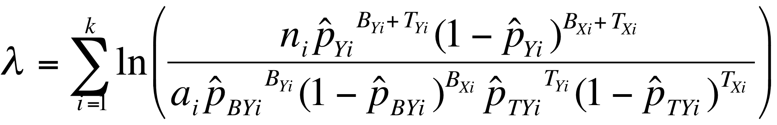
Framework of pVAAST
Cases
Cases
Controls
Controls
CLRT_{v}
Hu H, … Huff CD, Nature Biotechnology, 2014.

Slide 12
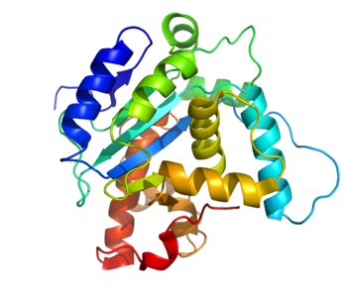
Framework of pVAAST
Cases
Cases
Controls
Variant classifier information
Controls
Variant classifier information
CLRT_{v}
Hu H, … Huff CD, Nature Biotechnology, 2014.

Slide 13
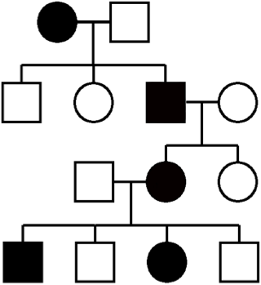
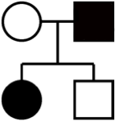
Framework of pVAAST
Pedigrees
Cases
Cases
Controls
Variant classifier information
Controls
Variant classifier information
CLRT_{v}
Hu H, … Huff CD, Nature Biotechnology, 2014.

Slide 14
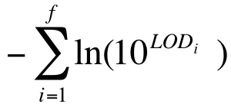
Framework of pVAAST
Pedigrees
Unrelated cases
Cases
Cases
Controls
Variant classifier information
Controls
Variant classifier information
CLRT_{v}
Hu H, … Huff CD, Nature Biotechnology, 2014.

Slide 15
Framework of pVAAST
Pedigrees
Linkage information
Unrelated cases
Cases
Cases
Controls
Linkage information
Variant classifier information
Controls
Variant classifier information
CLRT_{v}
CLRT_{p}
Hu H, … Huff CD, Nature Biotechnology, 2014.

Slide 16
A linkage model designed for sequencing data
Evaluates compound heterozygotes under the recessive model
Evaluates mutations under the dominant model
Gene-based, combining information from multiple variants across families
Selects variants to evaluate based on either:
  Case-control and variant prioritization information (optimal for multiple families)
  A combination of LOD score, case-control, and variant prioritization (optimal for a single family)
  LOD score only
Hu H, … Huff CD, Nature Biotechnology, 2014.

Slide 17
Number of families needed to identify a causal gene with 80% power (α=5x10⁻⁴⁾
Dominant
(affected 1st cousins)
Recessive
(affected siblings)
De novo
(parent-offspring trio)
Simulations based on a Wright-Fisher model with 50% of variants
causal and causal variants absent among controls. Control sample size was 1000.

Slide 18
GOLM1: A novel melanoma susceptibility gene
Previous linkage studies had implicated and replicated the locus, but with LOD scores < 3.
Whole-exome sequencing of 30 individuals in 15 families identified a rare, nonsynymous variant segregating with disease.
Gene-level p-value of 0.001 in pVAAST.
Variant frequency sufficient for case-control genotype validation.
  p=0.0002, OR=9.8 in 454 familial cases and 396 controls from Utah
  p=0.015, OR=2.5 in 1,534 cases and 1,146 controls from Texas
Teerlink C, Huff CD, …, Cannon-Albright, LA, JNCI, 2018.

Slide 19
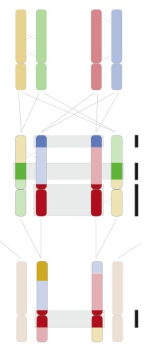
Identifying cryptic relationships and validating known relationships from IBD segment data using ERSA
Generation 1
Generation 2
Generation 3
Huff CD*, Witherspoon DJ*, et al. Genome Research, 2011.

Slide 20
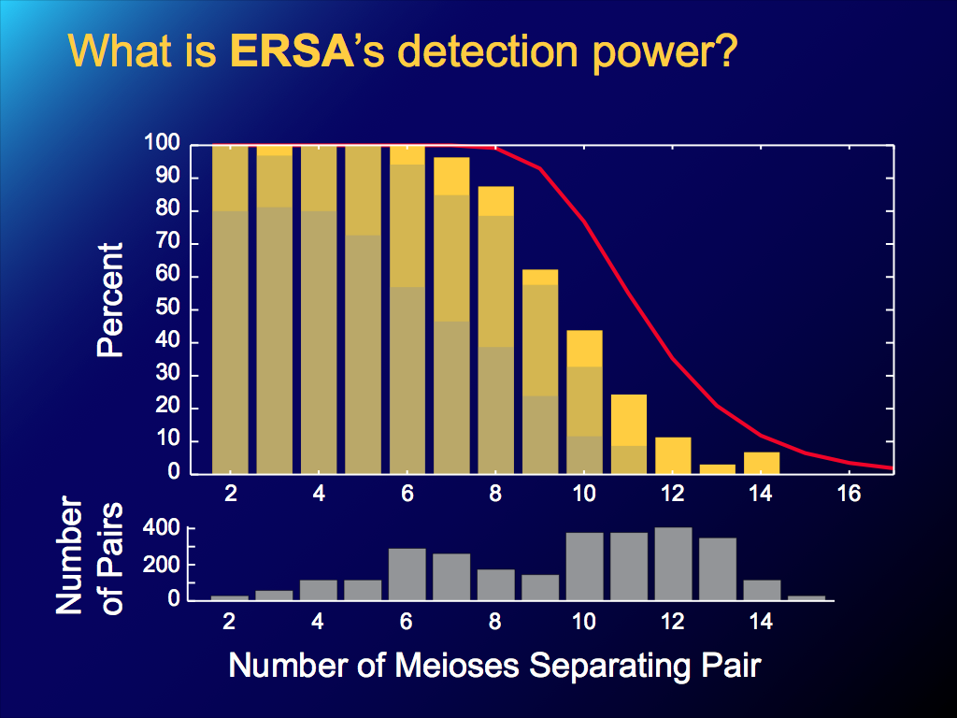
ERSA’s relationship detection accuracy from high-density SNP data
p<0.05
+/- 1 meiosis
Exact match

Slide 21
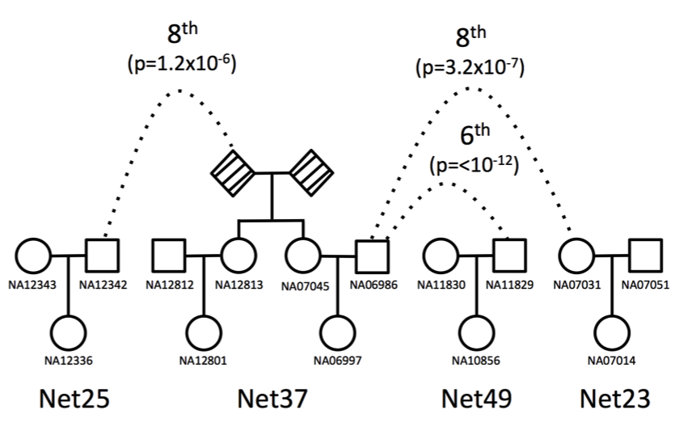
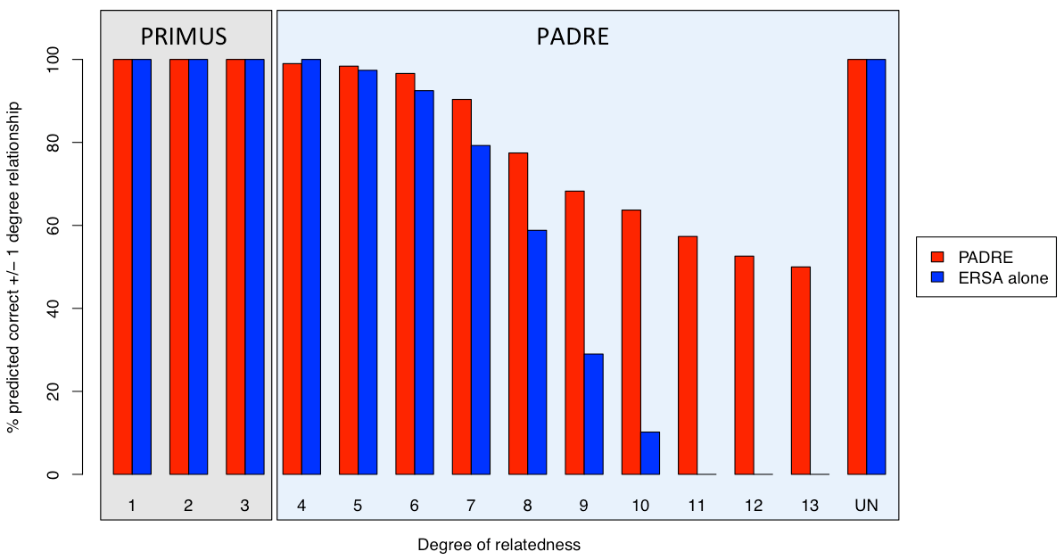
PADRE: Pedigree aware distant relationship estimation
A large pedigree reconstructed from HapMap3 CEU
Pairwise relationship accuracy on simulated pedigrees
PADRE¹ combines ERSA and PRIMUS² in a composite likelihood framework to reconstruct large, distantly related pedigrees.
Staples J., …, Below, J.E., Huff, C.D. AJHG, 2016.
Staples J., … Below J.E., AJHG, 2014.

Slide 22
Sequencing case-control studies with heterogeneous datasets
Heterogeneity in capture and sequencing technologies and protocols can introduce strong biases which overwhelm subtle signals of disease association.
For heterogeneous sequencing association studies, reprocessing of raw data and joint genotyping:
  Is a major computational effort.
  Is necessary but not sufficient – major platform biases often remain due to differences in sample preparation, exome capture, and sequencing.

Slide 23
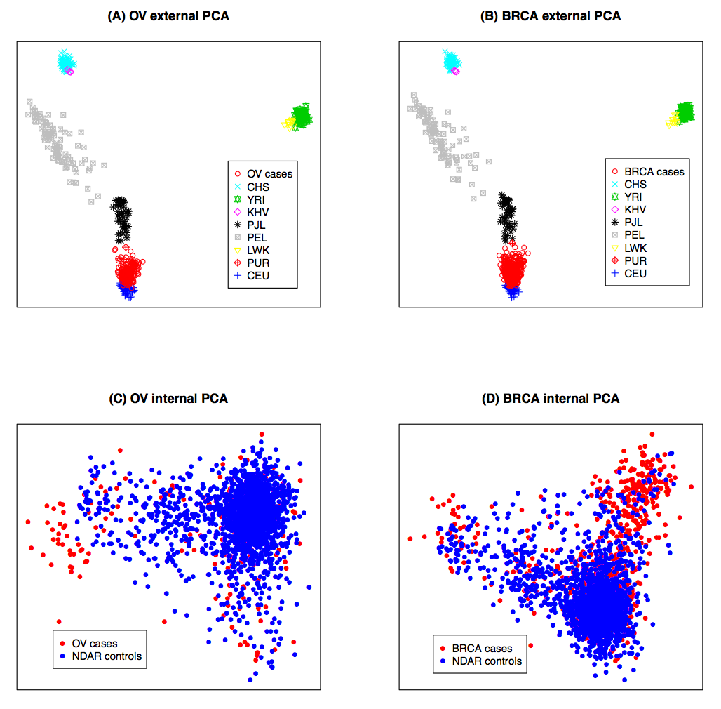
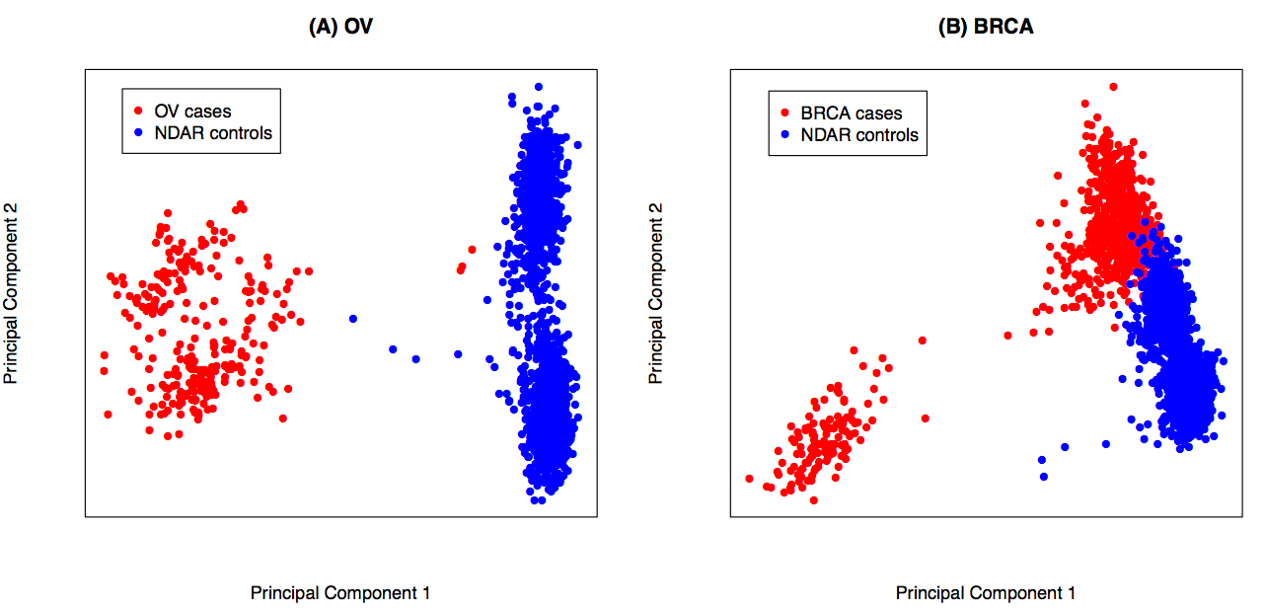
PCA of TCGA ovarian cancer cases projected onto 1000 Genomes reference panel

Slide 24
Joint genotyping/variant calling is generally necessary but not sufficient for cross-platform association studies
Without joint genotyping
With joint genotyping

Slide 25
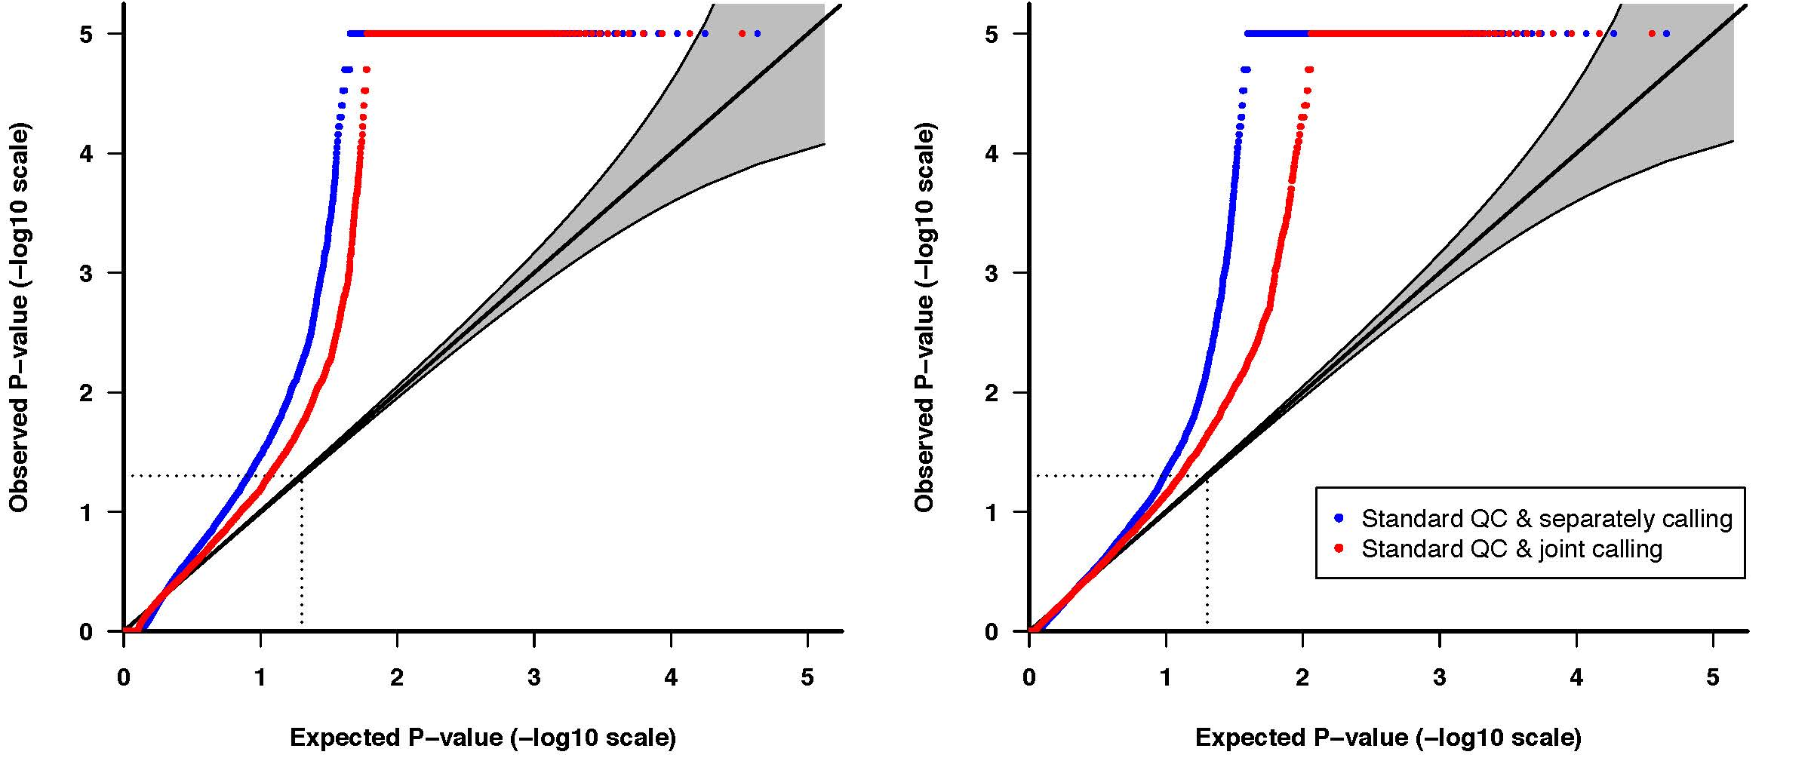
Joint genotyping/variant calling is generally necessary but not sufficient for cross-platform association studies
Ovarian Cancer
Breast Cancer
Whole-exome gene-based association tests (VAAST 2)

Slide 26
The cross-Platform Association Toolkit (XPAT)
Yao Yu, …, Huff CD, Nucleic Acids Research, 2018.

Slide 27
The cross-Platform Association Toolkit (XPAT)
Sample level:
Platform-specific detection of gender misidentification
Platform-specific Individual missing genotype rate (NC90)
Manual Steps:
Exclude low quality samples
Address gender misidentification
Standard QC metrics – mask by
Proportion of reads supporting alternative allele
Platform-specific missing genotype rates
Hardy-Weinberg equilibrium
Two stage PCA
External: Each individual will be projected onto a reference panel PCA space (default 1KG)
Internal: PCA conducted using only internal samples with samples and markers that passed standard QC.
Cross platform QC metrics – mask by
Cross-platform differential missing call rates
Cross-platform differential allele frequencies
Optionally: odds ratio test for variants with implausibly large effect sizes
Build covariate matrix file, variants mask list, figures and genotype files for downstream association studies
Yao Yu

Slide 28
Quantile-quantile (QQ) plots of VAAST 2 results, with joint calling and standard QC (blue line) and XPAT (red line)
Ovarian Cancer
Breast Cancer
Whole-exome gene-based association tests (VAAST 2)

Slide 29
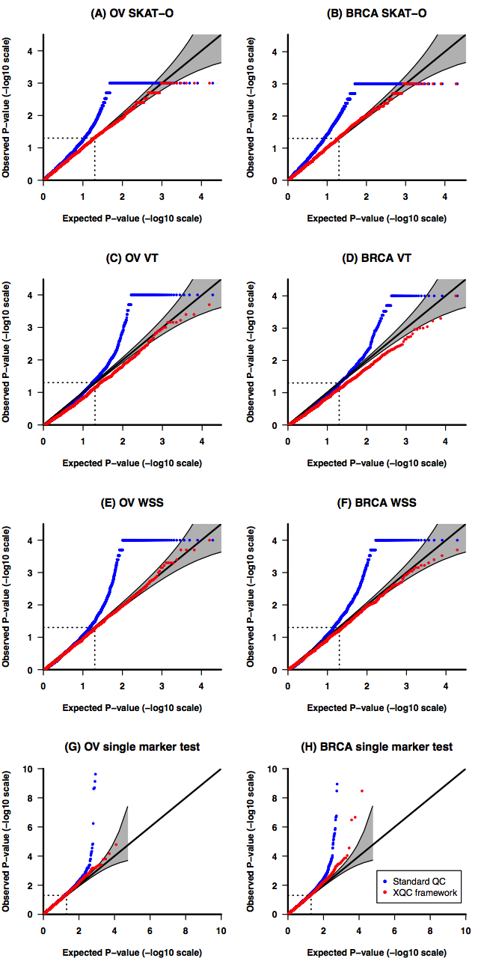
QQ-plots from four association tests with XPAT (red line) vs. joint calling and standard QC (blue line)
Ovarian Cancer
Breast Cancer
SKAT-O
WSS
SKAT-O
WSS
VT
Single marker (logistic regression)
VT
Single marker (logistic regression)

Slide 30
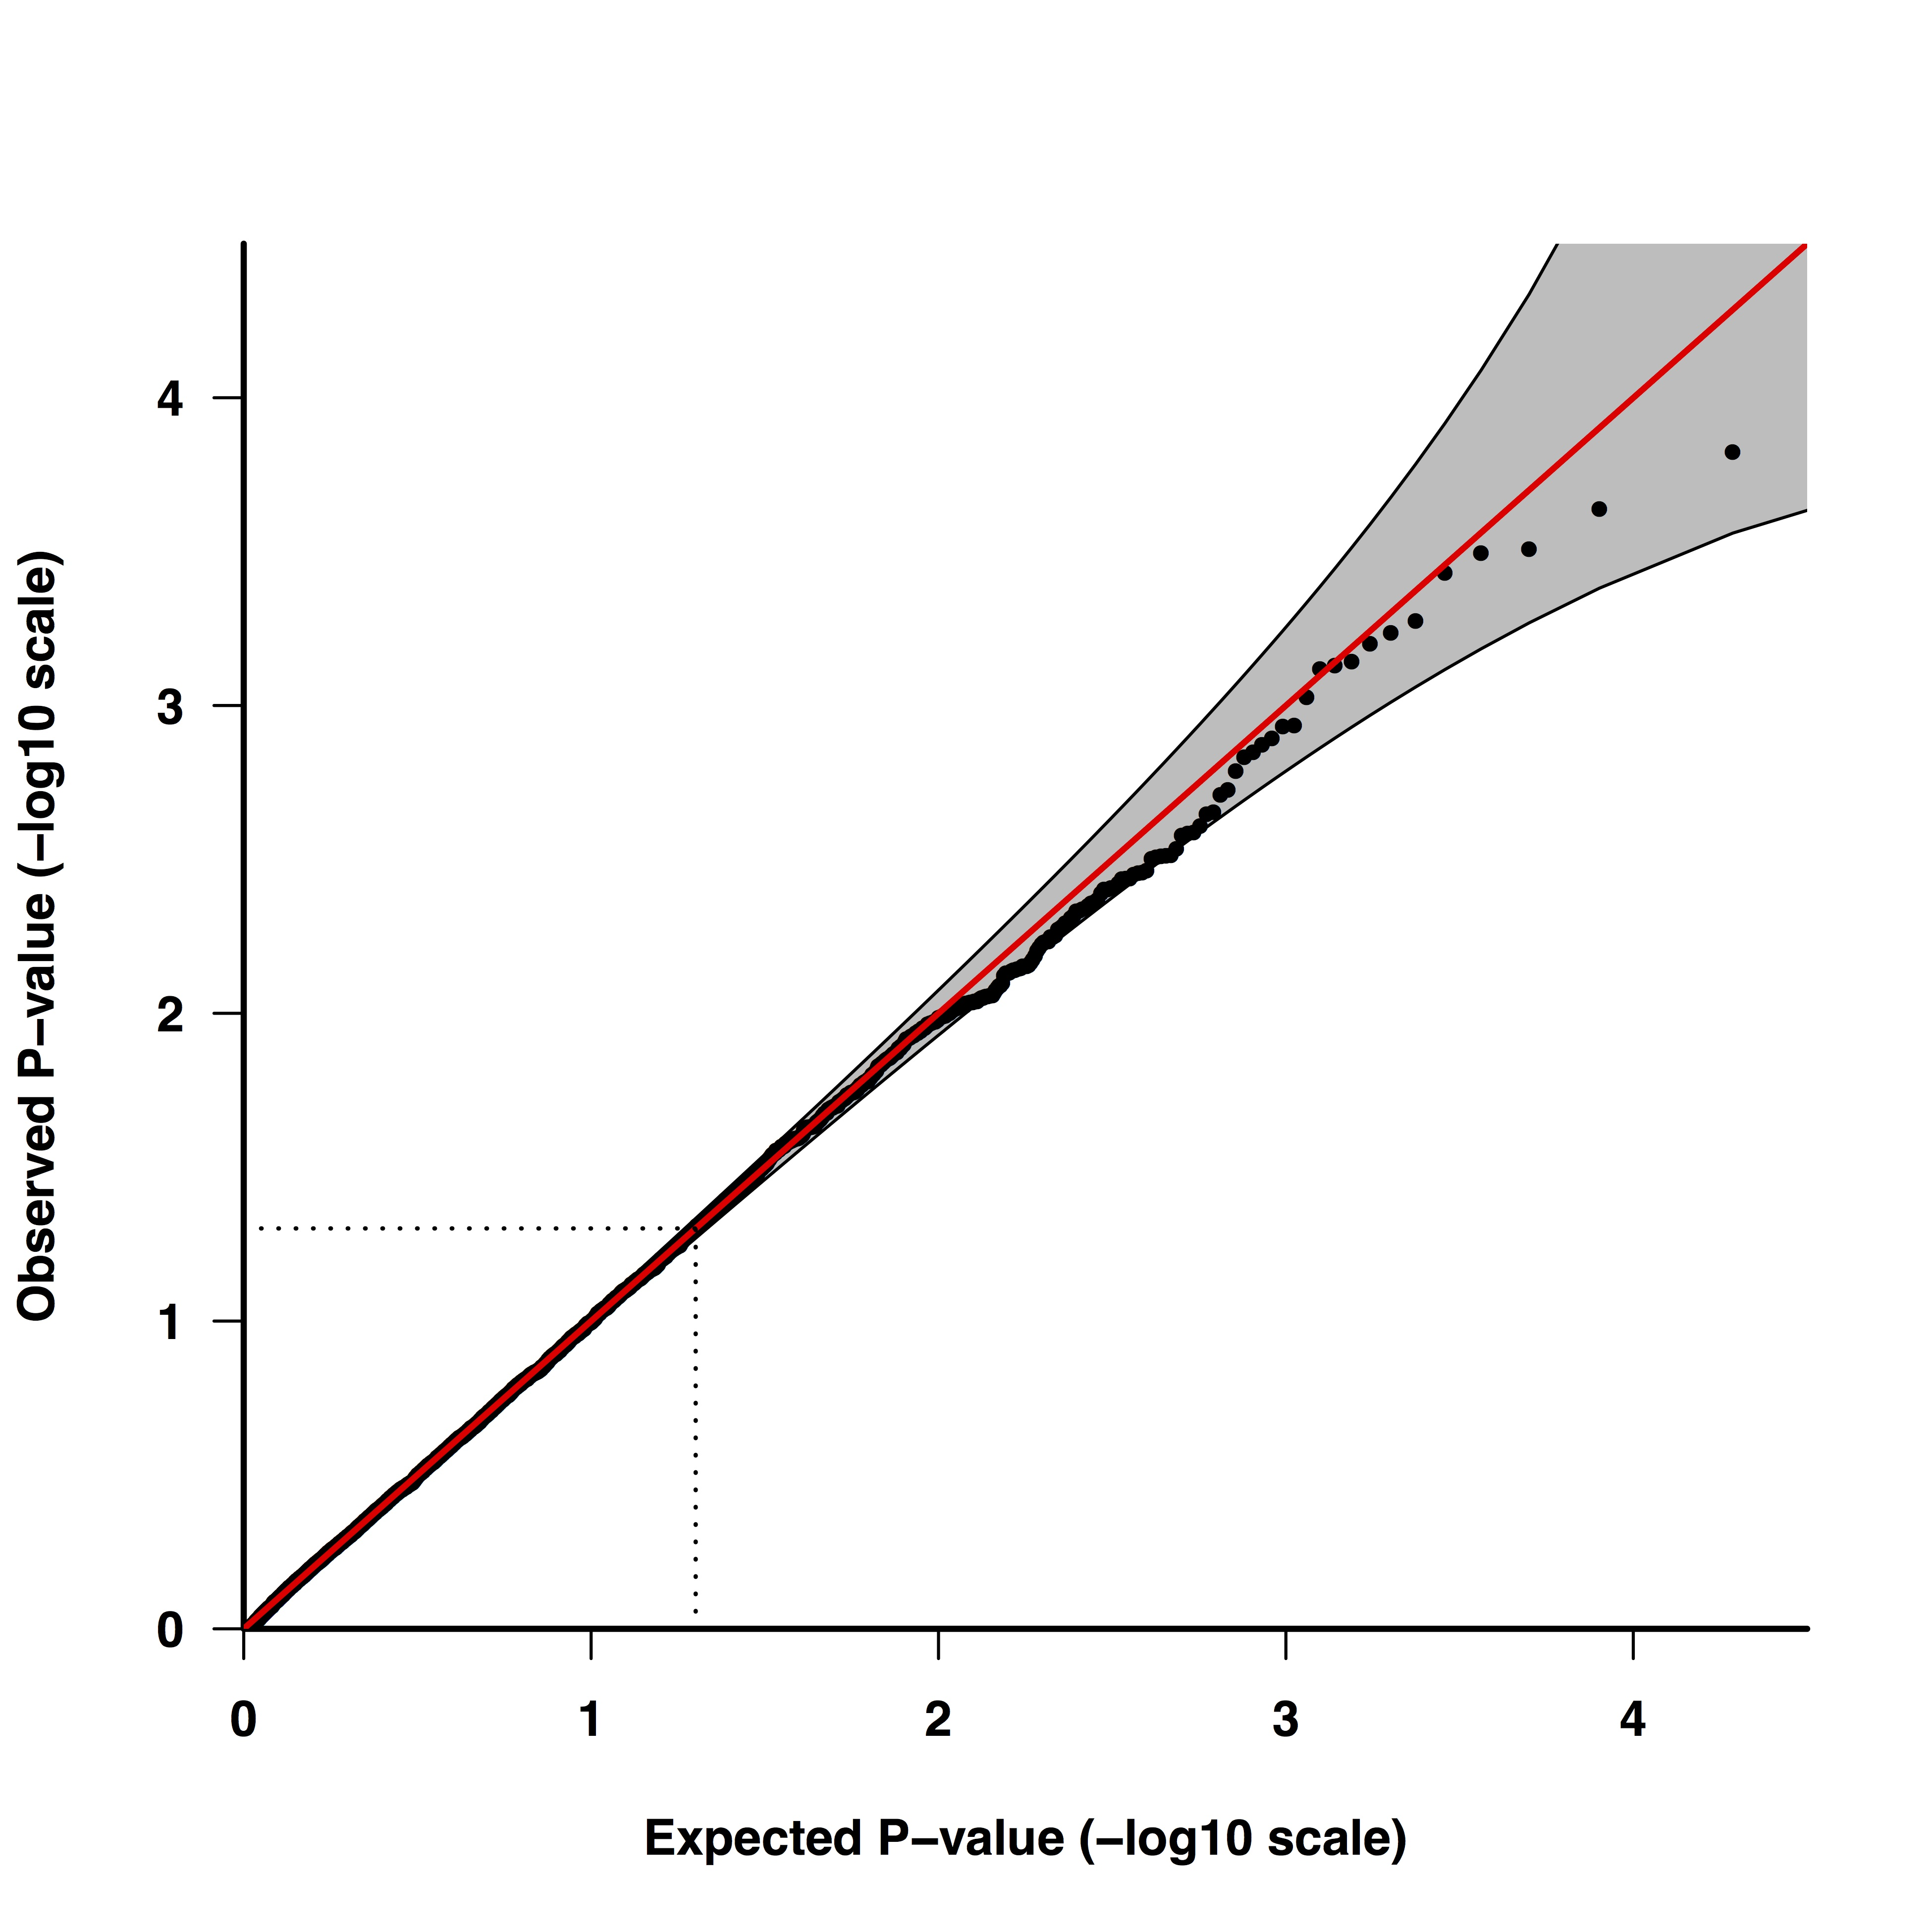
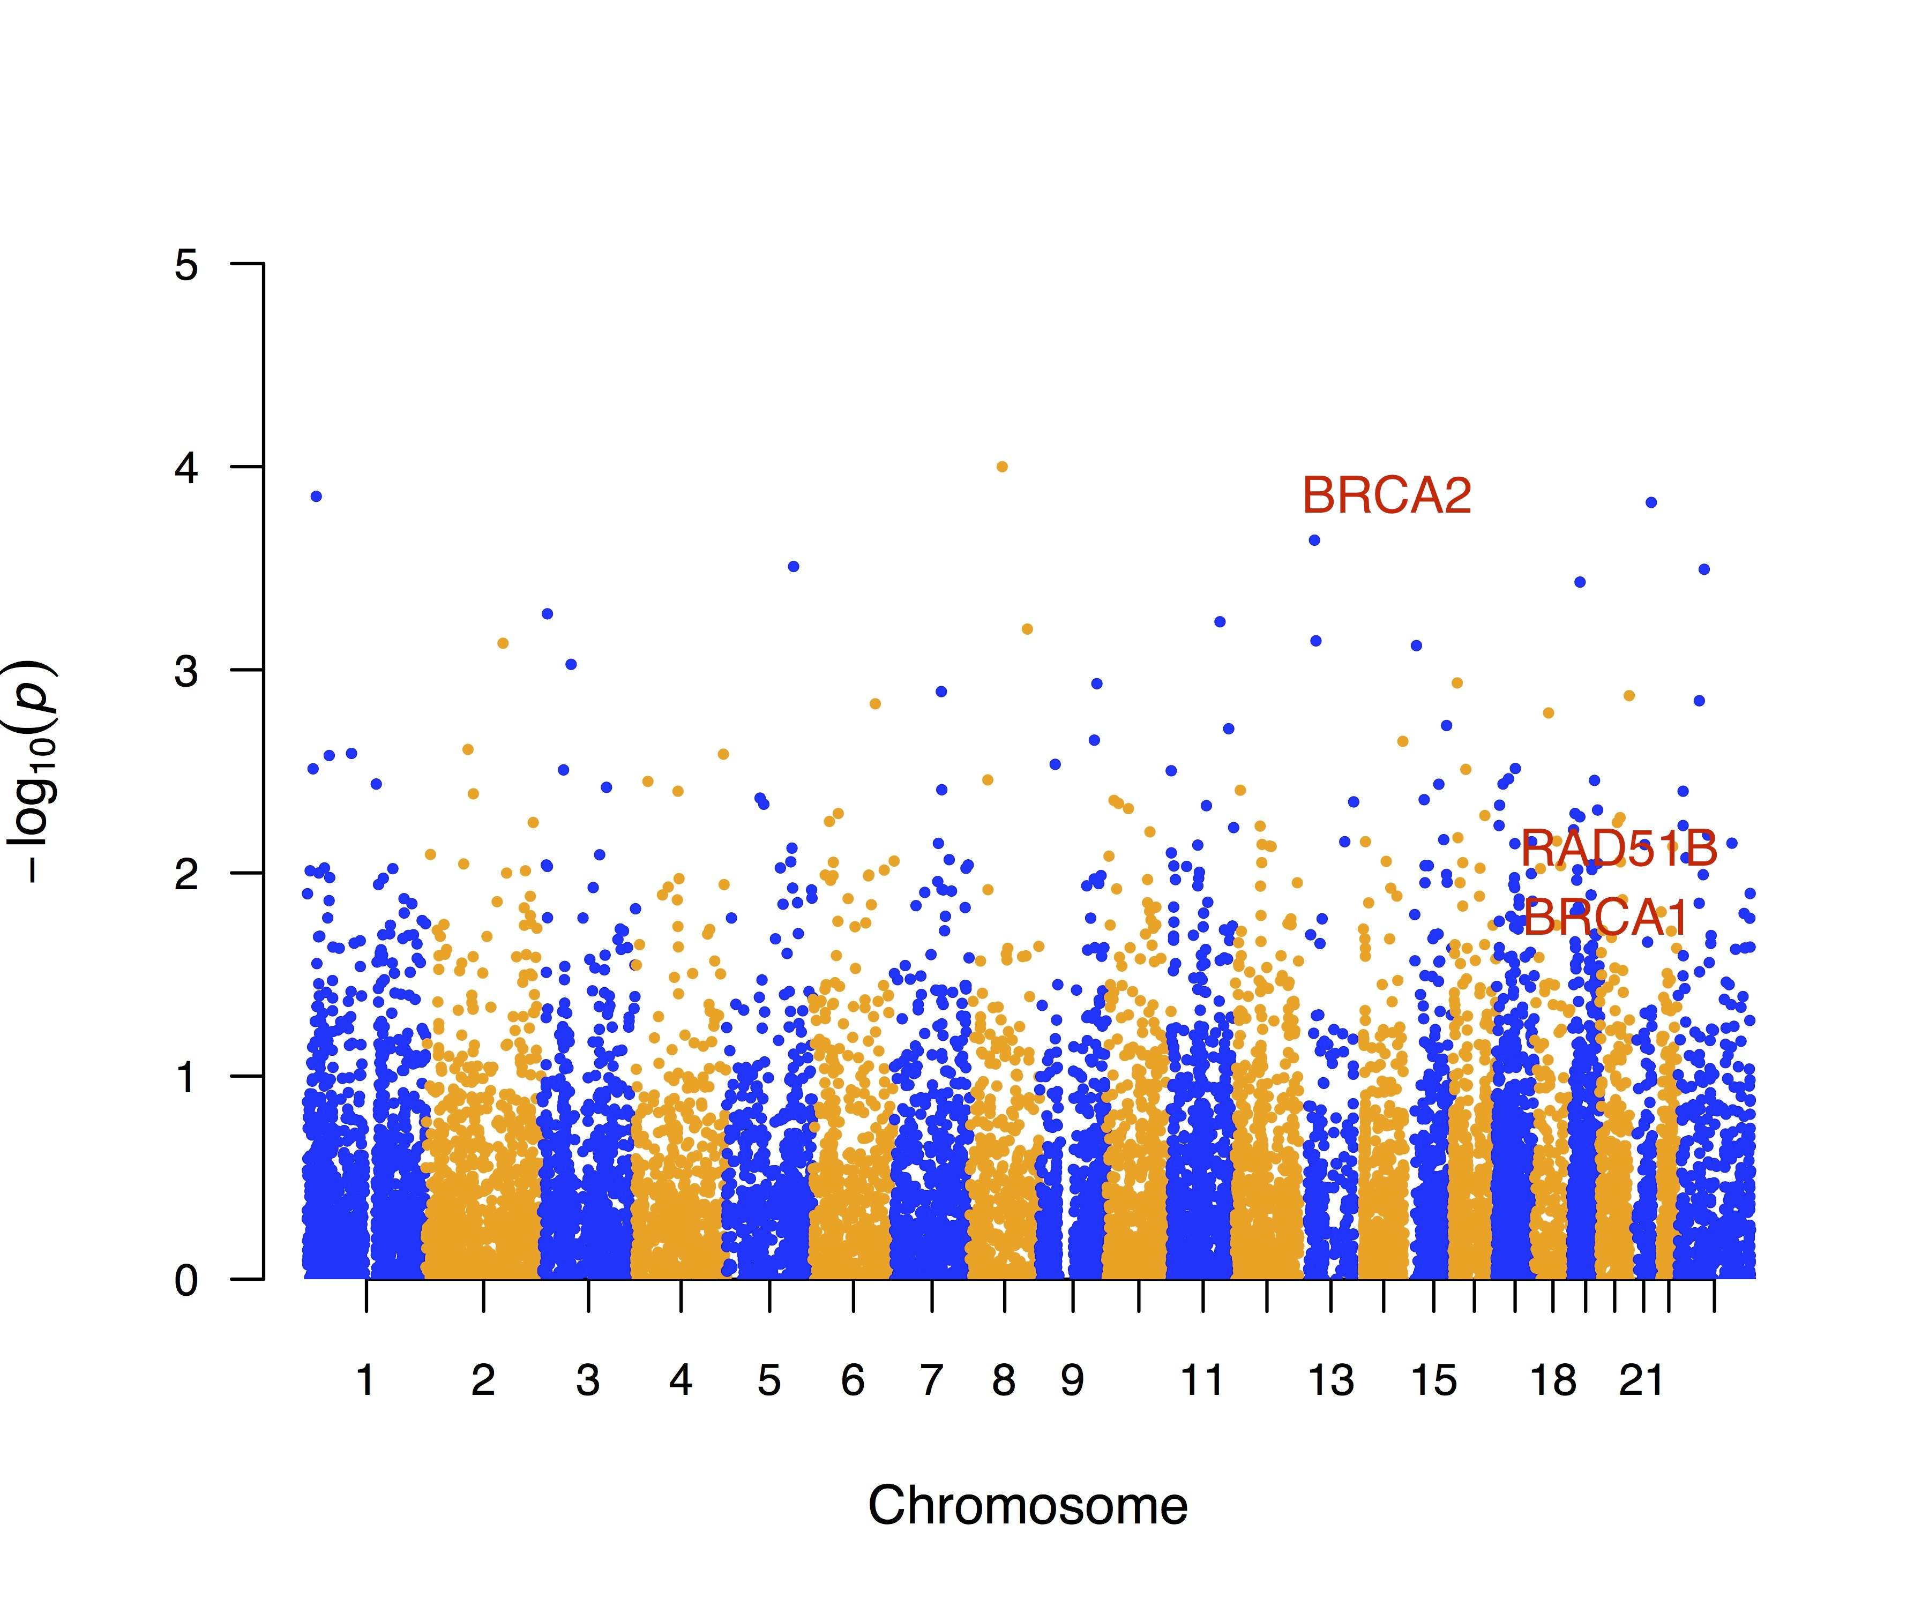
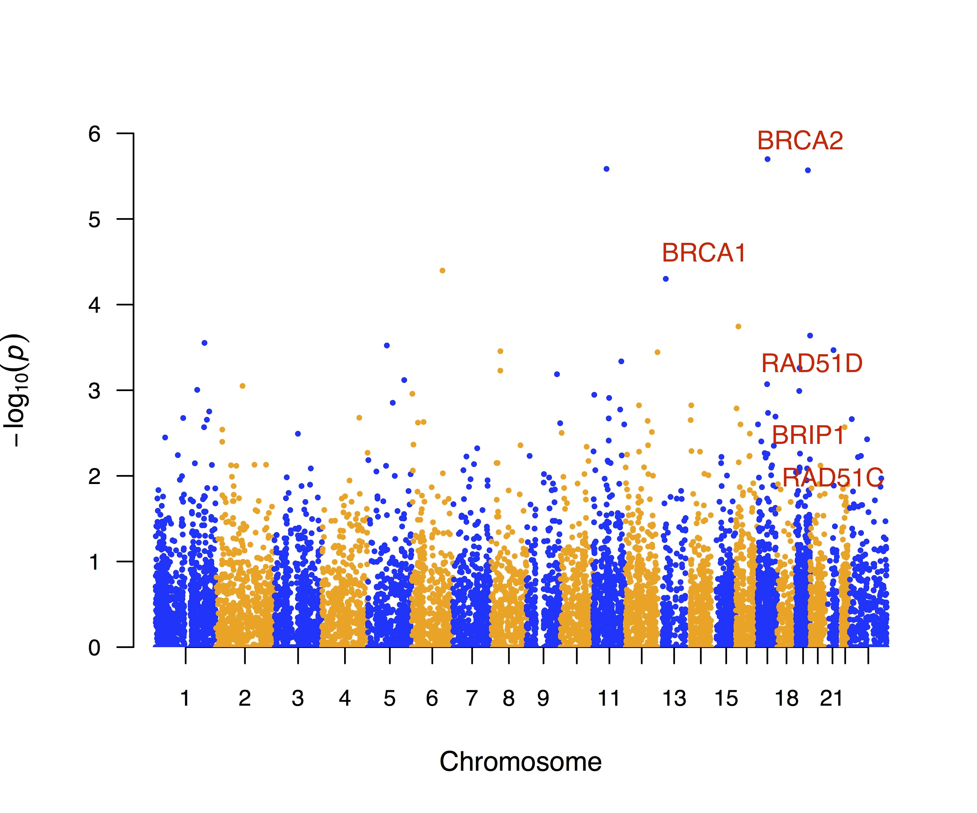
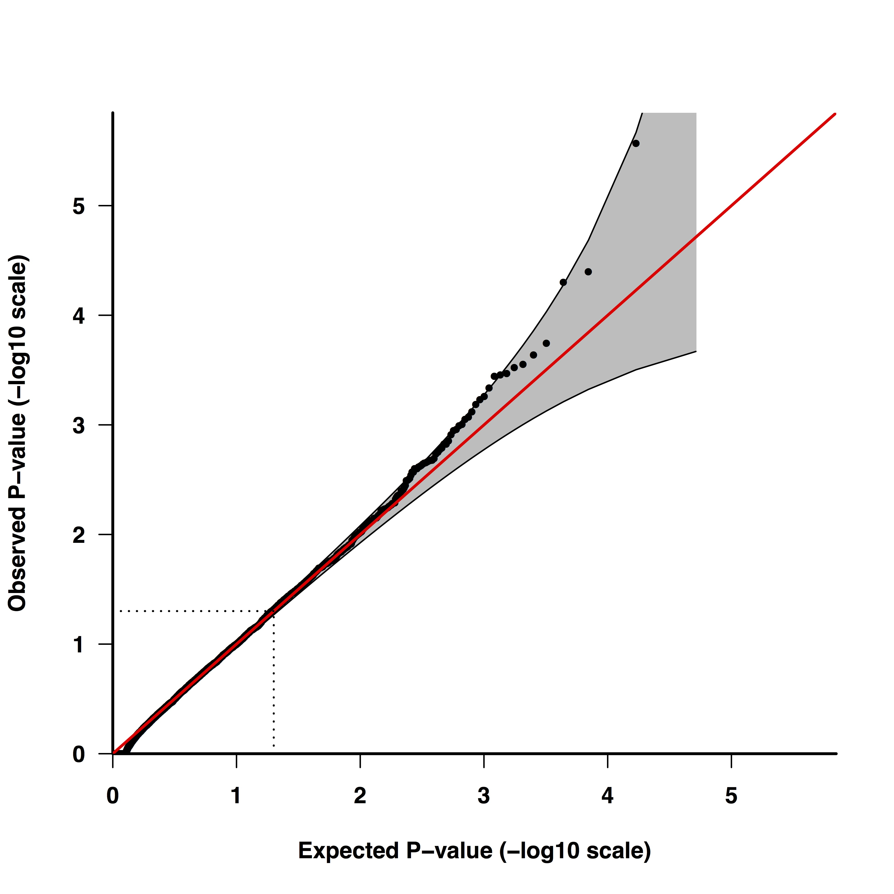
Case-control exome analyses with XPAT-VAAST 2
Breast Cancer
873 cases, 1722 controls
Gene | p
BRCA2 | 2x10⁻⁴
RAD51D | 0.0087
BRCA1 | 0.0087
NEIL3 | 0.031
CHEK2 | 0.043
NEIL1 | 0.048
PALB2 | 0.077
ATM | 0.14
RAD50 | 0.19
RINT1 | 0.41
RAD51C | 0.45
CDH1 | 0.55
TP53 | 0.56
Ovarian Cancer
272 cases, 1722 controls
BRCA1 | 1x10⁻⁵
BRCA2 | 5x10⁻⁵
RAD51D | 0.0061
BRIP1 | 0.0075
RAD51C | 0.024
PALB2 | 0.044
TP53 | 0.076
Yao Yu and Fulan Hu

Slide 31
Gene-based association test results for established breast and ovarian cancer susceptibility genes with p<0.05 in one or more tests
Yao Yu, …, Huff CD, Nucleic Acids Research, 2017.

Slide 32
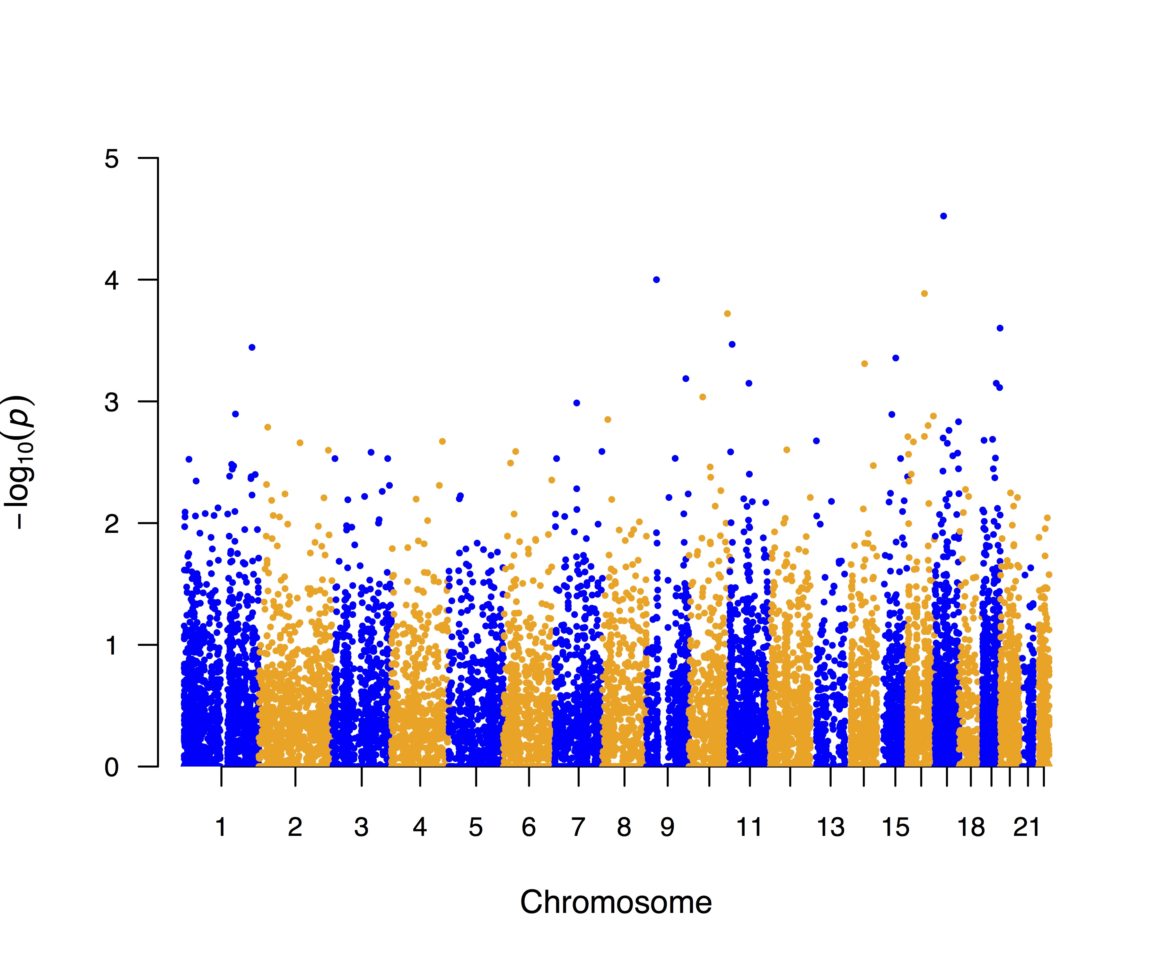
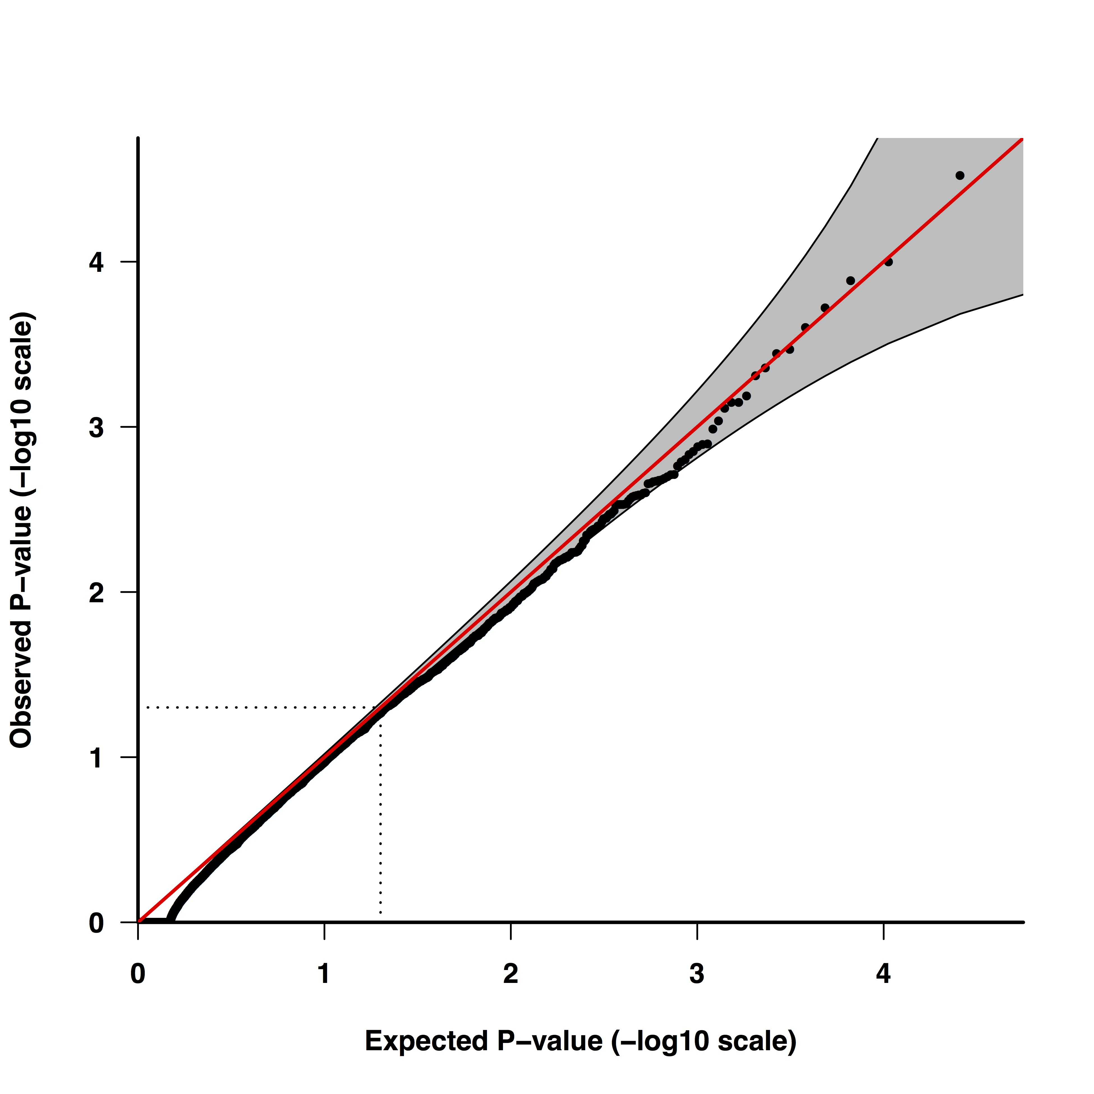
Soft Tissue Sarcoma XPAT-VAAST 2 results (219 cases, 3507 controls)
NF1 (p = 3x10⁻⁵)
Fulan Hu, Yao Yu, and Roger Chen

Slide 33
Soft-tissue Sarcoma association results
Gene | Variant category | Overall OR | MPNST OR
NF1 | LGD | 39.4 (7.1 – 219) | 1146 (149 – 8804)
NF1 | Non-LGD, predicted pathogenic | 16.3 (5.5 – 48.4) | 127 (22.5 – 719)
RB1 | LGD | Infinity (1.05 – Infinity) | -
RB1 | Non-LGD, predicted pathogenic | 12.0 (2.4 – 59) | -
TP53 | LGD | - | -
TP53 | Non-LGD, predicted pathogenic | Infinity (6.66 – Infinity) | -
MSH2 | LGD | 33 (2.4 – 462) | -
MSH2 | Non-LGD, predicted pathogenic | - | -
Fulan Hu, Yao Yu, Roger Chen

Slide 34
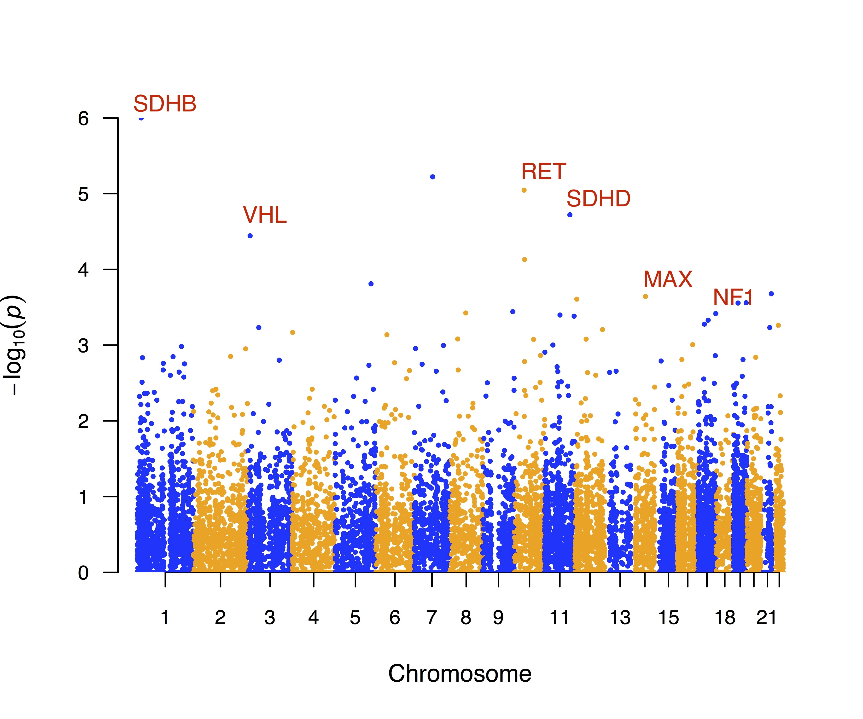
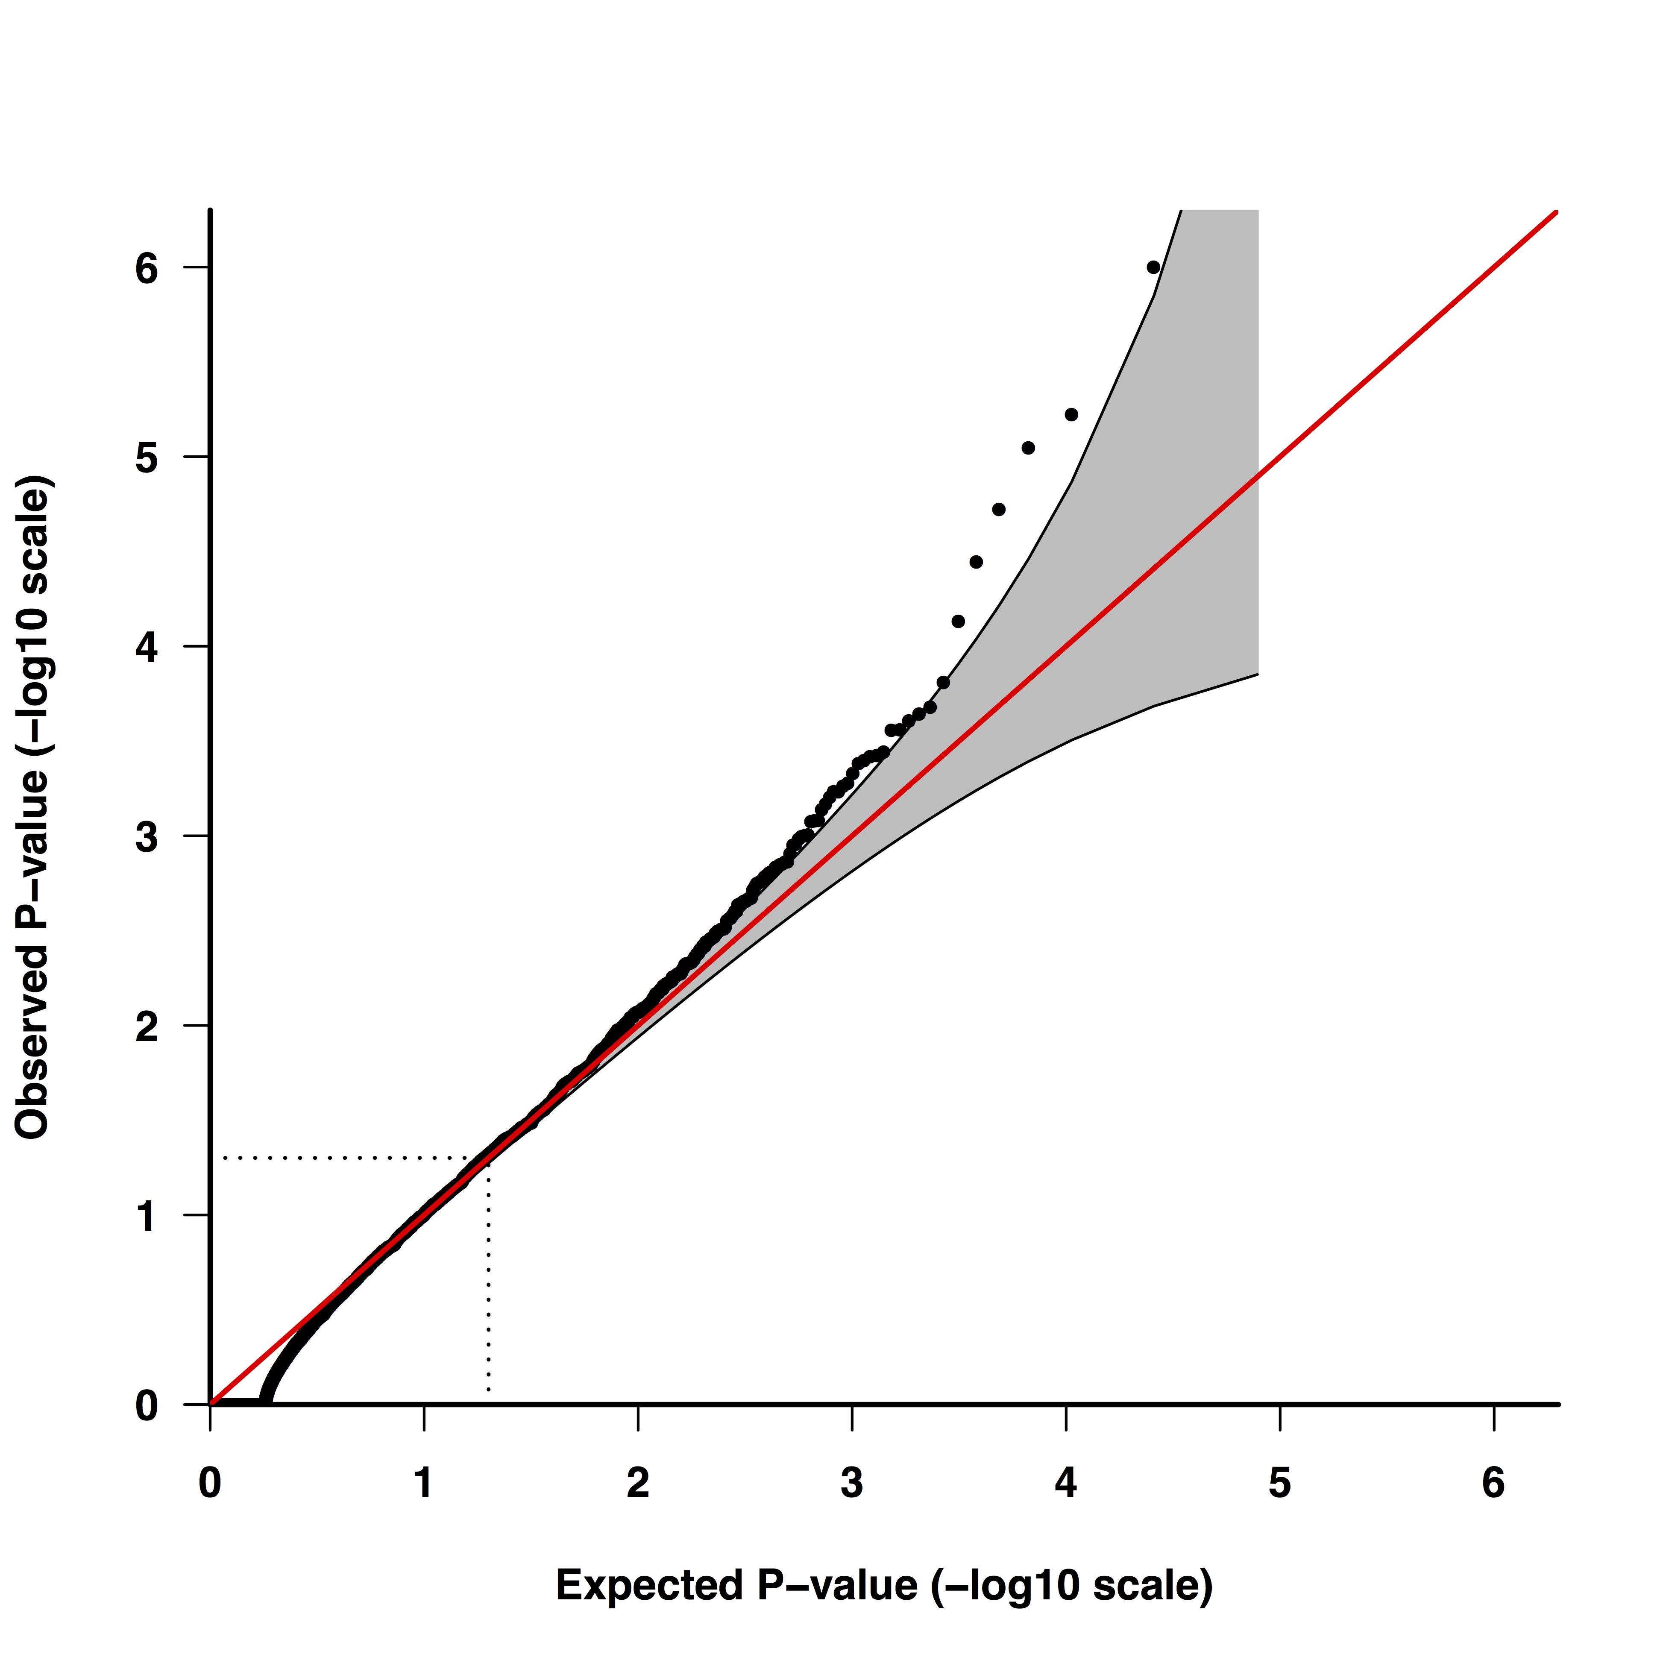
Pheochromocytoma and paraganglioma XPAT-VAAST 2 results
(144 cases, 3507 controls)
Variant effect size estimates
Gene | OR (95% CI) for Likely gene disrupting (LGD) variants | OR (95% CI) for predicted damaging missense (non-LGD) variants (CASM > 2)
SDHB | 100 (11 – 900) | 45 (13 – 154)
RET | - | 6.6 (2.4 – 17.9)
SDHD | - | -
VHL | - | 16.5 (2.7 – 99.2)
MAX | Infinity | -
NF1 | 50.1 (9.1 – 276) | 1.6 (0.21 – 12.4)
EGLN1 | - | 8.2 (0.8 – 79)
Genes in red have well-established roles in hereditary pheochromocytoma and paraganglioma
Shan Chen and Yao Yu

Slide 35
Somatic-germline interaction
Classic example: Two-hit model of carcinogenesis
Germline dominant, cellular recessive
Germline
Somatic
Non-hereditary
Hereditary
    Examples
    RB1 in retinoblastoma
    BRCA1 and BRCA2 in ovarian cancer
    Most germline variants in APC and colorectal cancer
    Some germline variants in TP53 and Li-Fraumeni syndrome

Slide 36
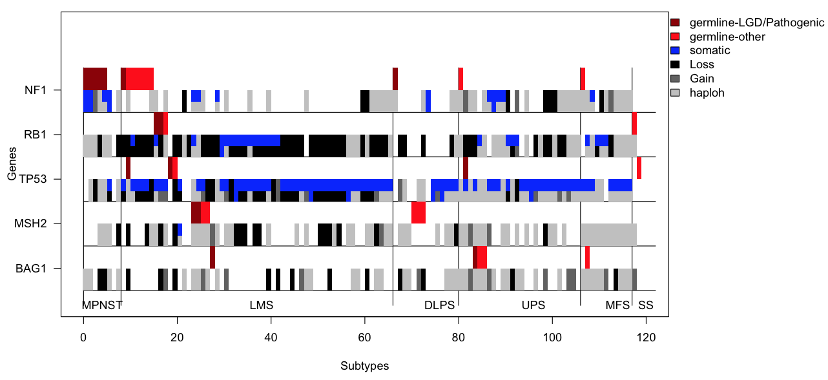
Germline variants and somatic mutational events in soft-tissue sarcoma
hapLOH: Vattathil S, Scheet P, Genome Research, 2013

Slide 37
Ongoing efforts at MD Anderson in melanoma and pancreatic, colorectal, ovarian, and head and neck cancer
Case-control analysis of heterogeneous whole-exome datasets from public repositories and other studies
XPAT and VAAST
Whole-exome sequencing of 50-250 familial cases and matched controls
Whole-exome sequencing of 700-2000 cases and controls
pVAAST
VAAST
Targeted sequencing of top genes in
thousands of cases and matched controls
VAAST
hapLOH
SGI
Sequence tumors of individuals with germline susceptibility variants

Slide 38
Acknowledgements
MD Anderson | University of Utah |  | Institute for Systems Biology | Other Institutions
Huff Lab | Mark Yandell | Lynn Jorde | Lee Hood | Daniel Park
Yao Yu | Steve Guthery | Sean Tavtigian | Jared Roach | Deepak Srivastava
Ryan Bohlender | Hillary Coon | David Goldgar | Gustavo Glusman | Jinchuan Xing
Shankaracharya | Wilfred Wu | Barry Moore | Robert Hubley | Shuoguo Wang
Hao Hu | Rebecca Margraf | Russell Bell | Lee Rowen | Martin G. Reese
Jiun Sheng Chen | Steven Flygare | Karl Voelkerding | Stephen Montsaroff | David J. Galas
Fulan Hu | Karen Eilbeck | Jacob Durtschi | Denise Abbott | Vidu Garg
Shan Chen | Lisa Cannon-Albright | Brett Kennedy |  | Hong Li
 | Erin L. Young | Craig Teerlink |  | Joellen Schildkraut
Paul Scheet |  | Mia Hashibe |  | Simon Gayther
Hua Zhao |  |  |  | Paul Pharaoh
Michelle Hildebrandt |  |  |  | Susan Ramus
Yuanqing Ye |  |  |  | Ellen Goode
Jeffrey E. Lee
Jerry Fowler
Xifeng Wu
Smruthy Sivakumar
Yihua Liu
Research Support
NIH/NIGMS R01 GM104390
NIH/NCI R01 CA195614
NIH/NCI R01 CA81244
NIH/NCI R01 CA177935
NIH/NCI R01 CA188943
MD Anderson Andrew Sabin Family Fellowship Program
MD Anderson Research Computing High Performance Computing (HPC) facility
MD Anderson Sequencing and Microarray Facility
MD Anderson Cancer Prevention Research Training Program (R25T)
MD Anderson Cancer Center Odyssey Program

Slide 39
Hierarchical models to estimate rare variant effect sizes (BRAVOE and HL)
ROC curve for identification of rare variants with effect sizes greater than OR = 1.2.
Table 1. Mean-Square Error of log(OR) prediction.

Slide 40
Multi-family results
Common, complex disease simulations
Structure of each simulated family
Control sample size of 1000
Locus population attributable risk of 0.05
50% of variants causal
Average variant frequency of 0.002
Odds ratio of causal variant a function of allele frequency with average odds ratio of 2.0

Slide 41
ERSA 2.0: Masking false-positive prone IBD regions in whole-genome sequence data
Li, H., …, Huff, C.D. PLoS Genetics, 2014.

Slide 42
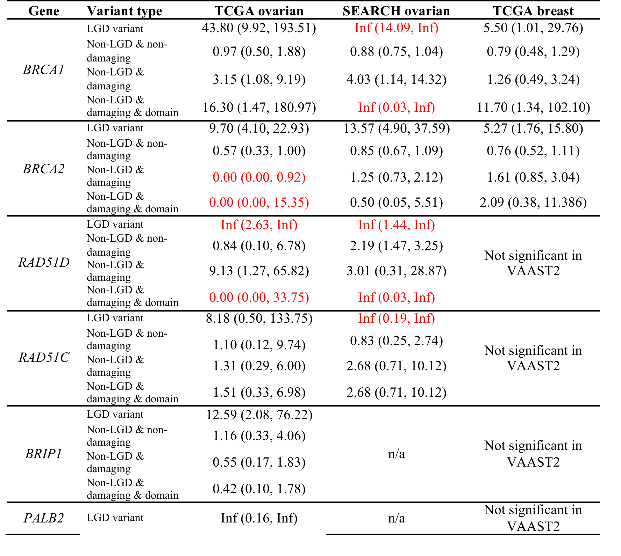
Odds ratio estimates for breast and ovarian cancer susceptibility genes
Results in red calculated from a Fisher’s Exact Test
Yao Yu, …, Huff CD, Nucleic Acids Research, 2017.

Slide 43
Somatic-Germline Interaction example from TCGA
BRCA1 in breast cancer, 2-hit model
SGI p-value = 0.007
 | Proportion with a detectable somatic event
BRCA1 carriers (inferred from VAAST using SGI¹) | 0.82
Non-carriers | 0.55
Odds ratio = 3.7
Suggests that copy number alterations at BRCA1 tend to occur more frequently in the tumors of BRCA1 carriers, indicative of a dosage effect in the direction of a 2-hit model in breast cancer.
1) Hu H, Huff CD, Pac Symp Biocomput, 2014.

Slide 44
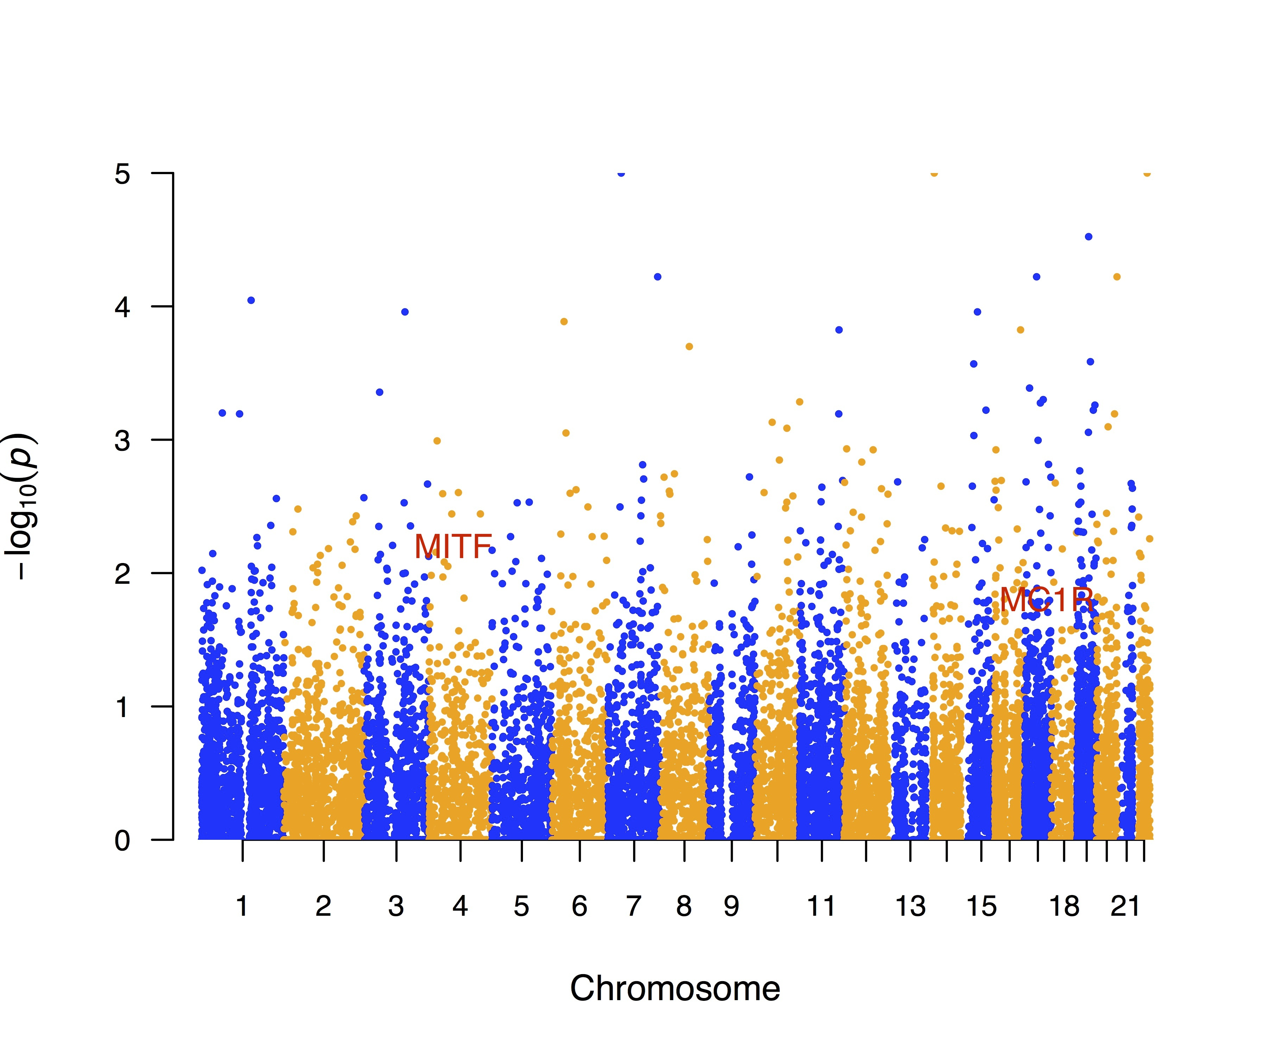
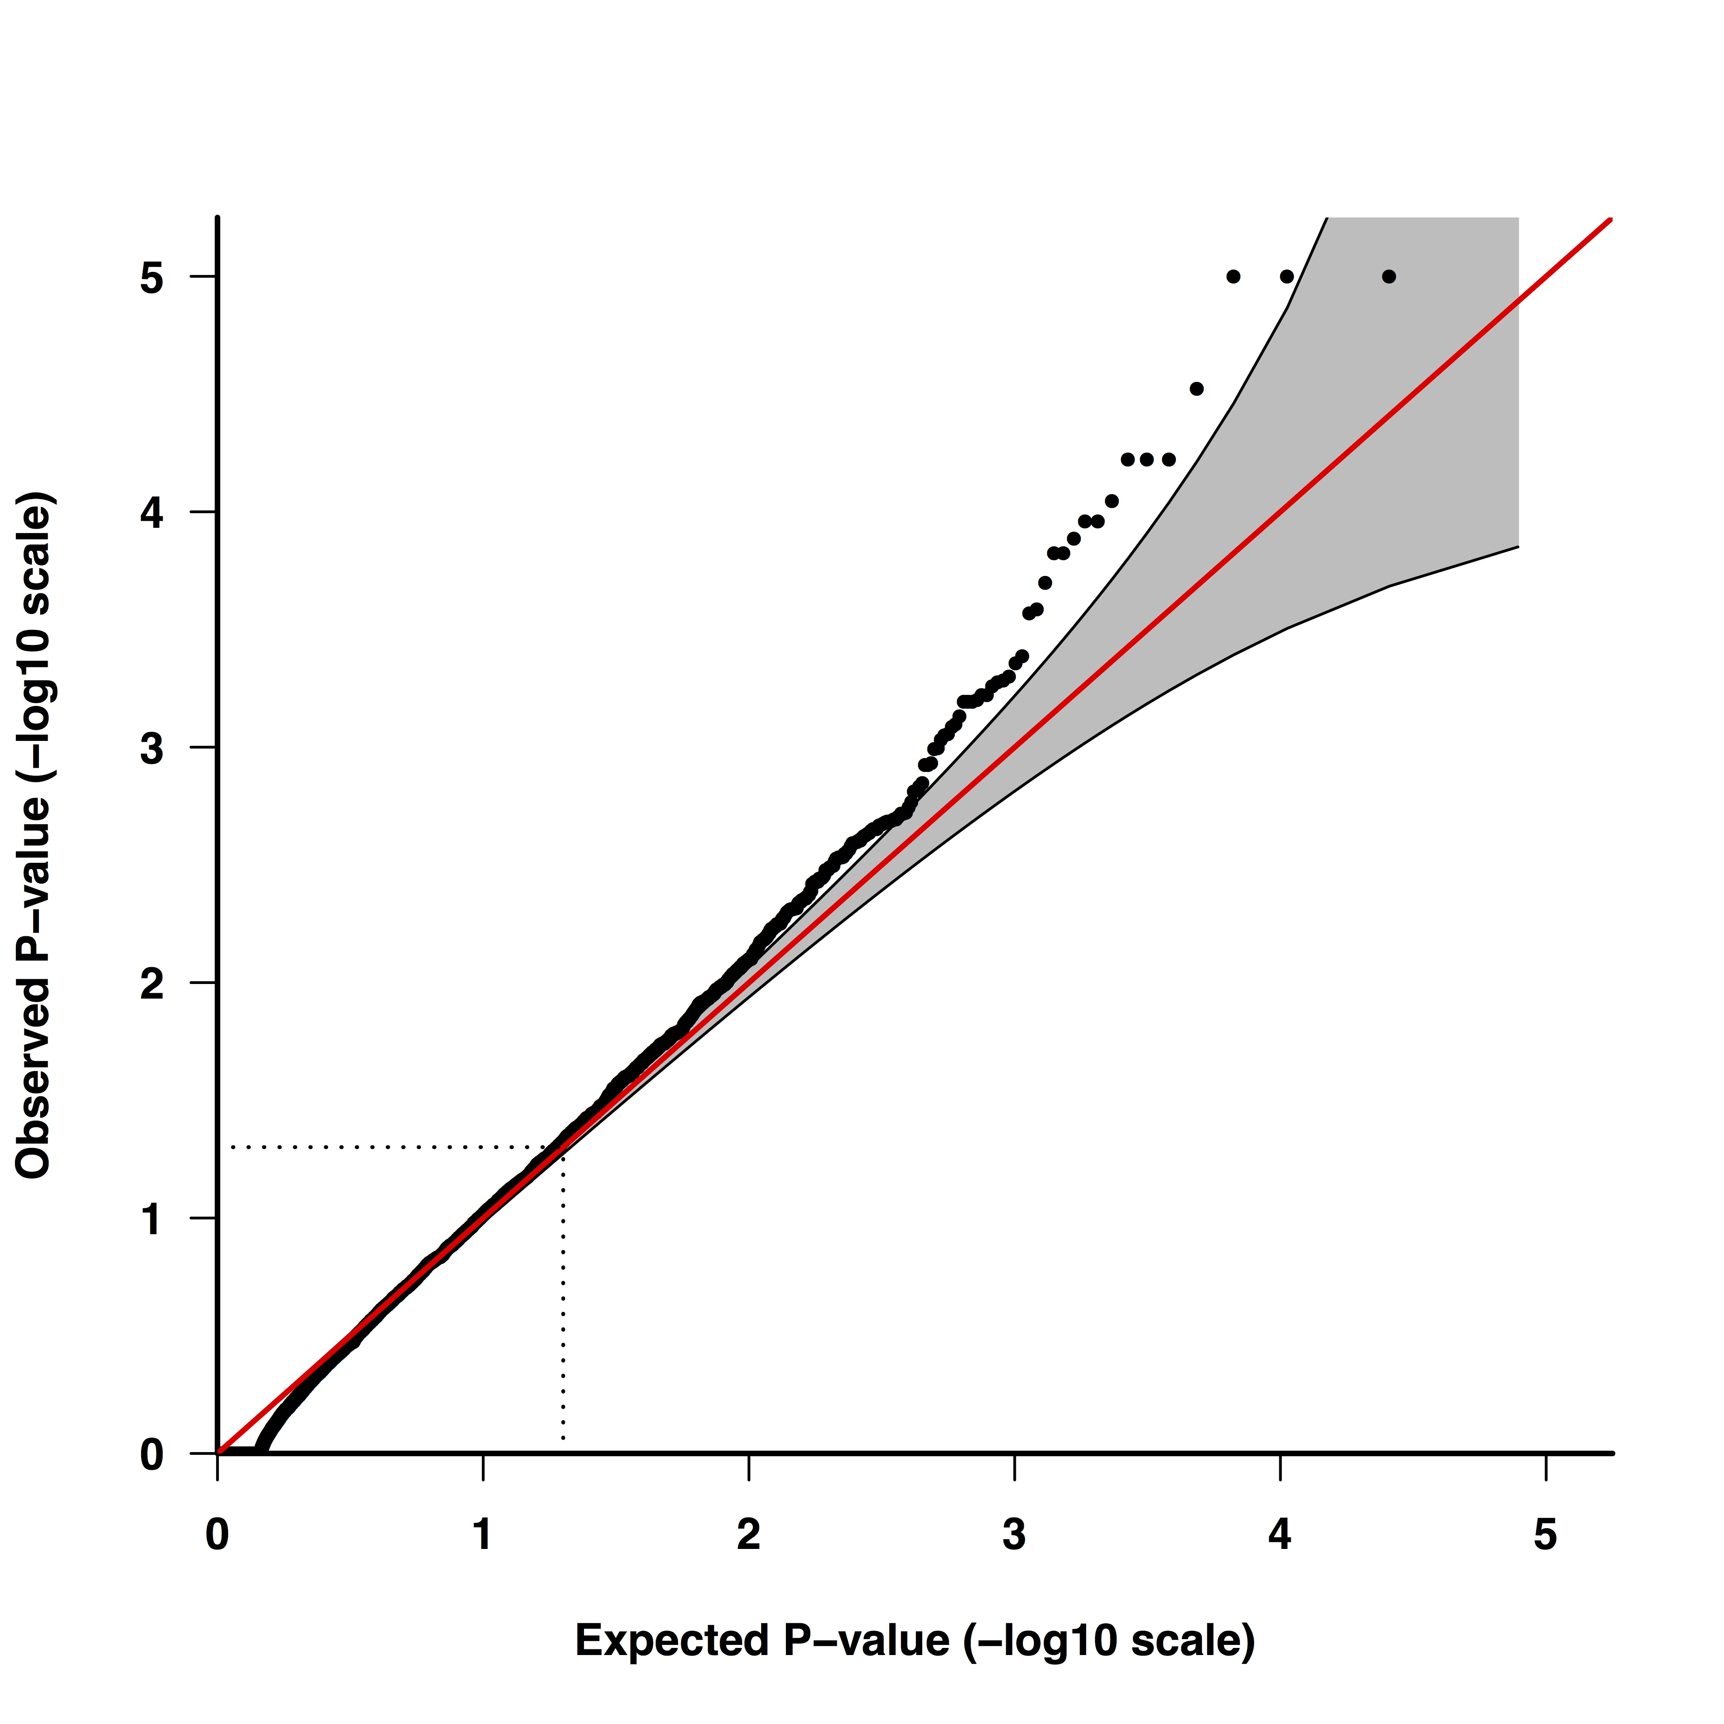
Melanoma XPAT-VAAST 2 results (314 cases, 3507 controls)
VAAST 2 association results for known cancer susceptibility genes with p<0.05
Yao Yu, …, Huff CD, BBA Molecular Basis of Disease, 2017

Slide 45
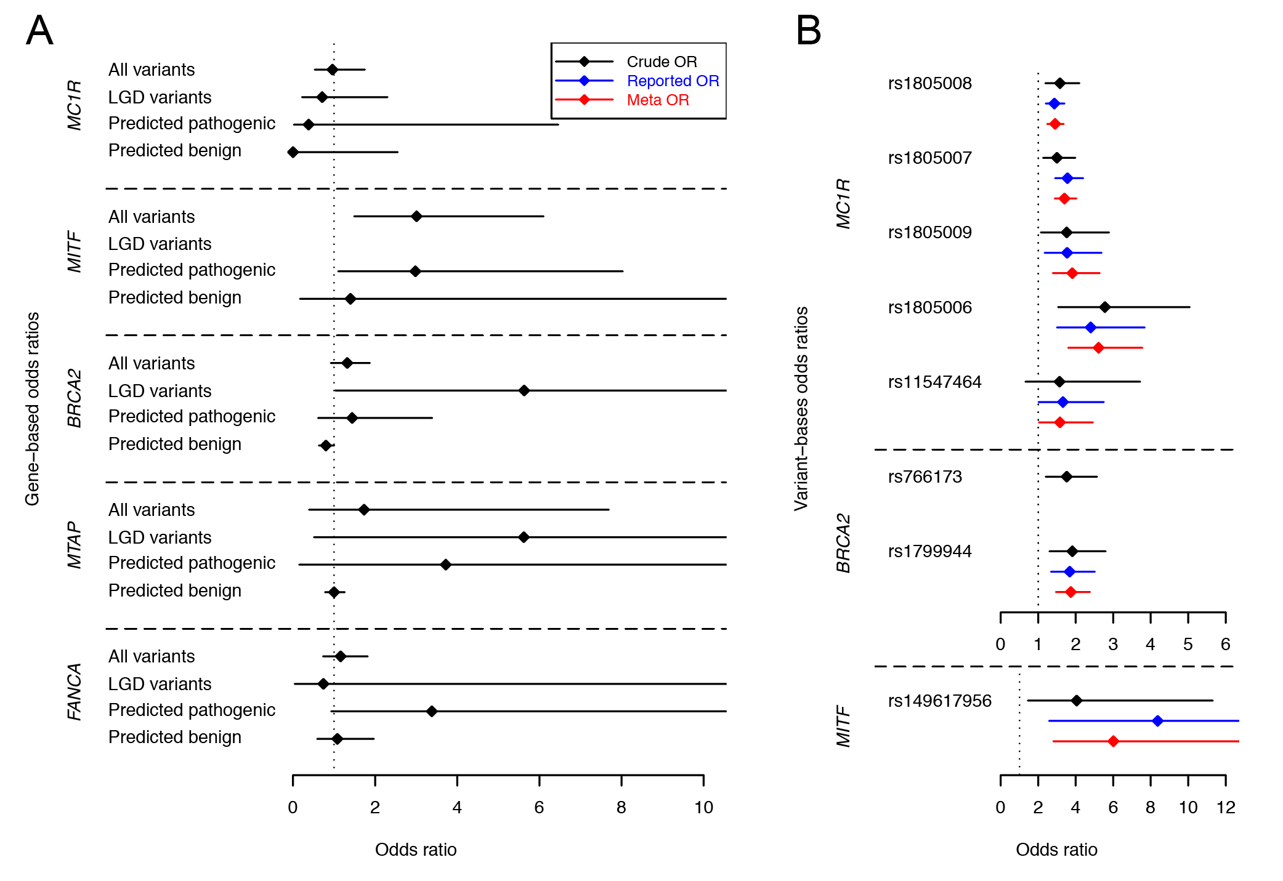
Melanoma association results
Odds ratio estimates for melanoma susceptibility genes and variants
Yao Yu, …, Huff CD, BBA Molecular Basis of Disease, 2017

Slide 46
pVAAST single family results: Genome-wide ranking of causal gene
Hu H, … Huff CD, Nature Biotechnology, 2014.

Slide 47
No evidence of attenuation in signal for ovarian cancer susceptibility genes from cross-platform QC in XPAT
Cross-platform with XPAT
Matched platform^{1,2,3} with standard QC
1) Song H., et al., 2014.
2) Song H., et al., 2015.
3) Ramus S., et al., 2015.
Power calculated from 1000 bootstraps. Each bootstrap sampled 250 cases and 1,000 controls with replacement from each dataset.

Slide 48
Variant prioritization
Receiver Operator Curve (ROC) for disease-causing variants
in HGMD and “benign” variants in 1000 Genomes

Slide 49
Variant prioritization using only categorical information
Receiver Operator Curve (ROC) for disease-causing variants
in HGMD and “benign” variants in 1000 Genomes

Slide 50
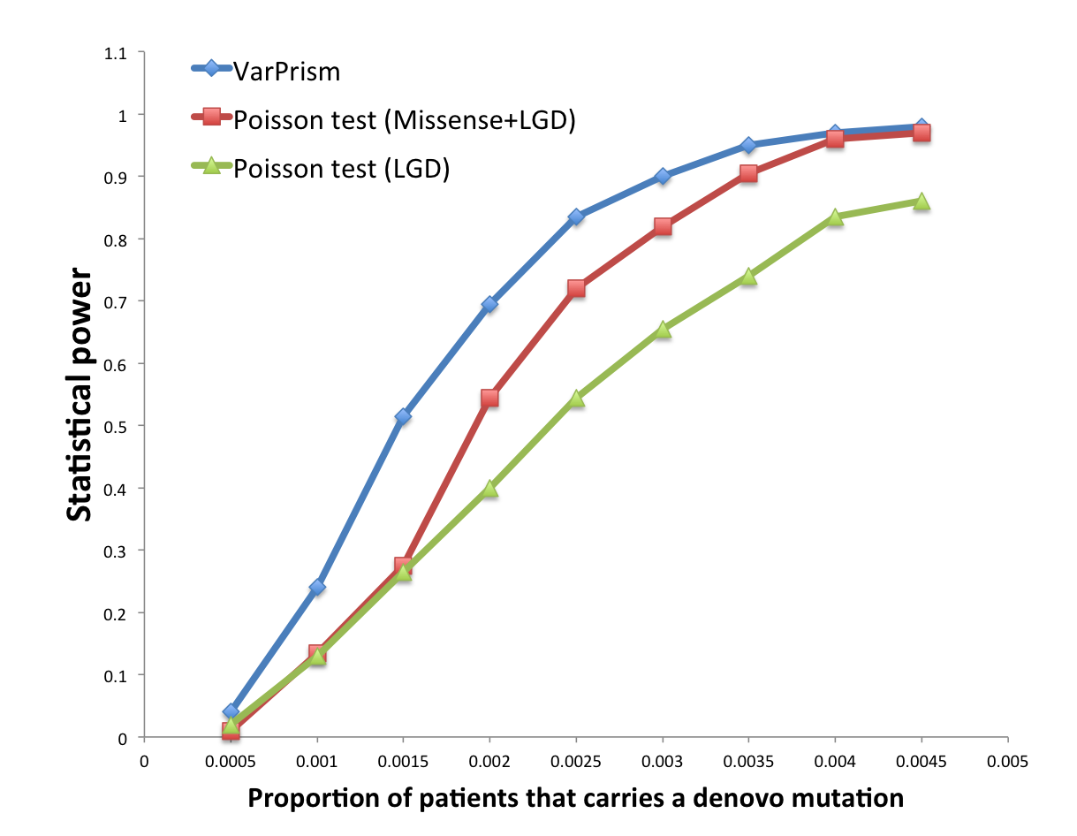
  VarPRISM: The Variant PRIoritization SuM test for identifying disease-causing de novo mutations in parent-offspring trios
Poisson LGD
Poisson Missense
+LGD
VarPRISM
Venn diagram for candidate autism risk genes identified under FDR of 0.3 from 2,508 parent-offspring trios.
Hu H, … Huff CD, Genome Medicine, 2016.

