Slide 1

Furthering Our Understanding of the Link between Health and Environment in an Urban Setting
October 30, 2017
Katherine Bennett Ensor, Ph.D.
Professor of Statistics
Rice University
ensor@rice.edu

Slide 2



A THINK
AND
DO TANK
MISSION: Advance understanding of the most important issues facing Houston and other leading urban centers through rigorous research, policy analysis, and public outreach; and collaborate with civic and political leaders to implement promising solutions to these critical urban issues.

Slide 3

Houston Urban Data Platform
Katherine B. Ensor, Director
Rudy Guerra, Co-Director http://kinder.rice.edu/UrbanData/

Slide 4

Urban Data Platform Repository
VRDE
VRDE+AWS
AWS

Slide 5

The value of Curated Archived Data
Vetted
Cleaned and research ready
Geo-referenced allowing linking across multiple data sets by shared geography
Regular update schedule
PUBLISHED and ARCHIVED
A ONE STOP SHOP….
Published, available in perpetuity
Author credit – please SHARE
Citations picked up by major indices
Sustainability
Updates receive NEW doi

Slide 6
UDP Data library
Approaching 50,000 variables
5 Terabytes and growing quickly
Spatial extent
  Address, block, census tract, super neighborhoods, cities, counties
  15 county region
Temporal coverage
  Stay current with regular update schedules
  Focus is 1990+; goal continuing adding history
  We are incorporating historical information as we can; e.g. 1930 imagery of Houston

Slide 7
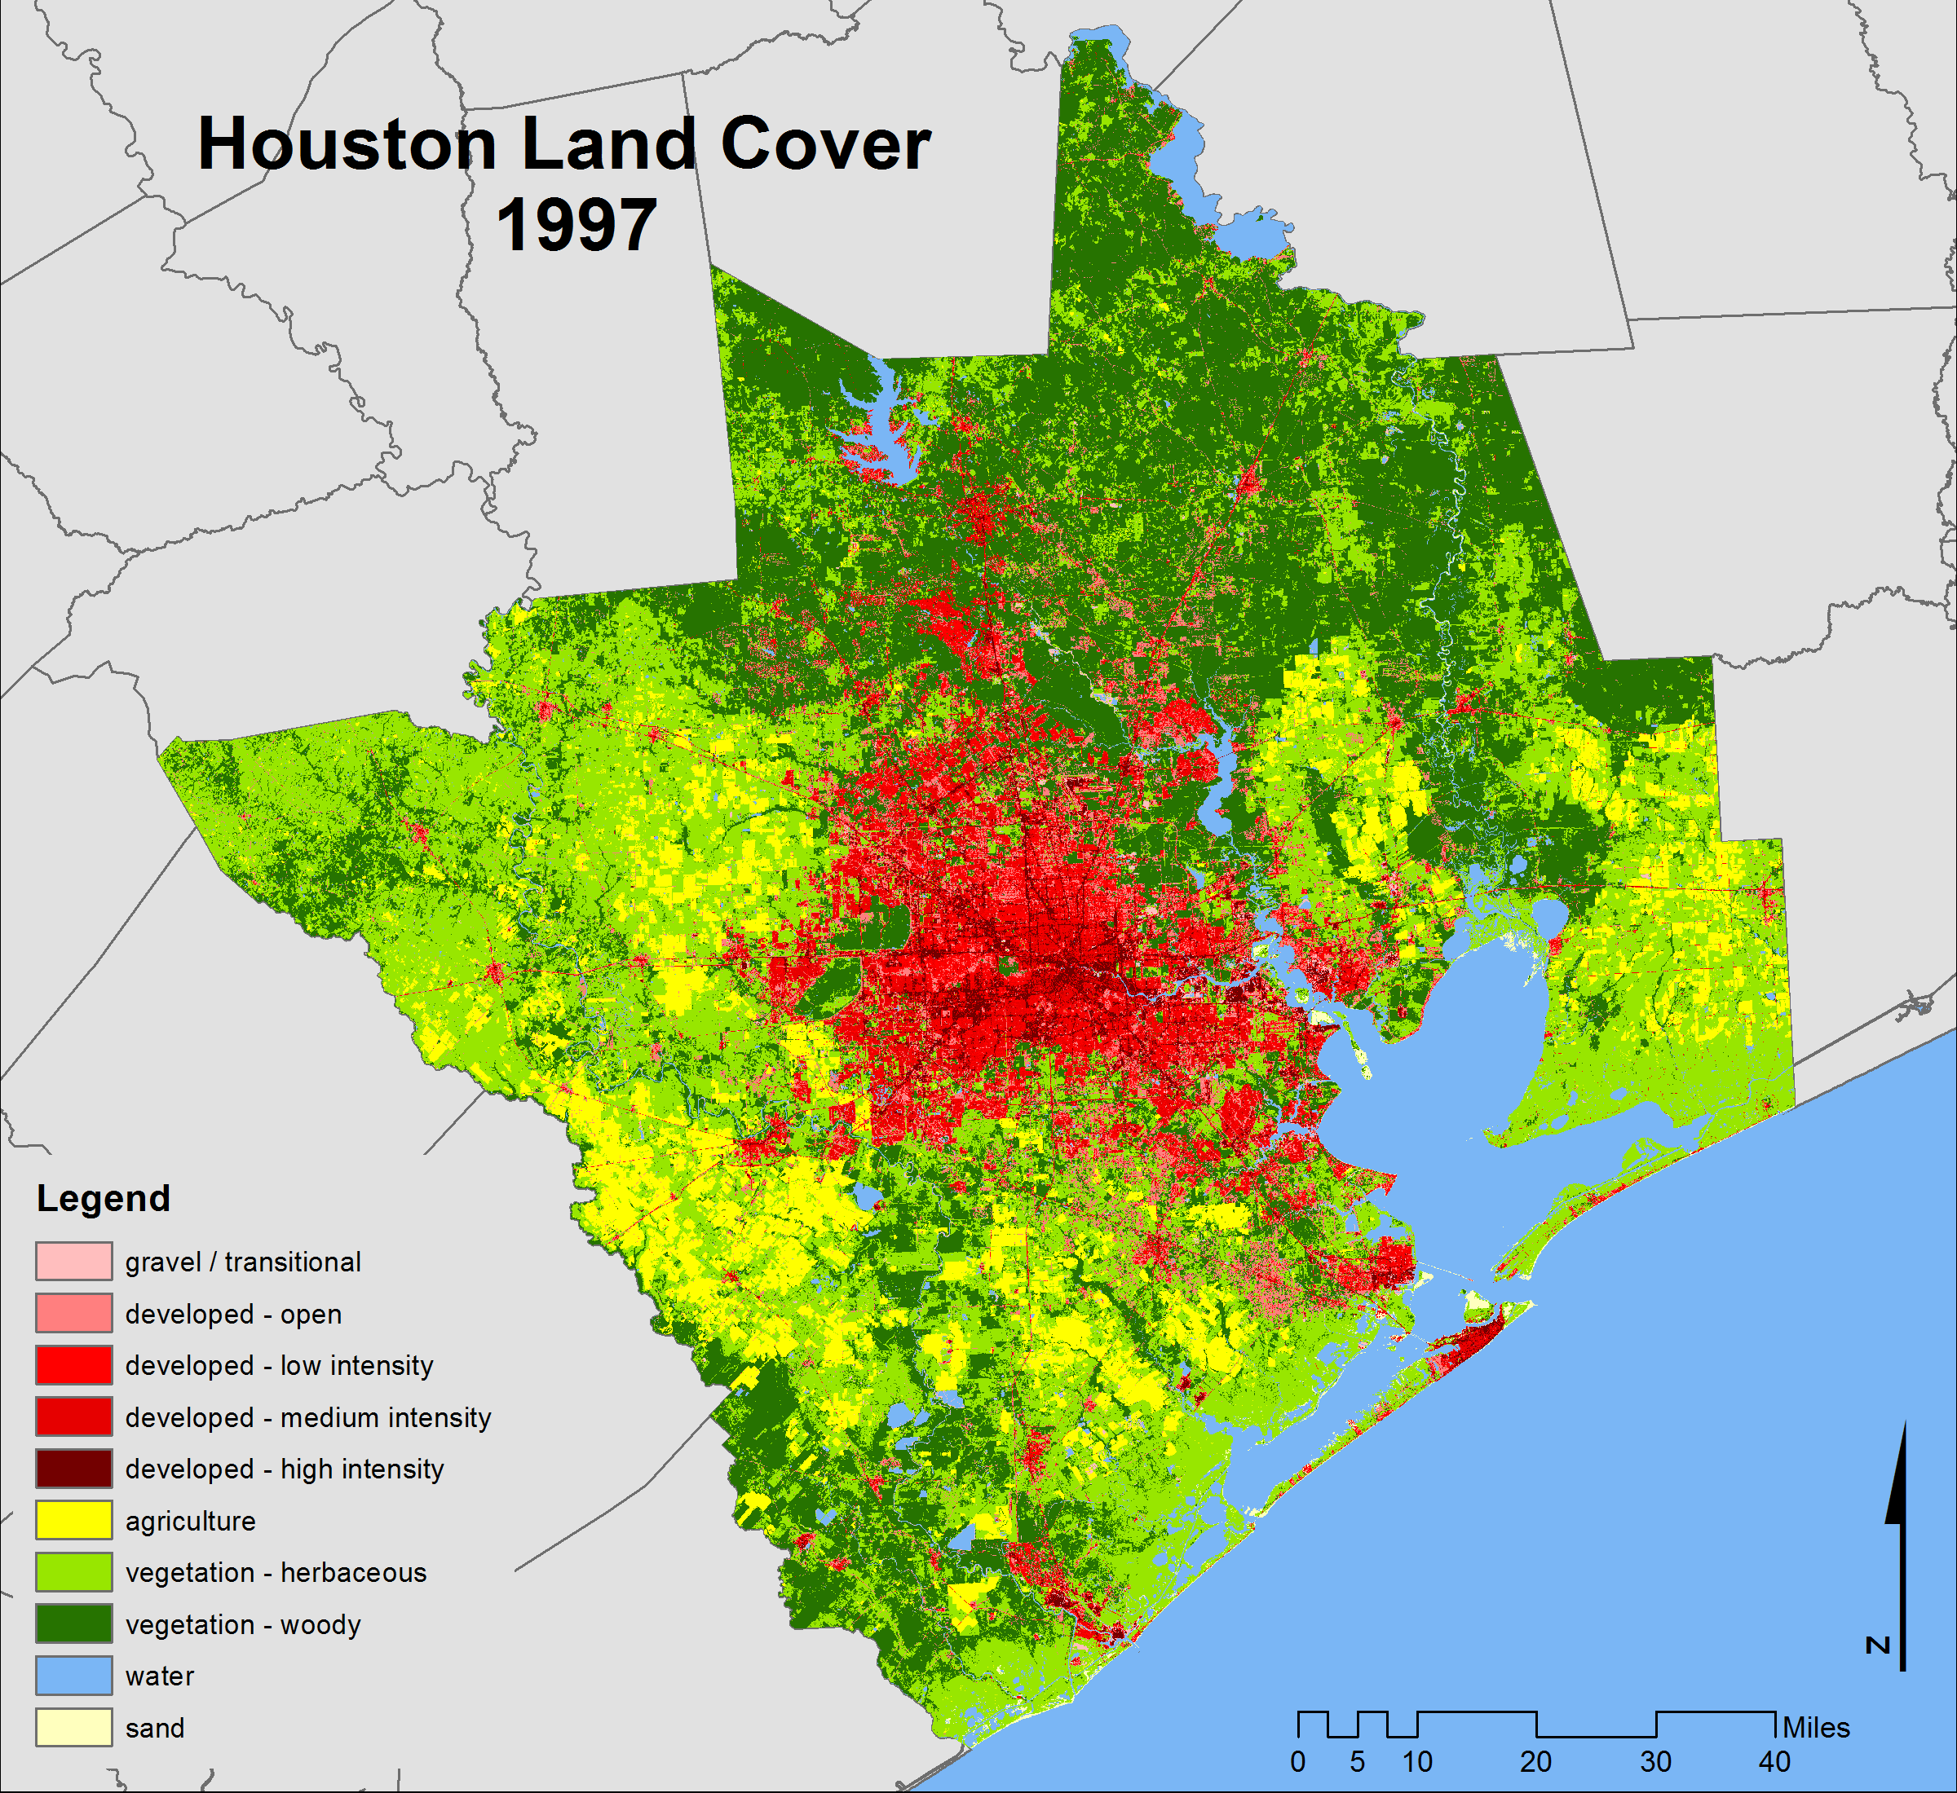
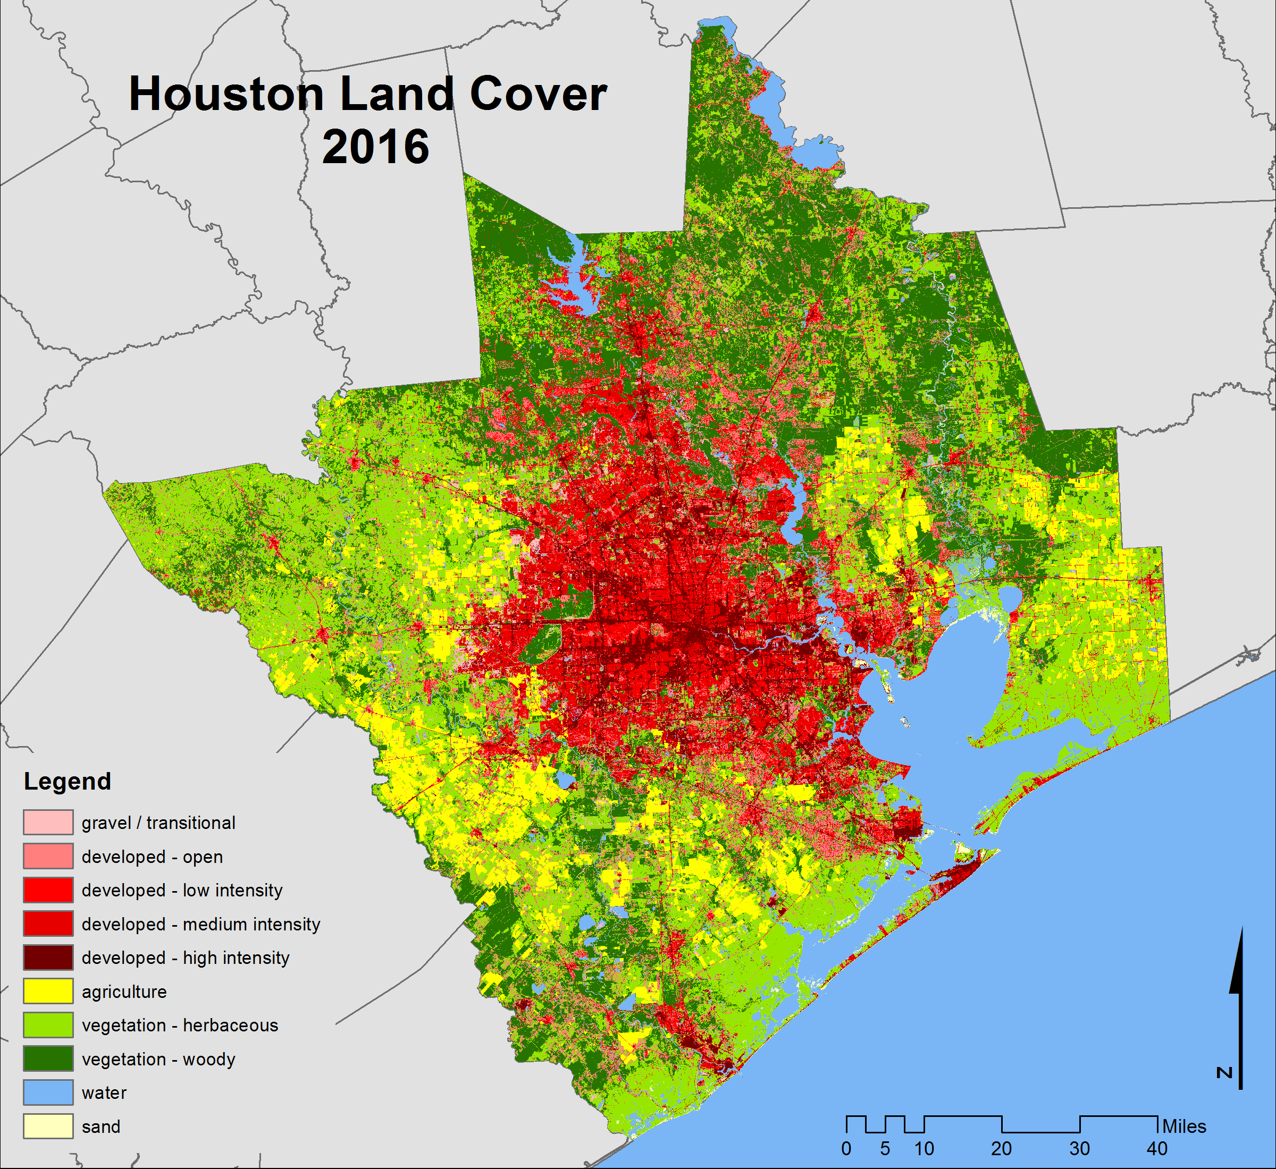
UDP Research: Cities CHANGE
Characterize spatio-temporal dynamics of land cover change in the greater Houston area between 1997-2016
C. Hakkenberg, Rice University Academy of Fellows Post-Doc

Slide 8
Air Quality and ACUTE Health Events

Slide 9
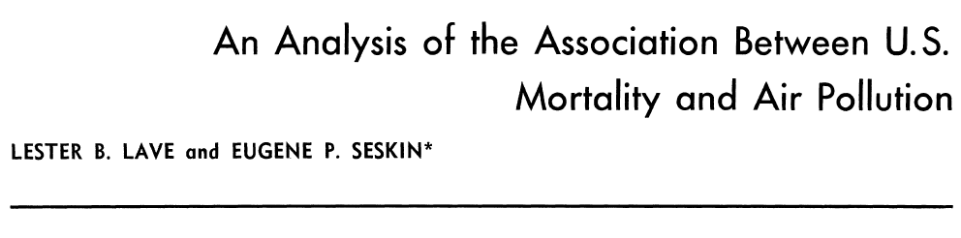
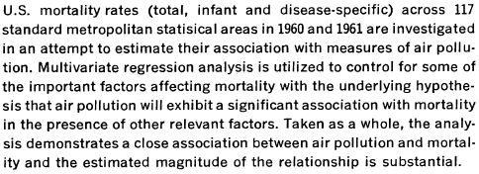
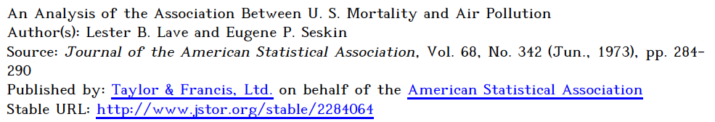

Slide 10
Rice Environmental Statistics and Health
Ensor, Raun Research Group
Summary of health statements from our most recent studies.
The increased risk of an asthma attack
  is 10% for single-day and 13% for three-day-long exposures when the ozone levels are between 50 to 70 ppb.
  If we move to higher levels of ozone in the range of 70 to 90 ppb, the risks increase to 21% for one day and 45% if exposed for three days.
For heart patients, the concern is a three-hour window of elevated ozone levels.
  A 20 ppb increase in ozone levels resulted in a 4% increase in risk of cardiac arrest associated with ozone.
  The impact is greatest when the ozone levels are above 75 ppb.

Slide 11
What statistical thinking supports these conclusions?
Let’s focus on Cardiac Arrest (CA)

Slide 12
Out of Hospital Cardiac Arrest
Why do we care?
Approximately 300,000 people in the U.S. experience an out-of-hospital cardiac arrest each year.
Of these 300,000 90% die or roughly 270,000 CA deaths per year.
In Houston, the number is approximately 1,400 CA events per year and 1,200 deaths.
There is growing evidence of a strong association between ambient air quality and CA.
Improved understanding at the LOCAL level can save lives.

Slide 13
Cardiac Arrest and Ozone
The Pathophysiological Link
BEYOND CORRELATION
Effects seen in animal toxicology studies
Found reduction in serum tocopherol (free radical scavenger)
Increase in gradient of alveolar-to-arterial PO2 potentially due to alveolar-arterial oxygen impairment
Changes in several proinflammatory cytokines in blood
see references in Raun, Ensor, Persse (2012, 2013) for details

Slide 14

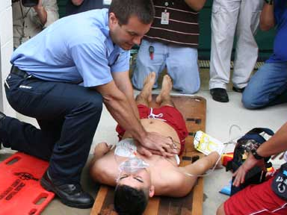
Houston EMS AND Cardiac Arrest (CA)
HEMS Responds to a resident of Houston every 3 minutes
2004 through 2011
  11,677 events
  1,400 per year
  Annual rate of 67 per 100,000 residents
Patient information
SPACE and TIME
BIAS??

Slide 15
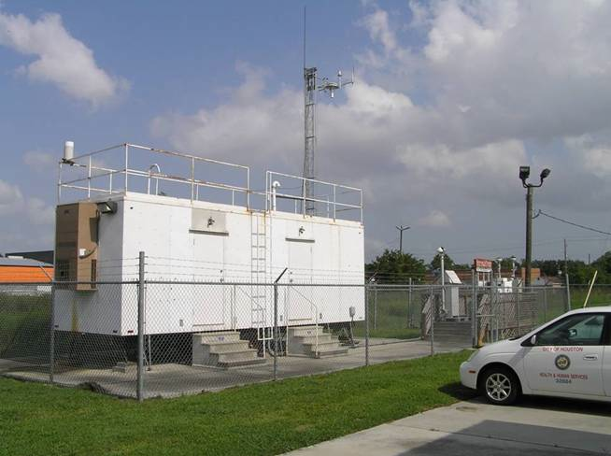
Monitoring the Ambient Air
Extensive air quality monitoring network for criteria pollutants since the 1970s and the original Clean Air Act
Hourly data -- aggregate of five minute observations
Houston AREA Ozone
44 monitoring locations – data available to the public
The spatial network for air toxics and particulates is sparse.
Use ambient levels as a proxy for human exposure.

Slide 16
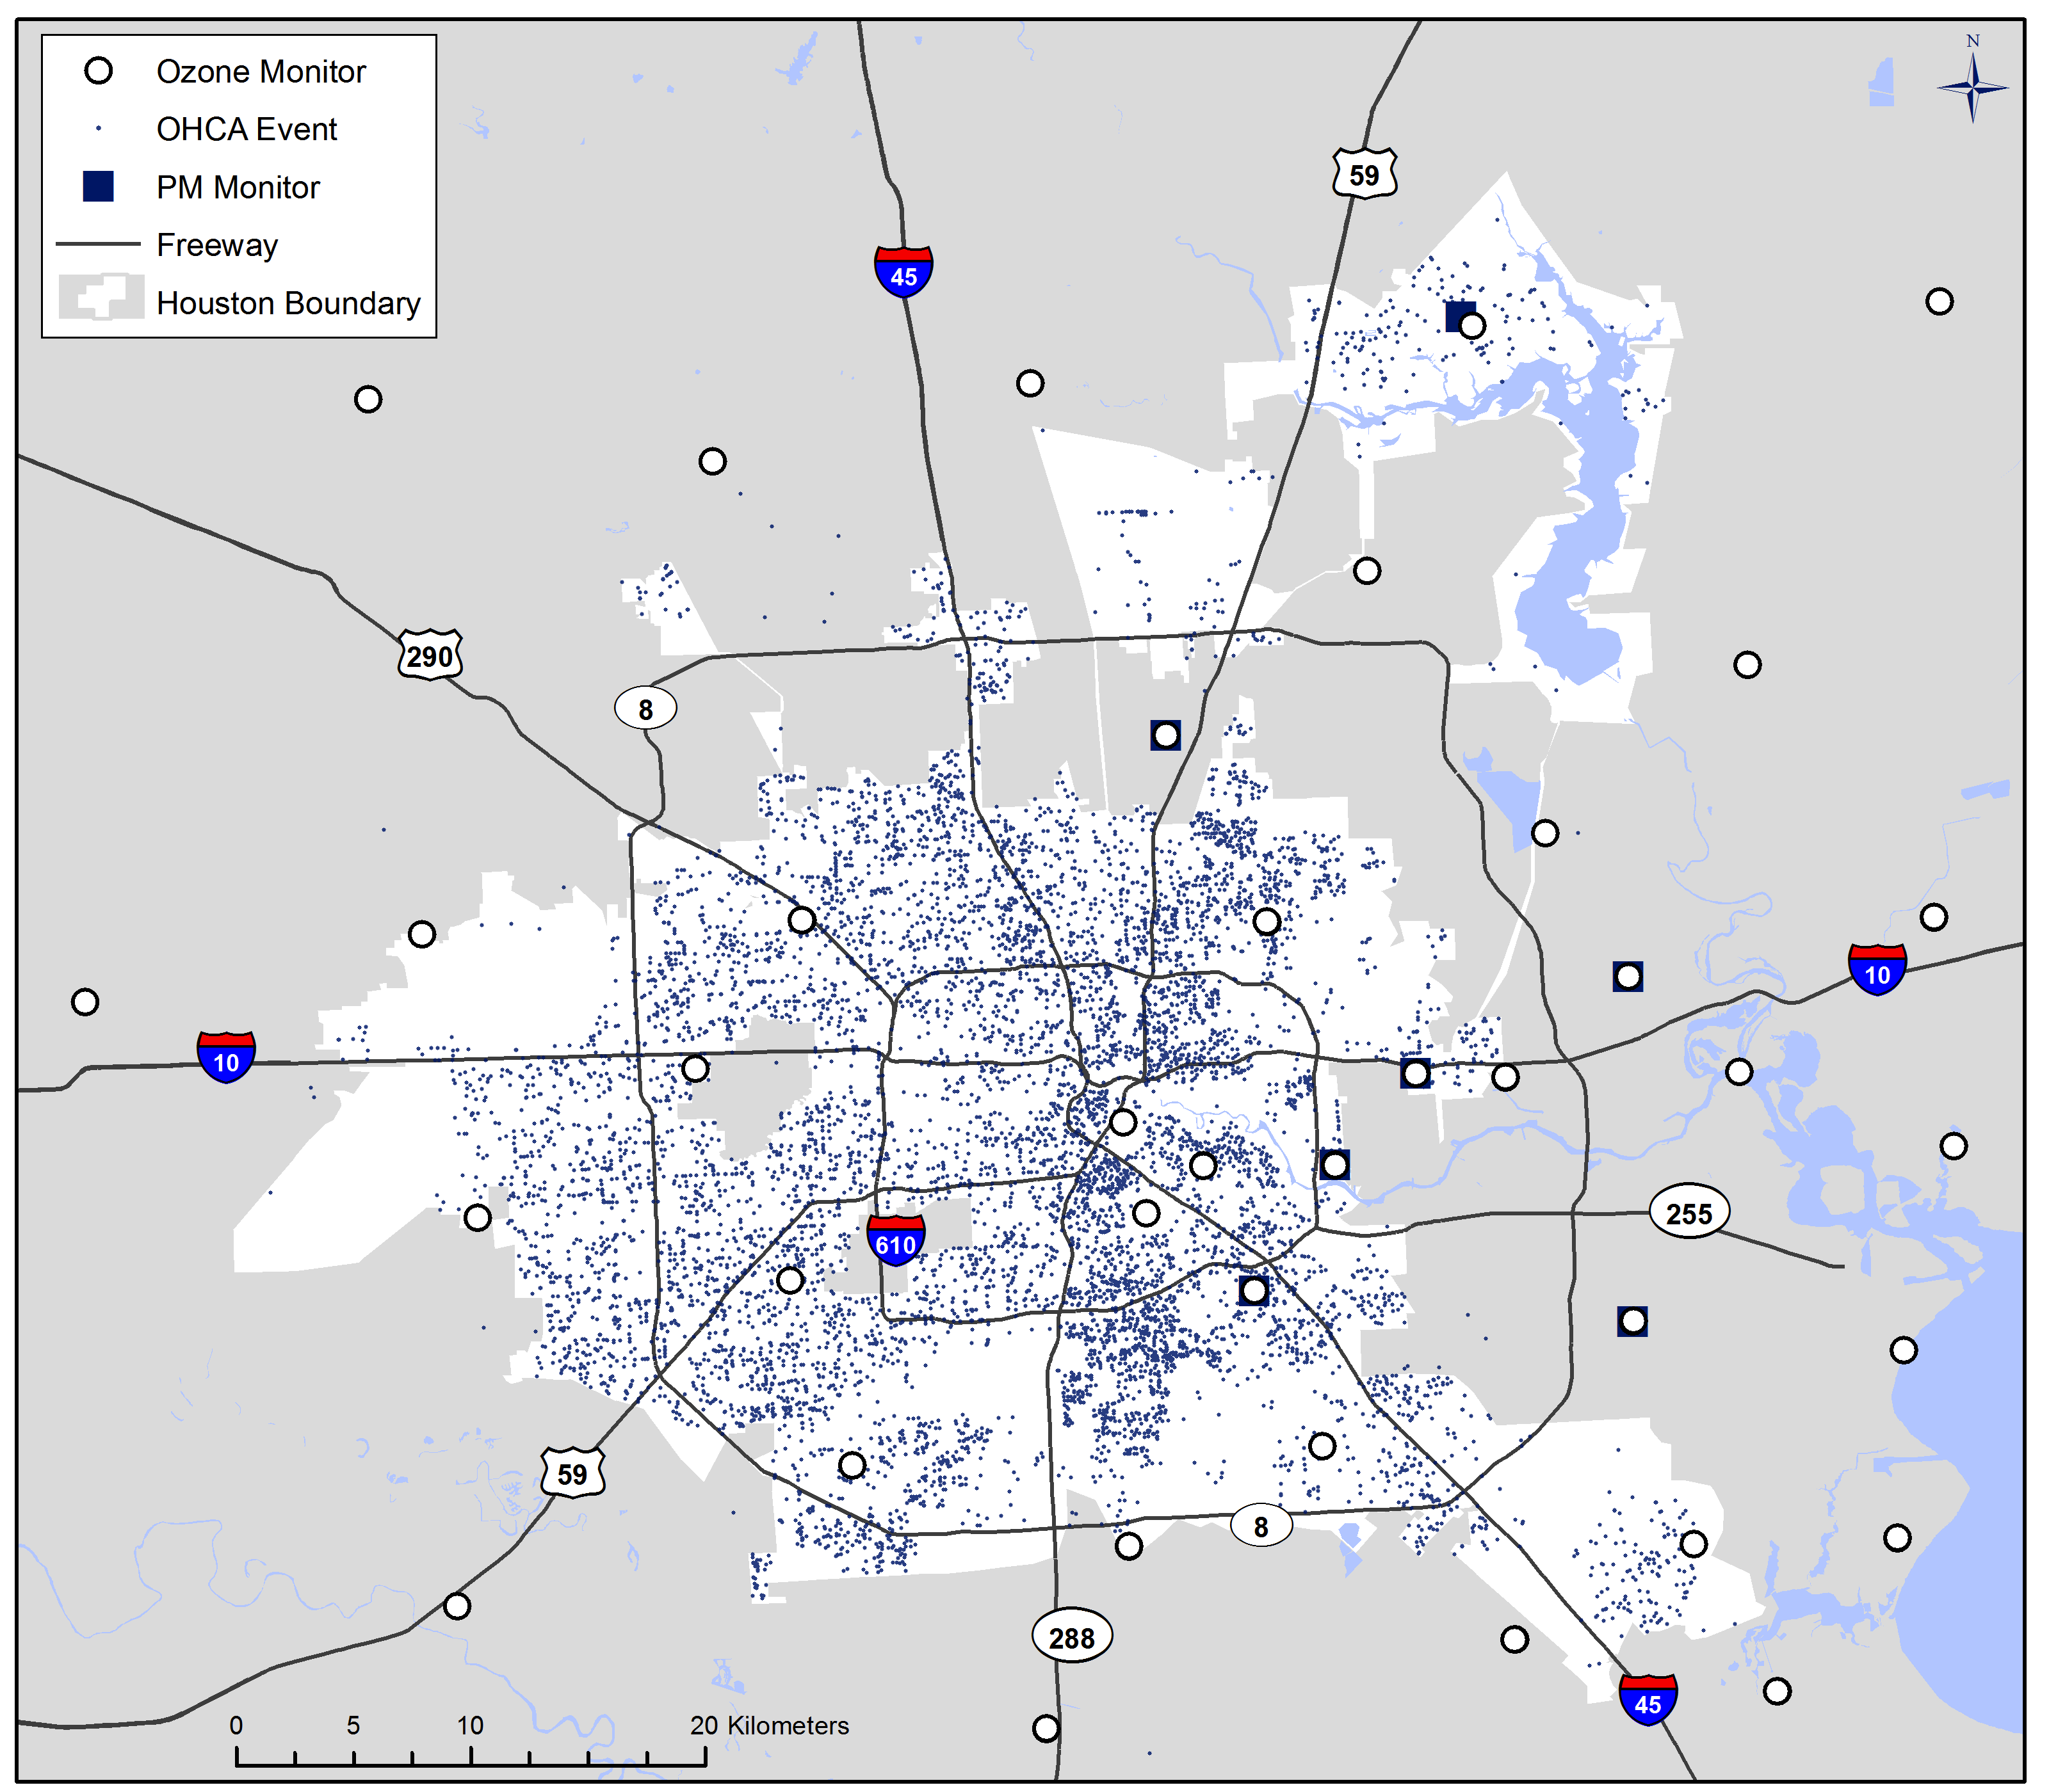
Cardiac Arrest and Air Pollution
Monitors
~40
Patients
11,677

Slide 17
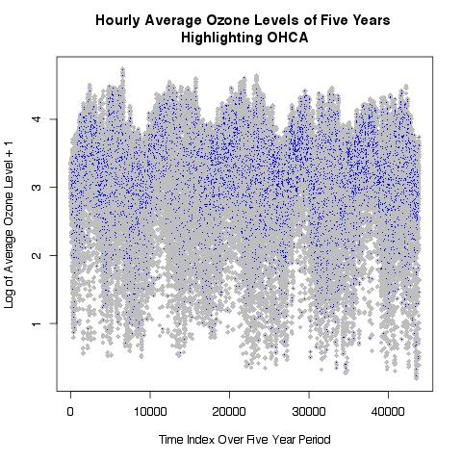
Looking Further at the Data
Consider average pollution level at each hour in the eight year period
Average pollution level at time of cardiac arrest
Cardiac arrest events cluster at higher Ozone levels
Scale is transformed to show features.

Slide 18
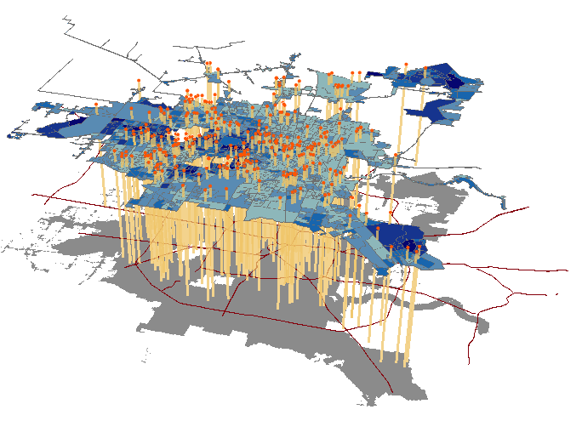
Linking – Point in Space Point in Time

Slide 19
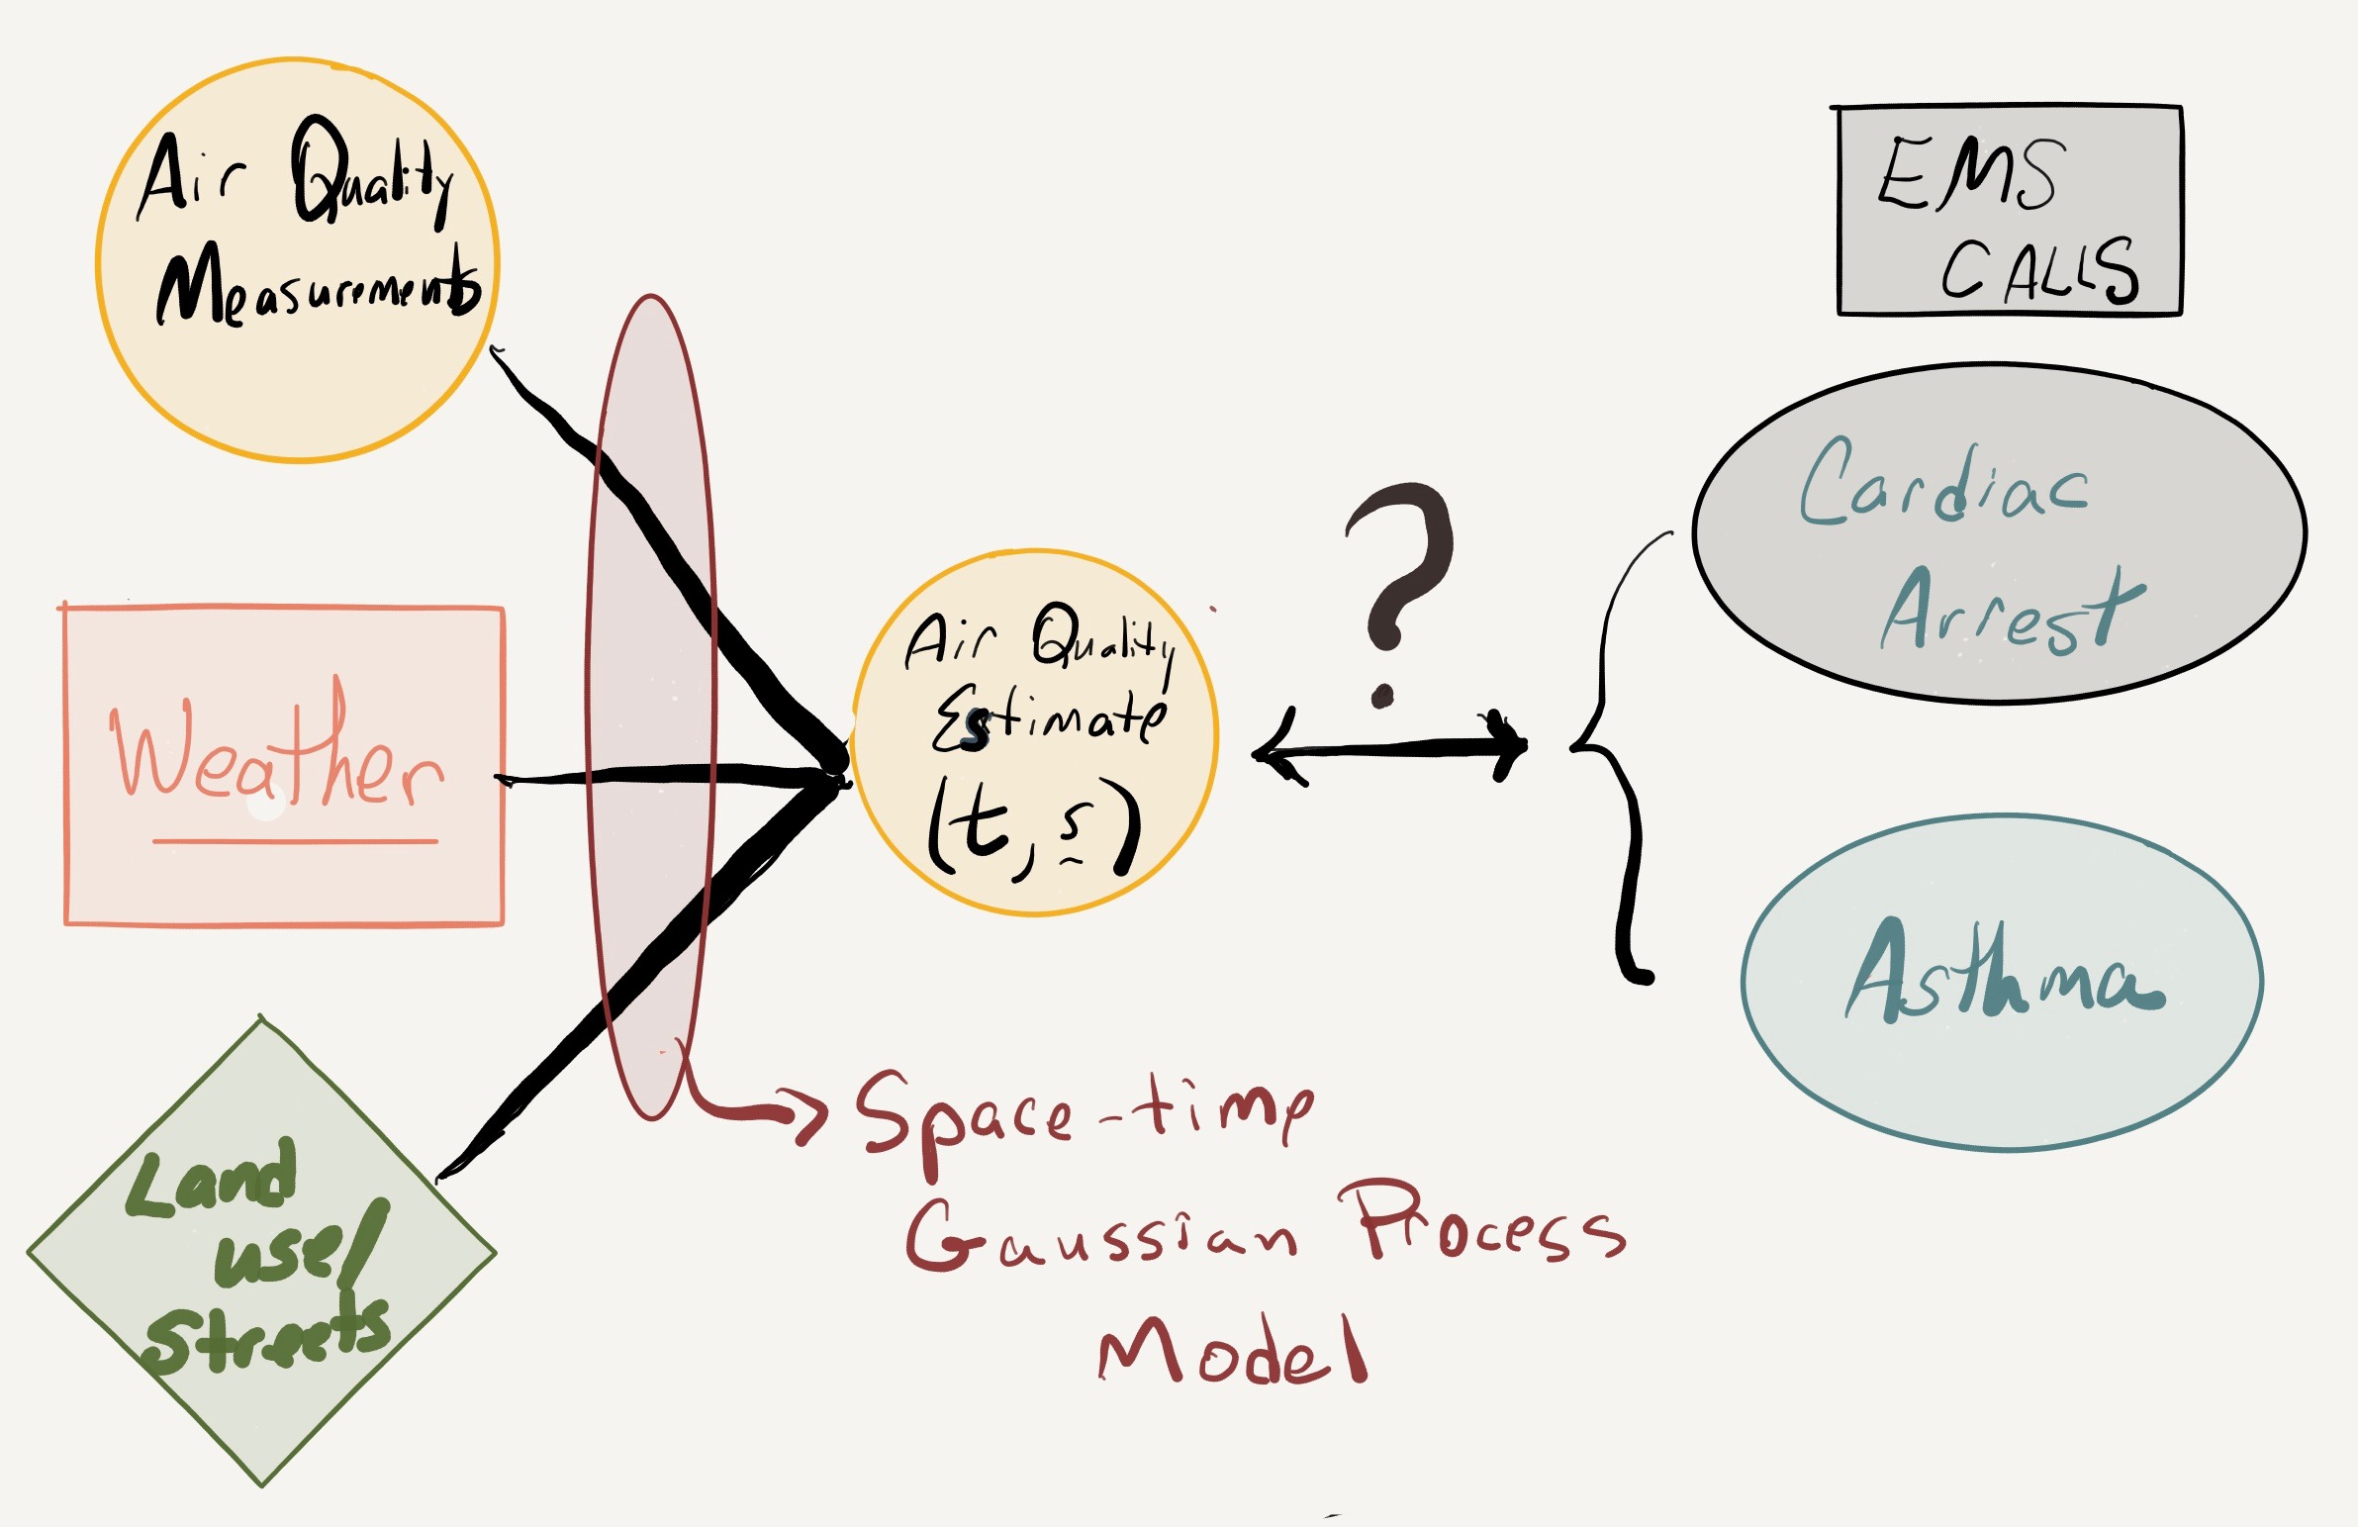
The Analysis Roadmap
Focus on Cardiac Arrest

Slide 20
Develop a data driven model for spatial interpolation and prediction of ambient ozone levels.

Slide 21
A WEALTH of Air Quality Measurements
1 decade 10x8760x40x25=
87,600,000
5 decades=438,000,000
Data points

Slide 22
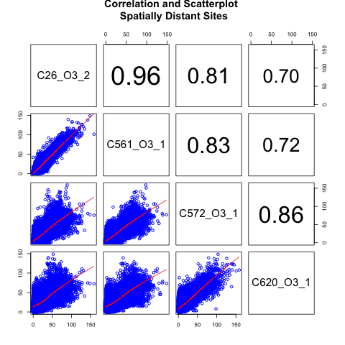
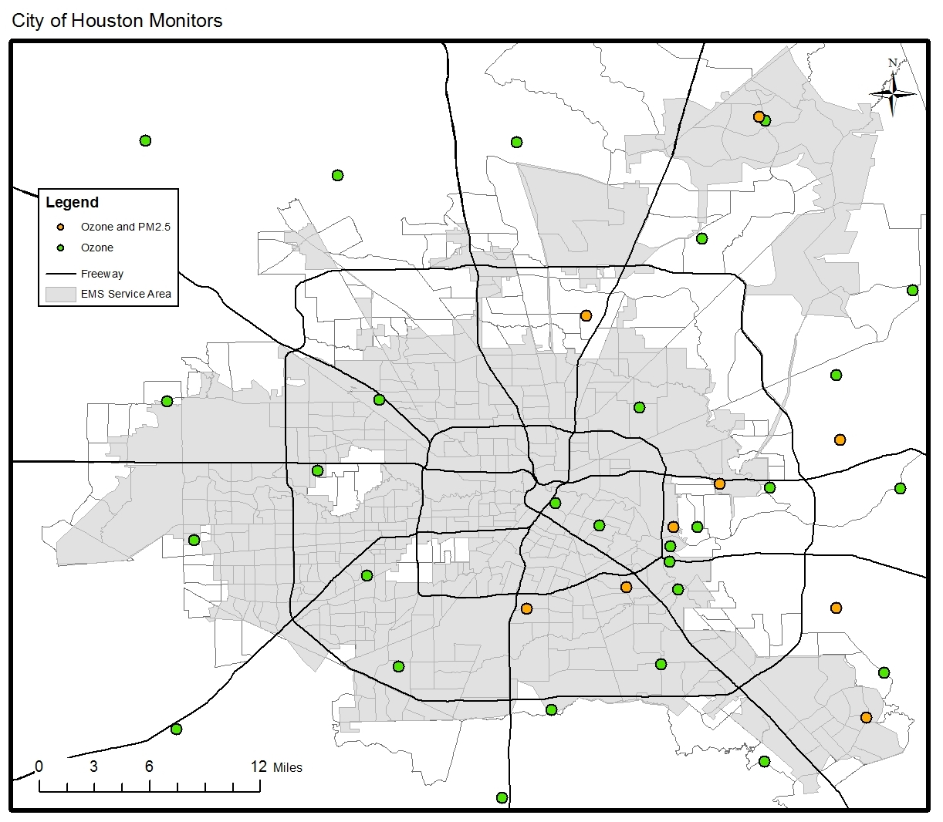
Spatial Estimation/Prediction
Works for Ambient Ozone
Wind
26
26
572
561
572
561
572
561
620
620
620

Slide 23
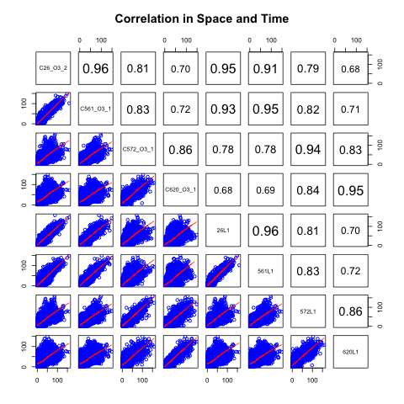
Spatial-Temporal Estimation Works Prediction Works
26
Simultaneous
561
572
620
26
561
Lag 1 Hour
572
620

Slide 24
Air Quality Statistical Model for Ambient Ozone
Spatial-temporal Gaussian process fit to transformed pollution data, meteorology + land use / roadways.
Large gain from temporal structure. Model parameters are a function of time of day.
Working on short time-scales of 1 hour, exponential spatial and temporal covariance model is sufficient.
For short-term temporal studies improved estimates can be obtained using a hybrid statistical model fusing the observational data with physical/chemical models of air quality.

Slide 25
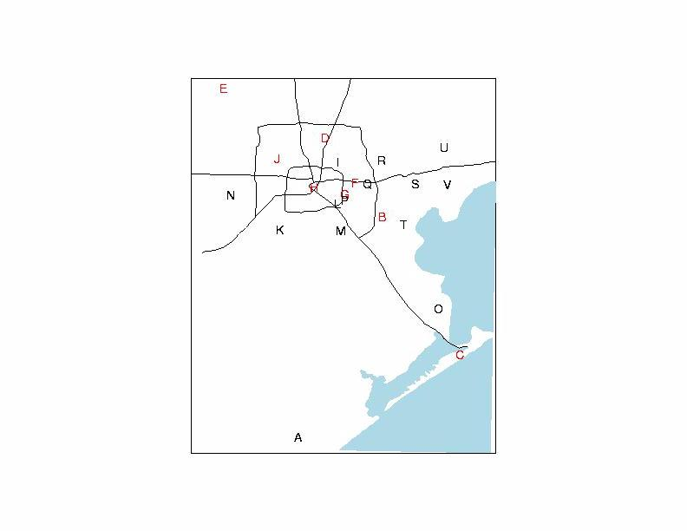
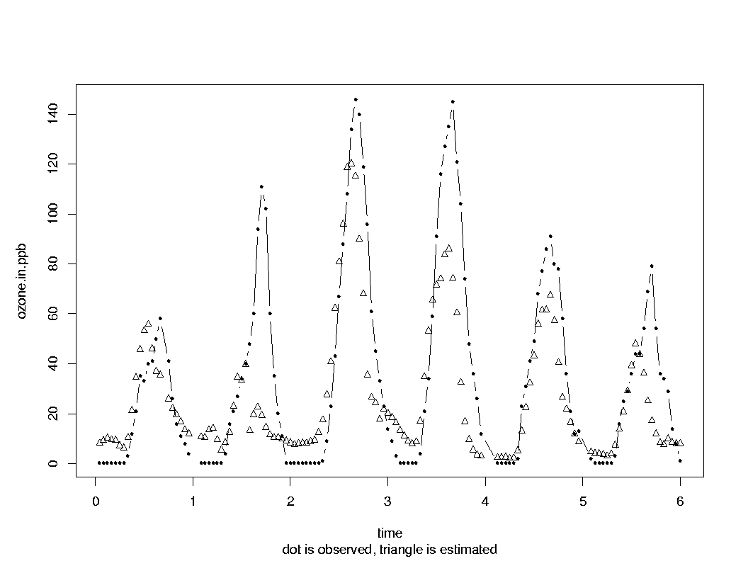
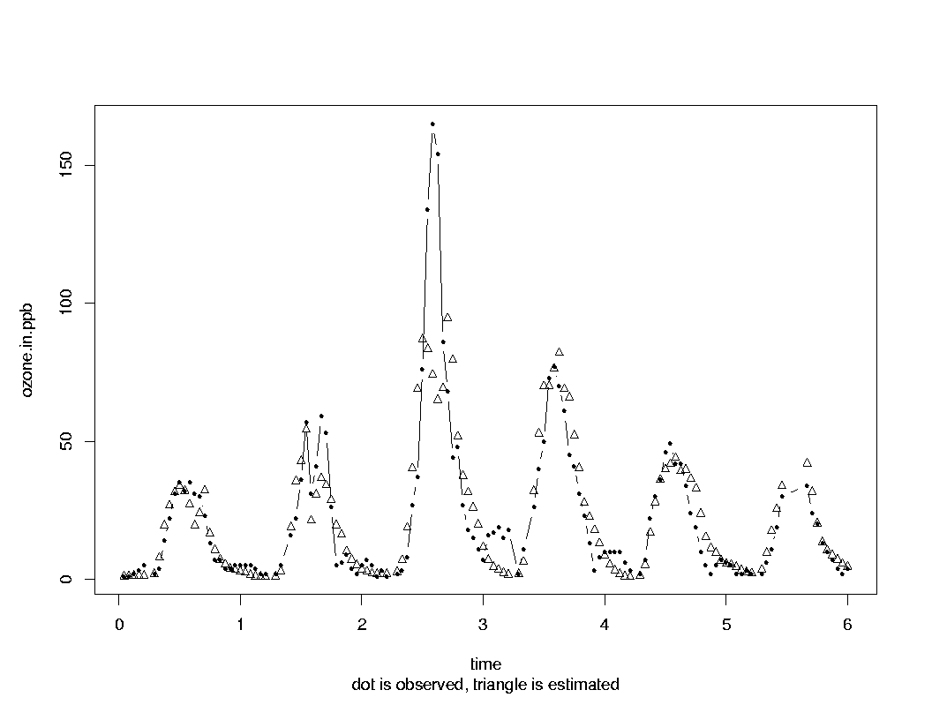
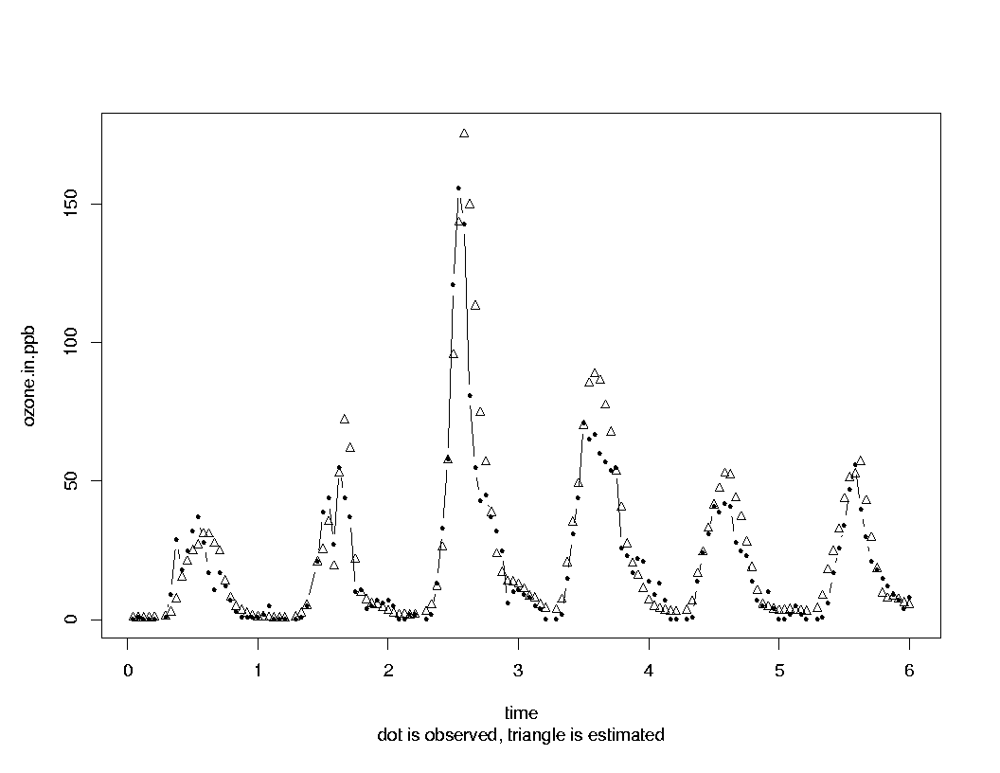
Cross Validation – 3 Locations
Site E
Site H
Site G

Slide 26
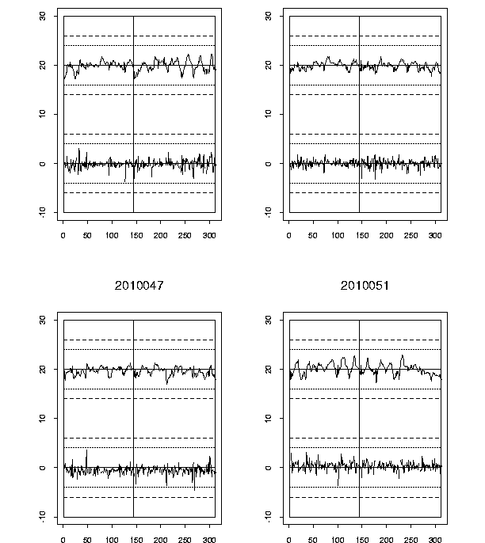
Out of Sample Residuals
The VALUE of TIME
A
A
B
B
C
C
D
D

Slide 27
Spatial-temporal interpolator evaluation
Cross-Validation results
MAPE 3%
MAPE for peak ozone (>80ppb) is 9%
MAPE for 1 step ahead forecast 8%
MAPE for 2 step ahead forecast 12%
COMMENTS
Miss some “spikes” at a given site -- leads to “outlier detection”
Under predict “ramp-ups”
No obvious bias for any given site
Estimates are computationally “instantaneous”

Slide 28
Toward a real-time forecasting tool for local multi-pollutant index

Slide 29
Toward Multi-Pollutant Model
Dynamic Analysis of Houston Correlations between Pollutants
7am
2pm
3 Years of Hourly Observations
Correlations change locally in time

Slide 30
Pollution Mixture Changes Over Seasons and By Time of Day
Weights given to each standardized pollutant.
2pm
First two orthogonal component multi-pollutant linear mixture.
Weights vary by day.
Different hour of the day will have different mixtures.
Patterns in weights are interesting in their own right.
Capture 60% to 90% of the variation.

Slide 31
Data Driven Space-Time Graphical Model for Dependence Between Pollutants
Schweinberger, Babkin and Ensor (2016)
Causal Pollution Relationships
1-Day Lag
Potential sources
Generate 80% of local
dependence

Slide 32
Understanding the ACUTE Impact of Air Quality on Health

Slide 33
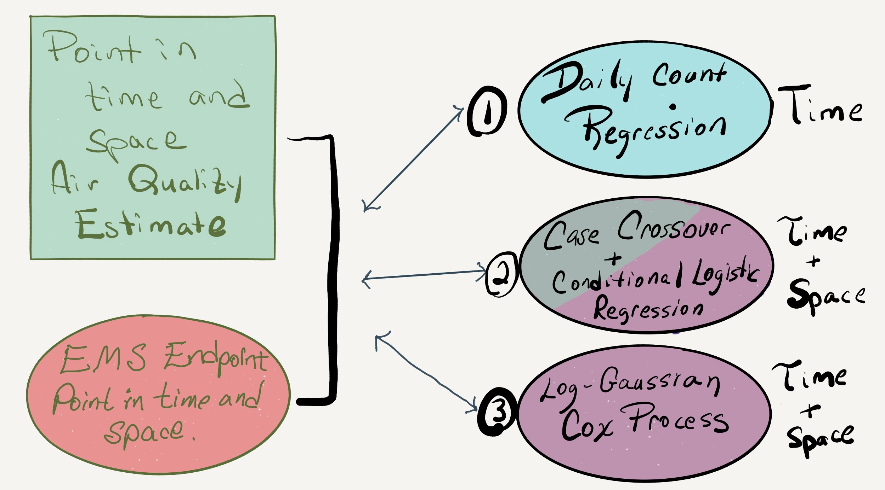
Air Quality & Health Link? HOW?
Each Strategy has DIFFERENT Assumptions

Slide 34
1. DAILY COUNT
REGRESSION

Slide 35
Ozone and Cardiac Arrest by Time of Day
Focus analysis on hours 8 am to 6pm
General constant number of heart attacks
Minimize confounding effect of time of day
Ozone and OHCA events vary with time of day.

Slide 36
Daily counts and Average Pollution
Count regression model
Impact of ozone on CA prevalence found between 8am to 6pm
An association was found between CA prevalence and average ozone using a time series Count Regression Model (quasi-Poisson).
Daily counts of CA - the population size is assumed constant.
8 hour Average Ambient Ozone Level between 9 am and 4pm
Co-variates:
  Nonparametric function of average apparent temperature between 9am and 4pm
  Average level of ozone between 9am and 4pm
Exploratory analysis that does not take in to account patient co-morbidities.

Slide 37
2. CASE-CROSSOVER
+
CONDITIONAL LOGISTIC REGRESSION
MAIN ANALYSIS

Slide 38
Case-Crossover
Time Stratified OR Bi-Directional Study Design
Subjects serve as their own control
The pollution level at the time of the event is compared to the average pollution level at similar times
For example, if the OHCA occurred at 10am on Tuesday, the level of ambient ozone at this time is compared to
  Time Stratified: 3 reference levels at the same time of day and day of week within the month.
  Bi-Directional: 1 or 2 reference levels at the same time of day and day of week before and after the event
A logistic regression model, conditional on the patient, is used to evaluate the impact of ambient ozone.
Mean is equivalent to Poisson Regression Approach.

Slide 39
Conditional Logistic Model
Tme and location of the OHCA
Event is the dependent variable
Controls are “manufactured”
The analysis is conditioned on the individual (e.g. EventID)
DATA EXAMPLE
head(datacombined[,c(3,4,5,19)])
Event EventID Referent O3aveL0h
1 1 1 0 15.942333
2 0 1 1 13.511613
3 0 1 2 1.746897
4 0 1 3 1.677097
5 1 2 0 25.411000
6 0 2 1 17.115000
15.9ppb (case) is compared to (controls) 13.5ppb, 1.7ppb and 1.7ppb

Slide 40
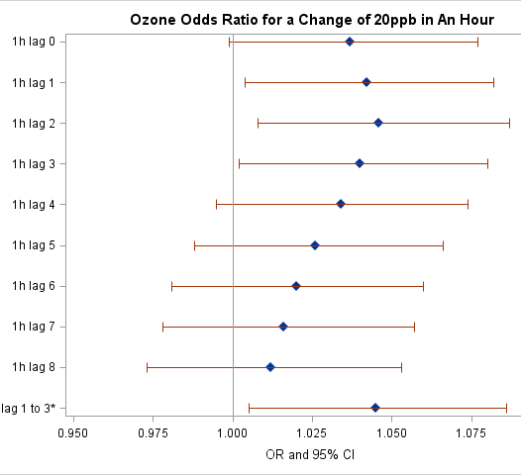
Time Stratified Case-Crossover
Spatial-Average
Final predictor variable is aggregate ozone over a 3 hour window leading up to the event
Co-morbidities are included in the model.
Each 20 ppb increase in ozone in the previous
  0 to 3 hours was associated with a
  4.4% increased risk of CA
  (95% CI: 1.004 to 1.085).
Notes:
> mean(hO3)
[1] 104.5657
> mean(hO3)/4
[1] 26.14143
> sd(hO3)
[1] 63.22012
> sd(hO3)/4
[1] 15.80503
> hO3=rowSums(datacombined[,c(19,21,23,25)],na.rm=T) ###spatial average
> shO3=scale(hO3)
> saT=scale(datacombined$ApparentTemp)
> spm=scale(datacombined$PMaveL0h)
> r=clogit(Event~shO3+strata(EventID),data=datacombined,method="approximate")
> summary(r)
Call:
coxph(formula = Surv(rep(1, 27248L), Event) ~ shO3 + strata(EventID),
data = datacombined, method = "breslow")
n= 27248, number of events= 6812
coef exp(coef) se(coef) z Pr(>|z|)
shO3 0.03657 1.03724 0.01980 1.847 0.0648 .
---
Signif. codes: 0 ‘***’ 0.001 ‘**’ 0.01 ‘*’ 0.05 ‘.’ 0.1 ‘ ’ 1
exp(coef) exp(-coef) lower .95 upper .95
shO3 1.037 0.9641 0.9978 1.078
Concordance= 0.5 (se = 0.373 )
Rsquare= 0 (max possible= 0.5 )
Likelihood ratio test= 3.41 on 1 df, p=0.06493
Wald test = 3.41 on 1 df, p=0.06476
Score (logrank) test = 3.41 on 1 df, p=0.06473
>

Slide 41
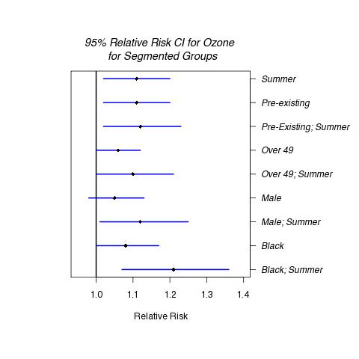
Consider Sub-Populations
Since subject specific information is available for the case-crossover analysis we can explore different sub-classifications
Patients with pre-exiting conditions, older patients, males and African Americans are at increased risk.
We also segmented by summer and winter months

Slide 42
3. LOG GAUSSIAN COX PROCESS
Additional goal of multiple endpoints and covariates

Slide 43
Log Gaussian Cox Process
Doubly Stochastic Process
Grid the space
Poisson regression model within each grid cell
Intensity of the Poisson regression is a stochastic process
Conditional on the observed intensity, the grid cell counts follow a nonhomogeneous Poisson process.
Slow – at our scale.
Working on strategic computational strategies

Slide 44
Ambient air quality as a PROXY for exposure?
Can we address this assumption?

Slide 45
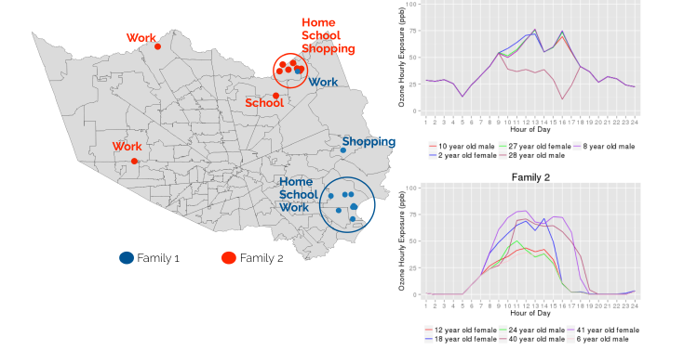
Exposure for SYNTHETIC population
Collaboration with Social and Decision Analysis Laboratory, Virginia Tech, Capital Campus
AGENT BASED SIMULATOR -- An attempt to understand indoor vs. outdoor exposure.
Towards an in silico Experimental Platform for Air Quality – Peres et al (2016)

Slide 46
Exposure for SYNTHETIC population
Collaboration with Social and Decision Analysis Laboratory, Virginia Tech, Capital Campus
AGENT BASED SIMULATOR -- An attempt to understand indoor vs. outdoor exposure.
Towards an in silico Experimental Platform for Air Quality – Peres et al (2016)

Slide 47
Simulated Exposure
3 zipcodes by income

Slide 48
What about age for the 3 zipcodes?

Slide 49
From data, to analysis, to understanding, to ACTION.
“Think and Do!”

Slide 50
Actions for Cardiac Arrest
Worked with American Heart Association to train Houston residents in by-stander CPR.
Targeted neighborhoods were identified by our analysis.
EMS staffing addressed -- optimize for Cardiac Patients in high risk neighborhoods during periods of greatest concern.
EMS response time investigated.

Slide 51
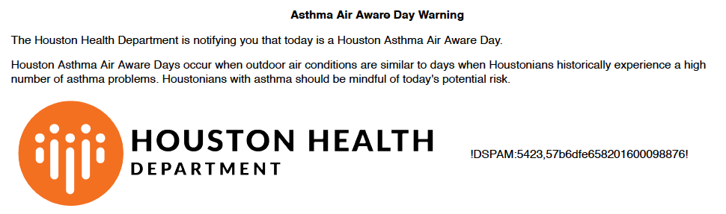
Actions for Asthma
Local Air Quality Alerts
Direct FEED to Schools and Medical Professionals
Forecasting pollution is possible.
For asthma, there is a clear signal of increased EMS calls on days with identifiable characteristics.
Leads to “ASTHMA AIR AWARE DAY” - Alerts to local health and “opt in” individuals.

Slide 52
Urban Analytics: Air Quality and Health
What did we learn and do?
Estimates and short-term forecasts of ambient ozone in space and time are feasible.
  A multi-pollutant air profile may be possible.
Identified a link between ambient ozone levels and key health endpoints --- noted concerns of representation of observational data.
  Simulated exposure to augment our understanding of movement through the city.
ACTED ON STATISTICALLY SOUND FINDINGS.

Slide 53
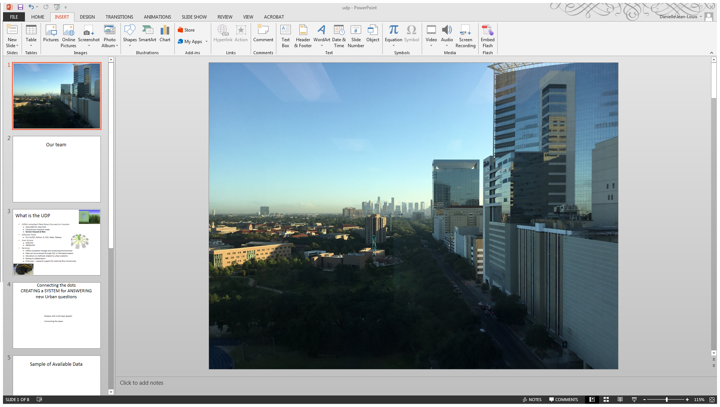
Houston Urban Data Platform
HoustonUrbanData.com
From data to information to action…

Slide 54
Thank you!
ensor@rice.edu

Slide 55
Key References
Towards an in silico Platform for Air Quality: A Houston, TX Case Study (2016). B. Pires, G. Korkmaz, B.Lewis, S. Shipp, S. Keller and K. Ensor. Submitted to Exposure Science and Environmental Epidemiology.
Dynamic PCA: Identifying the Relationship between Multiple Air Pollutants (2016). O. Melnikov, L. Raun and K. Ensor. arXiv: 1608.03022
High-Dimensional Multivariate Time Series with Local Dependence, Michael Schweinberger, Sergii Babkin and K. B. Ensor (2016). arXiv:1510.02159
Point Source Influence on Observed Extreme Pollution Levels in a Monitoring Network. KB Ensor, BK Ray, SM Thomas (2014). Atmospheric Environment.
Outlier detection in environmental monitoring network data: an application to ambient ozone measurements for Houston, Texas. GM Davis and KB Ensor. Journal of Statistical Computation and Simulation 76(5), 407-422.
Association of Out-of-Hospital Cardiac Arrest with Exposure to Fine Particulate and Ozone Ambient Air Pollution from Case-Crossover Analysis Results: Are the Standards Protective? L. Raun and K. B. Ensor (2012). James A. Baker III Institute for Public Policy of Rice University
A Case-Crossover Analysis of Out-of-Hospital Cardiac Arrest and Air Pollution. K. B. Ensor, L. H. Raun and D. Persse (2013). Circulation 127 (11), 1192-1199.
Geo-Spatial Analysis for Targeting Out-of-Hospital Cardiac Arrest Intervention (2013). American Journal of Preventative Medicine. 2013: Vol 45, pp 137-142. Editors’ Choice Archive
And the extensive references within these manuscripts.
For further information contact Kathy Ensor (ensor@rice.edu) .

